Slide 1
Creating an OLAC data provider at the Alaska Native Language Center
Gary Holton
ANLC
LSA Symposium:
The Open Language Archives Community
4 January 2002

Slide 2

ANLC Archives
10,000+ paper documents
5000+ recordings
Nearly everything written in or about Alaska Native and languages
Existing catalog uses proprietary metadata format
Notes:
existing metadata in database
implement web server which can access this database
develop script which can respond to OLAC protocols and provide metadata formatted in accordance with OLAC standards

Slide 3
Data Provider responds to metadata harvest requests
End User
Service Provider
Data Provider

Slide 4
Harvest request is a URL
A request to the data provider has the form of a URL which specifies a script and one of six request "verbs"
  http://archives.anlc.uaf.edu/anlc.php?verb=VERB
base URL
script name
verb

Slide 5
Harvest request verbs:
Identify
ListMetadataFormats
ListSets
ListIdentifiers
ListRecords
GetRecord

Slide 6
Response to "Identify" request
http://archives.anlc.uaf.edu/_x000b_olac/anlc.php?verb=Identify

Slide 7
Response to "GetRecord" request
http://archives.anlc.uaf.edu/
olac/anlc.php?verb=GetRecord&
metadataPrefix=olac&
identifier=KU962K1975a
http://archives.anlc.uaf.edu/
olac/anlc.php?verb=GetRecord&
metadataPrefix=olac&
identifier=ANLC3658

Slide 8
Implementation
Use scripting language (php, perl, etc.) to describe response to request verbs
Identify, ListMetadataFormats, ListSets have standard (fixed) responses
ListIdentifiers requires simple query of catalogue identifiers in database
GetRecord requires mapping from local metadata to OLAC metadata format

Slide 9
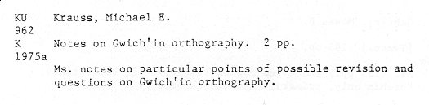
Original ANLC catalog record

Slide 10
ANLC metadata format
Catalog: KU962K1975a
Author: Krauss, Michael
Title: Notes on Gwich’in orthography
Description: Ms. notes on particular points of possible revision and questions on Gwich'in orthography.
Comments: 2 pp.
Keywords: orthography
URL: http://archives.anlc.uaf.edu/docs/KU962K1975a.pdf

Slide 11
Mapping ANLC to OLAC
one-to-one mappings
many-to-one mappings
  using "refine" attribute
  collapsing elements
one-to-many mappings

Slide 12
One-to-one mappings
some examples
Catalog number → <identifier>
Author → <creator>
Language → <subject.language>
Keywords → <type.linguistic>

Slide 13
Many-to-one mappings using refinements
Interviewer → <creator refine="interviewer">
Translator → <creator refine="translator">
Editor → <creator refine="editor">
Title → <title>Tsaan'tsuug</title>
English title → <title refine="alternate"
lang="en">Ruffed Grouse</title>

Slide 14
Many-to-one mappings without using refinements
some elements collapse to a single OLAC element
Notes
Comments
Description
Sound quality
description

Slide 15
One-to-many mappings
ANLC catalog number may also encode language and date information
Although this violates database design principles, we can provide legacy support
Example:
KU962K1975a
<subject.language code="X-SIL-KUC"/>
<date code="1975"/>

Slide 16
Communicating with the
Service Provider
OLAC protocols provide the means for the Service Provider to communicate with the Data Provider
Service Provider harvests periodically
<datestamp> allows harvester to determine which records need to be harvested
Service Provider then stores information in any desired format

Slide 17
Advantages for Data Provider
can maintain legacy databases
no need to provide search facilities and other value-added products
light load on web-server, since the server only responds to periodic harvest requests

Slide 18
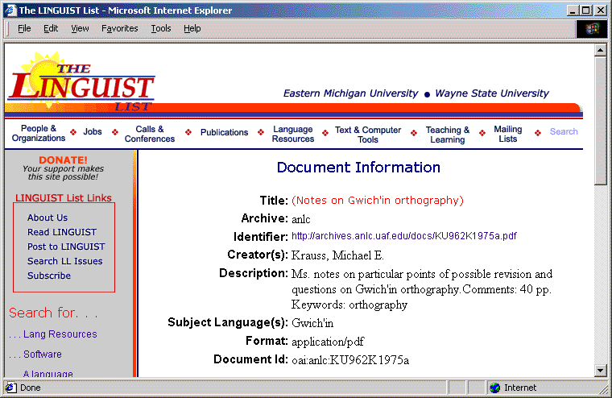
...the Service Provider

