Slide 1
Language Archives and Linguistic Anchoring of
Digital Archives
Chu-Ren Huang
Institute of Linguistics, Academia Sinica
LSA Symposium:
The Open Language Archives Community
4 January 2002

Slide 2
Linguistic Anchoring of Digital Archives
Language Archives serve communities beyond linguists
Linguistic description and interpretation underlies any digital archive items
In digital archives, each knowledge item should be temporally, geographically, and linguistically anchored.

Slide 3
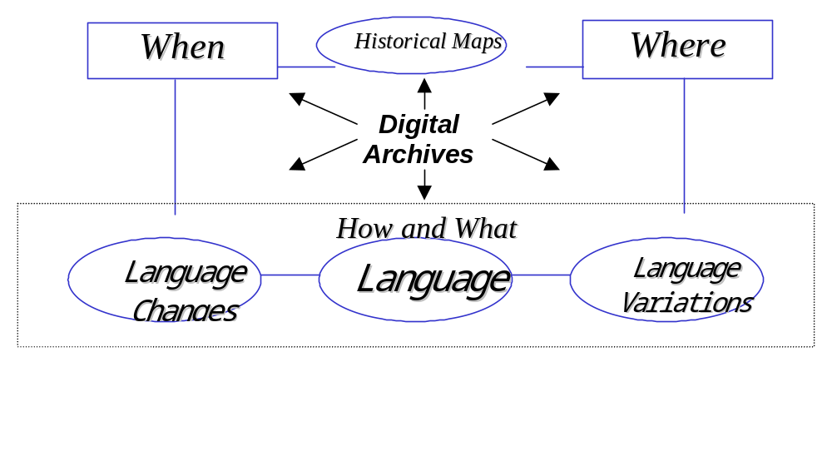
Language and Digital Archives

Slide 4
Digital Archives are
Linguistically Anchored
Archives are anchored with Lexical KnowledgeBase (LKB)
-because LKB as collection of lexical types instantiated in archives uniquely defines each archive
-And each lexical item is the conceptual atom projecting knowledge from archive to archive

Slide 5
From Linguistic Anchor to Knowledge Projection
Synergy of language archives anchored by lexical forms and supported by LKB generates new knowledge
Extension of linguistic anchoring based on LKB to all types of digital archives will lead to even more creative synergy

Slide 6
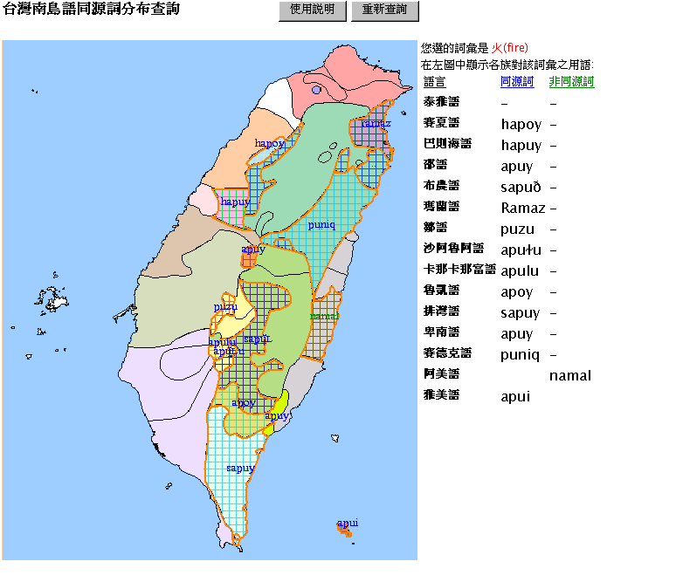
Where & What: Language Atlas

Slide 7
Multi-anchor Knowledge Linking
Geographical anchor based on GIS (geography information system)
-Ecology (Fauna, Weather, Geology etc.)
-Socio-Anthropological classification
Linguistic anchor based on LKB
-etymology, language grouping, loan words,

Slide 8
Linguistic Anchor and Authorship
Dream of the Red Chamber: The classical Chinese novel in which the authorship of the last 40 chapters are in dispute
The Use of Particle de in DRC
ch.1-40 ch.41-80 ch.81-120
Total fre. 537 604 620
得 de₁ 13.22% 17.88% 56.61%
的 de₂ 86.78% 82.12% 43.39%

Slide 9
Linguistic Anchor and Schools of Thoughts http://www.dmpo.sinica.edu.tw/~words
Classics in Confucianism:
Confucius’ Analacts, Mencius
Classics in Taoism
Lao-Zi, Zhuang-Zi
-Defining a sub-lexicon for each school of thoughts (e.g. in C and M but not in L or Z)
-Tracing use in literatures (e.g. -> Tang Poetry)

Slide 10
Synergy among Language Archives
How to synergize multiple archives
Each document is marked up with textual description features: topic, style etc.
Each feature selects a subset of documents
Sub-corpora (or new archives) can be created online according to user’s specification

Slide 11
OLACMS helps archive versatility
Given Shared Metadata Standard
New language archives can be created on the fly by harvesting existing archives
Rich information can be inferred by establishing temporal and geographic anchors for each document.

Slide 12
OLAC Infrastructure
Helps to Solve Language Archive Problems such as
Language Identification
and
Metadata Set for Multi-lingual Language Archives

Slide 13
The Language Identification Problem
The DC code (e.g. ‘en’ for English) is not enough to describe all the languages in the world
Ethnologue (http://www.ethnologue.org) is comprehensive but not complete
Potential Problems of using Ethnologue (or any existing language list)
  over-splitting
  over-chunking
  omission

Slide 14
A Fundamental Solution to Language Identification Problems
Registering language groups with an OLAC registration service
OLAC language classification server would house a comprehensive list of language family names (defined by users) and their extensional definitions (i.e. sets of Ethnologue codes)
  AS:Amis = {ALV, AIS}
ALV= Amis, AIS= Nataoran

Slide 15
Describing Multi-Lingual Resources in OLACMS
Directionality is crucial in multilingual resources
However, OLAC metadata is flat and unordered
Bi-directional MT
  <Language code= X/>
  <Language code= Y/>
  <Subject.language code= X/>
  <Subject.language code= Y/>

Slide 16
Multi-lingual Resources II
Text: language
Bitext (bilingual aligned corpus)
  There is always an directionality
  Original: language
  Translation: Subject.language
Language Description (Field Notes)
  Elicitation, transcription, translation, notes
  →Multiple related resources

Slide 17
OLAC and Asia
Asian Language Resources Committee
Mail List: alr@cl.cs.titech.ac.jp
Affiliated with the proposed AFNLP
Cataloguing Asian Language Resurces
Will adopt OLACMS and search engine
Coordinators:Togunana take@cl.cs.titech.ac.jp
Huang churen@sinica.edu.tw

Slide 18
OLAC and Taiwan
Both Academia Sinica and the Digital Archives National Project will join OLAC
AS corpora will be OLAC compliant soon
http://www.sinica.edu.tw/SinicaCorpus
http://www.sinica.edu.tw/Early_Chinese
http://www.ling.sinica.edu.tw/formosan
Other resources: spoken, Taiwanese etc.

