Slide 1
The Seven Pillars of Open Language Archiving: Introducing the OLAC Vision
Gary Simons
SIL International
LSA Symposium:
The Open Language Archives Community
4 January 2002

Slide 2
Unprecedented opportunity
Digital archiving of language documentation and description on the World-Wide Web offers:
  Minimal cost multimedia publishing
  Maximal access to the citizens of the world
Two aspects are particularly strategic:
  Tool for language preservation and maintenance
  Heightened ethical, legal, and policy concerns

Slide 3
Two possible futures
Digital archiving could hold:
  the promise of unparalleled access to information,
  or,
  the specter of unparalleled frustra-tion and confusion
The outcome will depend on whether we:
  act in community to define and follow best practice,
  or,
  act in isolation to proliferate idio-syncratic practices

Slide 4
A community to bridge the gap
What users want—the ideal
What users actually get —the gap
What it would take to bridge the gap—
a community that provides the
infrastructure for acting in concert

Slide 5
A building metaphor
The infrastructure is erected on seven pillars:
  Data
  Tools
  Advice
  Gateway
  Metadata
  Review
  Standards

Slide 6
What users want
The individuals who use and create language documentation and description are looking for three things:
  Data
  Tools
  Advice

Slide 7
1. Data
Information that documents or describes a language of interest
A wide variety of formats: print publications, computer data files, sound recordings, hand-written index cards, and so on
A wide variety of content: word lists, paradigms, texts, annotations, lexicons, grammar descriptions, and so on

Slide 8
2. Tools
Computational resources that facilitate creating, viewing, querying, or otherwise using language data
These include: application programs, components, fonts, style sheets, document type definitions, and so on

Slide 9
3. Advice
Information that users would typically solicit when they need help
For instance,
  What data sources should I rely on?
  What software tools should I use?
  What practices should I follow when creating data? When using data?

Slide 10
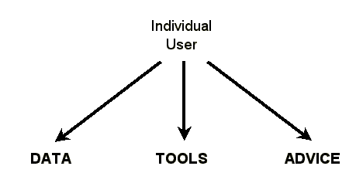
The ideal situation

Slide 11
What users actually get
The data are archived at hundreds of sites
  Some are on Web and user finds them
  Some are on Web but user can’t find them
  Some are not even on Web
The tools and advice are at hundreds of other sites

Slide 12
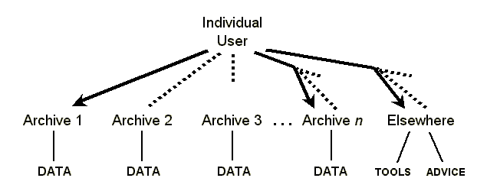
The gap

Slide 13
It’s even worse
The user may not find all existing data about the language of interest because different sites have called it by different names.
The user may not be able to use an accessible data file for lack of being able to match it with the right tools.
The user may locate advice that seems relevant but then has no way to judge how good it is.

Slide 14
What a community could provide
In order to bridge the gap, the individuals who use and create language documentation and description need a community that provides four things:
  A single gateway
  Uniform metadata
  A review process
  Standards

Slide 15
4. Gateway
A single portal through which users gain access to all available data, tools, and advice
The actual data, tools, and advice are
located on hundreds of sites all over the Internet—the gateway stores links to them.
By accessing the single gateway site, the user gains access to all available data,
tools, and advice.

Slide 16
5. Metadata
Uniform descriptions of all available data, tools, and advice
Not the data itself, but data about the data; thus it works for digital and non-digital holdings.
Uses specialized metadata elements to meet requirements specific to language archives:
  uniformly identifying languages
  matching data formats to the appropriate tools

Slide 17
6. Review
Peer review is an important function of any academic community
Peer evaluation of available data, tools, and advice
Review by individuals (with responses)
Review by community to establish some advice as recommended best practice

Slide 18
7. Standards
Provide the framework that allows the core infrastructure to function:
  Gateway—governed by a protocol for harvest- ing metadata from participating archives
  Metadata—governed by an XML schema that ensures uniformity across all archives
  Review—governed by a process that allows community to establish best practice

Slide 19
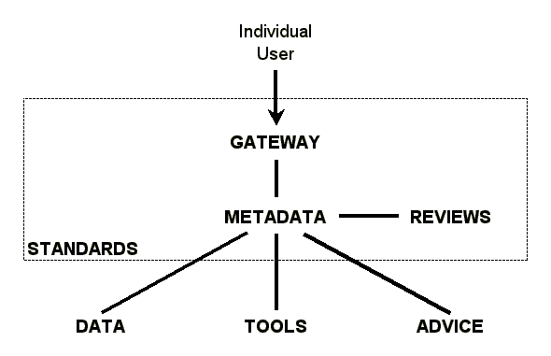
The community infrastructure

Slide 20
Open Language Archives Community
An international partnership of institutions and individuals who are creating a worldwide virtual library of language resources by:
  developing consensus on best current practice for the digital archiving of language resources
  developing a network of interoperating repositories and services for housing and accessing such resources

Slide 21
Participating archives (13)
Alaska Native Language Center
American Indian Studies Research Institute
American Philosophical Society American Indian Manuscript Collections
Comparative Bantu Online Dictionary
Deutsche Forschungszentrum für Künstliche Intelligenz
European Language Resources Association
Langues et Civilisations à Tradition Orale
Linguistic Data Consortium
Oxford Text Archive
Perseus Project
SIL International
TELRI Research Archive of Computational Tools and Resources
Typological Research Center

Slide 22
How does it work?
Participants follow three standards:
  OLAC Metadata Set
  OLAC Protocol for Metadata Harvesting
  OLAC Process
These extend proven standards from the digital library community:
  Dublin Core Metadata Set
  Open Archives Initiative Protocol for Metadata Harvesting

