Slide 1
Dsequares Internship project [zomato Bangalore Restaurants]
Ola El-Shiekh

Slide 2
Table of content
Introduction
EDA
Business Analysis
Data processing
Modelling
Summary

Slide 3
INTRODUCTION
The basic idea of analyzing the Zomato dataset is to get a fair idea about the factors affecting the establishment of different types of restaurant at different places in Bengaluru, aggregate rating of each restaurant. Bengaluru being one such city has more than 12,000 restaurants with restaurants serving dishes from all over the world. With each day new restaurants opening the industry has’nt been saturated yet and the demand is increasing day by day.
Inspite of increasing demand it however has become difficult for new restaurants to compete with established restaurants. Most of them serving the same food. Bengaluru being an IT capital of India. Most of the people here are dependent mainly on the restaurant food as they don’t have time to cook for themselves. With such an overwhelming demand of restaurants it has therefore become important to study the demography of a location. What kind of a food is more popular in a locality. Do the entire locality loves vegetarian food. If yes then is that locality populated by a particular sect of people for eg. Jain, Marwaris, Gujaratis who are mostly vegetarian. These kind of analysis can be done using the data.​

Slide 4
PRIMARY GOALS
Annual revenue growth

Slide 5
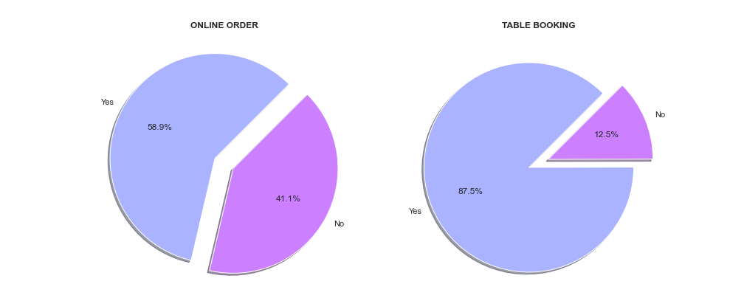
1- what’s most common in Bangalore Restaurants? Do they offer online ordering and table booking?

Slide 6
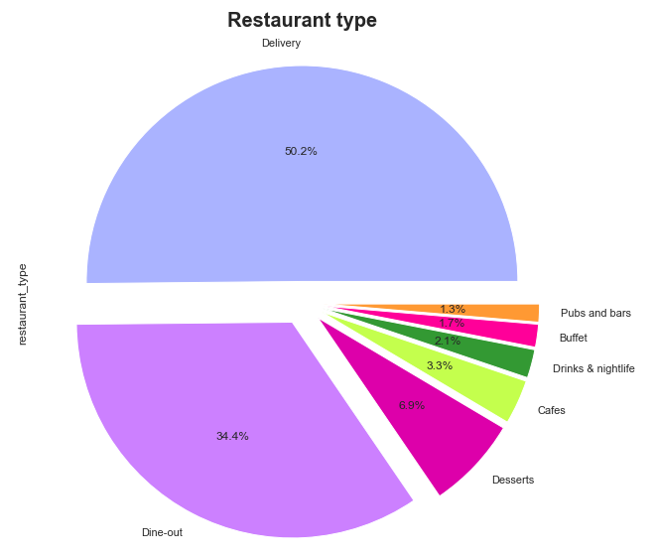
2- what are the types of services in Bangalore Restaurants ?

Slide 7
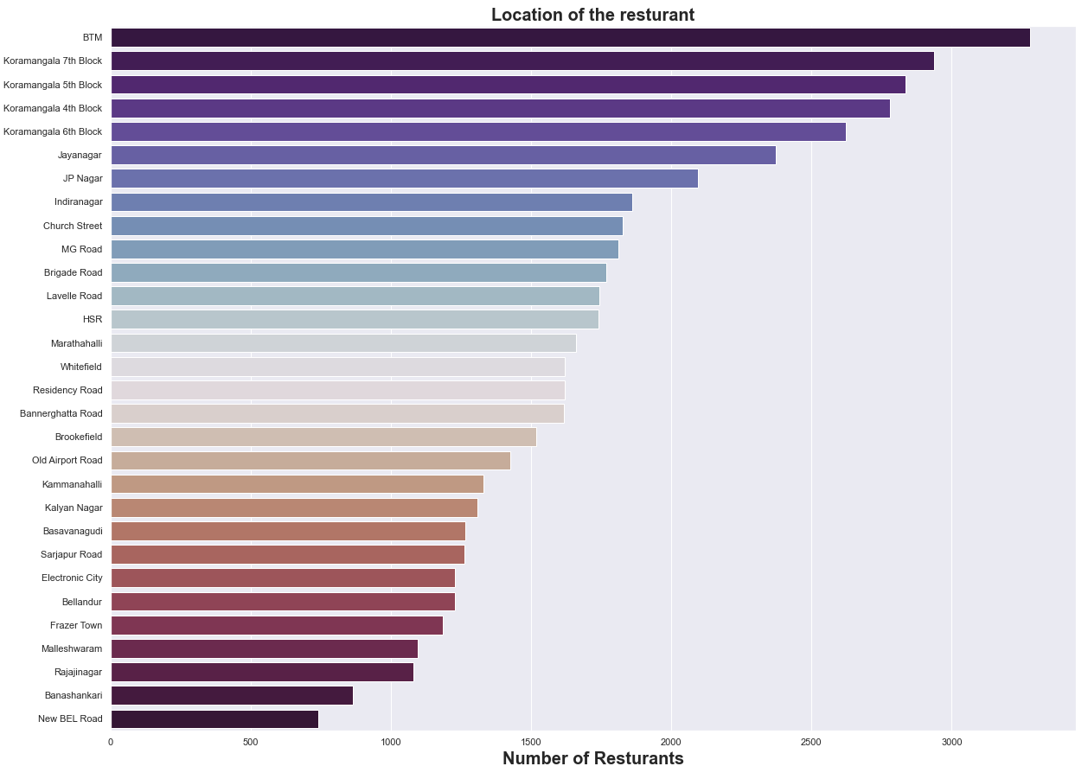
3- where are the Bangalore Restaurants located?

Slide 8
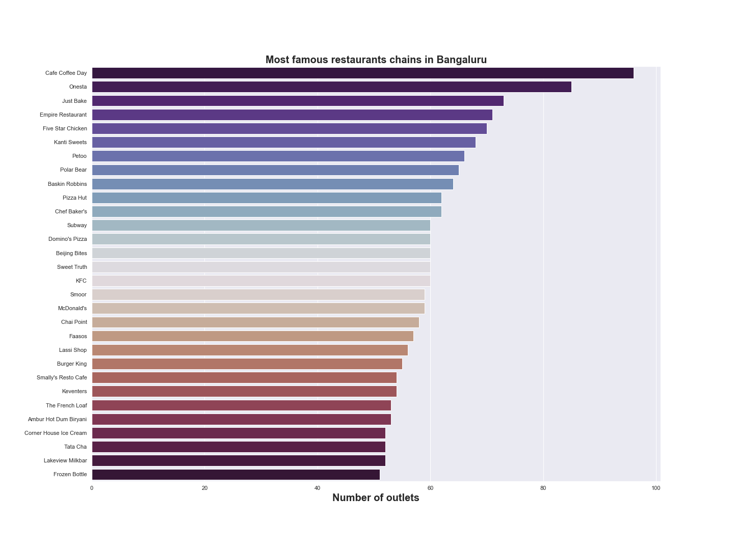
4- What are the most famous resturants in Bangalore?

Slide 9
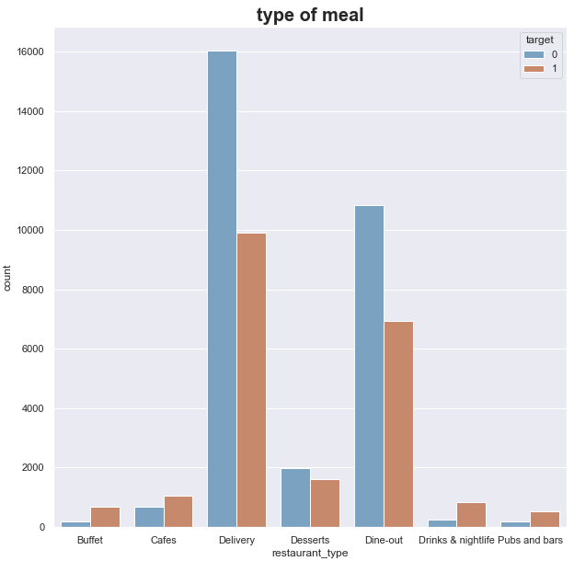
5- How does the restaurant type affect it's performance?

Slide 10
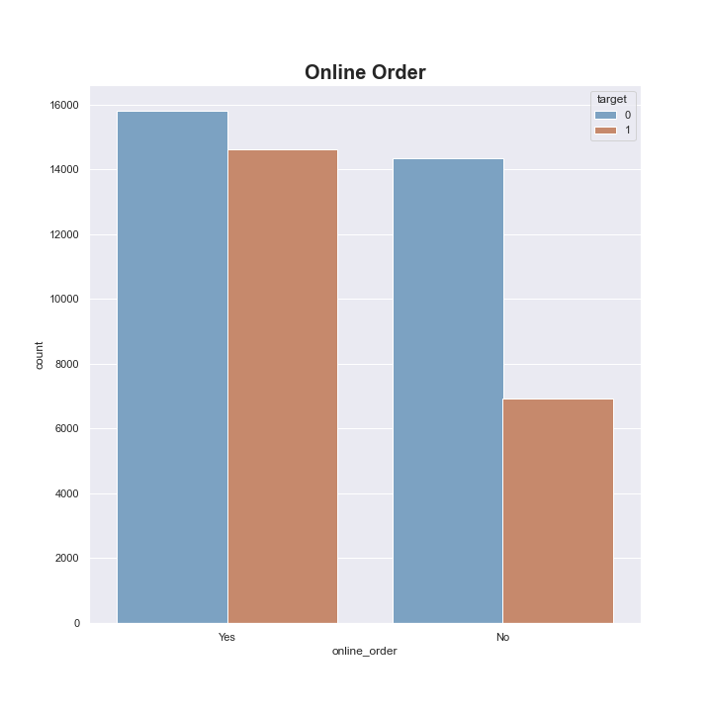
6- How does the availability of online booking affect restaurant Performance?

Slide 11
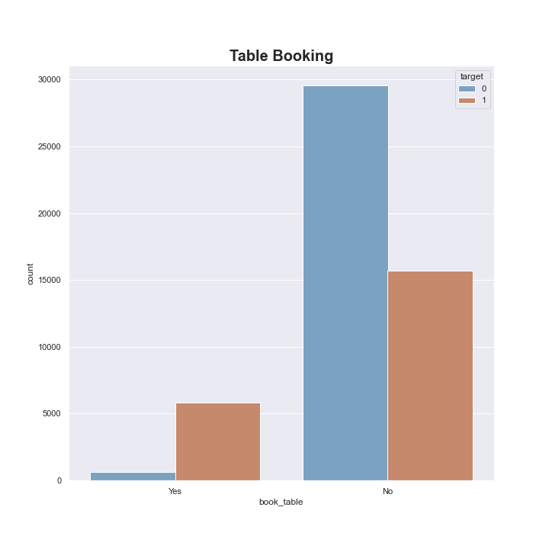
7- How does the availability of Table booking affect restaurant Performance?

Slide 12
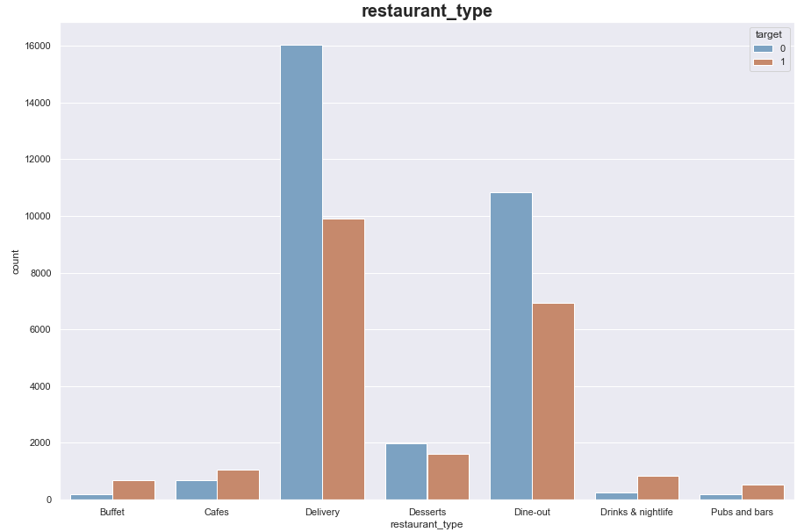
8- How does the Type of meals affect restaurant Performance?

Slide 13
9- What're the most common resurant types in Bangalor?

Slide 14
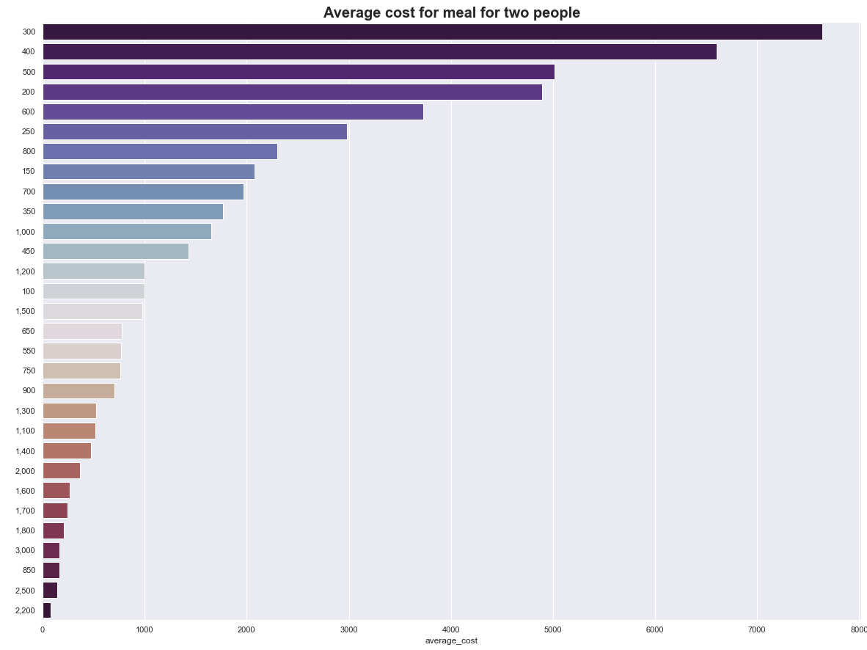
10- What're the most common Average cost for meal for two people in Bangalore?

Slide 15
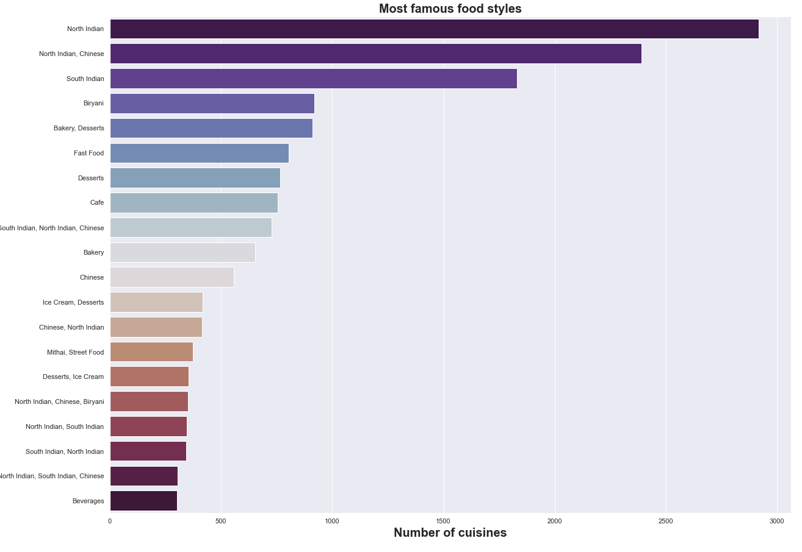
11- What're the most common food styles in Bangalore?

Slide 16
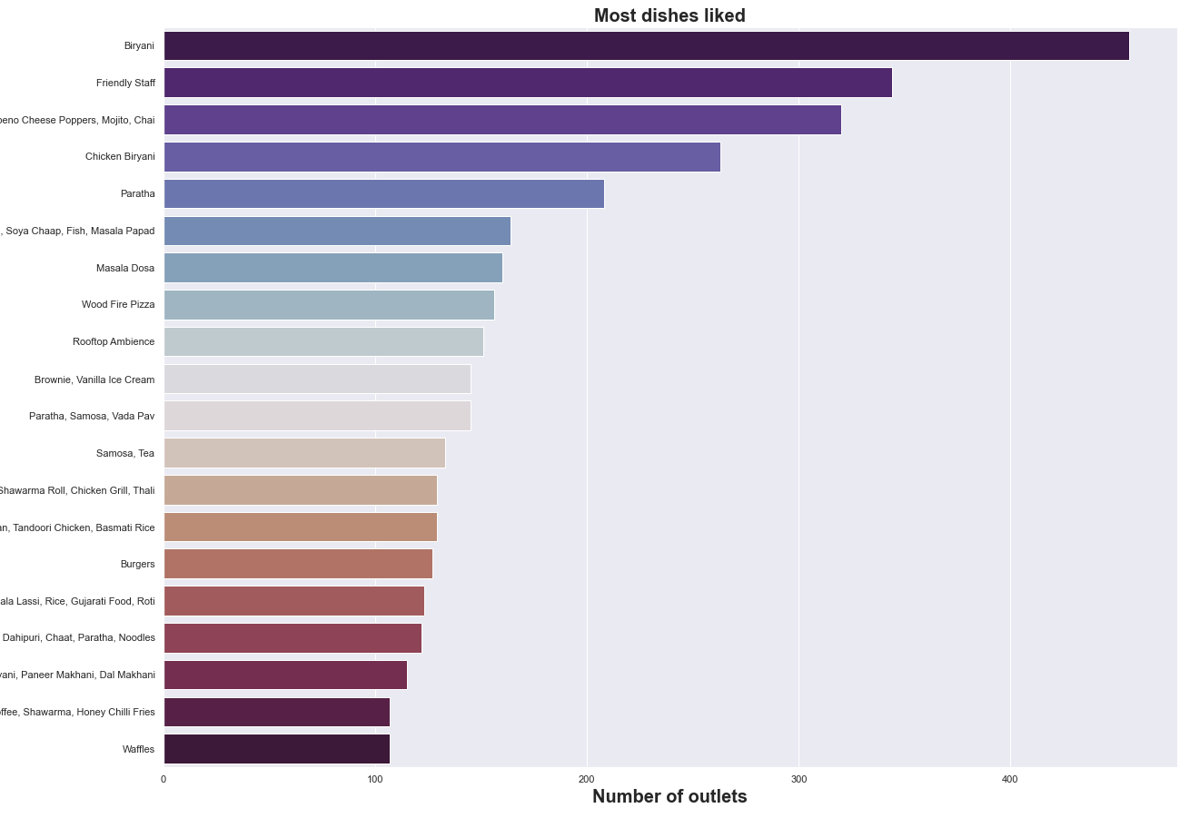
12 - What're the most dish liked in Bangalore ?

Slide 17
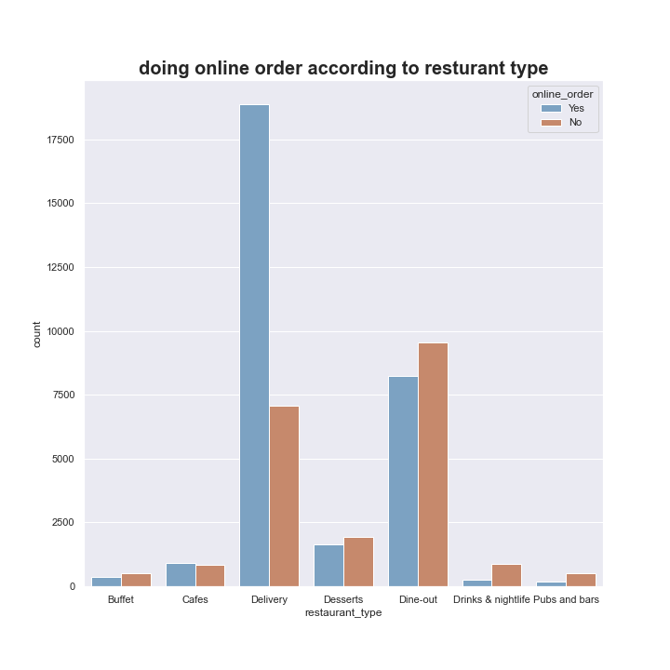
13- How does the Type of the restaurant affect Online ordering?

Slide 18
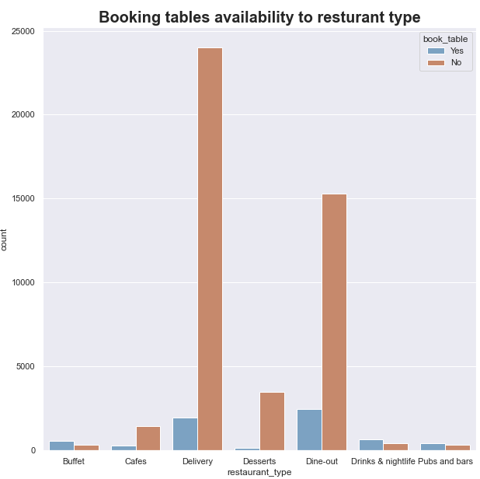
14- How does the Type of the restaurant affect Table booking availibility?

Slide 19
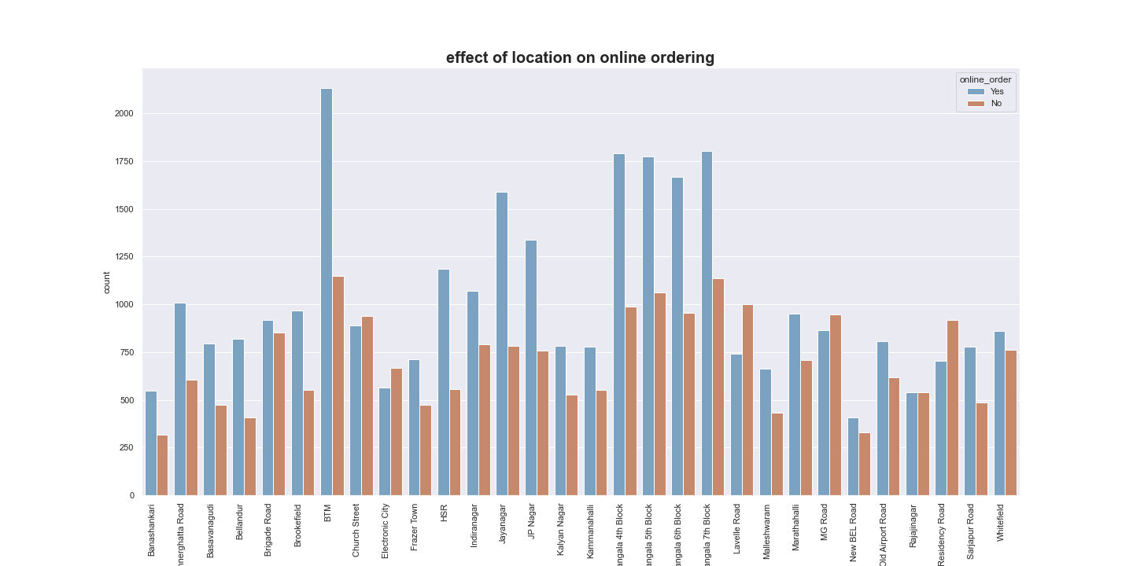
15- How does the Type of the restaurant Location affect Online Ordering?

Slide 20
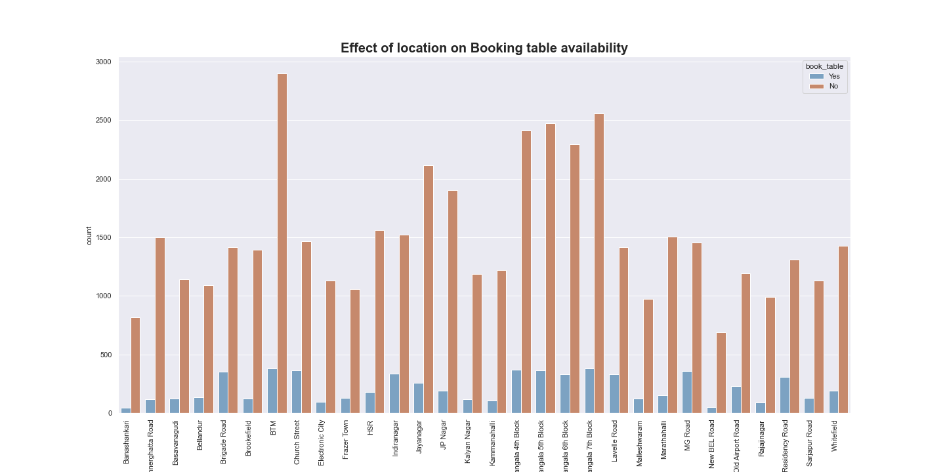
16- How does the Type of the restaurant Location affect Booking table availability?

Slide 21
Feature Engineering

Slide 22
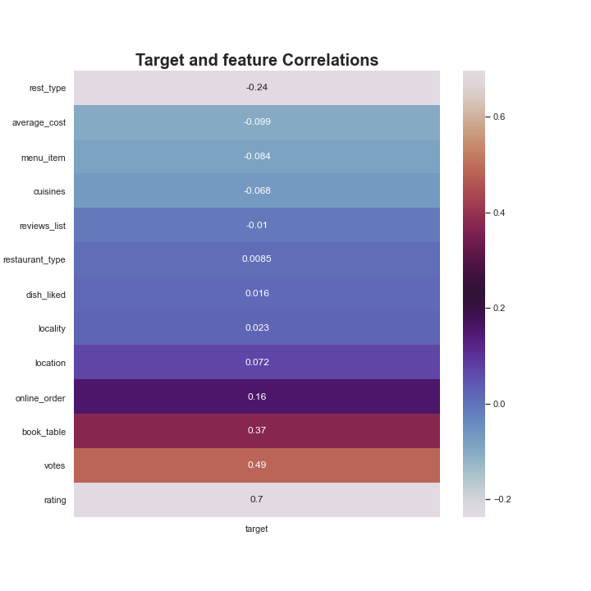
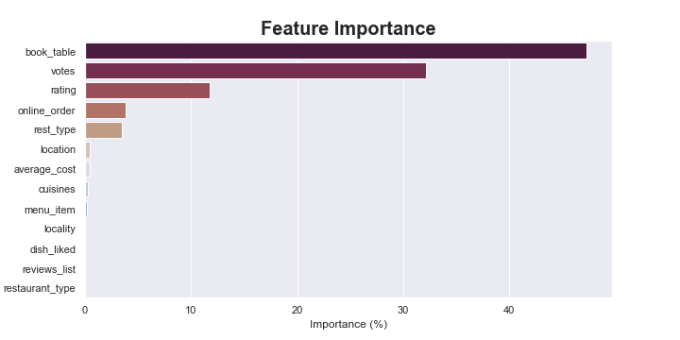

Slide 23
Modelling

Slide 24
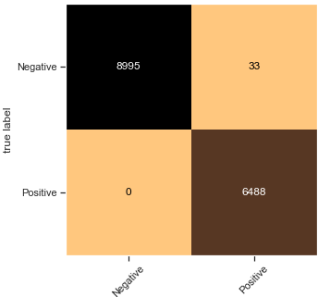
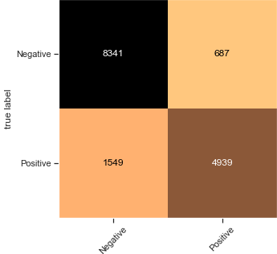
Logistic Regression
KNN CLF

Slide 25
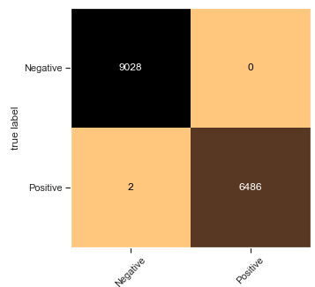
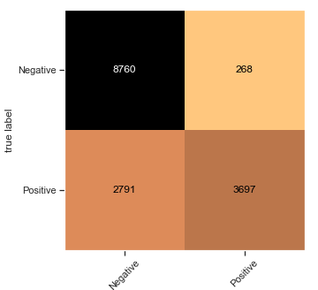
SVM
Navie bayes

Slide 26


Random Forest Classifier
Random Forest Classifier with GridSearch

Slide 27
XGBoost
Decision Tree Classifier

Slide 28
Model Selection

Slide 29
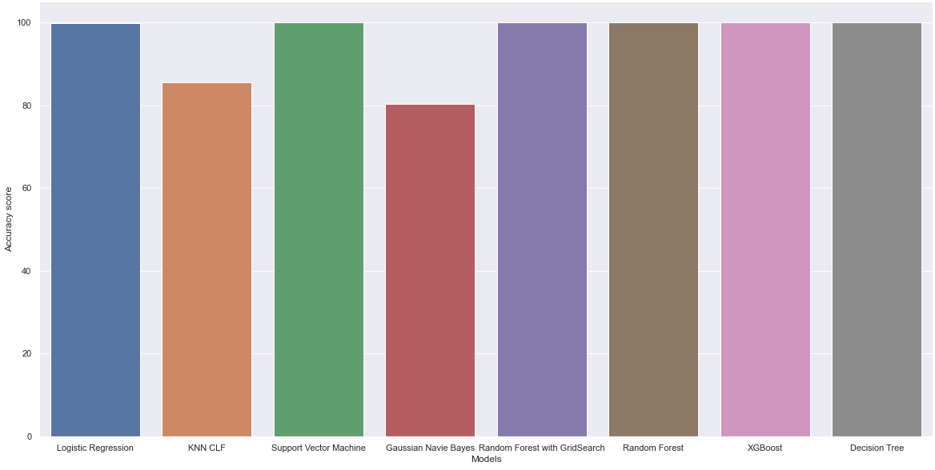

Slide 31
SUMMARY
After analyzing and Processing the data I came up with various business question and answered it using EDA.
At this project I tried my best to do what I can, I needed more time as I just received the email on Thursday evening and two days aren’t enough to come out with a good work.
There are much more to do with this data especially in the modelling part and the validation test.
I hope we can have a chance to discuss more about it, and any upcoming projects.

Slide 32
THANK YOU
Ola El-Shiekh
Ola.elshiekh71@gmail.com
01021183564
Ola El-shiekh | LinkedIn

