Slide 1

SDG 16 Analysis for Egypt
Peace, Justice and Strong
Institutions
Comparative Analysis with Finland and Jordan

Slide 2

Introduction
Sustainable Development Goal 16 focuses on promoting peaceful societies, ensuring access to justice, and building strong institutions.
Egypt currently faces major challenges in achieving SDG 16, despite showing strengths in security and civil registration. This analysis compares Egypt with Finland as a developed country and Jordan as a regional developing country to identify performance gaps, best practices, and improvement opportunities through governance reform and digital transformation.

Slide 3

Egypt SDG Performance Overview
🟦 Global Rank
🟦 improvement since 2015
91 / 167
+5.5 points
🟦 Overall SDG Score
🟥 SDG 16 Status
68.1 / 100
Major Challenges Remain (Red)
Egypt has shown gradual improvement in overall sustainable development performance; however, SDG 16 remains one of the weakest-performing goals, indicating structural governance challenges.

Slide 4
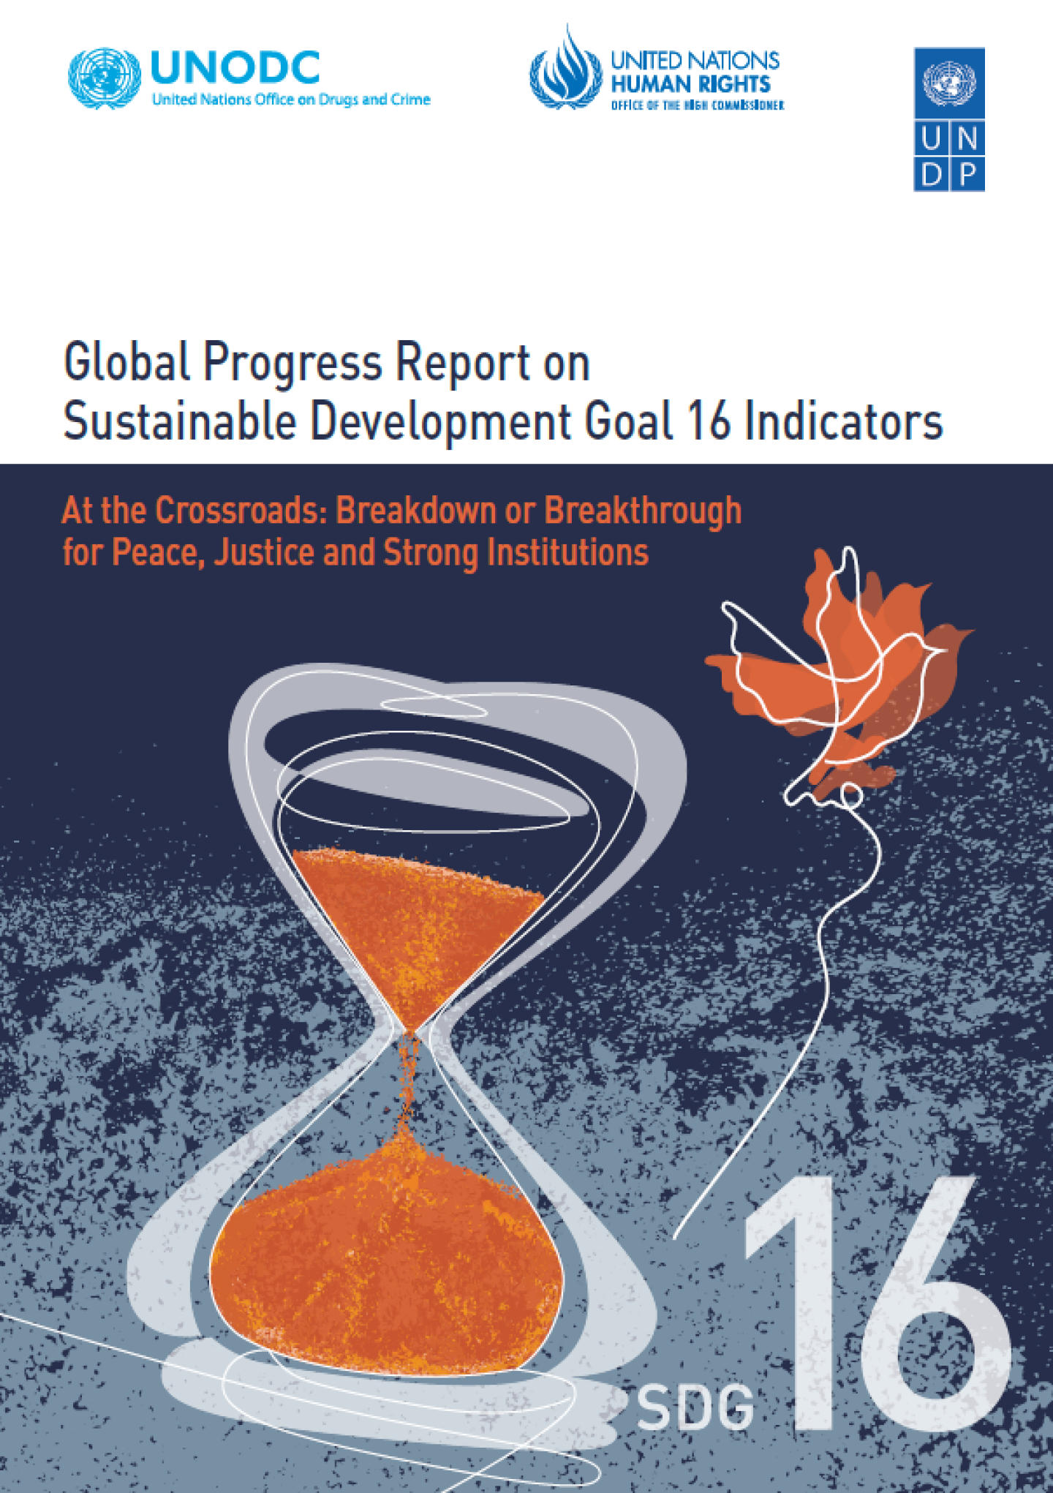
Key Insights
Strengths
Low homicide rate (1.3)
Good crime control (0.76) .Excellent birth registration (99.1%)
Weaknesses
Corruption perception low (30/100) Press freedom low (24.7/100) Administrative delays severe (0.19)
Indicator Diagnosis
Egypt demonstrates strong security-related performance with low homicide rates and effective crime control.
However, institutional indicators remain weak.
The weakest indicator is administrative timeliness (0.19), reflecting bureaucracy and slow governmental procedures.
Corruption perception and press freedom also remain major barriers to institutional trust and transparency.

Slide 5

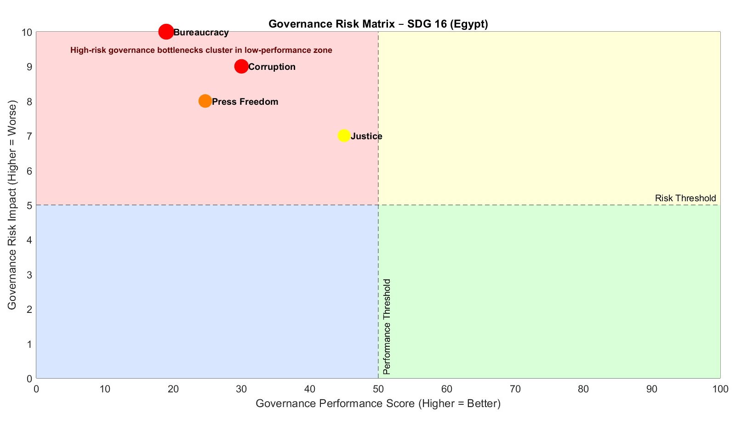

Slide 6
Governance Issue | Performance Score | Risk Impact | Interpretation
Bureaucracy | 19 | 10 | Critical bottleneck – worst overall
Corruption | 30 | 9 | High systemic institutional risk
Press Freedom | 24.7 | 8 | Weak transparency & accountability
Justice | 45 | 7 | Moderate performance, needs reform

Slide 7

International Comparison
Indicator | Egypt | Finland | Jordan
Corruption | 30 | 88 | 49
Press Freedom | 24.7 | 87.2 | 35.3
Justice Access | 0.45 | 0.71 | 0.55
Admin Timeliness | 0.19 | 0.80 | 0.55
Benchmarking Analysis
Finland significantly outperforms Egypt across all institutional indicators, particularly in corruption control, press freedom, and administrative efficiency.
Jordan performs better than Egypt in justice accessibility and institutional responsiveness, although both countries still face governance challenges.
The largest performance gap appears in administrative efficiency and corruption control.

Slide 8

Why the Difference?
Governance Quality
Digital Maturity
Administrative Efficiency
Finland benefits from stronger institutional accountability and regulatory enforcement.
Advanced e-government systems reduce delays and improve transparency.
Digital workflows and streamlined procedures significantly improve public service delivery.

Slide 9
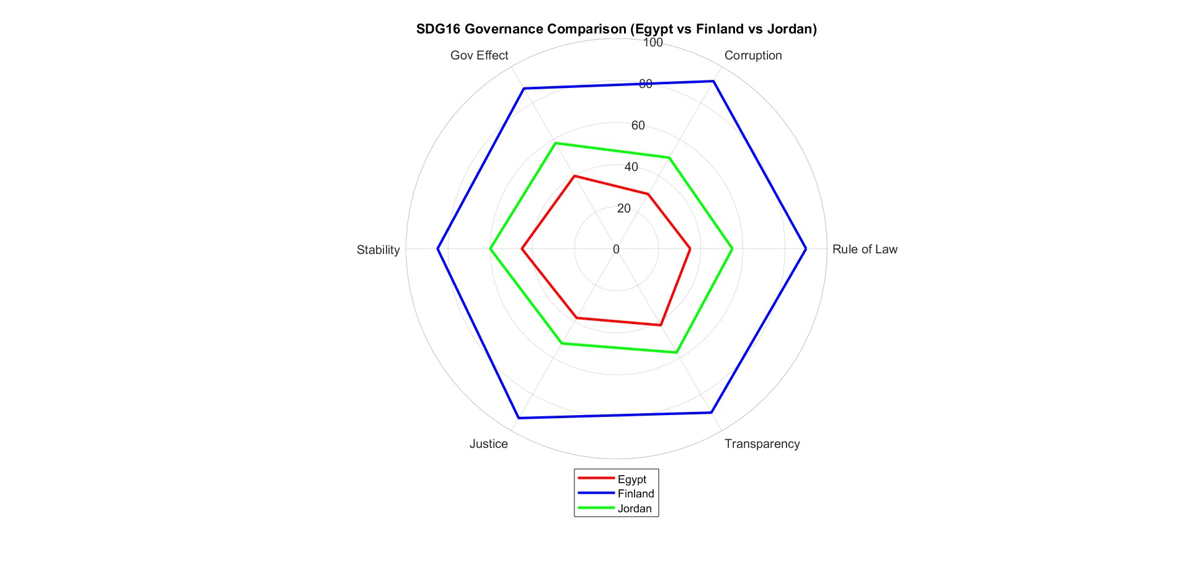
Interpretation of SDG 16
Finland shows the highest performance across all SDG 16 indicators, reflecting strong governance and low corruption.
Jordan demonstrates moderate governance performance with some areas for improvement in transparency and rule of law.
Egypt shows relatively lower scores, indicating challenges in institutional effectiveness and governance quality.
Overall, there is a clear gap between Finland and the two regional countries in SDG 16 performance.

Slide 10
SDG 16 Governance Comparison
Country | Performance Level | Key Strengths | Key Weaknesses | Overall Interpretation
Finland | Very High | Strong institutions, high transparency, low corruption, effective governance | Minimal weaknesses | Exemplary governance system aligned with SDG 16 targets
Jordan | Medium | Relatively stable institutions, balanced governance performance | Moderate transparency issues, room for improvement in rule of law and corruption control | Developing governance system with gradual improvement potential
Egypt | Low to Medium | Ongoing reforms in governance and institutional frameworks | Lower scores in rule of law, corruption control, and transparency | Faces structural governance challenges requiring institutional strengthening

Slide 11

SDG 16 Analysis
The collected data and comparative visualizations of Egypt, Finland, and Jordan across SDG 16 indicators highlight significant disparities in governance performance and institutional strength.
Egypt consistently scores lower in key governance dimensions such as rule of law, corruption control, and institutional transparency. This indicates structural challenges within governance systems, including limited enforcement efficiency, bureaucratic constraints, and reduced public trust in institutions. While some reforms are ongoing, their impact remains gradual and not yet reflected strongly in the indicators.
In comparison, Finland demonstrates a highly developed governance framework characterized by strong accountability, low corruption levels, and high institutional effectiveness. Jordan, while closer to Egypt in regional context, shows more balanced and slightly higher performance in several indicators, suggesting moderate institutional stability.
The gap observed between Egypt and Finland reflects not only differences in economic development but also differences in governance maturity, policy implementation efficiency, and institutional independence.

Slide 12
Governance + Digital Transformation
Role of Governance and Digital Transformation
Governance reform improves transparency, accountability, and institutional trust.
Digital transformation can accelerate SDG 16 progress through:
AI-powered governance dashboards
E-government service automation
Blockchain-based public records
Data-driven anti-corruption systems
Digital complaint and feedback platforms

Slide 13
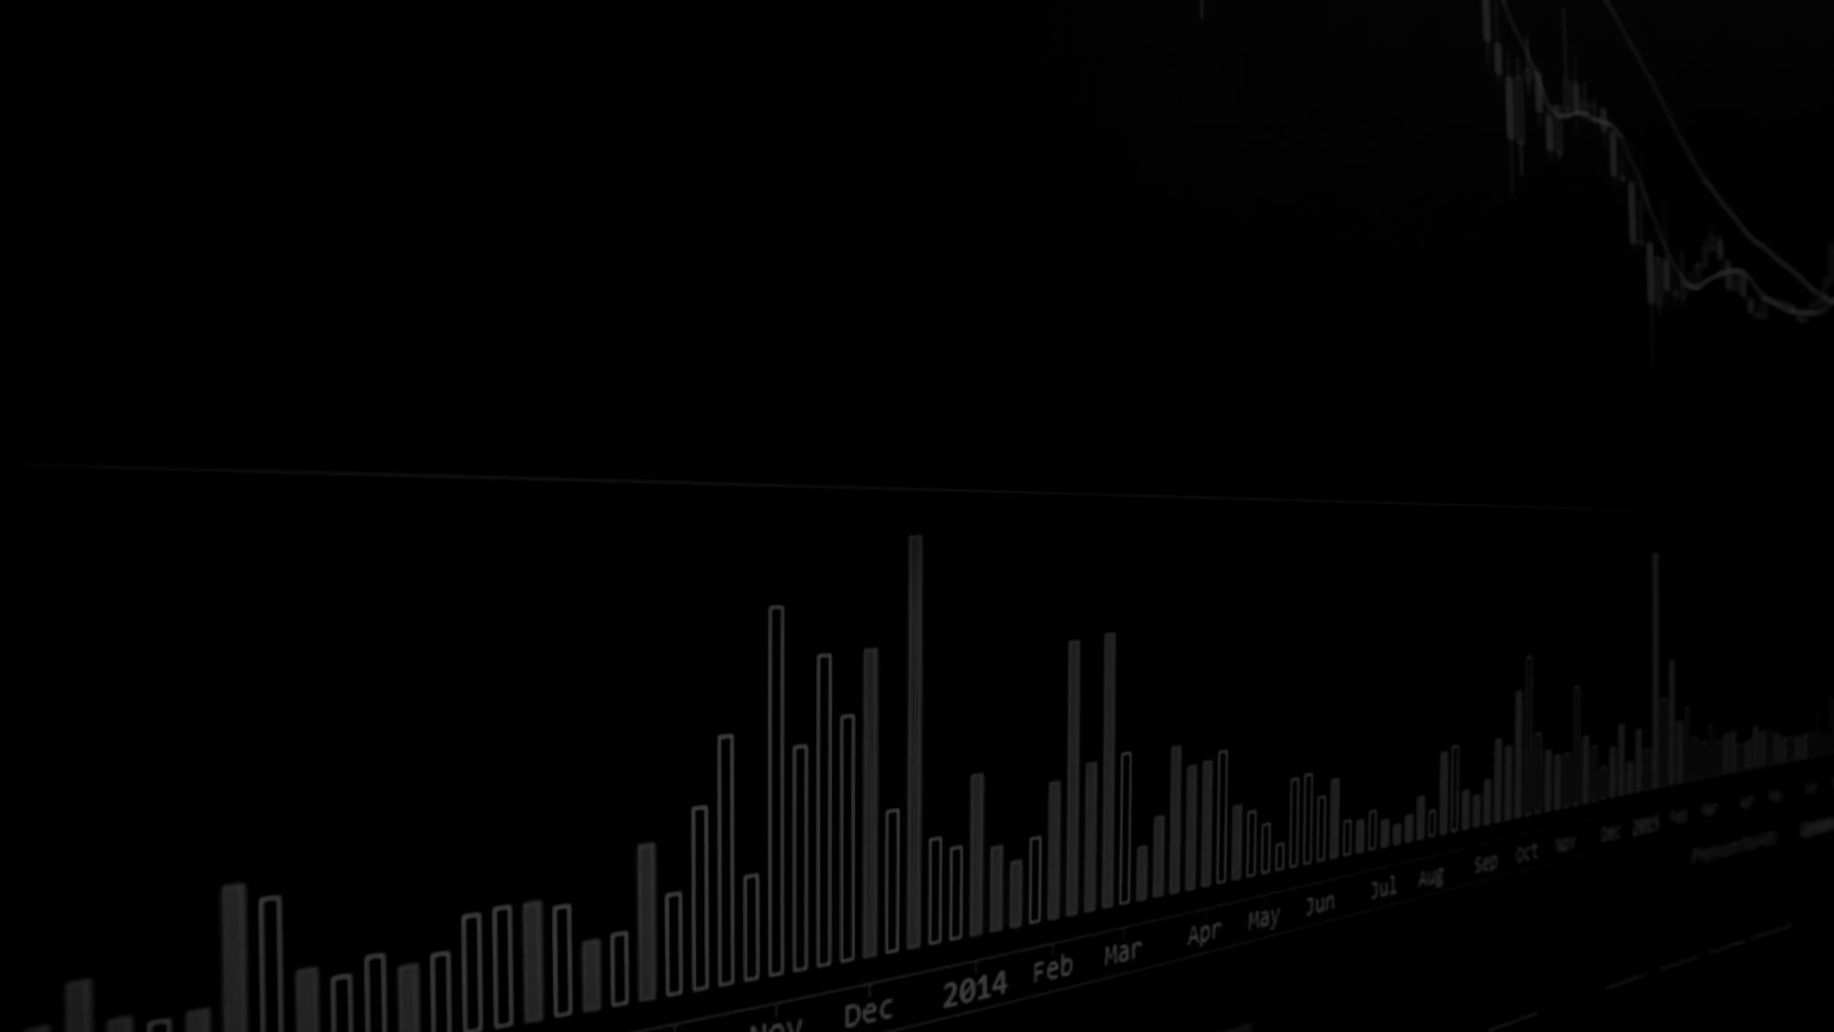
Recommendations
Short-Term
Medium-Term
Long-Term
Improve open-data transparency and performance monitoring.
Digitize public services and automate administrative procedures.
Strengthen institutional reform, anti-corruption policies, and justice accessibility.

Slide 14
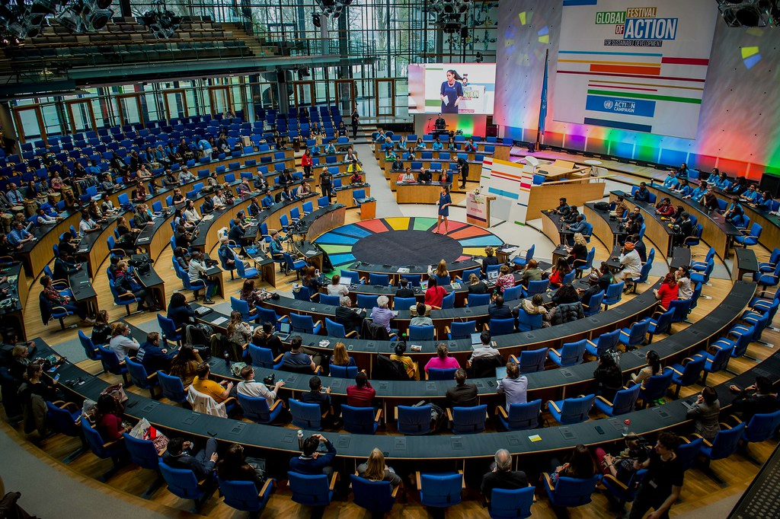
SDG’S VIEW

Slide 15

Policy-Oriented Analysis
Strengthening Rule of Law
Anti-Corruption Framework Enhancement
Institutional Efficiency Improvement
Public Transparency & Data Accessibility
Enhancing judicial independence, accelerating legal processes, and ensuring equal enforcement of laws
Expanding digital governance systems (e-government), increasing transparency in public procurement, and strengthening accountability mechanisms.
Reducing bureaucratic complexity and improving coordination between government entities through digital transformation.
Increasing access to public data and performance indicators to improve trust and enable evidence-based policymaking.
Civic Engagement & Accountability
Encouraging citizen participation in governance processes and strengthening feedback mechanisms between the public and institutions.

Slide 16

SUMMARY
The SDG16 comparison reveals a clear governance divide: Finland stands out with strong institutions, high transparency, and low corruption, while Jordan shows moderate and developing performance. Egypt, in contrast, faces deeper structural challenges in rule of law, accountability, and institutional effectiveness. Overall, the analysis highlights that strengthening governance quality and transparency is essential for Egypt to close the gap and advance toward SDG16 targets.

Slide 17

Thank You
Ola Yasser Elsheikh
oelshiekh053@gmail.com

