Slide 1
COVID & humidity
Can the rise of cases be related to lower humidity?

Slide 2
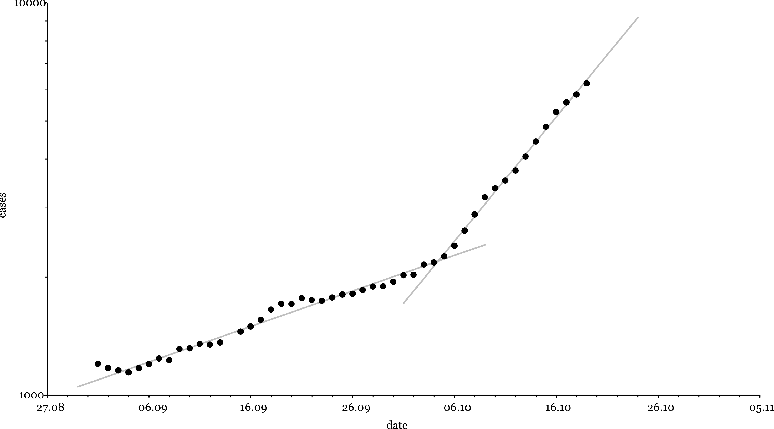


Rising number of cases In the beginning of October the number of cases in Germany rose rapidly
$T_{2}≈9.5$ days
$T_{2}≈33.2$ days

Slide 3
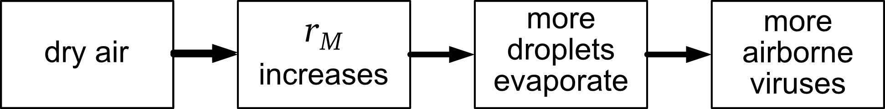
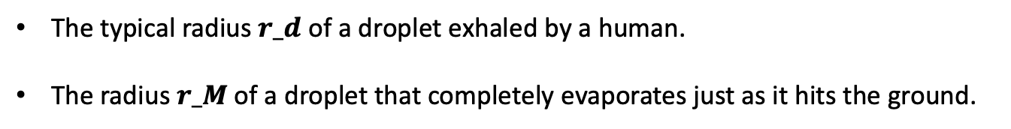
Reason Conjecture: the increase is correlated with the increased use of indoor heating
Is this causal chain responsible for the increase?
That this chain is a possibility is related to the coincidence of two length scales:
The typical radius $r_d$ of a droplet exhaled by a human.
The radius $r_M$ of a droplet that completely evaporates just as it hits the ground.
The radius $r_M$ depends on the humidity:

Slide 4
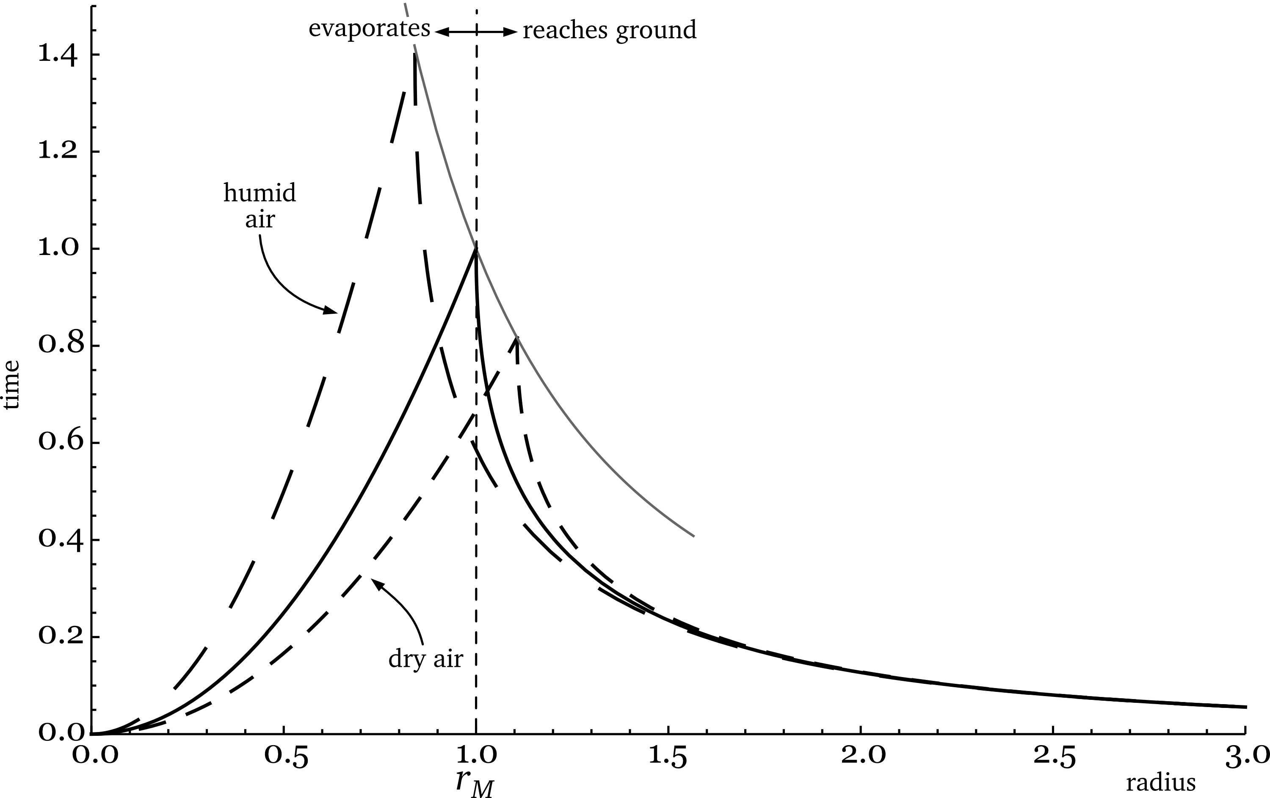
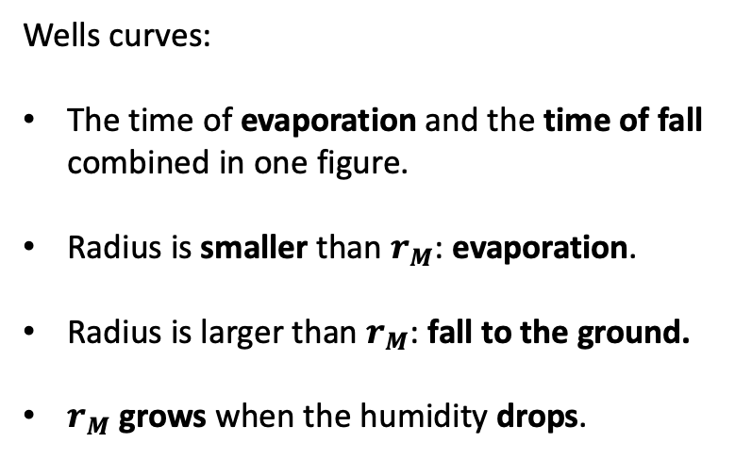
Falling droplets Two outcomes: Evaporation or fall to the ground
Wells curves:
The time of evaporation and the time of fall combined in one figure.
Radius is smaller than $r_{M}$: evaporation.
Radius is larger than $r_{M}$: fall to the ground.
$r_{M}$ grows when the humidity drops.

Slide 5
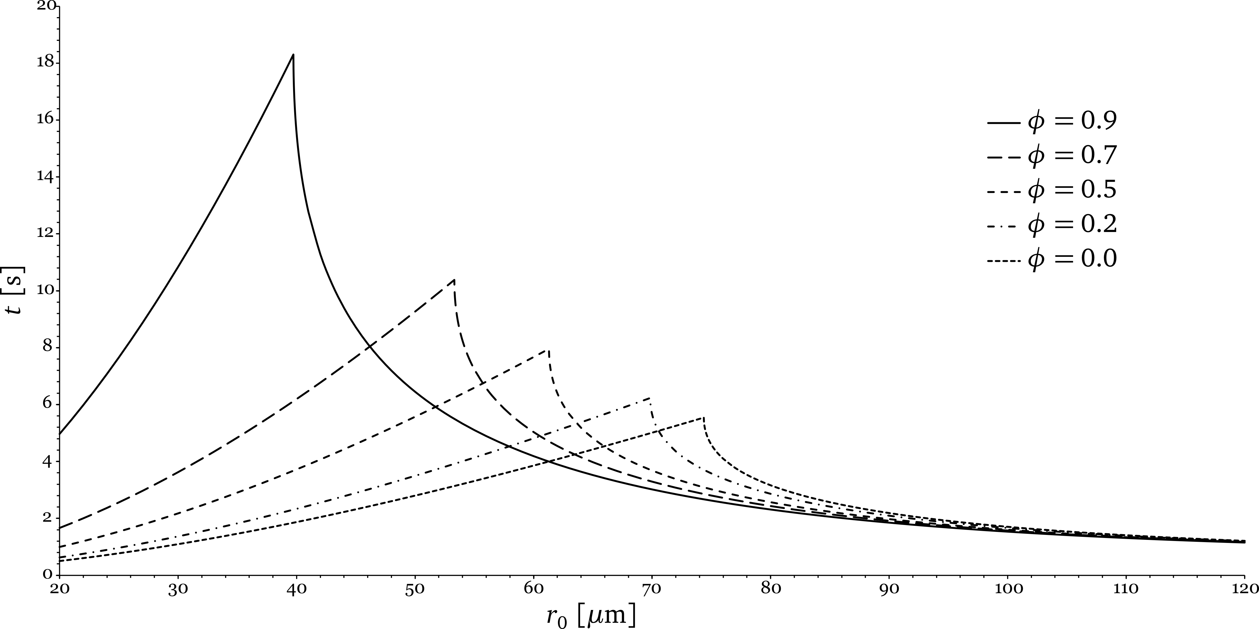


Results of the calculation The calculation follows Kukkonen et al. (see note)
$φ$ = humidity
dry air → large $r_{M}$
The JAVA code for this calculation is available at https://github.com/olafdreyer/covid

Slide 6
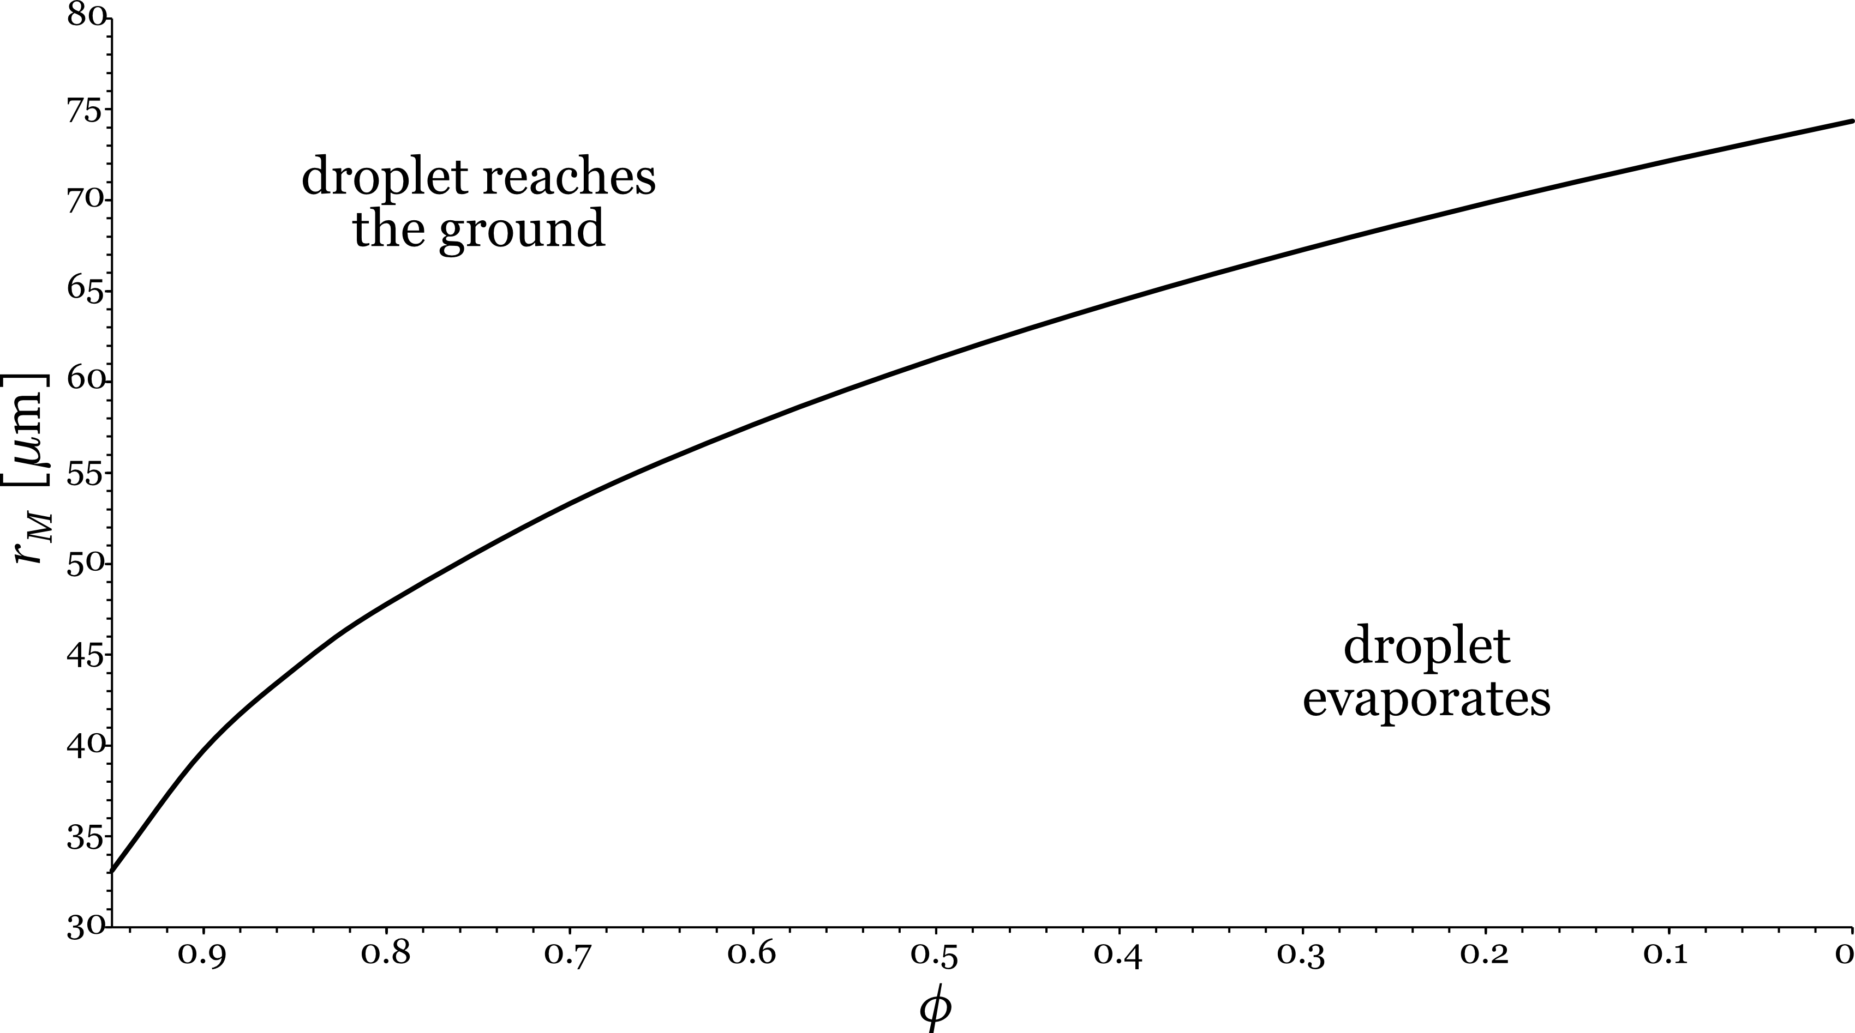
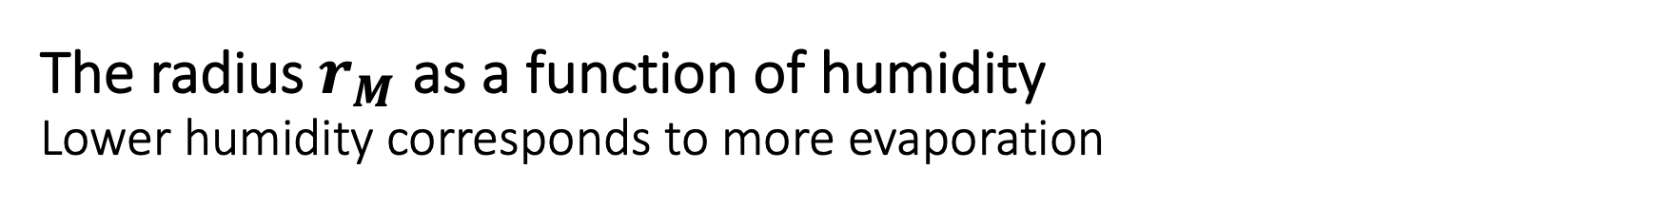
The radius $r_{M}$ as a function of humidity Lower humidity corresponds to more evaporation

Slide 7
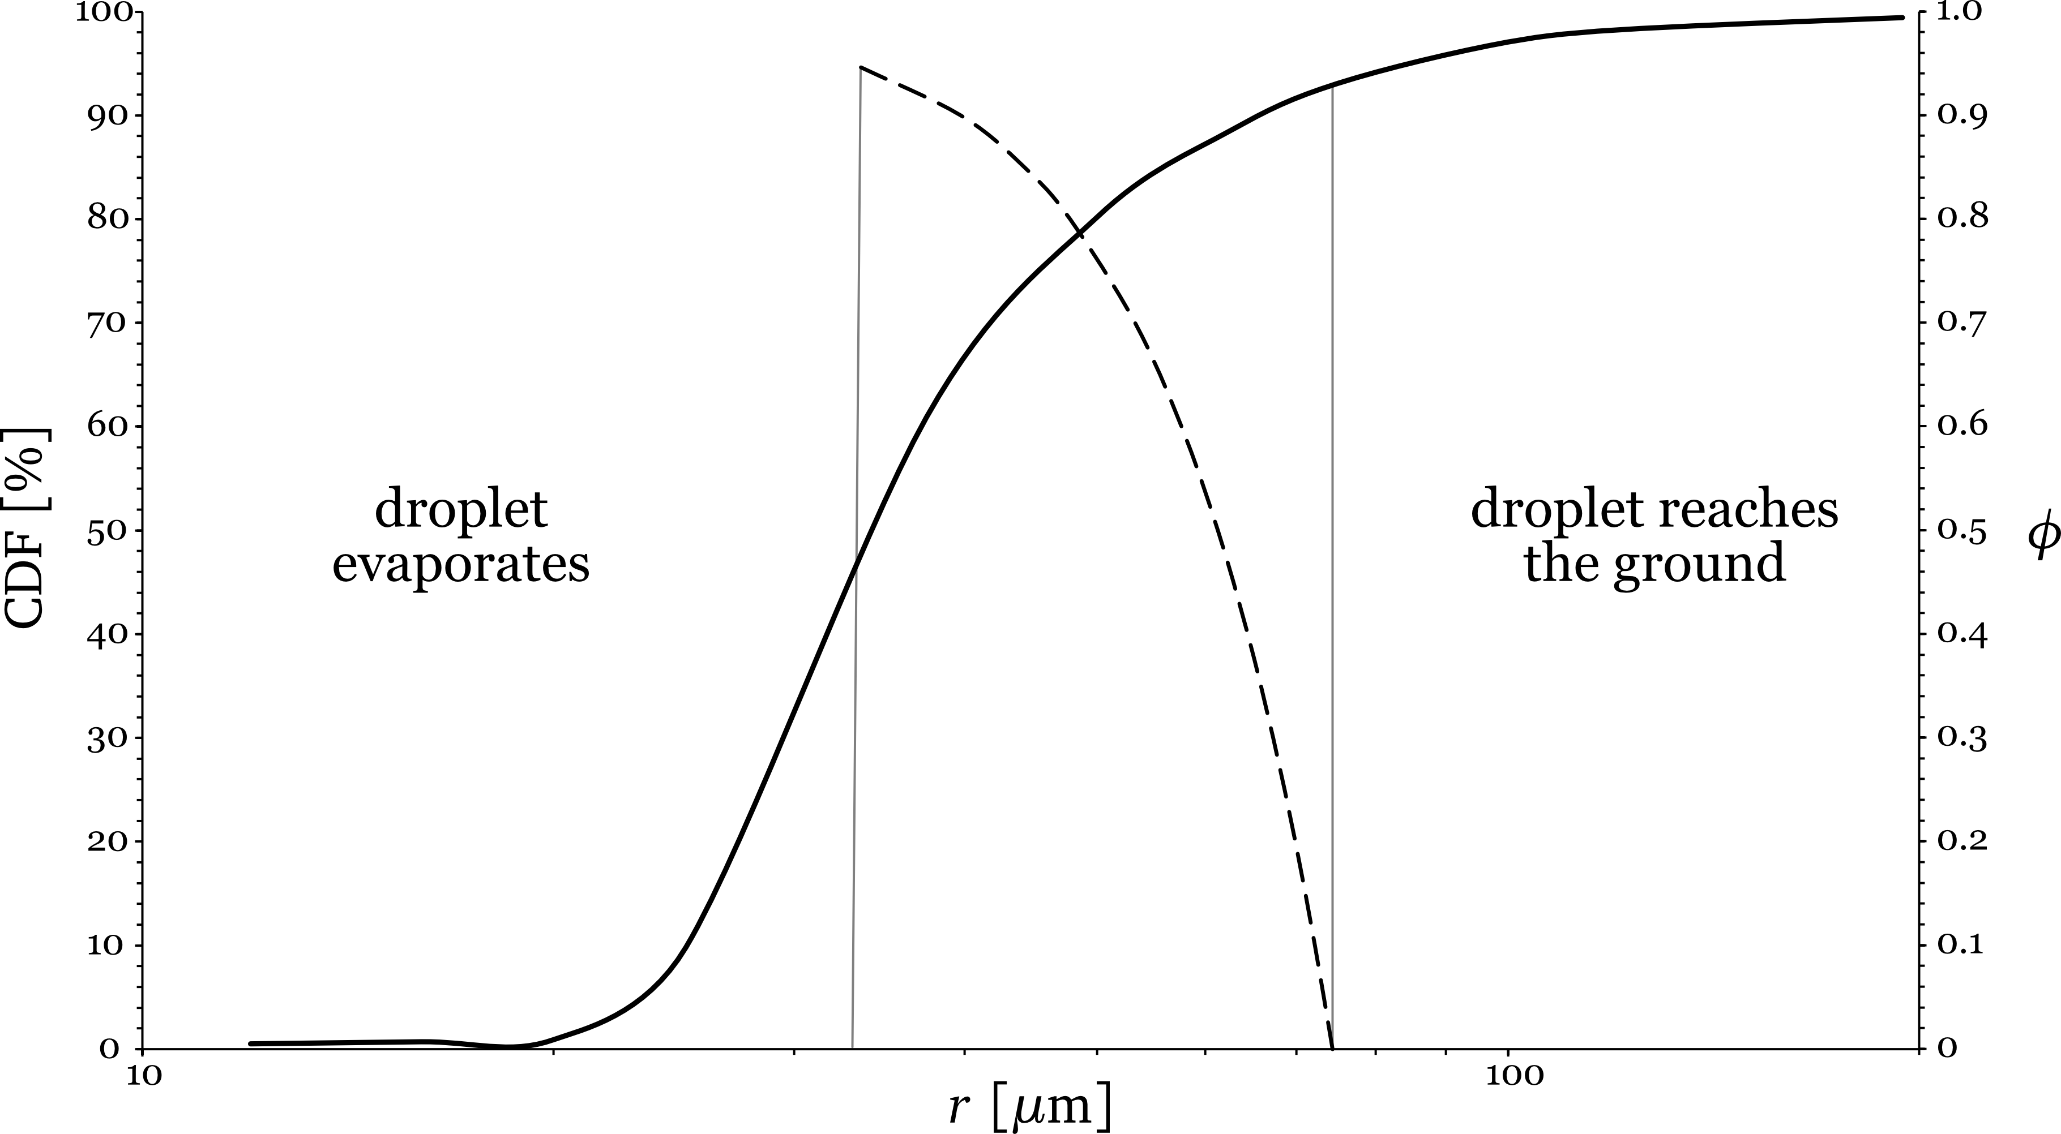

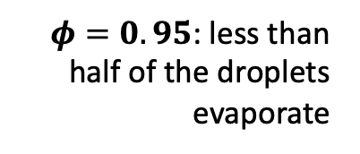
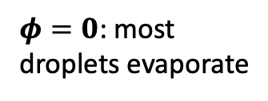
Comparison with the size of droplets exhaled by humans The values for $r_{M}$ overlap strongly with the radii of droplets exhaled by humans
$φ=0.95$: less than half of the droplets evaporate
$φ=0$: most droplets evaporate
CDF = cumulative distribution function
Results by Xie et al. (see note)

Slide 8
Conclusion The arrival of fall might have changed the effectiveness of COVID countermeasures
We have argued that this causal chain is plausible:
The simulation of the evaporation process and the fall of a droplet shows:
This is possible because $r_{M}$ and $r_{d}$ are roughly equal.
use of humidifiers
Frequent ventilation of indoor spaces
avoidance of indoor spaces (2nd lockdown)
masks
What can be done?

Slide 9
Peronal information
I am a physicist and mathematician. I have a Ph.D. in theoretical physics from the Pennsylvania State University and have worked for many years as a postdoctoral fellow in quantum gravity. For six years now I am working as a quantitative analyst in Frankfurt, Germany. I am advising banks on how to implement models of financial markets. My focus is on the risk management side of a bank. Contact information:
Olaf Dreyer
Oppenheimer Landstr. 19
60594 Frankfurt
Email: olaf.dreyer@gmail.com
Tel.: 0176 4858 4644

