Slide 1
ENTERPRISE MODEL CONTEXT PROTOCOL (MCP) SOLUTION
JANUS API GATEWAY & PORTAL
Securing, managing, and translating REST APIs into dynamic LLM tools.
Regulated Environment Ready • Zero-Dependency Go Binary • mTLS & Pluggable Vaults

Slide 2
JANUS MCP API GATEWAY
Architectural Concept & Technology
• Dynamic Tool Translation:
Translates standard REST endpoints into dynamic MCP tools on the fly. Generates JSON parameter schemas automatically based on predefined templates.
• Runtime Secret Resolution:
Credentials are redacted in configurations and resolved securely at execution time from AWS Secrets Manager, GCP, Azure Vault, or Local JSON stores.
• Zero-State Architecture:
Allows stateless clustering in Kubernetes EKS. Keeps configs in PostgreSQL or SQLite, allowing clean horizontal scale-out.
• Regulated Security Compliance:
Supports TLS 1.3, Mutual TLS (mTLS) for client verification, and Single Sign-On (OIDC/Okta) for web access. Specifically designed for air-gapped systems.
• Prefix & Scope Isolation:
Assigns tool namespaces (e.g. stripe_get_invoice) and generates specific client keys scoped to exact namespace globs.
• SPDX Software Bill of Materials:
Build pipelines generate validated SBOM files, proving dependency compliance in auditing reviews.

Slide 3
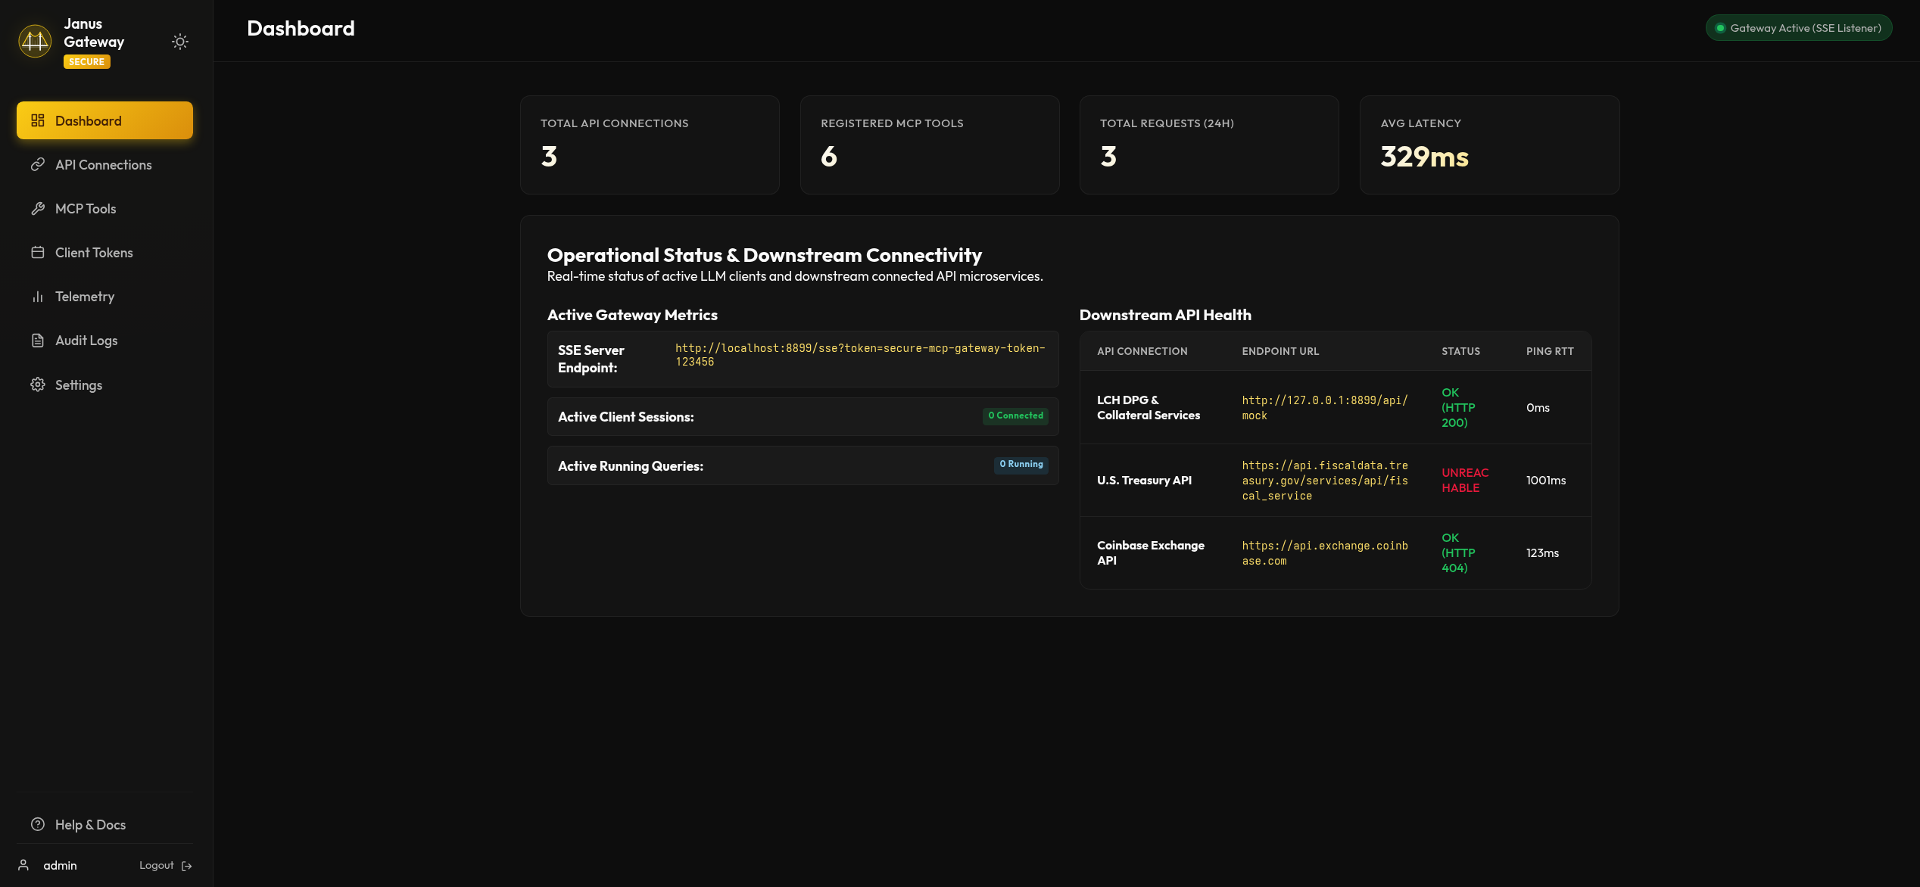
JANUS MCP API GATEWAY
The Administration Web Portal
• Central Control Plane:
A beautiful, premium single-page web console embedded directly inside the Go binary. Rebuilt using standard HTML & CSS for zero external asset dependency.
• Connection & Endpoint Wizards:
Wizard dialogs to easily link target microservices, define HTTP paths, specify methods, and input JSON schemas for tool call arguments.
• Client Access Scopes:
Administrators can generate client bearer tokens and limit their execution capability to specific API connection subsets.
Figure 3.1: Central gateway monitoring dashboard console in dark mode.

Slide 4
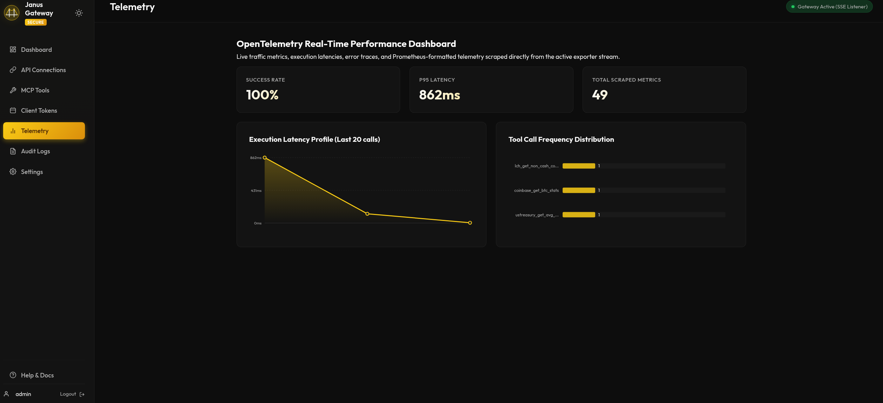
JANUS MCP API GATEWAY
Operational Telemetry & Auditing
• Continuous Telemetry:
Real-time tracking of request volumes, processing latency, DB size, active tokens, and upstream REST path health.
• Compliance Audit Logs:
Full historical table captures caller details, requested tools, dynamic HTTP target URL execution, success/error status, and duration.
• Prometheus Metrics Integration:
Exposes standard raw Prometheus endpoints `/metrics` for integration with company-wide DataDog, Grafana, or OpenTelemetry systems.
Figure 4.1: Real-time traffic, database, and connection telemetry.

Slide 5
JANUS MCP API GATEWAY
Remote Administration & CLI Utility
• Problem: Access Limitations:
Regulated networks prevent direct server console access or UI connections. Administrators need lightweight, remote, secure script tools.
• Solution: mcp-cli Utility:
A compiled command-line binary that connects to the portal API remotely over secure JWT sessions. Operates cleanly in local command shells.
• CLI Core Capabilities:
1. Remote authentication and session storage. 2. Diagnostic connectivity test: 'mcp-cli verify'. 3. Secret credential injection: 'mcp-cli vault set'. 4. Real-time diagnostic metrics: 'mcp-cli status'.
# Authenticate with Gateway
$ mcp-cli login admin --addr http://localhost:8899
✔ Successfully logged in. Session JWT saved.
$ mcp-cli verify
✔ Connection [stripe] is HEALTHY (200 OK) ✔ Connection [weather] is HEALTHY (200 OK)
$ mcp-cli status
Uptime: 2d 4h 12m | DB Size: 64.0 KB Total Requests: 1,842 | Failure Rate: 0.2%

Slide 6
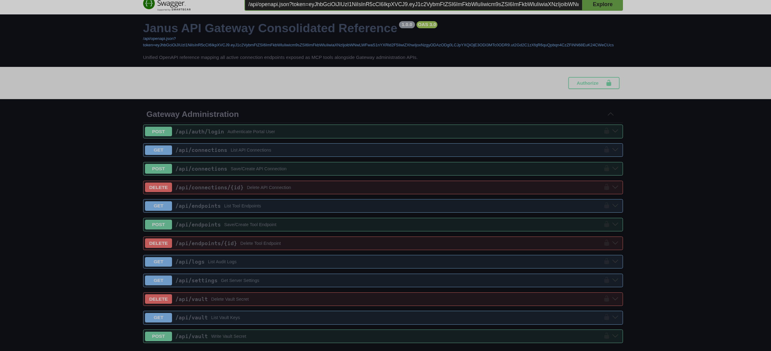
JANUS MCP API GATEWAY
Developer Onboarding & Setup
• Interactive Swagger Explorer:
The gateway automatically translates registered MCP tool mappings into a unified Swagger/OpenAPI spec page served at `/swagger.html` for easy testing.
• Local Stdio Integration:
Developers add the gateway directly into local IDE config files (e.g. Claude Desktop config) pointing to the compiled Go binary.
• Nix Declarative Sandbox:
Provides a reproducible build environment via Nix flakes. Run 'just build' to compile and 'just validate' to run tests.
Figure 6.1: Unified interactive Swagger UI API documentation explorer.

Slide 7
AGENT CLIENT INTEGRATIONS
Multi-Agent Client Integrations
• Claude & Desktop IDEs (Stdio):
Claude Desktop, VS Code Copilot extensions, and Codex wrappers connect via the stdin/stdout channel. The local client spawns the Janus binary as a sub-process, passing the authentication token securely in the process environment.
• Antigravity & Web Agents (SSE):
Google Antigravity SDK and other server-side agentic frameworks query tools over Server-Sent Events (SSE). The gateway acts as a high-performance SSE streaming server, validating headers on every frame.
• Dynamic Tool Discovery:
Regardless of client (Claude, Copilot, or Antigravity), the client automatically queries the `tools/list` endpoint at startup. It dynamically retrieves up-to-date tool schemas without hardcoded mapping updates.
// Claude Desktop Integration (claude_desktop_config.json)
{ "mcpServers": { "janus-gateway": { "command": "/usr/local/bin/mcp-gateway", "args": ["-stdio"], "env": { "MCP_GATEWAY_TOKEN": "client-bearer-token" } } } }
# Antigravity SDK Integration (Python)
from antigravity_sdk import Agent, ToolRegistry reg = ToolRegistry.from_mcp_sse( url="http://localhost:8899/sse", headers={"Authorization": "Bearer token"} ) agent = Agent(tools=reg.list_tools())

Slide 8
ENTERPRISE SECURITY & CAPABILITIES
API Security Shield & Enterprise Capabilities
• Credential Redaction (Zero-Trust):
Secrets (API keys, Basic Auth, custom headers) are stored in secure cloud/local vaults (AWS, GCP, Azure, SQLite). The LLM agent only queries references (e.g. prod/stripe/key); the gateway injects secrets at runtime, keeping them hidden from LLM memory.
• Namespace Prefix Scoping:
Isolates microservice endpoints behind client token scopes (e.g. stripe_*). Prevents prompt-injection attacks from triggering cross-service commands.
• Audit & mTLS Enforcement:
Every transaction is audited for duration, caller identity, and errors. Client-side CA checks enforce Mutual TLS (mTLS) for all incoming SSE traffic.
• Unified API-to-Tool Workspace:
Exposes all legacy microservices and proprietary REST APIs as standard local capabilities to your developer AI stack.
• Air-Gapped Operation:
Enables fully local LLM workflows in offline development terminals with no external telemetry egress.
• Dynamic Capability Updates:
Updating an endpoint mapping in the portal instantly exposes the new tool capability to all connected Claude, Copilot, and Antigravity agents without recompilation.

