Slide 1

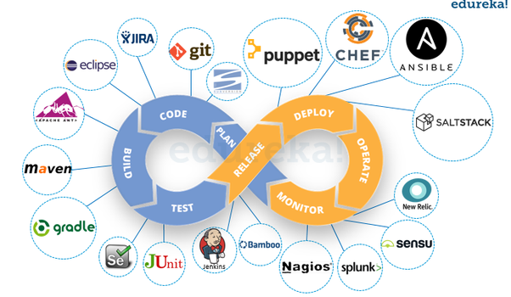
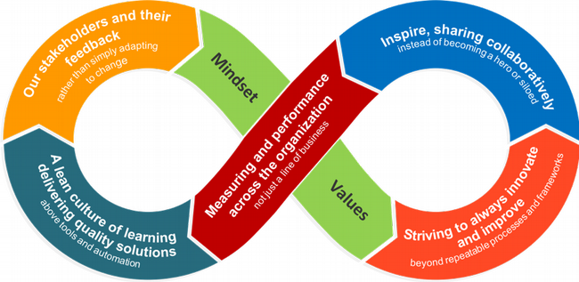
Classwork Assignment: Introduction to DevOps and Cloud Integration
This Photo by Unknown Author is licensed under CC BY-SA-NC
Ade Wale - Major Ola

Slide 2



Agenda
Task 1: Cultural Shift in DevOps
Task 2: Automation, CI/CD, and DevOps
Task 3: Role of a DevOps Engineer
Task 4: Cloud Integration with DevOps
Task 5: Key Cloud Services for DevOps (Example: AWS)

Slide 3




Task 1: Cultural Shift in DevOps
By breaking down silos between development and operations, teams can foster a shared sense of ownership and responsibility. This leads to faster problem-solving, increased efficiency, and higher-quality software. For instance, when developers and operations work closely together, they can identify potential issues early in the development cycle, preventing costly errors and delays. This collaborative approach is exemplified by companies like Amazon, which has embraced DevOps to rapidly innovate and deliver new products to market.

Slide 4

Task 2: Automation, CI/CD, and DevOps
CI/CD Tool | Features | Advantages | Limitations
Jenkins | Extensive plugin ecosystem, open-source | Highly customizable, large community | Complex configuration
GitLab CI/CD | Integrated with GitLab, built-in features | Streamlined workflow, efficient for GitLab users | Less mature than Jenkins
CircleCI | User-friendly interface, fast build times | Easy to learn and use, strong performance | Less customization options compared to Jenkins
Choosing a CI/CD tool depends on factors such as project size, team expertise, desired level of customization, and integration with existing tools. For small to medium-sized projects with a GitLab workflow, GitLab CI/CD might be a good choice. Larger projects requiring extensive customization and flexibility might benefit from Jenkins. CircleCI is suitable for teams prioritizing speed and ease of use.

Slide 5

Responsible for building, deploying, and maintaining cloud-based infrastructures. Collaborates with development and operations teams to automate processes and improve software delivery.
Task 3: Role of a DevOps Engineer
DevOps Engineer
Required Skills and Experience:
Strong proficiency in scripting (Python, Bash, PowerShell)
Experience with cloud platforms (AWS, Azure, GCP)
Knowledge of containerization (Docker, Kubernetes)
CI/CD pipeline tools (Jenkins, GitLab CI/CD)
Networking and security fundamentals
Essential Soft Skills:
Excellent communication and collaboration
Problem-solving and critical thinking
Adaptability and willingness to learn
Attention to detail and organizational skills

Slide 6

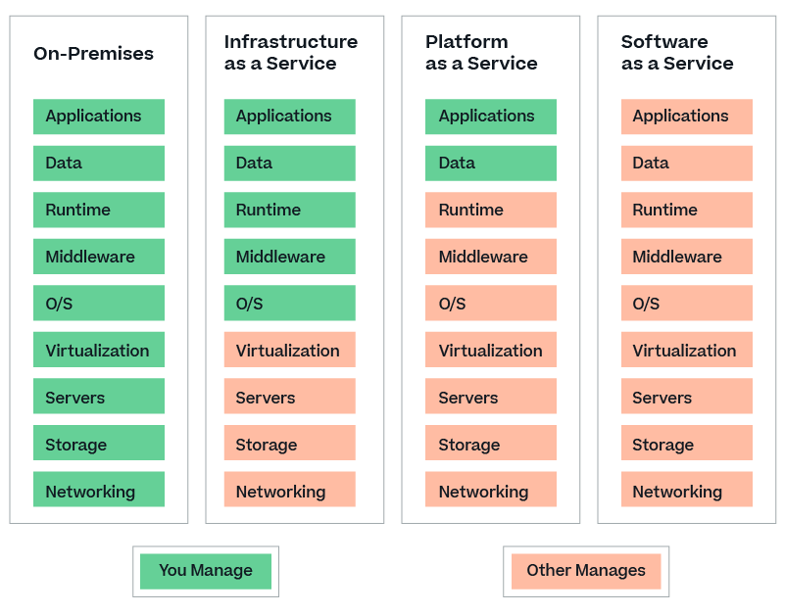
Task 4: Cloud Integration with DevOps
IaaS (Infrastructure as a Service): Provides virtualized hardware resources (servers, storage, networking). DevOps teams can manage infrastructure more efficiently.
PaaS (Platform as a Service): Offers a platform for developing and deploying applications (runtime, database, middleware). DevOps focuses on application development and deployment.
SaaS (Software as a Service): Delivers software applications over the internet. DevOps teams can leverage SaaS for collaboration and productivity tools.
DevOps aligns with all models by automating infrastructure provisioning (IaaS), application deployment (PaaS), and software updates (SaaS).

Slide 7


Task 5: Key Cloud Services for DevOps (Example: AWS)
AWS for DevOps:
Compute: EC2 instances for scalable applications, Lambda for serverless functions.
Storage: S3 for object storage, EBS for block-level storage.
Networking: VPC for isolated network environments, Route 53 for DNS management.
Identity Management: IAM for user and role-based access control.
Benefits:
Rapid provisioning of resources
Auto-scaling to handle varying workloads
Cost-efficiency through pay-per-use model
High availability and disaster recovery options

