Slide 1
Effective Stress and Pore-Water Pressure
The single most important idea in soil mechanics
Day 1 | Session 2 | Geomorphological Hazards of Slopes | Uni. Silesia, Katowice | Ola Fredin (NTNU)

Slide 2
Why this lecture comes first
Mohr–Coulomb strength, infinite-slope stability, and rainfall triggering all depend on one variable: σ′
You cannot interpret slope failures without knowing how water changes effective stress
Terzaghi (1925; formalised 1943): the founding observation of geotechnical engineering
Goal: make σ′ = σ − u second nature before moving to failure criteria

Slide 3
§1
Terzaghi’s principle

Slide 4
Terzaghi’s principle of effective stress
Total stress = effective stress + pore-water pressure:
σ = σ′ + u
σ — total normal stress (weight of everything above the plane per unit area)
u — pore-water pressure (pressure of water filling voids between grains)
σ′ — effective stress (stress carried by grain skeleton at grain-to-grain contacts)
Physical insight:
Water cannot resist shear. Only the grain skeleton can. Shear strength depends on σ′, not σ.
Terzaghi (1925) Erdbaumechanik; Terzaghi (1943) Theoretical Soil Mechanics
τ_f = c′ + σ′ tan φ′

Slide 5
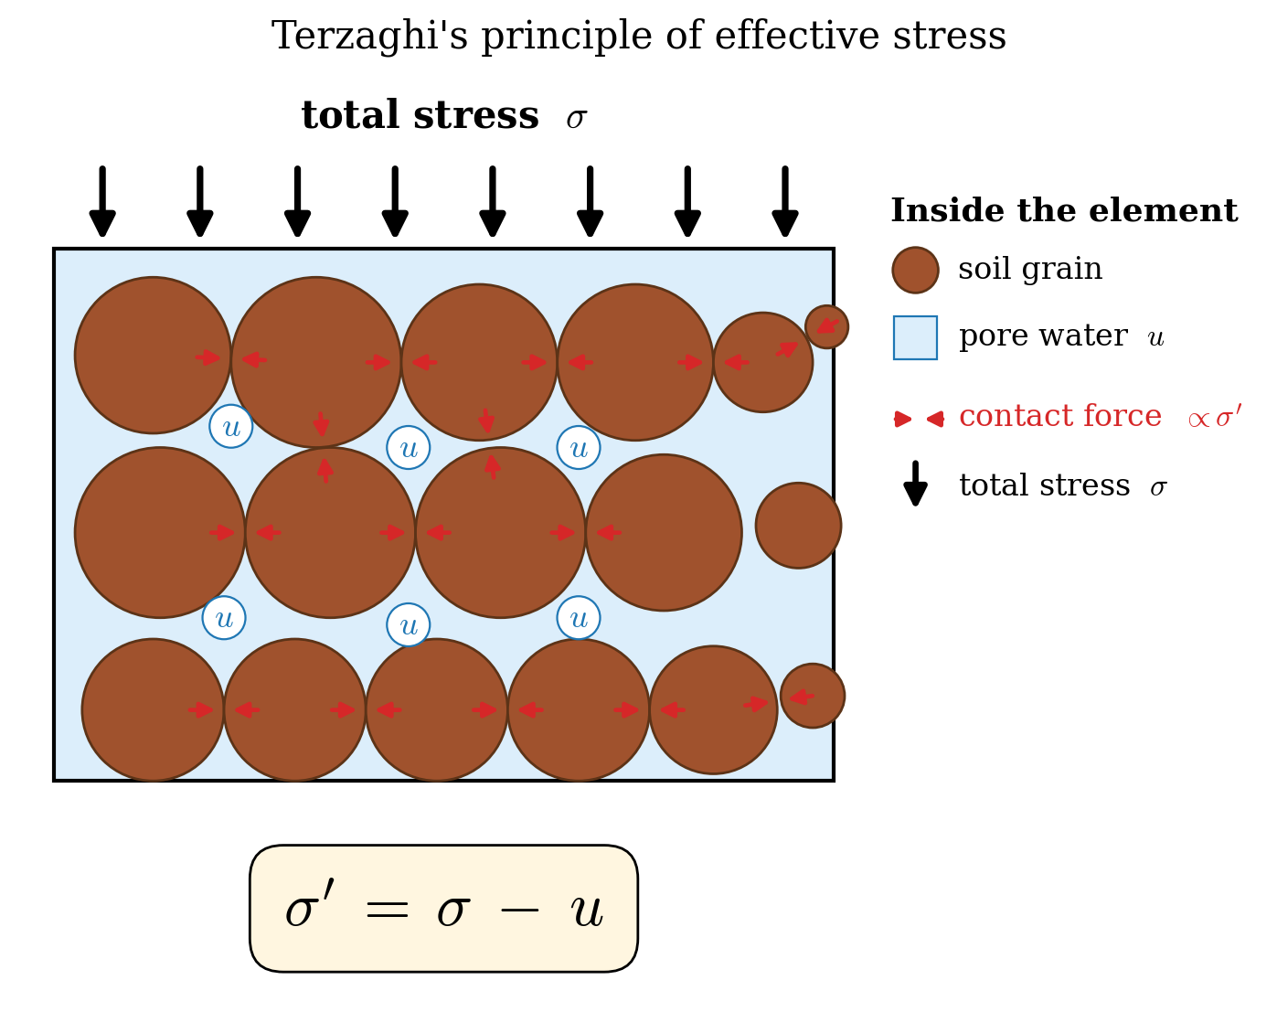
The grain-skeleton picture
A saturated soil element = grain skeleton (solid) + pore water (fluid)
External load σ shared: water carries u isotropically; grains carry σ′ = σ − u at contacts
Grains are nearly incompressible at engineering stresses — all deformation lives in the contacts
Adding load rapidly (undrained): u rises, not σ′ — Skempton’s B parameter captures this
Only when drainage occurs (drained loading) does σ′ increase and the skeleton compress
Grain skeleton (brown) and pore water (blue). External load σ shared between u and grain-contact stress σ′.

Slide 6
§2
Vertical stress profiles

Slide 7
Stress profiles in a saturated soil column
Total vertical stress: σ_v(z) = γ z (weight of soil above, per unit area)
Pore pressure below water table at depth z_w: u(z) = γ_w (z − z_w) for z > z_w
Effective vertical stress: σ′_v(z) = σ_v − u = γ′ z (below WT, where γ′ = γ − γ_w ≈ 10 kN/m³)
Above the water table (unsaturated zone): u < 0 (suction) — slope strength enhanced
Always draw all three panels: σ_v (left), u (centre), σ′_v (right)

Slide 8
Effect of a rising water table
Before rainfall (water table at depth z_w):
σ′ = γ z − γ_w (z − z_w)
After rainfall (water table rises to surface, z_w → 0):
σ′ = (γ − γ_w) z = γ′ z
Change in effective stress at depth z:
Δσ′ = − γ_w z_w < 0
σ is unchanged; only u rises; σ′ falls — this is why pore pressure drives slope failure
Rising water table reduces σ′ while leaving σ unchanged — this is the rainfall-slide mechanism

Slide 9
Four canonical loading scenarios
Drained / undrained
Other scenarios
Drained loading: slow; water drains; u unchanged; σ′ rises → strengthening
Undrained loading: rapid; no drainage; load goes to u; σ′ unchanged (short-term undrained strength c_u)
Rapid drawdown: reservoir lowered fast; seepage force reverses; u elevated; σ′ drops → destabilising
Reservoir filling: water raises both σ and u; σ′ change depends on drainage
Flysch slopes: drainage times months to years → often partially drained during a storm
Rule of thumb: if loading is fast relative to t_c = H²/c_v, use undrained analysis

Slide 10
Pore pressure ratio r_u
Normalised pore pressure ratio: r_u = u / (γ z)
r_u = 0: dry slope — FS at its maximum
r_u = 0.5: half overburden carried by pore water — typical worst case for translational slides
r_u = 1.0: hydrostatic to the surface — effective stress → 0 at slip surface
In the infinite-slope model (Notebook 04): r_u maps directly to the saturation parameter m
Regional models (SHALSTAB, TRIGRS): prescribe spatially variable r_u from a rainfall scenario

Slide 11
Jupyter Notebook 02
Effective Stress and Pore-Water Pressure
Plot σ_v, u, σ′_v for a user-specified soil column (γ, depth, water table position)
Animate water table rising during a storm — watch σ′ fall in real time
Compare drained vs undrained response to a surface load
Calculate r_u for a Carpathian flysch case (γ = 21 kN/m³, z = 4 m, storm scenario)
Output figures: effective_stress_profile.svg, water_table_shift.svg, effective_stress_bars.svg

Slide 12
Key Points & References
σ = σ′ + u — Terzaghi (1925): the foundation of soil mechanics
Shear strength depends on σ′, never on σ alone
Rising water table reduces σ′ while leaving σ unchanged
r_u = u/(γz) — convenient dimensionless pore-pressure ratio for FS calculations
Drained vs undrained: drainage time relative to loading rate controls which applies
Everything in notebooks 03–05 is a direct consequence of this principle
Selected references
Terzaghi K (1925) Erdbaumechanik. Franz Deuticke, Wien
Terzaghi K (1943) Theoretical Soil Mechanics. Wiley
Skempton AW (1960) Géotechnique 10: 143-147
Craig RF (2004) Craig’s Soil Mechanics, 7th edn. Spon
Lambe TW & Whitman RV (1969) Soil Mechanics. Wiley

