Slide 1
Mohr Circles and the Mohr–Coulomb Failure Criterion
When does a slope actually fail?
Day 1 | Session 3 | Geomorphological Hazards of Slopes | Uni. Silesia, Katowice | Ola Fredin (NTNU)

Slide 2
The central question of slope stability
We know the stress state of a soil element (σ, τ on any plane) and its strength
Failure: shear stress on a plane reaches available shear strength on that plane
Two tools: (1) Mohr circle — maps the complete stress state to a single circle in (σ, τ) space
(2) Mohr–Coulomb envelope — the boundary in (σ, τ) space beyond which failure occurs
Failure: the Mohr circle touches the envelope. Pre-failure: circle lies below the envelope.

Slide 3
§1
Stress on an inclined plane

Slide 4
Normal and shear stress on a plane inclined at θ
For a 2-D element with principal stresses σ₁, σ₃ (σ₁ > σ₃):
σ_θ = (σ₁ + σ₃)/2 + (σ₁ − σ₃)/2 · cos 2θ
τ_θ = (σ₁ − σ₃)/2 · sin 2θ
Mohr’s insight (1900):
As θ varies 0–90°, the point (σ_θ, τ_θ) traces a circle centred at ((σ₁+σ₃)/2, 0) with radius (σ₁−σ₃)/2
Every possible stress state on every possible plane through that element lies on the Mohr circle
Mohr O (1900) Zeitschr. des VDI 44: 1524-1530
Key values:
Maximum shear stress: τ_max = (σ₁−σ₃)/2 at θ = 45°

Slide 5
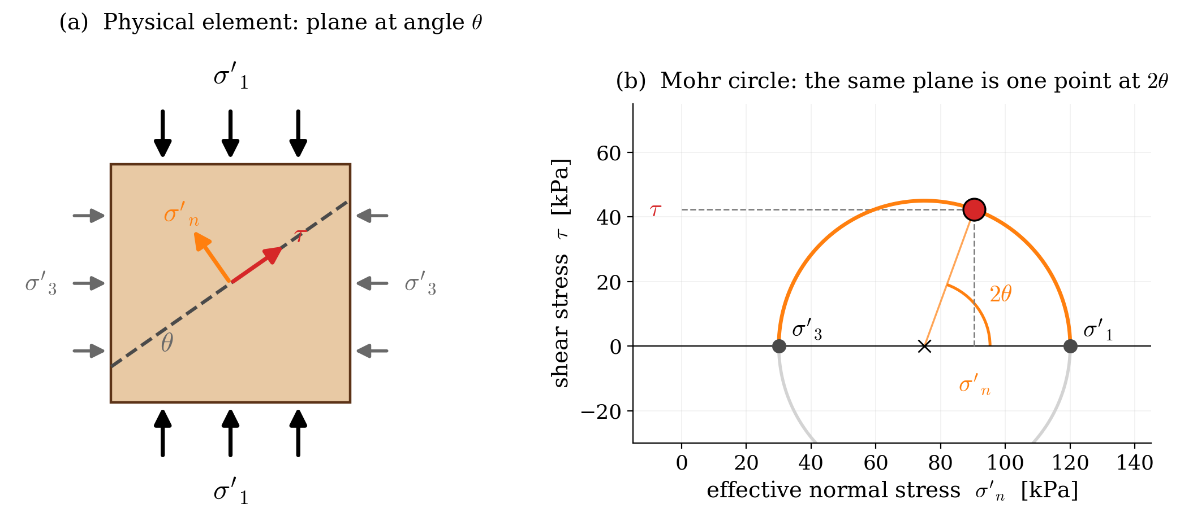
The Mohr circle
Centre: C = ((σ₁ + σ₃) / 2, 0)
Radius: R = (σ₁ − σ₃) / 2 — half the deviator stress
Horizontal axis: normal stress σ (positive = compression)
Vertical axis: shear stress τ (positive = counterclockwise)
The two ends of the horizontal diameter = principal planes, where τ = 0
A large circle far to the left (low σ, high τ) → approaching failure
Mohr circle for a 2-D stress element. All planes through the element are encoded on the circle.

Slide 6
§2
The Mohr–Coulomb failure criterion

Slide 7
Mohr–Coulomb failure envelope
Coulomb (1776): shear strength on a plane is a linear function of normal stress:
τ_f = c + σ tan φ
In effective-stress form (the operative form for slope analysis):
τ_f = c′ + σ′ tan φ′
c′ — effective cohesion (kPa): residual strength → c′ ≈ 0 for granular soils
φ′ — effective friction angle: sand 28–36°, silt 24–30°, Carpathian flysch 20–28°
Coulomb CA (1776) Mém. Acad. Roy. Sci. Paris
Failure:
Mohr circle touches the envelope → element yields on the plane at θ = 45° + φ′/2

Slide 8
Effect of pore pressure on the Mohr circle
Effective stress: σ′ = σ − u shifts the Mohr circle to the left by amount u
Total-stress circle: position relative to the total-stress envelope is irrelevant for failure
Effective-stress circle: moves left as u rises — approaches the failure envelope
At failure: the effective circle just touches the failure envelope
Physical story: rainfall raises u → circle shifts left → touches envelope → slope fails
Notebooks 04 and 05 quantify exactly when this happens as a function of rainfall intensity and duration

Slide 9
Measuring c′ and φ′ in the laboratory
Laboratory methods
Typical parameter ranges
Direct shear test: shear a sample at three different σ′ values → fit a line through (σ′, τ_f) points
Triaxial test: apply confining pressure σ₃, increase σ₁ to failure → draw Mohr circle at failure
Multiple triaxial tests at different σ₃ → common tangent = envelope → c′, φ′
Residual vs peak: back-analysis of old landslides uses residual strength
Typical values for slope materials:
Dense sand/gravel: c′ ≈ 0 kPa, φ′ = 32–40°
Sandy silt (colluvium): c′ = 5–15 kPa, φ′ = 28–34°
Carpathian flysch shale: c′ = 5–20 kPa, φ′ = 20–28°
Sensitive clay (residual): c′ ≈ 0, φ′ = 12–18°
Weathered crystalline rock: c′ = 10–50 kPa, φ′ = 28–38°

Slide 10
Worked example: Carpathian flysch slope
Slope angle β = 28°, soil depth z = 4.5 m, γ = 20.5 kN/m³
Strength parameters: c′ = 8 kPa, φ′ = 24° (typical Carpathian flysch shale)
Dry state (u = 0): σ′ = 71.5 kPa; τ = 38.9 kPa; τ_f = 40.0 kPa → stable (FS = 1.03)
After heavy rainfall (water table at surface, m = 1): u = 34.4 kPa
σ′ falls to 37.1 kPa; τ still 38.9 kPa; τ_f = 25.3 kPa → FAILURE (FS = 0.65)
Mohr circle has shifted left onto the failure envelope — the Terzaghi + Mohr–Coulomb chain is complete

Slide 11
Jupyter Notebook 03
Mohr Circles and the Mohr–Coulomb Failure Criterion
Interactive Mohr circle: drag σ₁, σ₃ sliders and watch the circle update in real time
Overlay failure envelope with adjustable c′ and φ′ — identify the failure point
Pore-pressure animation: raise u and watch the circle approach the failure envelope
Carpathian flysch worked example: reproduce the rainfall-triggered failure numerically
Output figures: mohr_element_and_circle.svg, mohr_circle_failure.svg

Slide 12
Key Points & References
Mohr circle: complete stress state of a point encoded in one circle in (σ, τ) space
Mohr–Coulomb envelope: τ_f = c′ + σ′ tan φ′ — boundary beyond which soil yields
Failure when circle touches envelope — on the plane at θ = 45° + φ′/2
Rainfall raises u → circle shifts left → approaches envelope → slope fails
Direct shear / triaxial tests measure c′ and φ′
Carpathian flysch: c′ = 5–20 kPa, φ′ = 20–28°; cohesion often lost on pre-existing shear surfaces
Selected references
Mohr O (1900) Zeitschr. des VDI 44: 1524-1530
Coulomb CA (1776) Mém. Acad. Roy. Sci. Paris 7: 343-382
Terzaghi K (1943) Theoretical Soil Mechanics. Wiley
Bishop AW (1955) Géotechnique 5: 7-17
Craig RF (2004) Craig’s Soil Mechanics, 7th edn. Spon

