Slide 1
Infinite Slope Stability
The workhorse model of shallow-landslide hazard assessment
Day 2 | Session 1 | Geomorphological Hazards of Slopes | Uni. Silesia, Katowice | Ola Fredin (NTNU)

Slide 2
Why the infinite slope model?
Simplest model that captures the essential physics of a translational slide
Three assumptions: planar slip surface parallel to slope; uniform soil; end effects negligible
Despite simplicity, embedded in every regional susceptibility model: SHALSTAB, TRIGRS, SINMAP
Transparent: every parameter has a physical meaning; failure mechanism is unambiguous
Limitations: curved surfaces, lateral boundaries, pipe flow — need more complex models

Slide 3
§1
Geometry and the FS equation

Slide 4
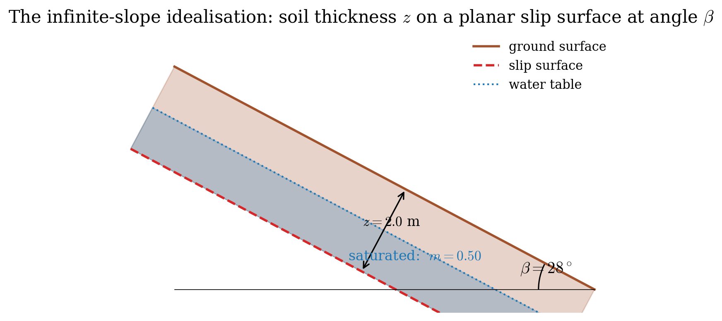
Infinite slope geometry
Slope angle β, soil thickness z (normal to slope), unit weight γ
Slip surface parallel to slope at depth z
Water table depth z_w below surface; saturated fraction m = (z − z_w) / z ∈ [0, 1]
Flow assumed parallel to slope within the saturated zone
Stresses on slip surface: σ_n = γz cos²β; τ = γz sinβ cosβ
Pore pressure: u = m γ_w z cos²β (slope-parallel flow assumption)
Infinite slope cross-section: soil layer of depth z, water table at fraction m from the base.

Slide 5
Factor of Safety: full form
Available shear strength (Mohr–Coulomb) over mobilised shear stress:
FS = c′ / (γz sinβ cosβ) + tanφ′ / tanβ − mγ_w tanφ′ / (γ tanβ)
Cohesionless soil (c′ = 0), dry (m = 0):
FS = tanφ′ / tanβ
→ FS = 1 when β = φ′ (angle of repose for cohesionless soil)
Fully saturated, cohesionless (c′ = 0, m = 1):
Saturation approximately halves FS in a cohesionless slope
FS = (γ − γ_w) / γ · tanφ′ / tanβ ≈ 0.5 · tanφ′ / tanβ

Slide 6
FS vs slope angle for cohesionless soil (φ′ = 28°)
FS = 1.0 marks the failure threshold. Saturation halves FS for cohesionless soil. c′ = 0, φ′ = 28°.

Slide 7
§2
The saturation parameter m

Slide 8
How saturation controls stability
m = 0: dry slope — maximum stability; FS determined only by β and φ′
m = 0.5: half-saturated — common after short rain events
m = 1.0: water table at surface — minimum stability; FS halved for cohesionless soils
Cohesion c′ helps at small depths but decreases in relative importance as z increases
Highest sensitivity to m near the critical angle β ≈ φ′
Field observation: Carpathian slides typically initiate when m → 1 during prolonged rainfall

Slide 9
Critical failure depth for cohesive soils
Set FS = 1 and solve for z at given m:
z_c = c′ / [ γ cosβ (tanβ − tanφ′) − m γ_w cosβ tanφ′ ]
Physical interpretation:
z_c is the depth at which a slope just reaches FS = 1 at given rainfall scenario
Soil depth > z_c: unstable; depth < z_c: stable (at that water table)
As β → φ′ from above: z_c → ∞ (cohesion alone stabilises the slope)
Practical use (SHALSTAB approach):
After Montgomery & Dietrich (1994) Water Resour. Res. — the basis for SHALSTAB
Map z_c across a DEM: cells with soil depth > z_c are classified as unstable

Slide 10
From FS to regional susceptibility maps
Steady-state (SHALSTAB)
Transient (TRIGRS) / Probabilistic (SINMAP)
SHALSTAB (Montgomery & Dietrich 1994): infinite slope FS + steady-state hydrology
Topographic wetness index (TWI) predicts m from catchment area A and slope tanβ
Output: instability index log(q/T) mapped across DEM — calibrate T to inventory
TRIGRS (Baum et al. 2008): adds Iverson (2000) transient infiltration
SINMAP (Pack et al. 1998): probabilistic version with parameter uncertainty
All three share the same FS core equation — only the hydrological model differs
Notebook 04: build your own 1-D susceptibility profile along a DEM cross-section

Slide 11
Worked example: Carpathian flysch (Notebook 04)
Slope: β = 28°, z = 4.5 m, γ = 20.5 kN/m³, c′ = 8 kPa, φ′ = 24°
Dry (m = 0): FS = 0.42 + 0.84 = 1.26 (stable)
m = 0.5: pore-pressure term subtracts 0.22 → FS = 1.04 (marginal)
m = 1.0: pore-pressure term subtracts 0.44 → FS = 0.82 (FAILURE)
Critical depth at m = 1: z_c = 3.2 m — consistent with 3–5 m field observations in flysch

Slide 12
Jupyter Notebook 04
Infinite Slope Stability
Implement the full FS equation in Python; explore parameter sensitivity interactively
Plot FS vs β, FS vs m, and the FS heatmap FS(β, m) with the FS = 1 isoline
Compute z_c and plot critical-depth contours vs saturation
Carpathian flysch worked example: reproduce the dry → m = 1 transition numerically
Extension: build a 1-D susceptibility profile along a DEM cross-section

Slide 13
Key Points & References
FS = c′/(γz sinβ cosβ) + tanφ′/tanβ − m(γ_w/γ)(tanφ′/tanβ)
Dry cohesionless slope: FS = tanφ′/tanβ; fails when β = φ′
Full saturation (m = 1) approximately halves FS in cohesionless soils
Critical depth z_c: soil deeper than z_c is unstable at given water table
SHALSTAB/TRIGRS embed this equation in a spatially distributed hydrological model
Notebooks 04 and 05 connect FS to a time-varying pore-pressure field
Selected references
Taylor DW (1937) J. Boston Soc. Civ. Engrs 24: 197
Montgomery DR & Dietrich WE (1994) Water Resour. Res. 30: 1153
Baum RL et al. (2008) USGS Open-File Rep. 2008-1159
Iverson RM (2000) Water Resour. Res. 36: 1897
Pack RT, Tarboton DG & Goodwin CN (1998) Proc. IUFRO Conf.

