Slide 1
Rainfall Triggering of Slope Failures
Adding time to the stability equation
Day 2 | Session 2 | Geomorphological Hazards of Slopes | Uni. Silesia, Katowice | Ola Fredin (NTNU)

Slide 2
Rainfall: the dominant trigger worldwide
Rainfall drives >50% of all landslides globally; in humid mountain belts the fraction is >90%
Notebooks 02–04 built the mechanism: rain infiltrates → u rises → σ′ falls → FS < 1
What this lecture adds: TIME — rainfall has intensity, duration, and aftermath
The slope responds with a delayed pore-pressure pulse; forecasting failure = forecasting when that pulse drives FS below 1
Two main tools: (1) Iverson (2000) diffusion model (physical, site-specific); (2) Intensity–Duration thresholds (empirical, regional)

Slide 3
§1
Three time-scales of response

Slide 4
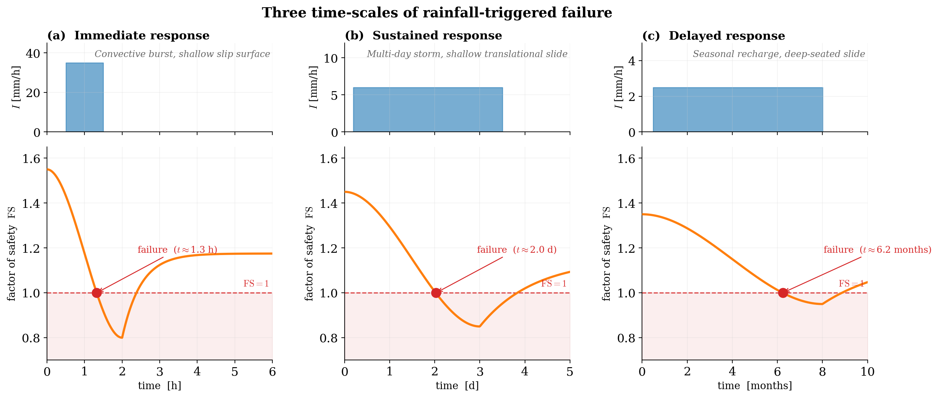
Three regimes of rainfall-driven failure
Immediate (minutes–hours): short high-intensity burst on shallow, conductive soil over impermeable bedrock — Alpine debris cones during convective storms; z ≈ 0.5–1.5 m
Sustained (hours–days): classic shallow translational slide on flysch / glacial till — rising water table over days of moderate rain; dominant in Carpathians, Sudetes, Norwegian fjords
Delayed (weeks–months): deep-seated rotational slides in clay-rich terrain; z = tens of metres; failure tracks seasonal groundwater peak, not individual storms
Different regimes need different forecasting tools: ID thresholds for first two; piezometer-based EWS for deep-seated slides
Three-panel schematic: same hyetograph + FS(t) plotted on time axes of hours, days and months. After Wieczorek & Glade (2005).

Slide 5
§2
Iverson (2000) infiltration model

Slide 6
Pore-pressure diffusion during a storm
Iverson (2000): pore-pressure response governed by 1-D linear diffusion:
∂ψ/∂t = D · ∂²ψ/∂z², D = K_z / S
D — hydraulic diffusivity (m²/s); K_z — vertical saturated hydraulic conductivity; S — specific storage
Natural time-scale at depth z:
τ(z) = z² / D
z = 3 m, D = 10⁻³ m²/s (sandy gravel): τ ≈ 2.5 hours (immediate response)
Iverson RM (2000) Water Resour. Res. 36: 1897-1910
z = 3 m, D = 10⁻⁶ m²/s (silt): τ ≈ 100 days (delayed response)
Steady pore-pressure rise for constant rainfall I < K_z:
Δψ_ss = I z / K_z · cos²β

Slide 7
From pore pressure to FS time series
At each time step: σ′(t) = σ_n − u(t); τ_f(t) = c′ + σ′(t) tanφ′
FS(t) = τ_f(t) / τ — the factor of safety is now a time series
FS starts above 1.0 (stable); falls during the storm; may cross 1.0; recovers after drainage
Time of failure = when FS first reaches 1.0 from above
TRIGRS: runs the Iverson model on every DEM cell simultaneously → FS map evolving during storm
Calibration needs K_z, D, c′, φ′, γ for each soil unit (site investigation or literature)

Slide 8
§3
Intensity–Duration thresholds

Slide 9
What is an ID threshold?
Empirical lower envelope in log(I)–log(D) space below which no landslides have been triggered
I — rainfall intensity (mm/h); D — storm duration (h)
General form: I = α · D^(−β) with β ≈ 0.5–0.8
Calibration: landslide event inventory + associated rainfall records; fit the lower envelope
Regional validity: depends on climate, soil type, slope geometry — cannot transfer globally without recalibration
Operational use: national EWS compare real-time gauge data to the threshold → alert levels

Slide 10
Intensity–Duration thresholds: global and Central European
Landslide-triggering events plot above the line. Caine (1980) Geografiska Annaler; Guzzetti et al. (2008) Earth-Sci. Rev.; Tichavský et al. (2019) Geomorphology.

Slide 11
Early warning systems in Central Europe and Norway
Czech Geological Survey: threshold-based EWS covering ~90,000 km² of flysch belt; SMS alerts to municipalities
Polish Geological Institute: OSTRZEGA system — threshold + geological map; Carpathian focus
NVE (Norway): continuous monitoring for hazardous sites — GPS, extensometers, piezometers, seismometers + multi-parameter threshold matrix
Lead time: 0–12 hours for shallow slides; deep-seated systems may provide days of warning
Limitation: ID thresholds define alert levels, not binary go/no-go
Integration: EWS output → emergency services and road/rail closure protocols

Slide 12
Jupyter Notebook 05
Rainfall Triggering of Slope Failures
Run the Iverson (2000) model: specify K_z, D, z, storm intensity and duration → plot Δu(t) and FS(t)
Explore how D (hydraulic diffusivity) controls response time — fast vs slow soils
Plot the three ID threshold curves (Caine, Guzzetti, Central European) on log–log axes
Worked example: Carpathian flysch — 48-hour frontal rain + 24-hour aftermath
Output figures: rainfall_pore_pressure_response.svg, fs_time_series.svg, id_thresholds.svg

Slide 13
Key Points & References
Three time-scales: immediate (hrs), sustained (days), delayed (weeks–months)
Iverson (2000): pore pressure governed by 1-D diffusion; D = K_z/S controls time-scale
FS(t): translate pore-pressure time series into a stability time series
ID threshold: I = α D^(−β) — empirical lower envelope for landslide-triggering rainfall
Central European threshold: I ≈ 3.9 D^(−0.47) (Tichavský et al. 2019)
EWS: Czech CGS, Polish PGI-NRI, NVE Norway all use threshold-based alert systems
Selected references
Iverson RM (2000) Water Resour. Res. 36: 1897-1910
Caine N (1980) Geografiska Annaler 62A: 23-27
Guzzetti F et al. (2007) Earth-Sci. Rev. 83: 135-152
Guzzetti F et al. (2008) Nat. Hazards Earth Syst. Sci. 8: 1521-1538
Tichavský R et al. (2019) Geomorphology 329: 1-13
Wieczorek GF & Glade T (2005) in: Jakob M & Hungr O (eds) Debris-Flow Hazards

