Slide 1
Rockfall Trajectories and Runout
Predicting where the block stops — and what it hits
Day 3 | Session 1 | Geomorphological Hazards of Slopes | Uni. Silesia, Katowice | Ola Fredin (NTNU)

Slide 2
Rockfall as a hazard
Rockfall: detachment of a block from a steep face; free fall, bouncing, rolling, sliding to rest
Unlike landslides: no shear surface — purely kinematic once detachment occurs
Hazard zone: every fjord-side road, alpine valley town, Carpathian tourist trail is exposed
Norway: ~1700 fatal rockfall events since AD 1000 (Furseth 2006); Tafjord 1934 tsunami (40 killed)
Central Europe: limestone and sandstone cliffs in Tatras, Karkonosze, Bohemian Karst
Design question: where is the 500-yr stopping point? What is the kinetic energy at the road?

Slide 3
§1
Four motion modes

Slide 4
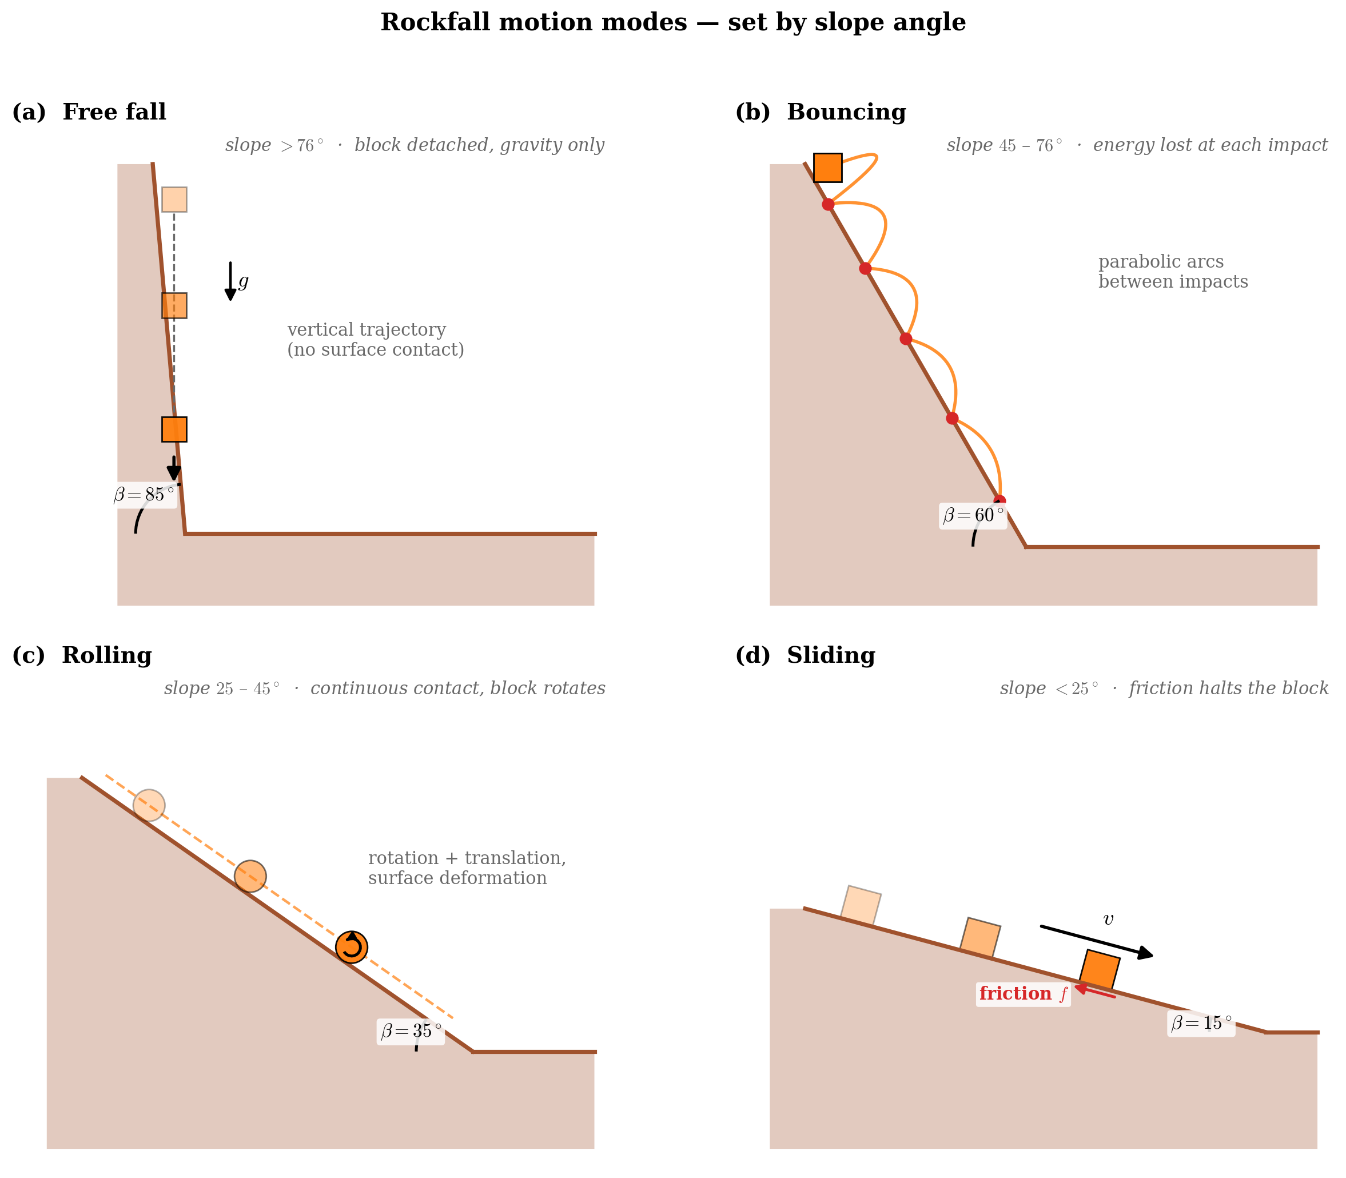
Fall → Bounce → Roll → Slide
Free fall (β > 76°): block detached; only gravity acts; vertical cliffs and headscarps
Bouncing (β 45–76°): intermittent surface contact; energy lost at each impact through normal restitution
Rolling (β 25–45°): continuous surface contact; rotational energy; losses to surface deformation
Sliding (β < 25°): translational motion; halted by friction; common on fan deposits
Transition angles are empirical and vary with block size and shape
A Norwegian fjord-slope block sees all four in sequence: free fall off 200-m cliff → bounce on talus → roll across apron → slide to stop on beach
Four motion modes as slope angle decreases from ~85° to ~15°. After Ritchie (1963) and Whalley (1984).

Slide 5
§2
Energy-line and shadow-angle methods

Slide 6
Heim’s fahrböschung (energy line)
Heim (1932): the straight line from source to stopping point defines the travel slope:
tan α = H / L
H — total fall height; L — horizontal travel distance; α — fahrböschung (energy-line angle)
Typical values:
Individual rockfalls (< 10³ m³): α = 30–45°
Large rock avalanches (> 10⁶ m³): α = 10–20° (long-runout paradox: size → lower α)
Zero-parameter runout estimate:
Heim A (1932) Bergsturz und Menschenleben. Fretz & Wasmuth, Zürich
L_max = H / tan(α_min)
α_min from regional inventory lower envelope

Slide 7
Evans & Hungr (1993) shadow-angle method
Evans & Hungr (1993): systematic analysis of 16 rockfall sites in British Columbia
Shadow angle: the zone below α_min from the cliff base empirically always receives blocks
Method: identify cliff base on DEM; project shadow line downslope; everything below is hazard zone
Advantage: purely geometric — only requires a good DEM; no velocity/restitution parameters
Conservative by design: lower envelopes used; intended for screening-level hazard maps
Complement with lumped-mass simulation for site-specific design (net heights, energy barriers)

Slide 8
§3
Lumped-mass simulation and Monte-Carlo

Slide 9
Restitution coefficients
At each bounce: kinetic energy is partially lost through deformation and fragmentation
Normal restitution: e_n = v_n,after / v_n,before
Tangential restitution: e_t = v_t,after / v_t,before
Rock on rock: e_n ≈ 0.5–0.8, e_t ≈ 0.7–0.9
Rock on soil: e_n ≈ 0.2–0.5, e_t ≈ 0.5–0.8 (energy absorbed by soil deformation)
Rolling friction: μ_r ≈ 0.3–0.7 (forested) to 0.05–0.2 (smooth rock)
Parameter uncertainty is large → Monte-Carlo is standard practice

Slide 10
Monte-Carlo runout analysis
Sample e_n, e_t, μ_r from probability distributions (log-normal or triangular)
Run N = 100–1000 trajectories; each gives a different stopping distance x_stop
Build empirical CDF of stopping distance: P(stops before x) = fraction of trajectories
Hazard zoning: high-hazard = area reached by ≥10% of trajectories; medium = 1–10%; low = 0.1–1%
Outputs: runout probability map, energy envelope (barrier design), bounce-height envelope (net height)
Notebook 06: implement this in Python; ~50 lines for a full probabilistic runout map

Slide 11
Practical hazard zoning (Norwegian practice)
NVE guidelines (2014): three hazard zones based on annual exceedance probability: 1/100, 1/1000, 1/5000
Inhabited areas: land-use regulation requires P < 1/1000 per year for new buildings
Empirical α angles for Norwegian lithologies (gneiss, schist, phyllite): typical α_min ≈ 28–32°
Protective measures: catching ditches, embankments, rockfall nets (Geobrugg, Maccaferri), concrete galleries
3-D simulation (RockyFor3D, RAMMS::Rockfall): integrates forest structure and terrain ruggedness

Slide 12
Jupyter Notebook 06
Rockfall Trajectories and Runout
Implement a 2-D lumped-mass ballistic simulator with variable e_n, e_t, μ_r
Compute the energy-line angle α and compare to a synthetic Norwegian fjord-slope profile
Run a Monte-Carlo ensemble (N = 200) with log-normal parameter distributions
Build the runout CDF and identify P10, P50, P90 stopping distances
Output figures: shadow_angle_concept.svg, rockfall_single_trajectory.svg, runout_probability.svg

Slide 13
Key Points & References
Four motion modes: fall → bounce → roll → slide, determined by slope angle
Heim fahrböschung: tanα = H/L; α_min from inventory gives zero-parameter runout estimate
Evans & Hungr (1993) shadow-angle: geometric, DEM-only, conservative screening tool
Restitution coefficients (e_n, e_t, μ_r) control energy loss at each bounce
Monte-Carlo: sample parameter uncertainty → runout CDF → hazard zones at P10/P50/P90
Norwegian practice: three zones at annual exceedance probability 1/100, 1/1000, 1/5000
Selected references
Heim A (1932) Bergsturz und Menschenleben. Fretz & Wasmuth
Evans SG & Hungr O (1993) Can. Geotech. J. 30: 620-636
Ritchie AM (1963) Hwy Res. Rec. 17: 13-28
Dorren LKA (2003) Prog. Phys. Geogr. 27: 69-87
Furseth A (2006) Skredulykker i Norge. Tun Forlag
NVE (2014) Sikkerhet mot skred. Veileder nr. 7/2014

