Slide 1
Debris-Flow Runout
Volume, mobility and the fan — where people live
Day 3 | Session 2 | Geomorphological Hazards of Slopes | Uni. Silesia, Katowice | Ola Fredin (NTNU)

Slide 2
Why debris flows are dangerous
A saturated mixture of water, sediment and organic debris moving 1–10 m/s down a steep channel
Unlike rockfall: moves as a coherent mass AND grows by entraining channel bed — 10³ m³ → 20,000 m³ over 3 km
Unlike a flood: carries boulders, destroys buildings, buries roads without warning
The deposition fan is the preferred location for Tatra and Carpathian villages
Global impact: Stava (Italy) 1985 — 268 killed; Vargas (Venezuela) 1999 — 10,000+ killed
Central Europe: Tatras flash floods + debris flows 2001 (Małopolska), 2010 (Nizke Tatry)

Slide 3
§1
Anatomy of a debris-flow path

Slide 4
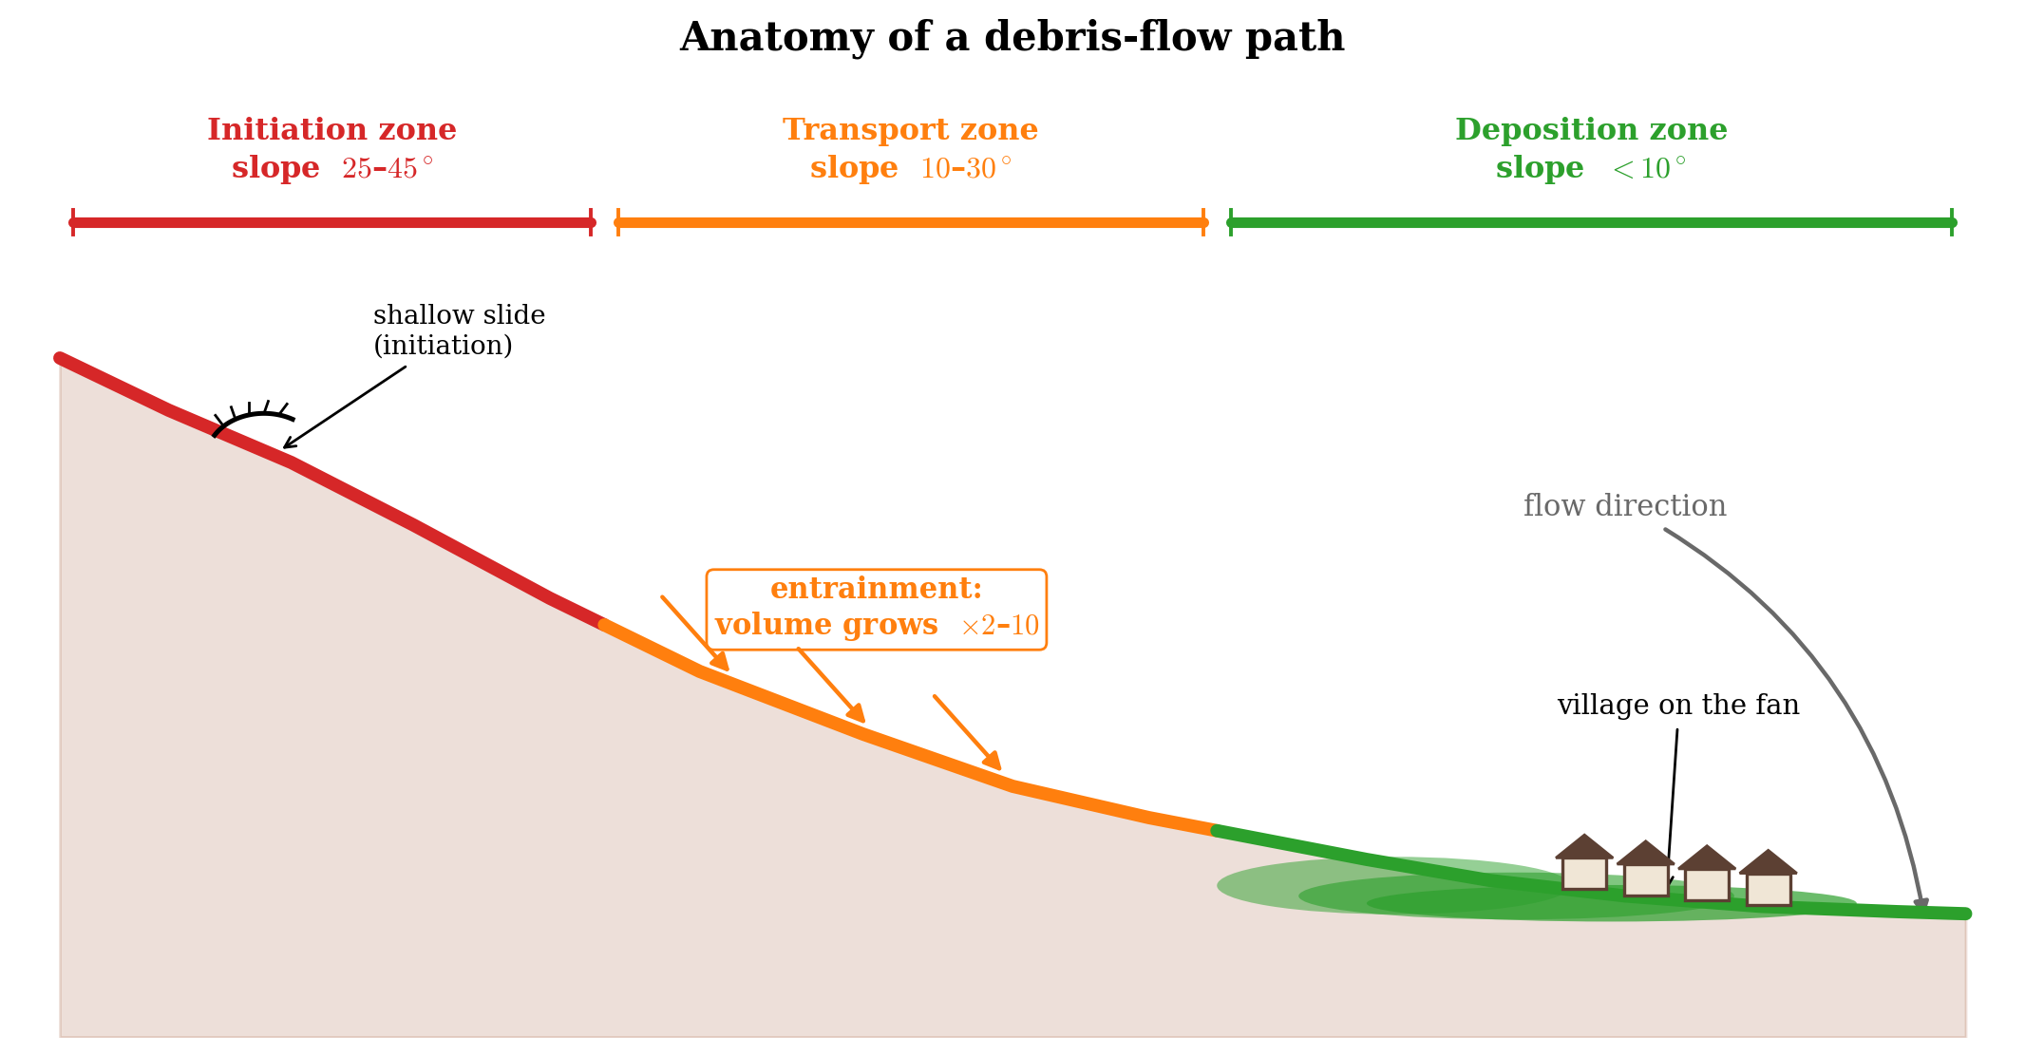
Three-zone anatomy
Initiation zone (slope 25–45°): shallow translational slide on saturated hollow; V₀ = 10³–10⁵ m³
Transport / entrainment zone (slope 10–30°): pre-existing channel; volume multiplies 2–10× by bed entrainment
Deposition zone (slope < 10–12°): the fan; flow spreads, decelerates, deposits load; most settlements here
Key question for hazard: for a given V₀, how far down the fan does the flow reach?
Empirical scaling laws give zero- or one-parameter answers from DEM + inventory
Three zones along a longitudinal profile. Entrainment multiplies volume 2–10× in the transport zone. After Hungr et al. (2001).

Slide 5
§2
Volume–runout scaling laws

Slide 6
Rickenmann (1999) and Iverson (1997) scaling
Rickenmann (1999): runout length scales with the cube root of volume:
L = k · V^(1/3)
L in metres, V in m³; k — mobility coefficient:
Lahars (volcanic): k = 100–150; Mountain debris flows: k = 30–80; Hyper-concentrated: k = 15–30
Corominas (1996): mobility ratio H/L in log–log space:
log(H/L) = a · log V + b
Rickenmann D (1999) Nat. Hazards 19: 47-77; Corominas J (1996) Eng. Geol. 43: 169-185
Global regression: a ≈ −0.16, b ≈ 0.02; H/L ≈ 0.3–0.6 for debris flows
Dimensional argument (Iverson 1997): same V^(1/3) exponent from inertial scaling

Slide 7
Runout length vs initiation volume: Rickenmann (1999) scaling
L = k V^(1/3). Shaded band reflects uncertainty in k. Rickenmann (1999) Nat. Hazards.

Slide 8
§3
α–β analysis and Monte-Carlo

Slide 9
The α–β method
α angle: straight line from source to stopping point, measured from horizontal
β angle: slope of channel bed where gradient decreases below ~15° (fan apex)
Empirical regression: tanα = a tanβ + b — calibrate from regional inventory
Nora Andreassen (NTNU, unpublished MSc 2026): updated α–β coefficients for Norwegian debris flows — used in Notebook 08
Advantage: only needs DEM + mapped inventory; applicable at regional scale
QGIS Notebook 08 lab: measure β from a 1 m LiDAR DTM and predict α → runout

Slide 10
Monte-Carlo runout for uncertain initiation volume
V₀ is rarely known precisely — multiple shallow slides may merge in the channel
Approach: sample V₀ from a log-normal distribution (CV ≈ 0.5–1.0 is typical)
For each V₀: compute L = k V₀^(1/3) with k also sampled from its uncertainty range
Build empirical CDF of L: P(L > x) = probability of exceedance at distance x from fan apex
Use as horizontal axis of a hazard zonation map on the fan
Notebook 07: N = 1000 realisations in ~10 lines of Python

Slide 11
Dynamic models: when scaling laws are not enough
Scaling laws give one number: how far. Dynamic models give flow path, depth, velocity, pressure
Voellmy (1955): resistive force = μ σ_n + ρ g v² / ξ (basal friction + turbulence)
RAMMS::Debris Flow (WSL, Switzerland): 2-D depth-averaged shallow-water + Voellmy rheology
FLO-2D (O’Brien et al.): viscous-inertial model; widely used for fans with complex topography
When to use dynamic models: site-specific design of retention walls/check dams; complex fan topography
Data requirement: field-measured flow depths, velocities and runout for ≥2–3 events to calibrate μ and ξ

Slide 12
Jupyter Notebook 07
Debris-Flow Runout
Apply Rickenmann (1999) and Corominas (1996) to a synthetic Tatra channel with known V₀
Build the α–β regression: plot tanα vs tanβ and fit the linear relationship
Run Monte-Carlo for uncertain V₀: build the runout CDF and map P10, P50, P90 stopping positions
Discuss: where do you draw the hazard zone boundary on the fan?
Output figures: debris_flow_volume_runout.svg, debris_flow_mobility.svg, runout_distribution.svg

Slide 13
Key Points & References
Debris flows grow in transit — a 10³ m³ initiation can deliver 10⁴–10⁵ m³ to the fan
Rickenmann (1999): L = k V^(1/3); k = 30–80 for mountain debris flows
Corominas (1996): H/L mobility ratio — log(H/L) ≈ −0.16 log V + 0.02
α–β method: tanα = a tanβ + b, calibrated from regional inventory
Monte-Carlo: sample V₀ and k uncertainties → runout CDF → probabilistic hazard zones
Dynamic models (RAMMS, FLO-2D) for site-specific design and complex fan topography
Selected references
Rickenmann D (1999) Nat. Hazards 19: 47-77
Iverson RM (1997) Rev. Geophys. 35: 245-296
Corominas J (1996) Eng. Geol. 43: 169-185
Hungr O et al. (2001) Can. Geotech. J. 38: 987-1004
Voellmy A (1955) Schweiz. Bauzeitung 73: 212-285
Christen M et al. (2010) Nat. Hazards Earth Syst. Sci. 10: 1357-1371

