Slide 1
Bandwitdh Control Approaches
Cisco versus Mikrotik on Multitenancy
Abril de 2016
Olaf Reitmaier
<olafrv@gmail.com>

Slide 2
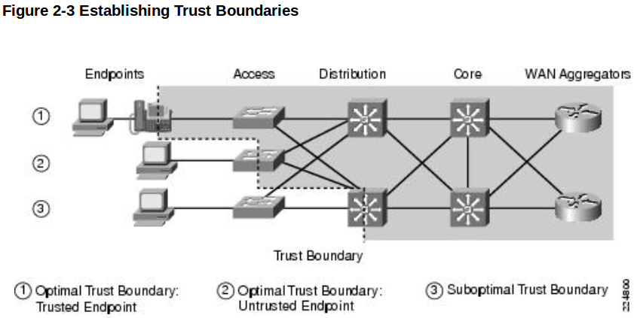
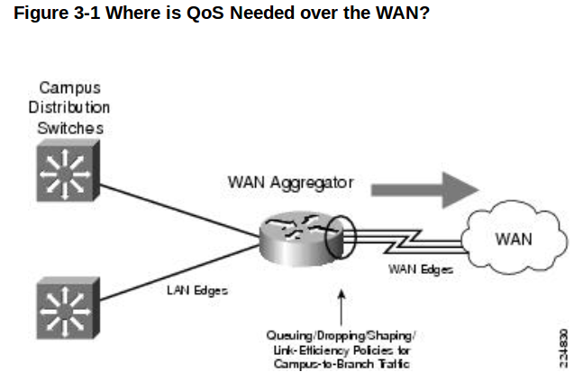
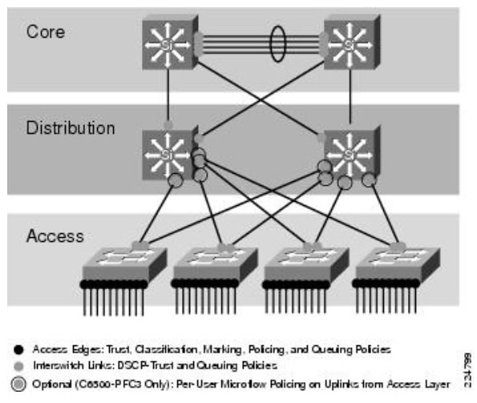
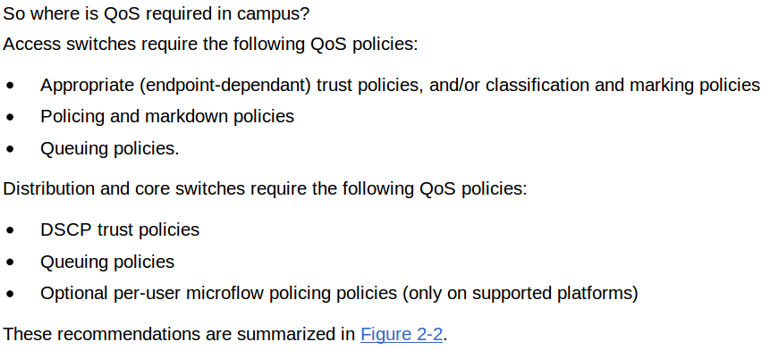
Cisco - QoS Enterprise Design
Acc. → Policy ↔ Agg. → Shaping
http://www.cisco.com/c/en/us/td/docs/solutions/Enterprise/WAN_and_MAN/QoS_SRND/QoS-SRND-Book/QoSDesign.html
http://www.cisco.com/c/en/us/td/docs/solutions/Enterprise/WAN_and_MAN/QoS_SRND/QoS-SRND-Book/WANQoS.html

Slide 3
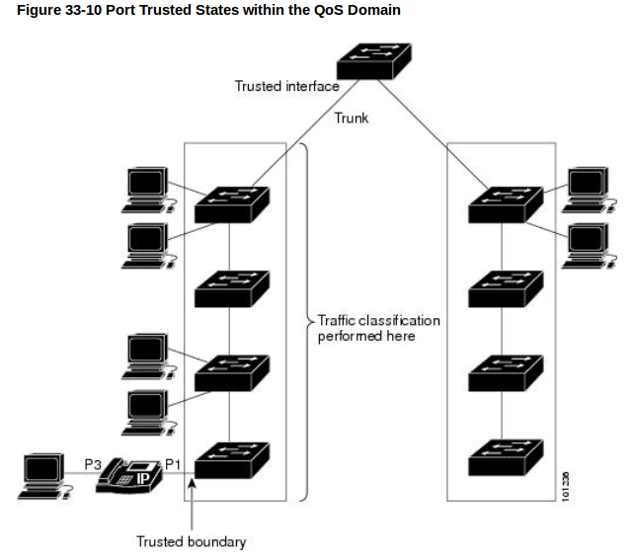
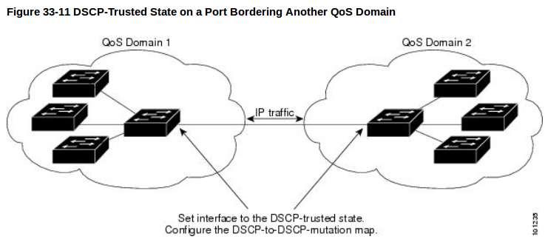
Cisco – QoS Multi-Tenancy
Bandwitdh Provisioning
Real-Time (i.e. Defaulto → VoIP)
Best-Effort (i.e. Default → Data)
What about Multi-tenancy?

Slide 4
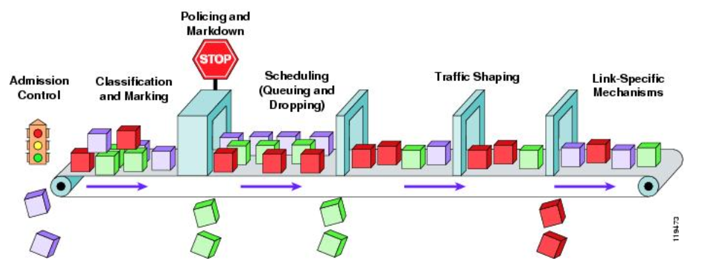
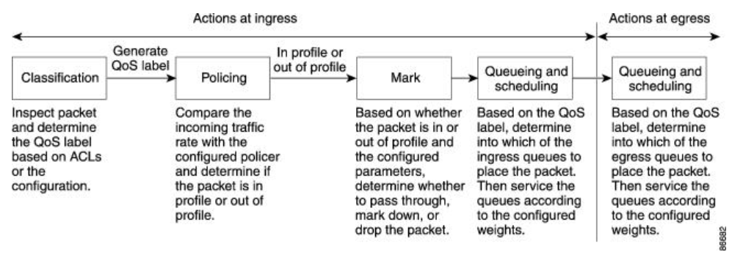
Quality of Service (QoS)
http://www.cisco.com/c/en/us/td/docs/switches/lan/catalyst2960/software/release/12-2_55_se/configuration/guide/scg_2960/swqos.html
http://www.cisco.com/c/en/us/td/docs/solutions/Enterprise/WAN_and_MAN/QoS_SRND/QoS-SRND-Book/QoSIntro.html

Slide 5
QoS – On What?

Slide 6
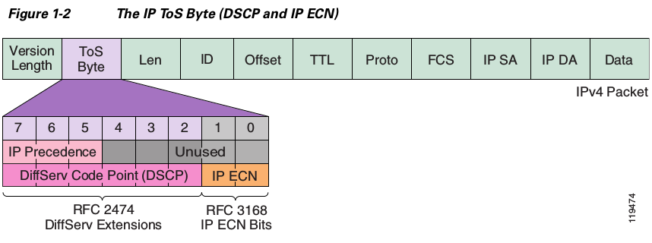
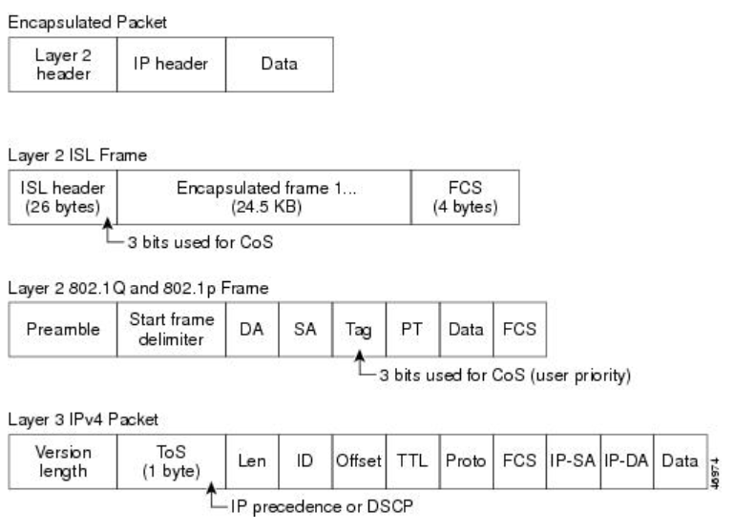
QoS - Labels for Classification and Marking
→ Layer 2 (Ethernet/MAC/VLAN)
→ Class of Services (CoS)
→ 2^3 bits → 8 variations
→ Layer 3-4 (IP/TCP/UDP)
→ Type of Services (ToS), IP Precedence
(IPP), Diff. Service Code Points (DSCP),
IP Explicit Congestion Notification (ECN).
→ 2^6 bits →64 variations (w/ IP-ECN)
→ SRC/DST IP or Port → ∞
→ Layer 7 (Application)
→ Network Based Application
Recongnition (NBAR)
→ App Payload Signature (Propietary)
http://www.cisco.com/c/en/us/td/docs/switches/lan/catalyst2960/software/release/12-2_55_se/configuration/guide/scg_2960/swqos.html
http://www.cisco.com/c/en/us/td/docs/solutions/Enterprise/WAN_and_MAN/QoS_SRND/QoS-SRND-Book/QoSIntro.html
http://www.cisco.com/c/en/us/products/ios-nx-os-software/network-based-application-recognition-nbar/index.html

Slide 7
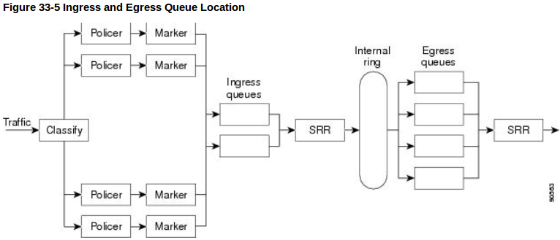
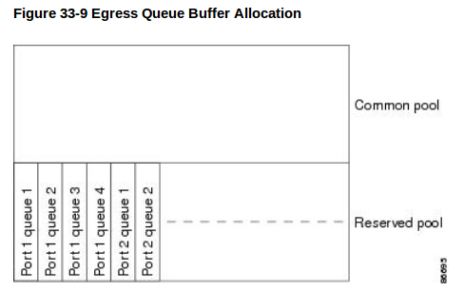
Cisco - QoS HW Escalability
Traffic Flow Direction
Ingress != Egress
Egress Queue Quantity
→ Per Port →Maximum 4

Slide 8
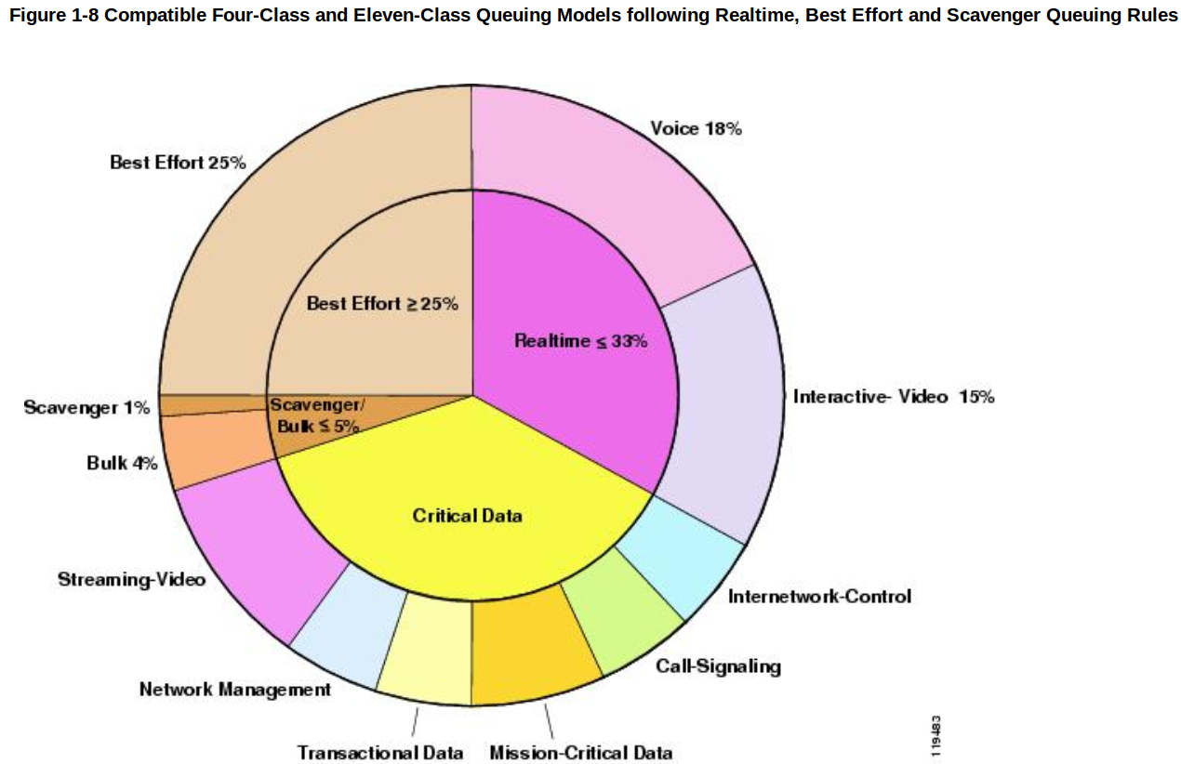
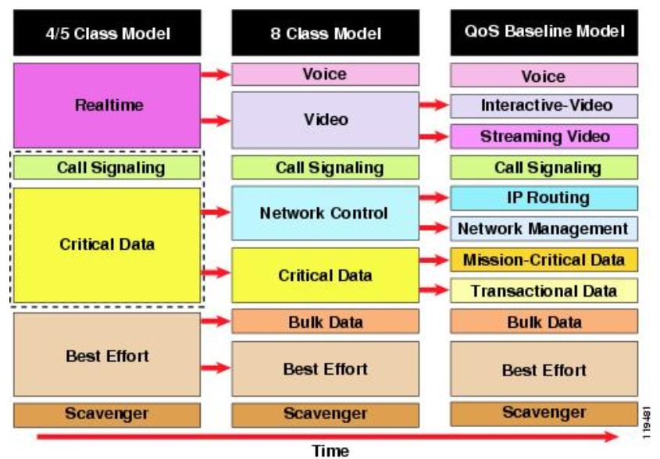
Cisco - QoS Model (Defaults)
http://www.cisco.com/c/en/us/td/docs/solutions/Enterprise/WAN_and_MAN/QoS_SRND/QoS-SRND-Book/QoSIntro.html

Slide 9
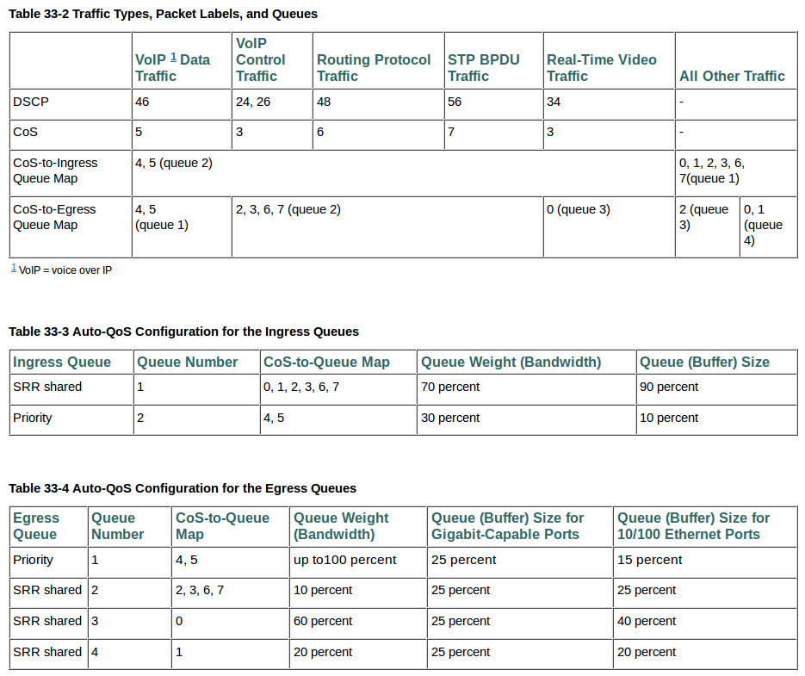
Cisco – QoS Label → Mappings

Slide 10
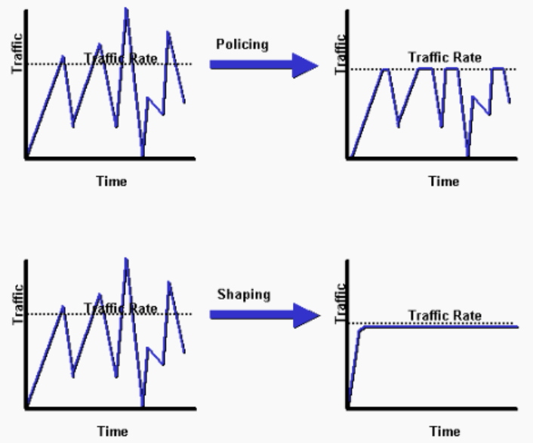
Cisco - Traffic Policing vs Shapping for Bandwitdh Control
In/Out-Bound
Max-Limits
Excess Drop
Excess Re-Mark (DSCP/IPP)
Lower Priority
Outbound
Memory
Buffers
Queues
Scheduling
→ Based Weighted Fair Queuing (CBWFQ)
→ Low Latency Queuing (LLQ).
Later Transmission
http://www.cisco.com/c/en/us/support/docs/quality-of-service-qos/qos-policing/19645-policevsshape.html
http://www.cisco.com/c/en/us/td/docs/ios/12_2/qos/command/reference/fqos_r/qrfcmd1.html#wp1017391
http://www.cisco.com/c/en/us/td/docs/ios/12_2/qos/command/reference/fqos_r/qrfcmd6.html
http://www.cisco.com/c/en/us/td/docs/ios/12_2/qos/command/reference/fqos_r/qrfcmd9.html#wp1102948

Slide 11
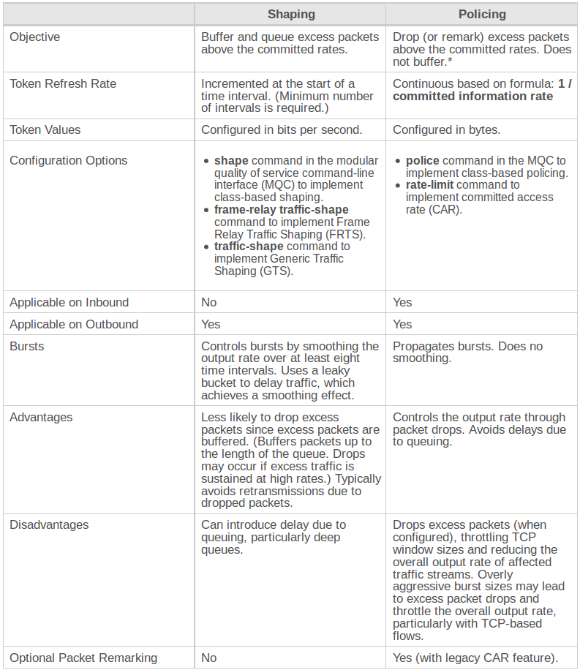
Cisco - Traffic Policing vs Shapping
Policing
rate-limit
→ on interface → ACL
→ ACL := MAC, IPP, MPLS EXP
→ ACL → kbps
policy-map-class (bandwidth)
→ on interface → POLICY
→ POLICY → CLASS
→ CLASS → kbps XOR %port
Shaping
policy-map-class (shape)
→ average
→ peak
→ cir (comm. info. rate)
→ bc (comm. burst size)
→ be (excess burst)
Warning
policy & priority => shape
→ priority overrides police!!!

Slide 12
Mikrotik (RouteBand)
Letonian Company
Router OS Linux (Licensed, Never Expire)
  http://wiki.mikrotik.com/wiki/Manual:License
Layer 2 (Bridger) ↔ Layer 3 (Router)
Hierachical Token Bucket (Multi-Queue Tree)
Disable Connection Tracking for all the router or by interfaces when is not needed NAT or Stateful Firewall to avoid asimetric routed traffic drop (BGP).

Slide 13
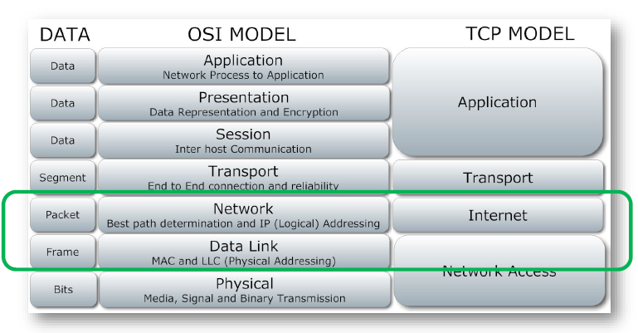
Mikrotik – Network Layers

Slide 14
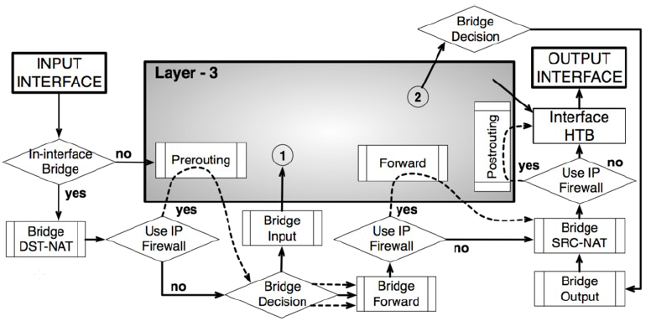
Mikrotik – Layer 2 - Bridging

Slide 15
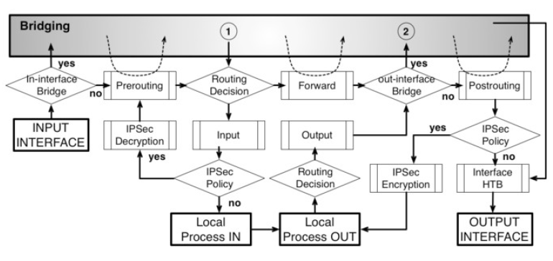
Mikrotik – Layer 3 - Routing

Slide 16
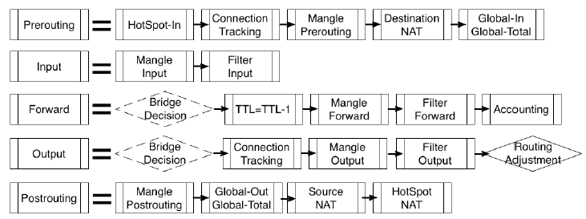
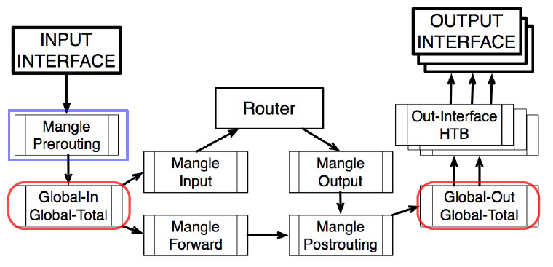
Mikrotik – Traffic Flow

Slide 17
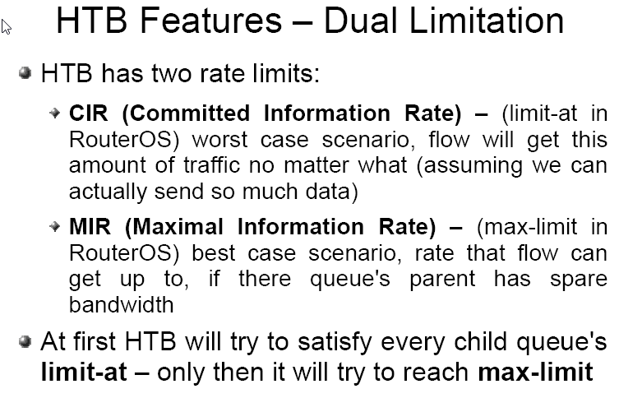
Mikrotik – Queueing

Slide 18
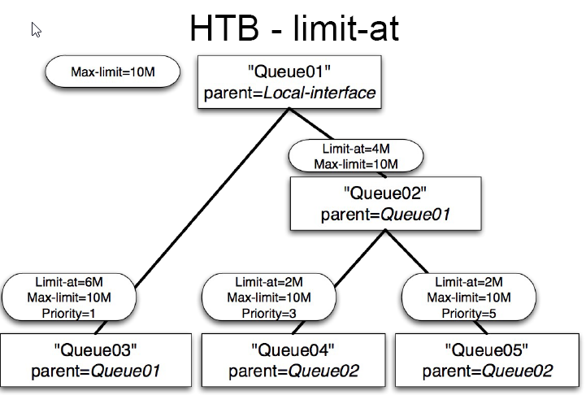
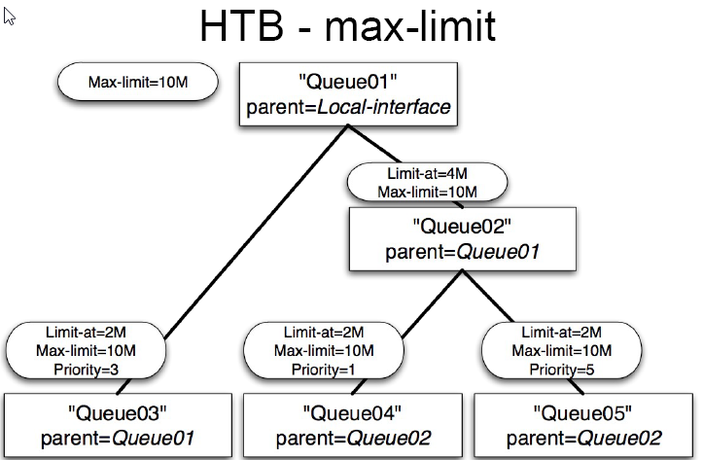
Mikrotik – HTB Queue Example

Slide 19
Mikrotik – QoS Design
Layer 2 – Bridge Filter/Firewall

Slide 20
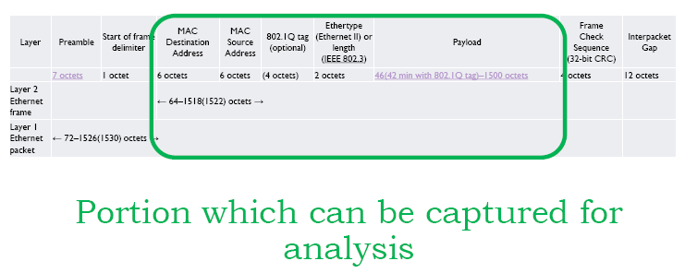
Mikrotik – Layer 2 – Ethernet Frame

Slide 21
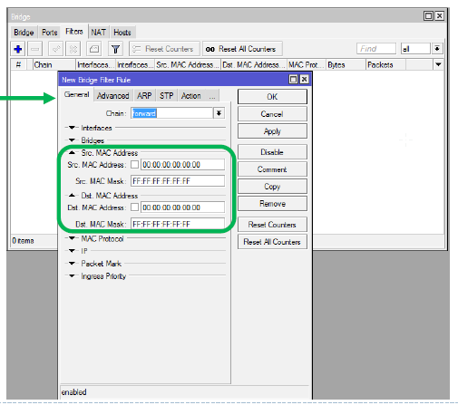
Mikrotik – Bridge Filter – Properties
General
Properties

Slide 22
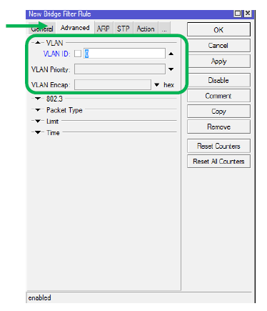
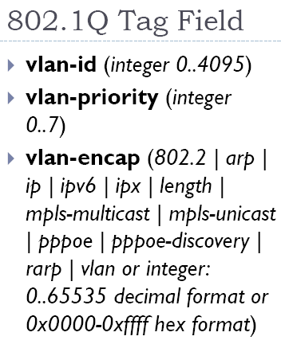
Mikrotik – Bridge Filter - VLAN
Advanced
Properties

Slide 23
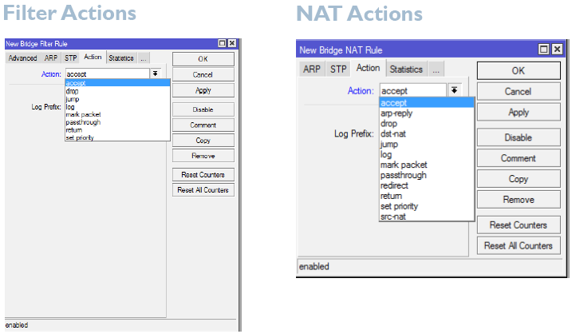
Mikrotik – Bridge Filter - Actions

Slide 24
Mikrotik – QoS Design
Layer 3 – IP Filter / Firewall

Slide 25
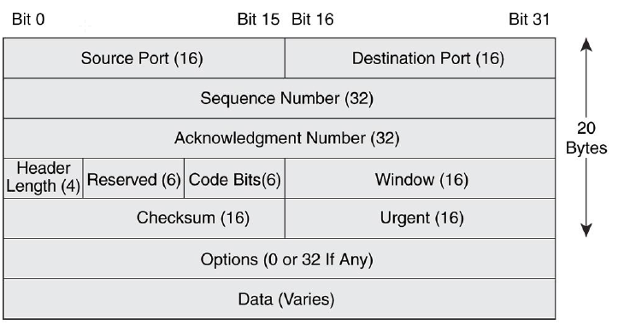
Mikrotik – Layer 3 - Packet Header
L3 TCP Header (L2 Frame Payload)

Slide 26
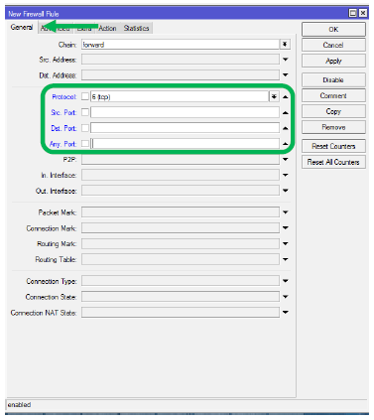
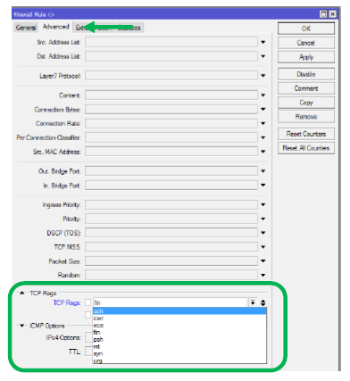
Mikrotik – IP Filter - Properties
General
Properties
Advanced
Properties

Slide 27
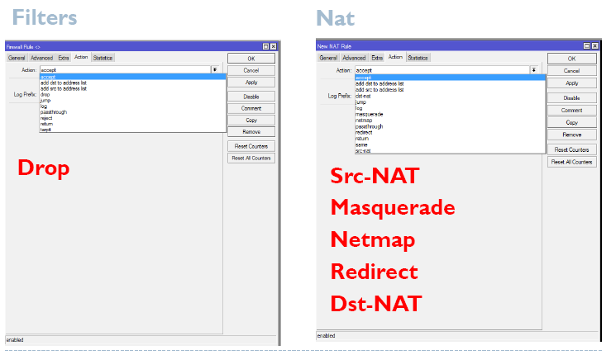
Mikrotik – IP Filter - Actions

Slide 28
Mikrotik – QoS Design
Traffic Queue Engineering:
Parent Queue → Max-At: 100 Mbps
Children Queues →Limit-At: X<100 Mbps
Bandwidth Control L2/L3:
In→ Interface (Iface) VLAN ID (~ any physical)
Bridge Filter (Mark DSCP → Iface VLAN ID)
Route Filter
  Iface VLAN ID & Mark DSCP & Address (Src): 0.0.0.0
  Connection-Mark → Child Queue #1

Slide 29
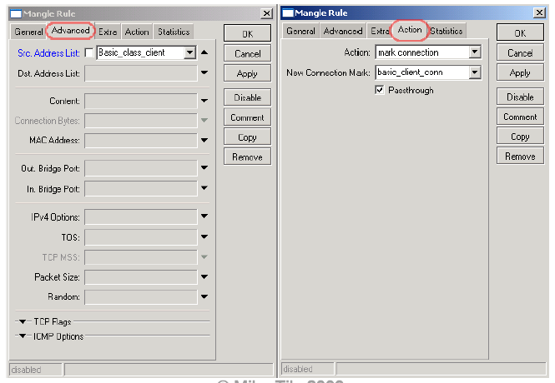
Mikrotik – QoS Design

Slide 30
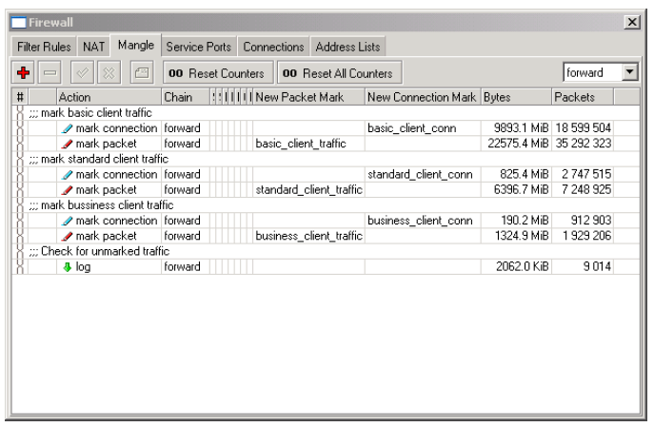
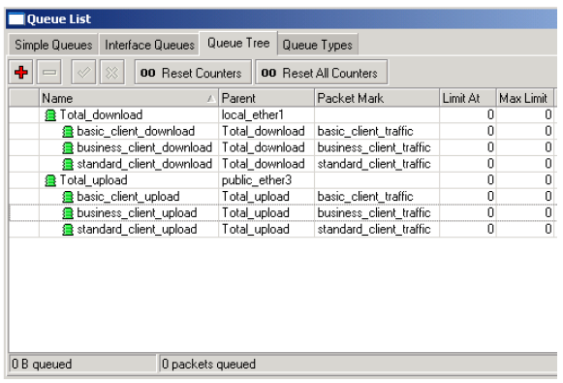
Mikrotik – QoS Design

Slide 31
Mikrotik – Alternatives
NetEqualizer → NetEqualizer 1000/5000
Exinda → Exinda 4000/6000/8000/10000
Blue Coat → Packet Shaper 3500/7500/12000
Allot Communications → Service Gateway Tera/9500/Virtual Edition/NetXplorer

Slide 32
APPENDIX A. Cisco QoS Extras

Slide 33
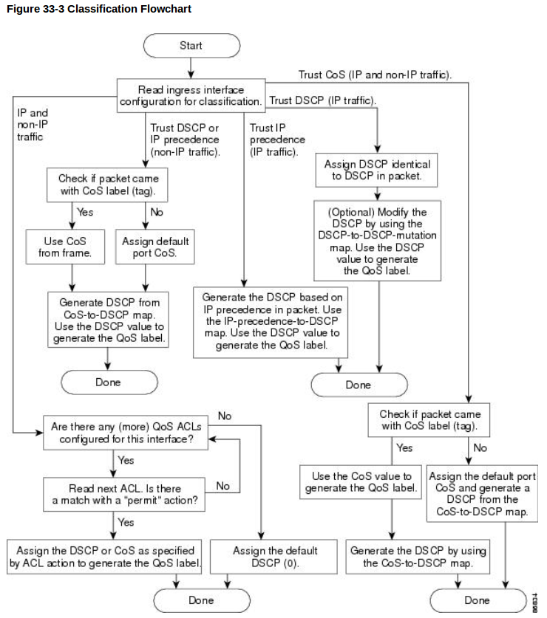
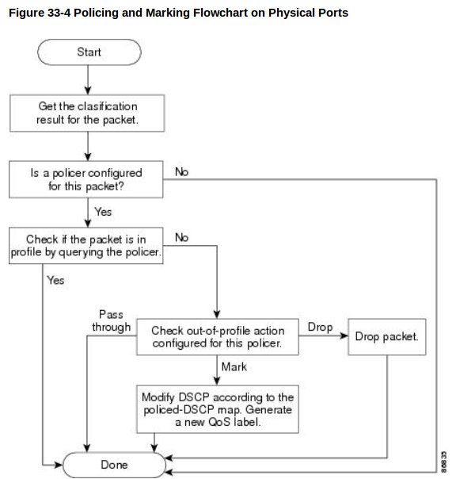
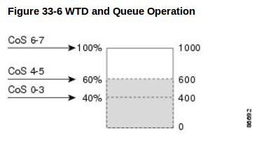
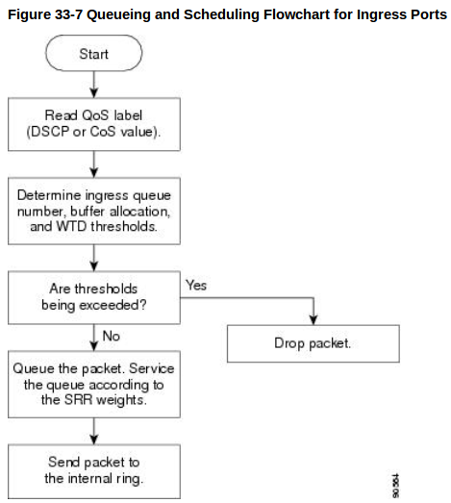
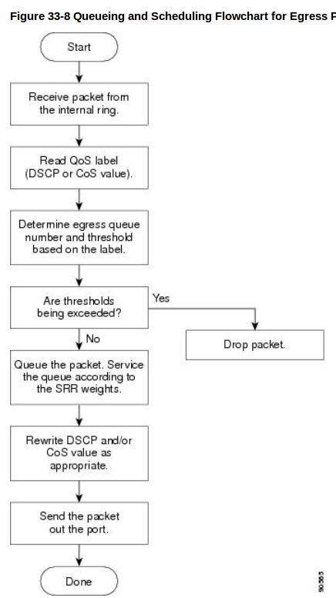
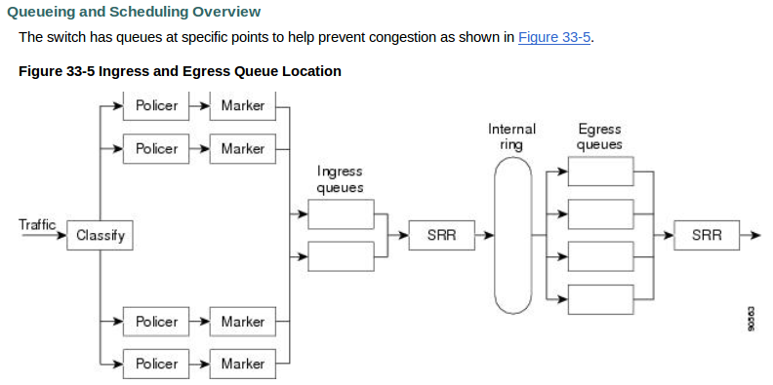
QoS Flows

Slide 34
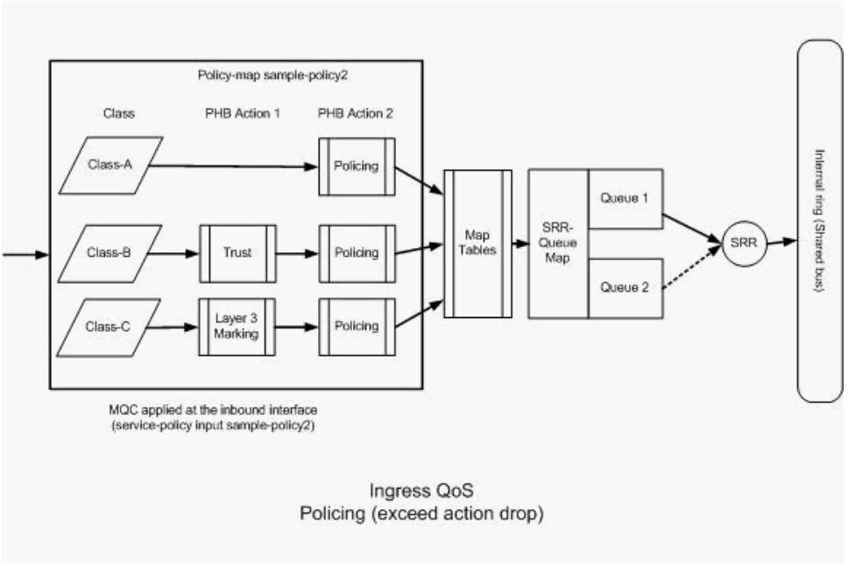
Clasif./Mark./Policing - Ingress QoS
http://www.cisco.com/c/en/us/support/docs/switches/catalyst-3750-series-switches/91862-cat3750-qos-config.html

Slide 35
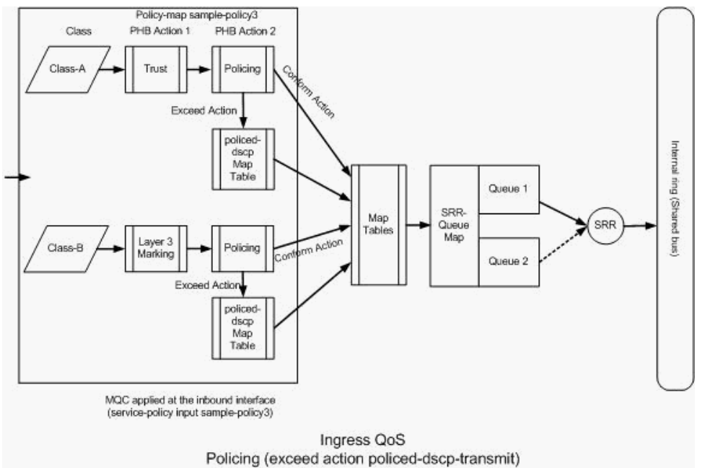
Clasif./Mark./Policing - Ingress QoS
http://www.cisco.com/c/en/us/support/docs/switches/catalyst-3750-series-switches/91862-cat3750-qos-config.html

Slide 36
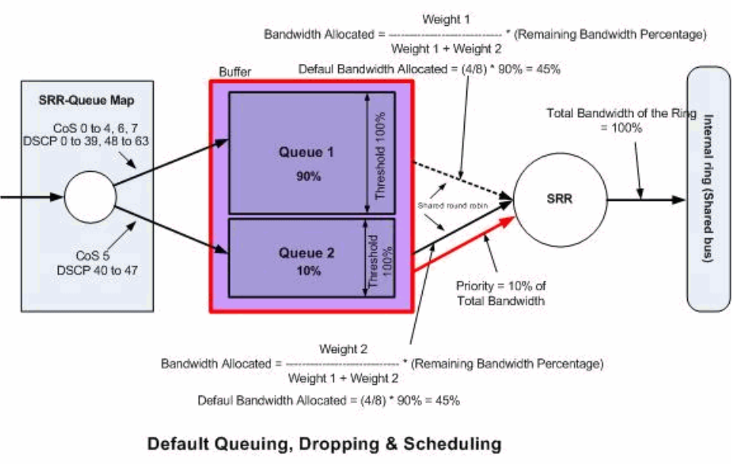
Congestion Managment
http://www.cisco.com/c/en/us/support/docs/switches/catalyst-3750-series-switches/91862-cat3750-qos-config.html

Slide 37
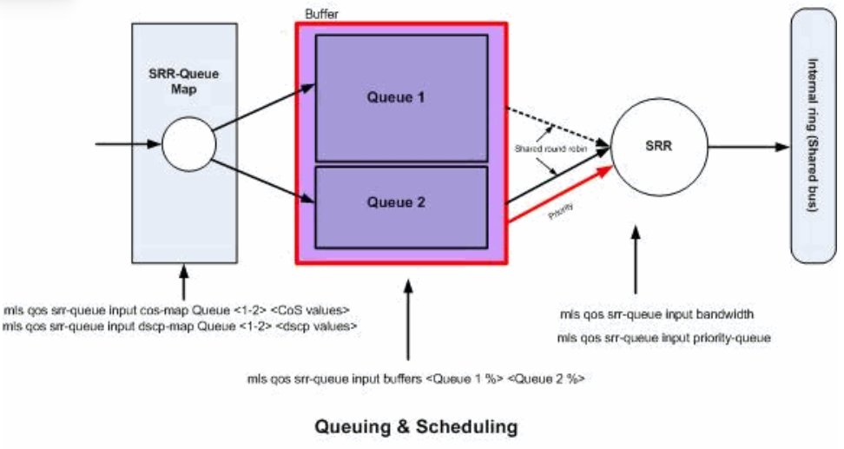
Congestion Managment
http://www.cisco.com/c/en/us/support/docs/switches/catalyst-3750-series-switches/91862-cat3750-qos-config.html

Slide 38
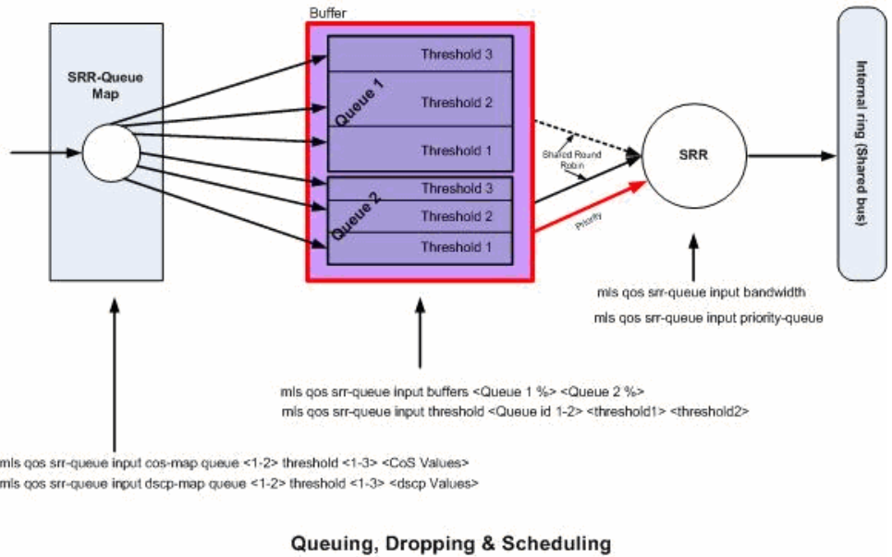
Congestion Managment
http://www.cisco.com/c/en/us/support/docs/switches/catalyst-3750-series-switches/91862-cat3750-qos-config.html

Slide 39
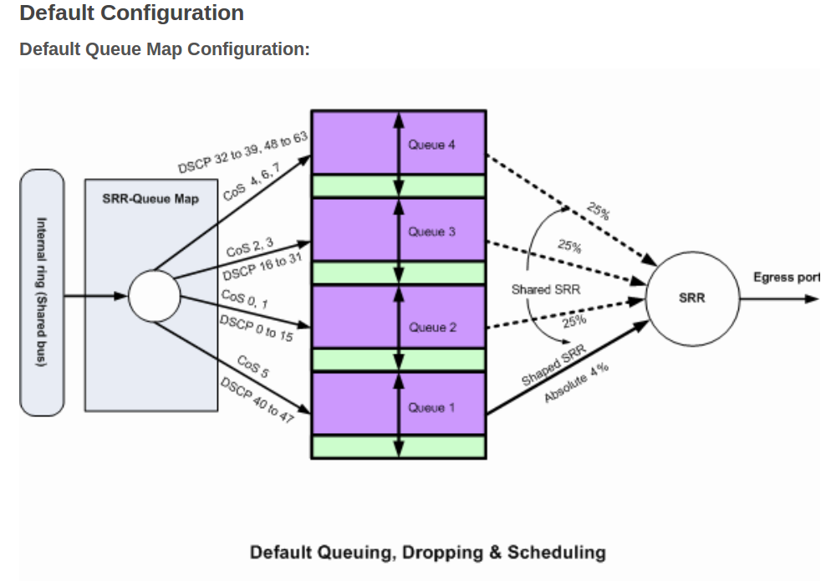
Congestion Managment
http://www.cisco.com/c/en/us/support/docs/switches/catalyst-3750-series-switches/91862-cat3750-qos-config.html

