Slide 1

PoC of Administration
Phased Approach
Olaf Reitmaier, Feb. 2019

Slide 2
PoC Azure Administration – Sign Up
Individual Account
Microsoft domains / accounts (e.g. Hotmail, Outlook, Office365)
Enterprise Account (!= Enterprise Enrollment)
Managed domains (i.e. contoso.com, example.com)
Non public mail services Domain/account (i.e. gmail.com)
Non Microsoft domains / accounts
Need verification through TXT records on DNS (Ownership verification)
Power BI > Office 365 > Managed Domain > Change Domain/Directory
Azure Directory Services… (IAM = Identity And Access Mgmt.)

Slide 3
PoC Azure Administration - Portal
Subscription ID
Billing (e.g. Free trial, Pay as you Go, Open License, Support Plans)
Cost/Pricing tier: Free, basic, standard, premiun, etc.
Accounts (e.g. storage, batch, integration, automation)
Resource Manager (Group)
Resource (i.e. machine, container, network, etc).
Workspace (e.g. log analytics)
Service (e.g. directory Service, security center).
“Classic”/”Classical”
Resource naming (i.e. RG => Resource Group, SA => Storage Account)
Resource Tagging (i.e. Key1 = Value2, Key1 = Value2, CMDB-Like)

Slide 4
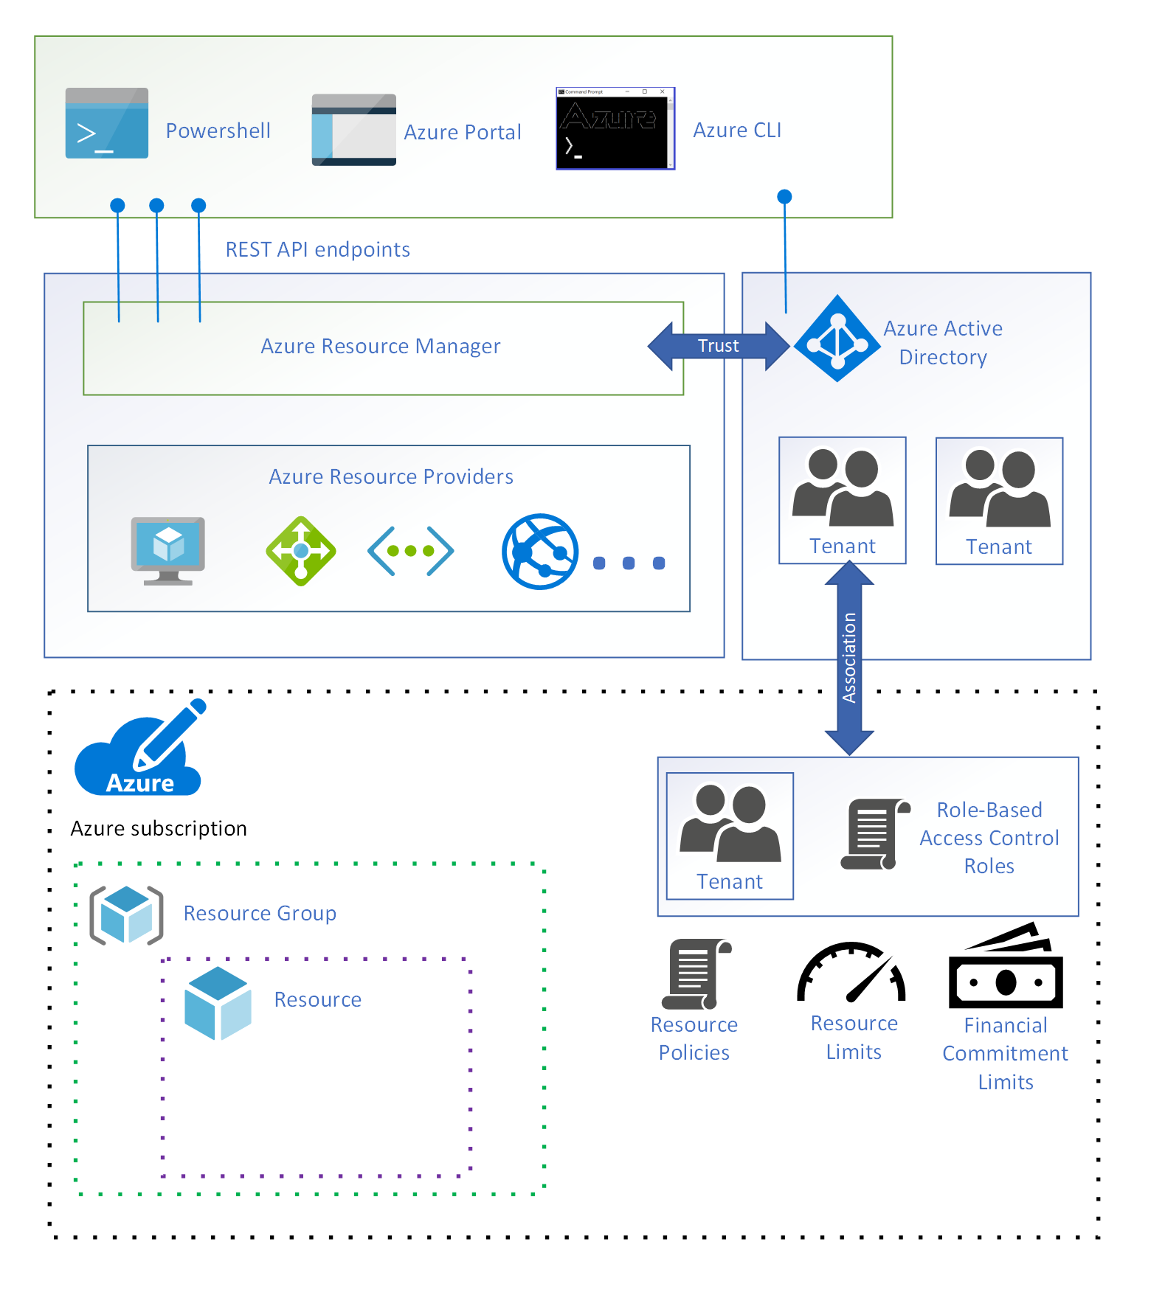
PoC Azure Administration – Resource Groups
Frontend
ARM
RBAC
Backend
https://docs.microsoft.com/en-us/azure/architecture/cloud-adoption/getting-started/azure-resource-access

Slide 5
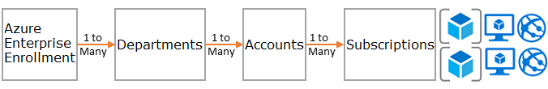
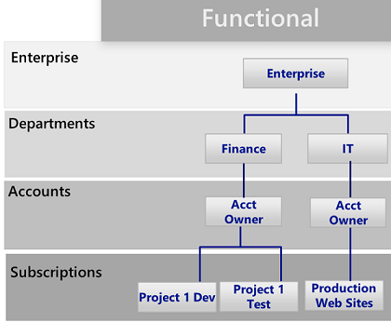
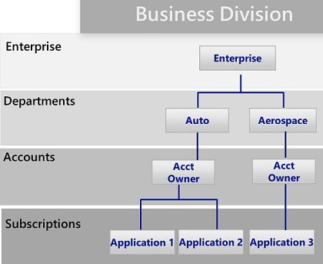
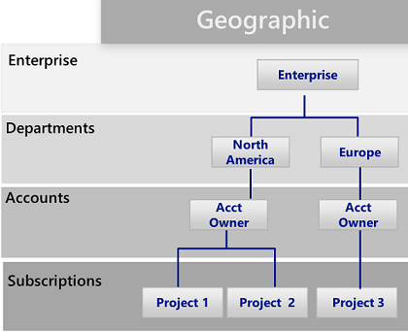
PoC Azure Administration – Azure Subs. (Usage)
Enrollment?
Resources?
https://techcommunity.microsoft.com/t5/ITOps-Talk-Blog/Best-practices-for-naming-your-Microsoft-Azure-resources/ba-p/294480
https://docs.microsoft.com/es-es/azure/architecture/cloud-adoption/appendix/azure-scaffold?wt.mc_id=itshowcase-codeapps

Slide 6
PoC Azure Administration - Services
General
Compute / Containers
Storage
Networking
Web / Mobile / Database
Analytics
AI + Machine Learning
Internet of Things
Integration
Identity
Security
DevOps
Migrate
Management & Governance
Intune
Other

Slide 7
PoC Azure Administration – Group/Perm.
Compute
Storage
Migrate
Analytics
Identity
Operations
Group (RW)
Net. & Security Group (RW)
Networking
Security
Identity
Architecture
Group
Architecture
Group
Web / Mobile
Database
Analytics
IoT
DevOps
Identity
All
Groups
Automation
Group (RW)
General
Mgmt. & Governance
Architecture
Architecture
Group

Slide 8
PoC Azure Administration – Resource Groups
RGCloudShell
All Users/Groups
RGLogging
Log Workspace (Monitoring/Auditing)
RGBackup
Azure Backup / Site Recovery Vault
Life-Cycle/Relations (e.g. Production, Development, Test, Line-Of-Bussiness-Application, IaaS-Workload)
Another possibilities: Core, Client(s), etc.

Slide 9
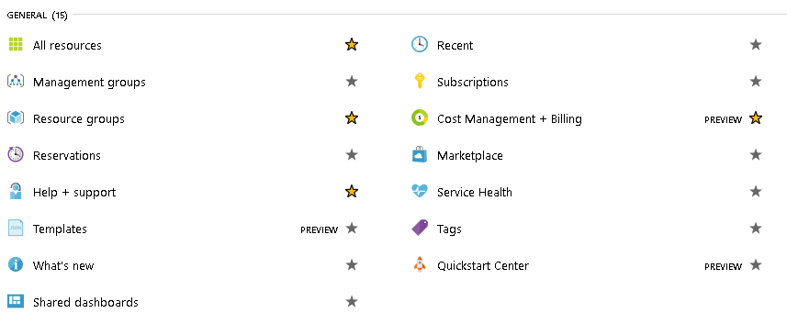
PoC Azure Administration - General
(ARM)
Create Resource Groups y Managment Groups
Visualize All Resources/Services, Billing, Subscriptions & Marketplace.
Down/Upload/Use/Store Resource Templates (Deploy States).

Slide 10
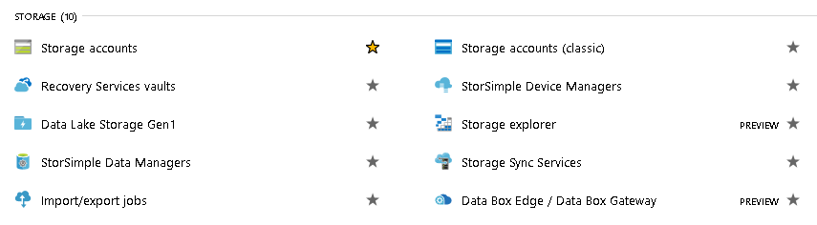
PoC Azure Administration - Storage
(~AWS Snowball)
Create Storage Account(s)
Visualize/Restore VM/File from a Recovery Service Vault
Use the Storage Explorer (e.g.Storage Container -> Block, BLOB, SMB, Tables, Queue)

Slide 11
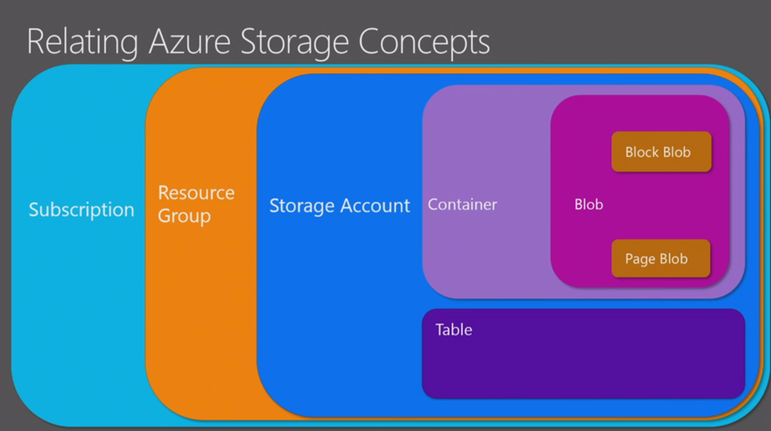
PoC Azure Administration – Storage Concepts

Slide 12
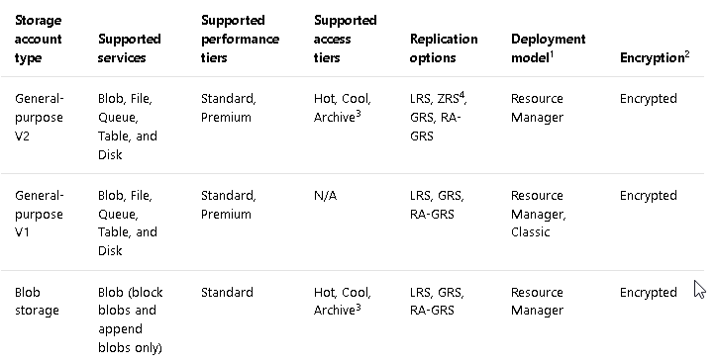
PoC Azure Administration - Storage Account
Page Blobs
Page Blobs
https://docs.microsoft.com/en-us/azure/storage/common/storage-account-overview

Slide 13
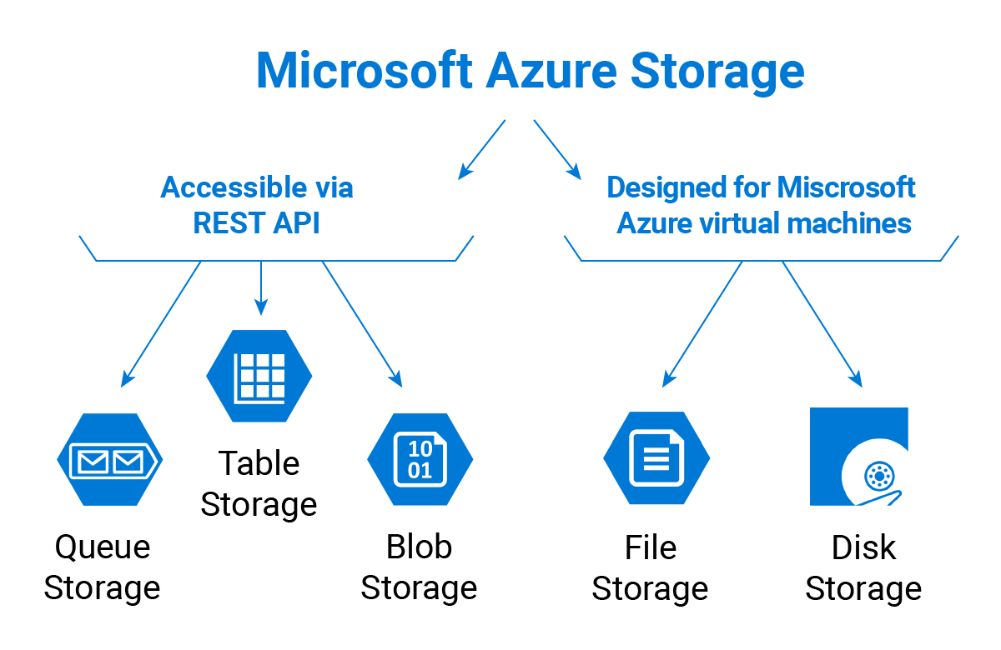
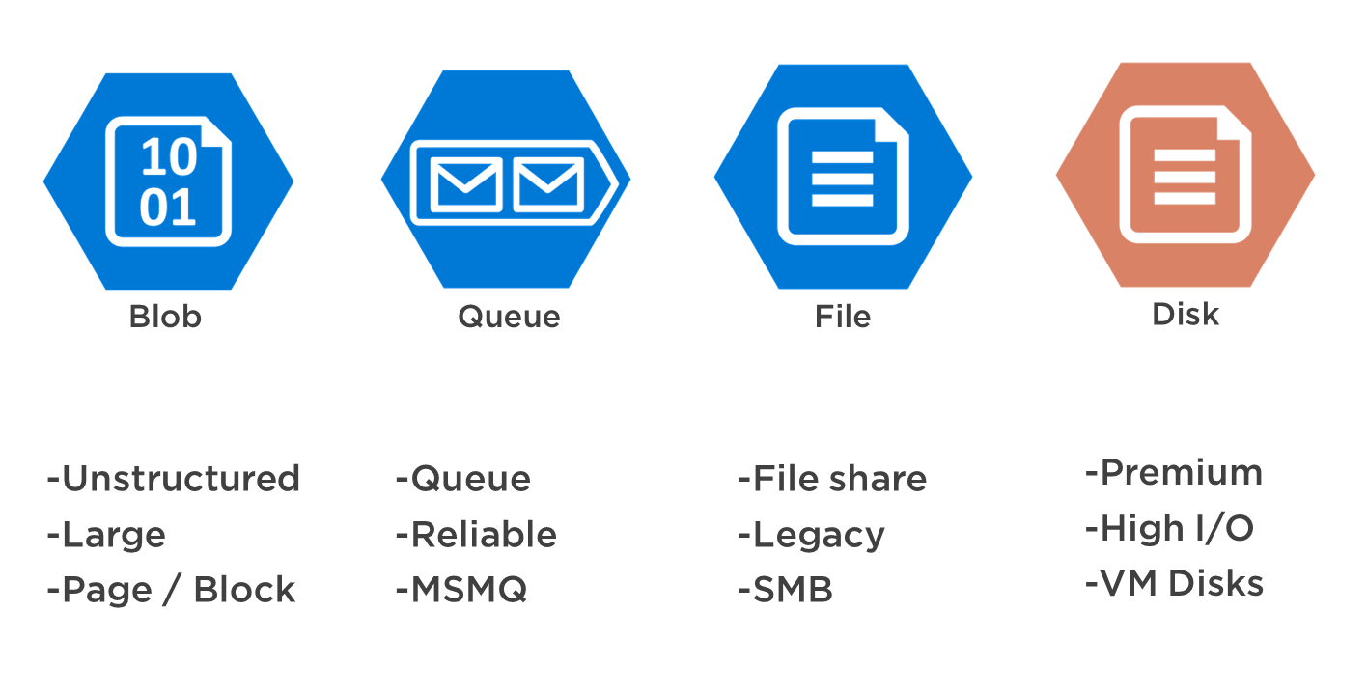
PoC Azure Administration – Storage Types
https://www.cloudberrylab.com/resources/blog/microsoft-azure-storage-types-explained/
https://stackify.com/store-data-azure-understand-azure-data-storage-options/

Slide 14
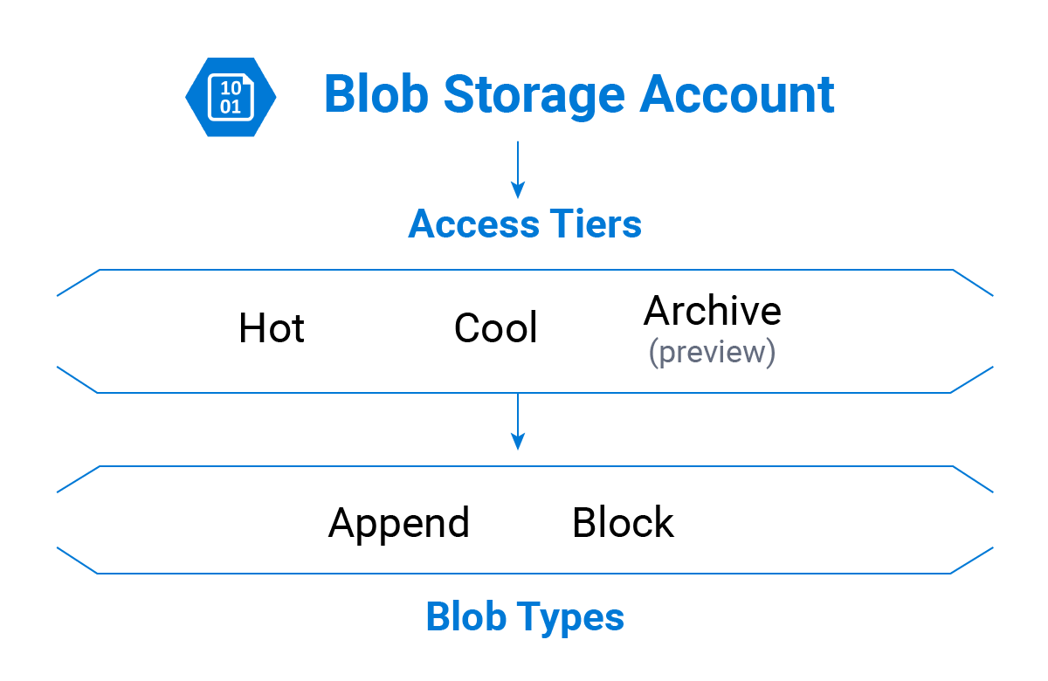
PoC Azure Administration – Storage Types
https://www.cloudberrylab.com/resources/blog/microsoft-azure-storage-types-explained/

Slide 15
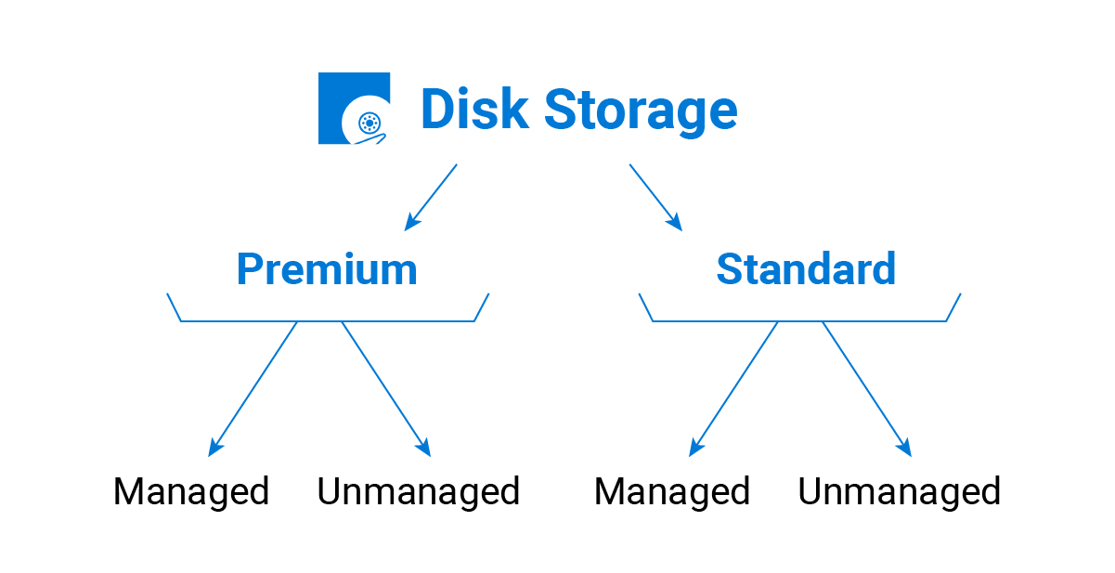
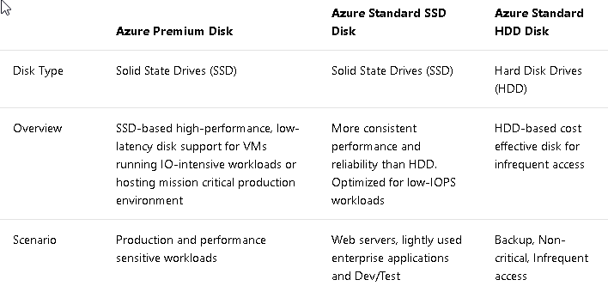
PoC Azure Administration – Storage Types
https://www.cloudberrylab.com/resources/blog/microsoft-azure-storage-types-explained/
https://docs.microsoft.com/en-us/azure/virtual-machines/windows/about-disks-and-vhds

Slide 16
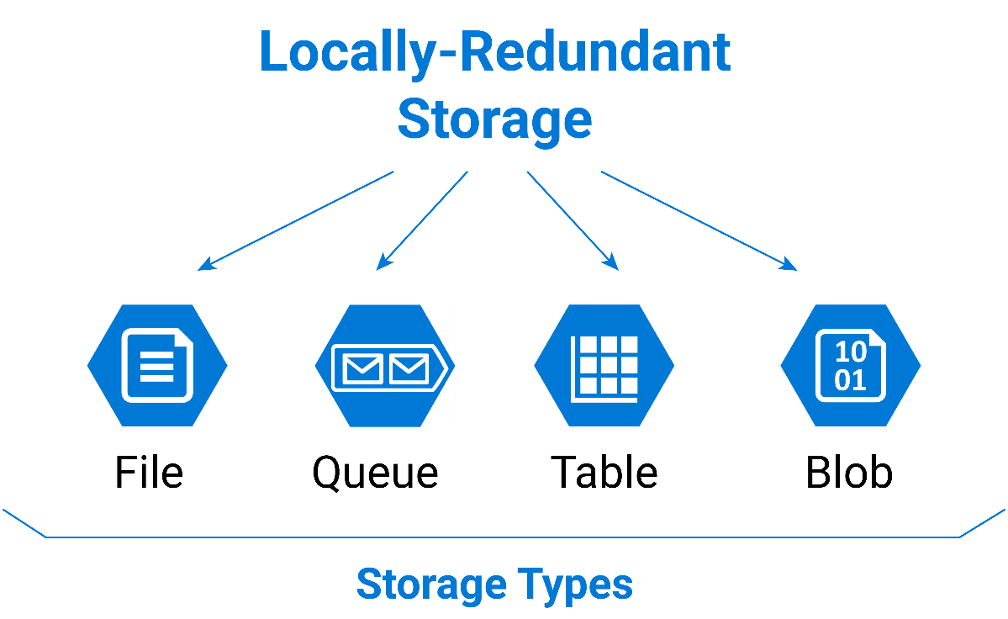
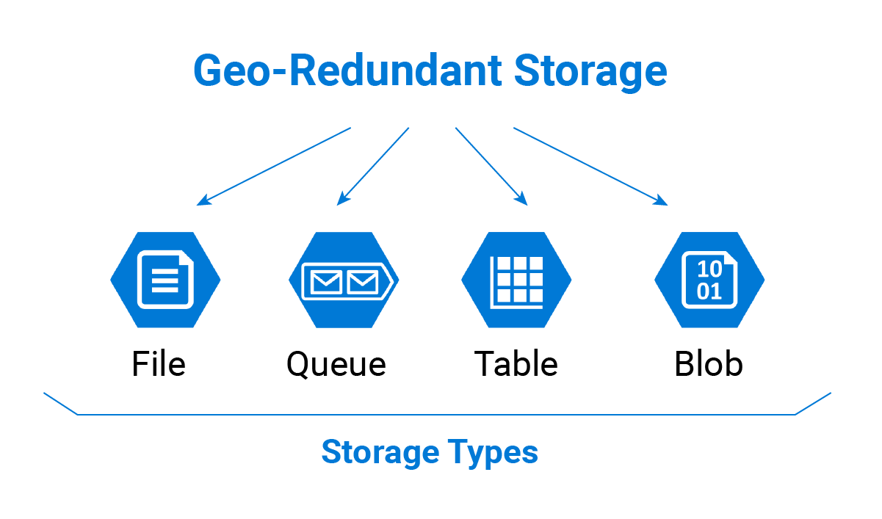
PoC Azure Administration – Storage Types
https://www.cloudberrylab.com/resources/blog/microsoft-azure-storage-types-explained/

Slide 17
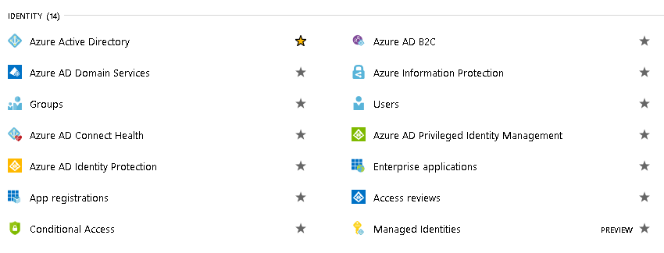
PoC Azure Administration - Identity
Create User, Groups y Roles.
Assign Roles/Permissions to User/Group over a Resource (Group)

Slide 18
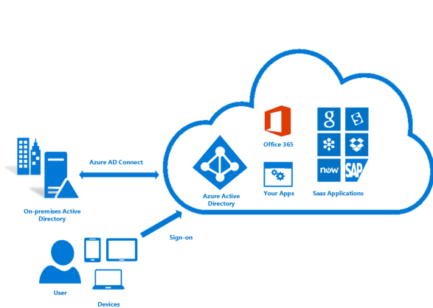
PoC Azure Administration – On/Off-Premises Identity Mgmt.
https://docs.microsoft.com/es-es/azure/architecture/cloud-adoption/appendix/azure-scaffold?wt.mc_id=itshowcase-codeapps

Slide 19
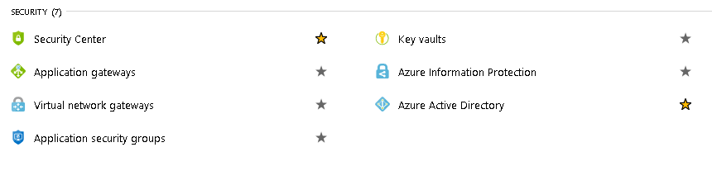

PoC Azure Administration - Security
Activate the Security Center (Free Trier)
Know the Key Vaults (Explain Key1 & Key2 Master Keys)
Networking & Identity

Slide 20
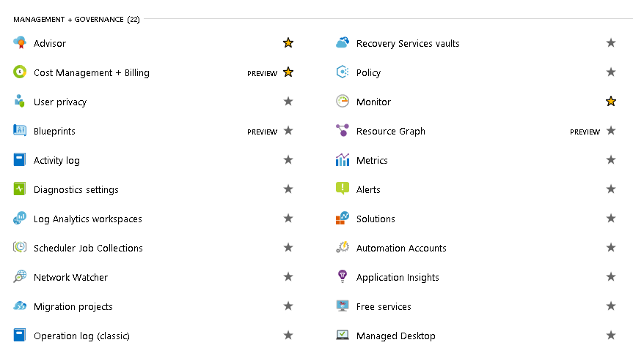
PoC Azure Administration – Mgmt. / Gov.
All Departments
(APM)
Create Log Analytics Workspace
Visualize Metrics / Resource Graph / Activity Log
Configure/Visualize Diagnostic Settinsg / Log Analytics
Configure Alerts & Notification (E-Mail, Billing).
Enable/Visualize Advisor

Slide 21
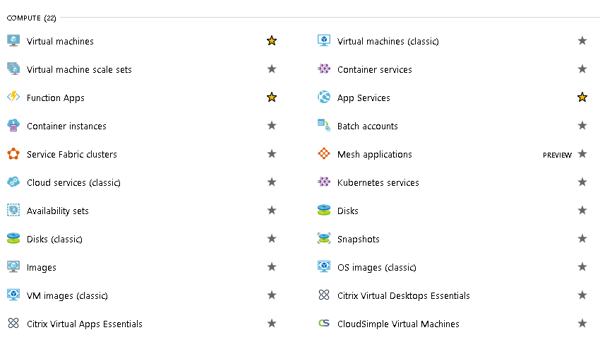
PoC Azure Administration - Compute
Create a Virtual Machine from Images (MarketPlace) and a Scale Set with Disks/Snapshot
Create a Container (Stack Prefered) based in Docker and Kubernetes

Slide 22
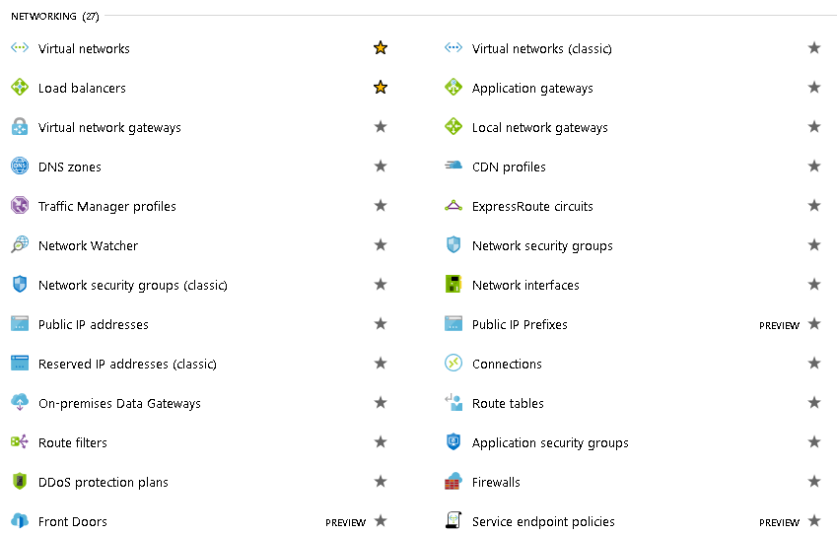
PoC Azure Administration - Networking
(VPN)

Slide 23
PoC Azure Administration - Networking
Azure Network Security Best Practices
https://docs.microsoft.com/en-us/azure/security/azure-security-network-security-best-practices

Slide 24
PoC Azure Administration - Networking
https://azure.microsoft.com/mediahandler/files/resourcefiles/azure-network-security/Azure%20Network%20Security.pdf

Slide 25
PoC Azure Administration - Networking
https://azure.microsoft.com/mediahandler/files/resourcefiles/azure-network-security/Azure%20Network%20Security.pdf

Slide 26
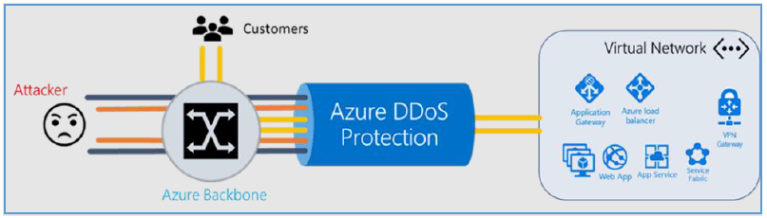
PoC Azure Administration - Networking
https://azure.microsoft.com/mediahandler/files/resourcefiles/azure-network-security/Azure%20Network%20Security.pdf

Slide 27
PoC Azure Administration - Networking
https://azure.microsoft.com/mediahandler/files/resourcefiles/azure-network-security/Azure%20Network%20Security.pdf

Slide 28
PoC Azure Administration - Networking
Internet connectivity
Point-to-site VPN (P2S VPN)
Site-to-Site VPN (S2S VPN)
ExpressRoute
Hybrid
Cloud
VNet to VNet via VPN (VNet-to-VNet connection)
VNet to VNet via ExpressRoute
VNet to VNet via Virtual Network Peering (VNet Peering) and VNet Transit
Intra-Cloud
https://azure.microsoft.com/en-us/blog/networking-to-and-within-the-azure-cloud/

Slide 29
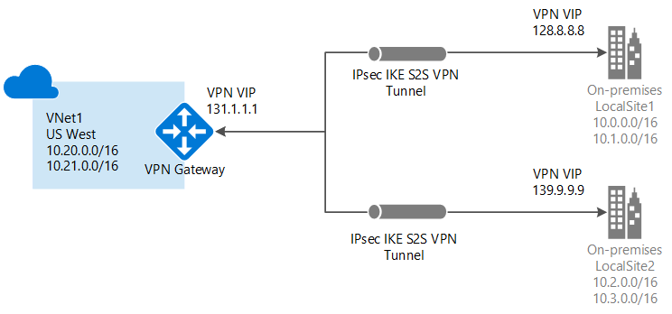
PoC Azure Administration - Gateway
https://docs.microsoft.com/en-us/azure/vpn-gateway/vpn-gateway-about-vpngateways

Slide 30
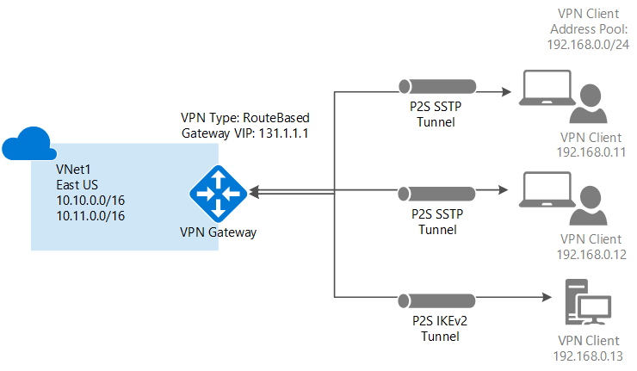
PoC Azure Administration - Gateway
https://docs.microsoft.com/en-us/azure/vpn-gateway/vpn-gateway-about-vpngateways

Slide 31
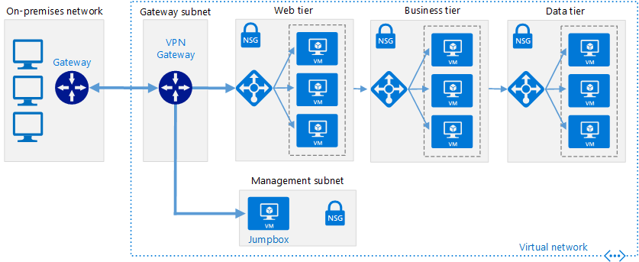
PoC Azure Administration - Gateway
https://docs.microsoft.com/en-us/azure/architecture/reference-architectures/hybrid-networking/vpn

Slide 32
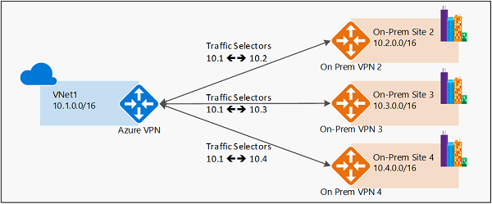
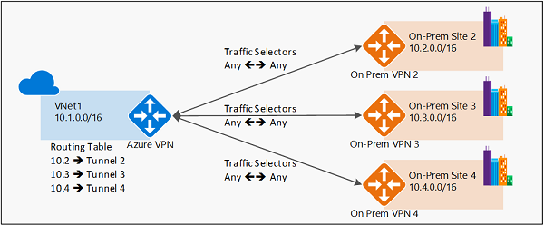
PoC Azure Administration - Gateway
Policy
Based
Route
Based
https://docs.microsoft.com/en-us/azure/vpn-gateway/vpn-gateway-connect-multiple-policybased-rm-ps

Slide 33
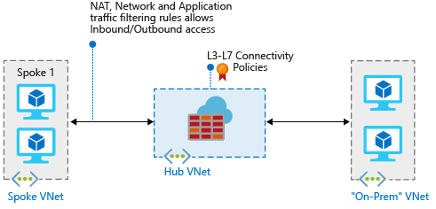
PoC Azure Administration - Firewall
https://docs.microsoft.com/es-es/azure/firewall/tutorial-hybrid-ps

Slide 34
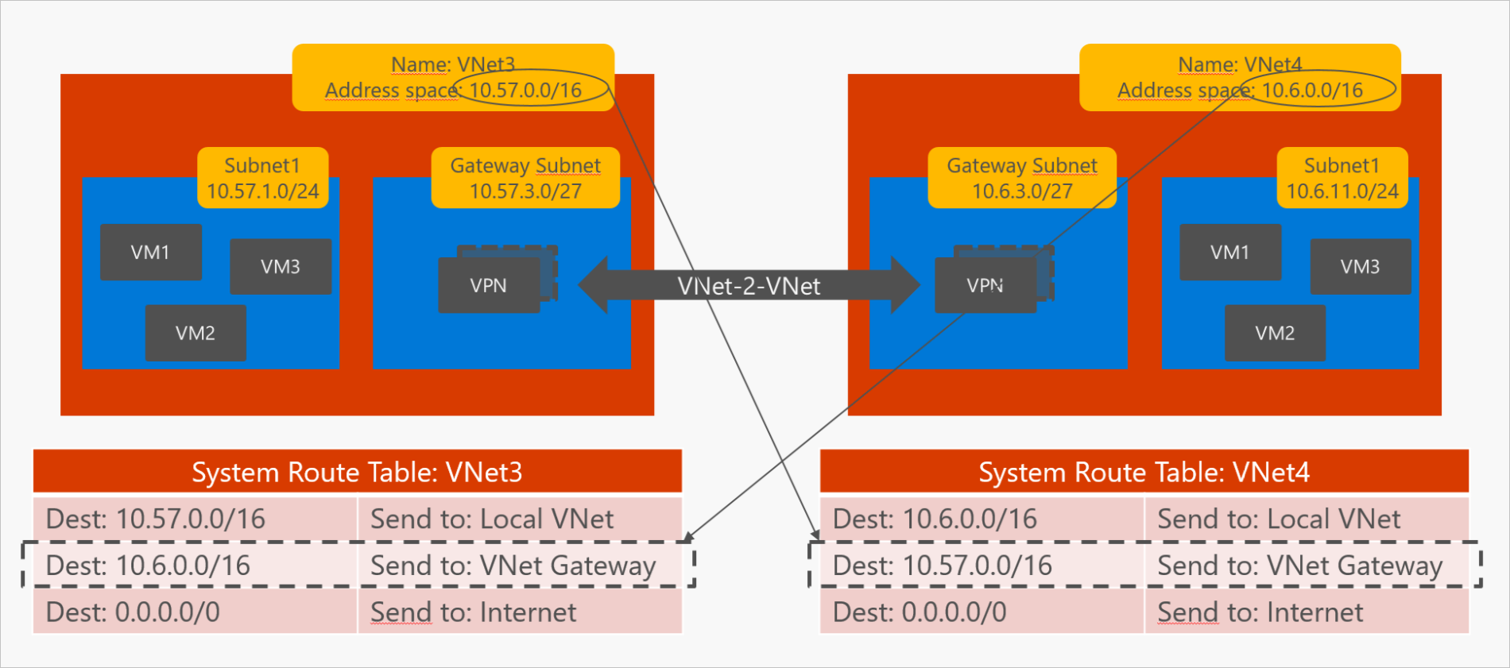
PoC Azure Administration - Networking
VNet-to-VNet via VPN
https://azure.microsoft.com/en-us/blog/networking-to-and-within-the-azure-cloud-part-2/

Slide 35
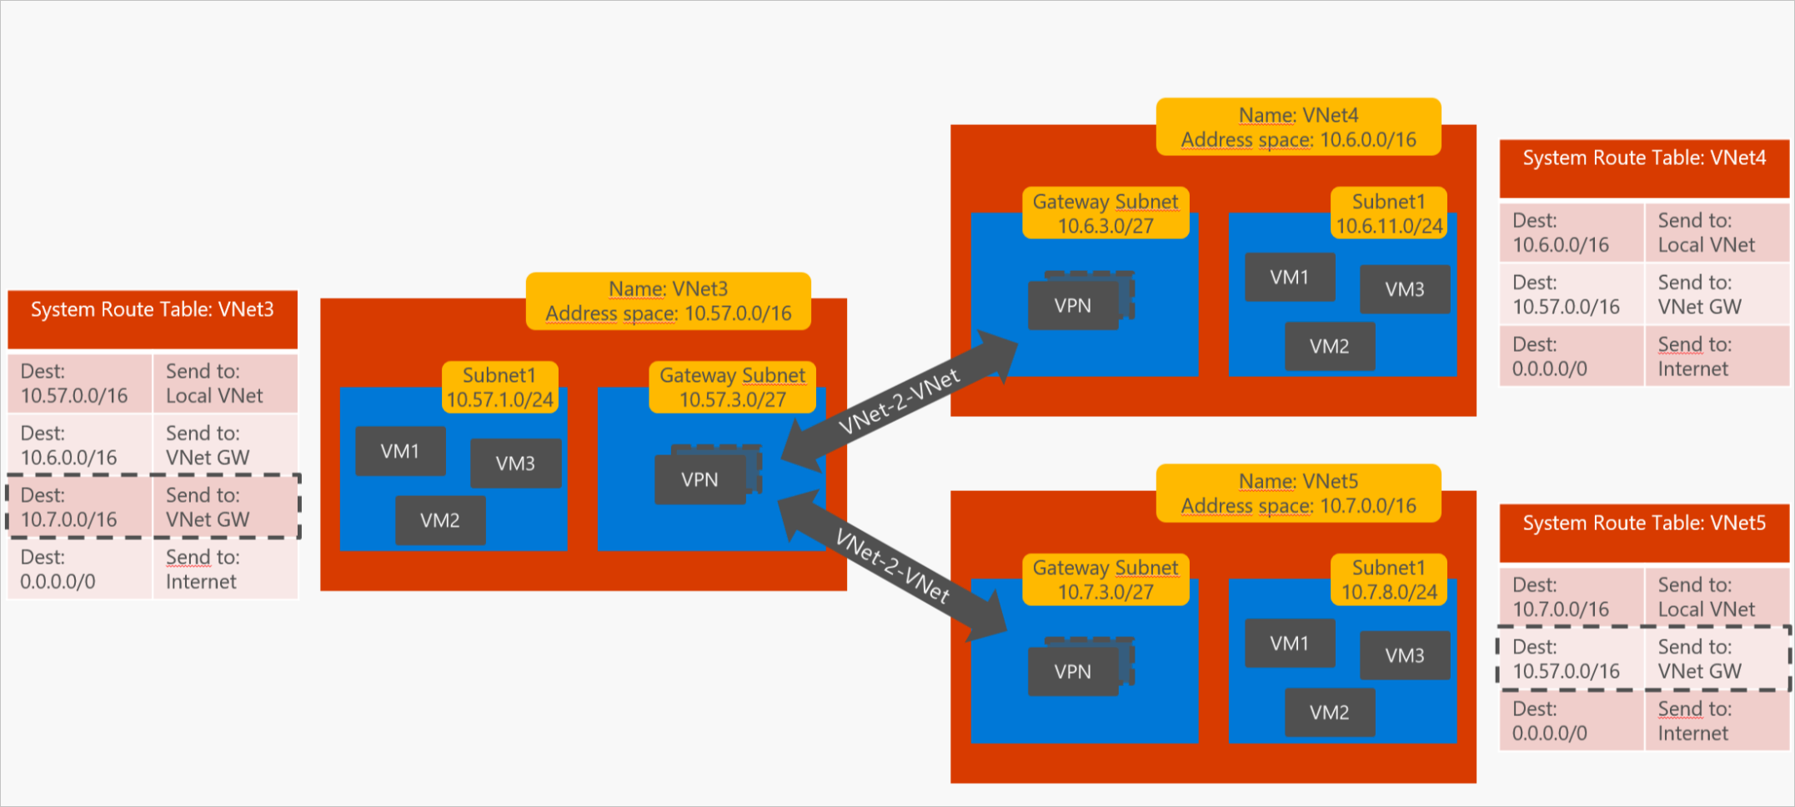
PoC Azure Administration - Networking
VNet-to-VNet via VPN
https://azure.microsoft.com/en-us/blog/networking-to-and-within-the-azure-cloud-part-2/

Slide 36
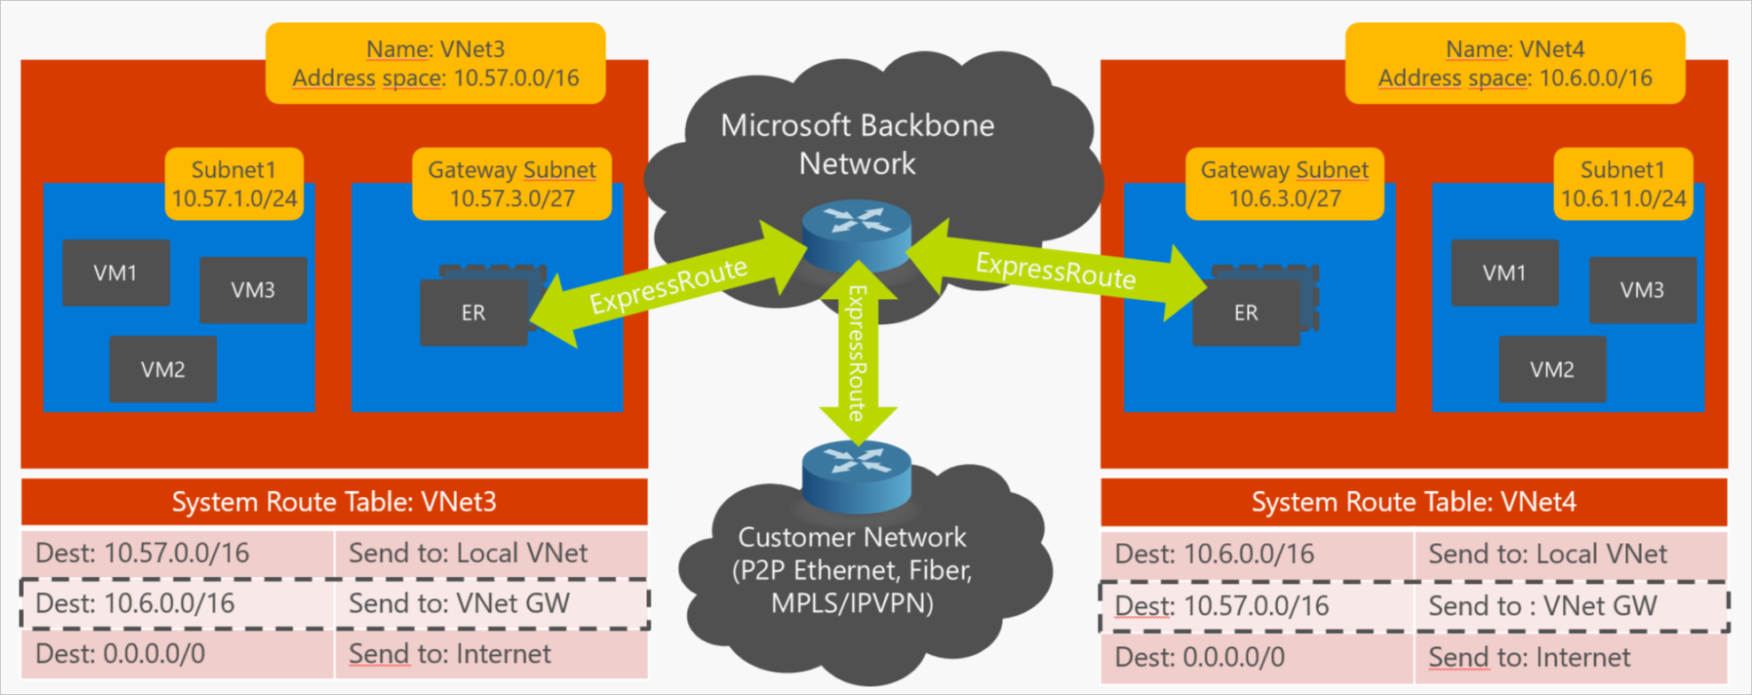
PoC Azure Administration - Networking
VNet-to-VNet via ExpressRoute
https://azure.microsoft.com/en-us/blog/networking-to-and-within-the-azure-cloud-part-2/

Slide 37
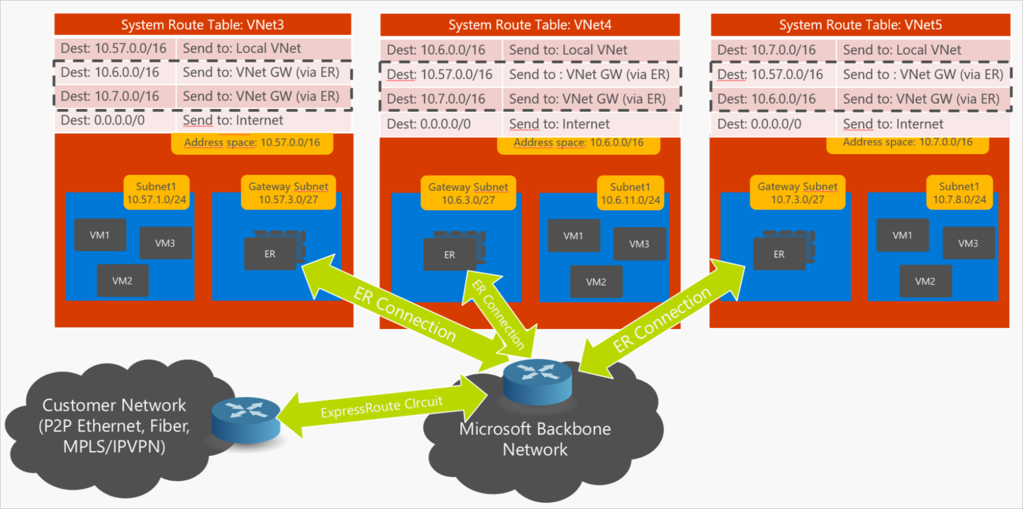
PoC Azure Administration - Networking
VNet-to-VNet via ExpressRoute
https://azure.microsoft.com/en-us/blog/networking-to-and-within-the-azure-cloud-part-2/

Slide 38
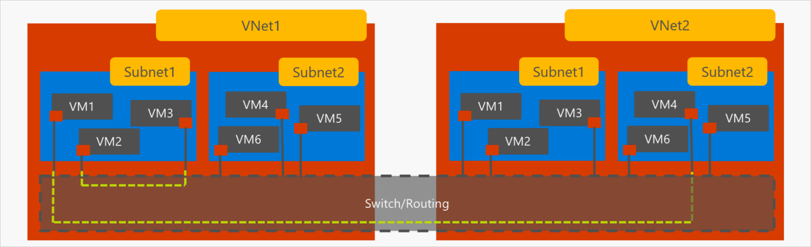
PoC Azure Administration - Networking
VNet-to-VNet with Virtual Network Peering
https://azure.microsoft.com/en-us/blog/networking-to-and-within-the-azure-cloud-part-2/

Slide 39
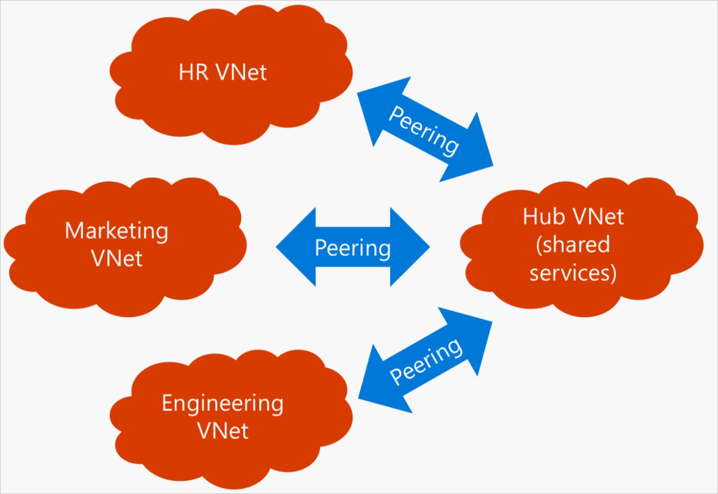
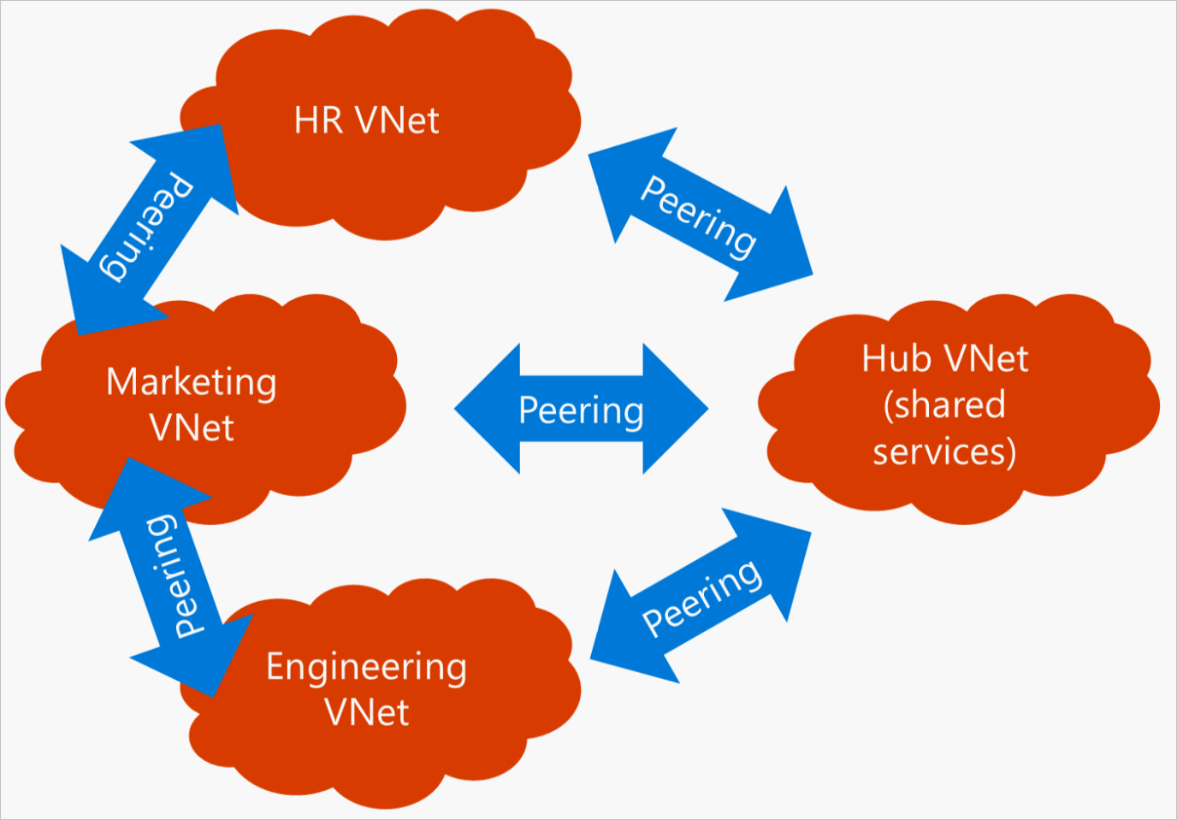
PoC Azure Administration - Networking
VNet-to-VNet with Virtual Network Peering
https://azure.microsoft.com/en-us/blog/networking-to-and-within-the-azure-cloud-part-2/

Slide 40
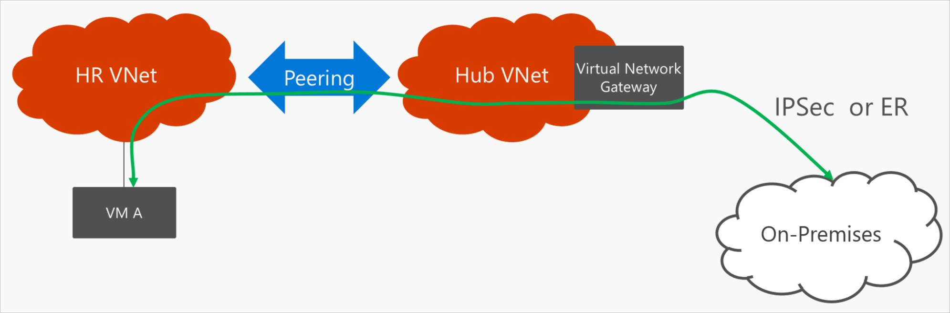
PoC Azure Administration - Networking
VNet-to-VNet with Virtual Network Peering
https://azure.microsoft.com/en-us/blog/networking-to-and-within-the-azure-cloud-part-2/

Slide 41
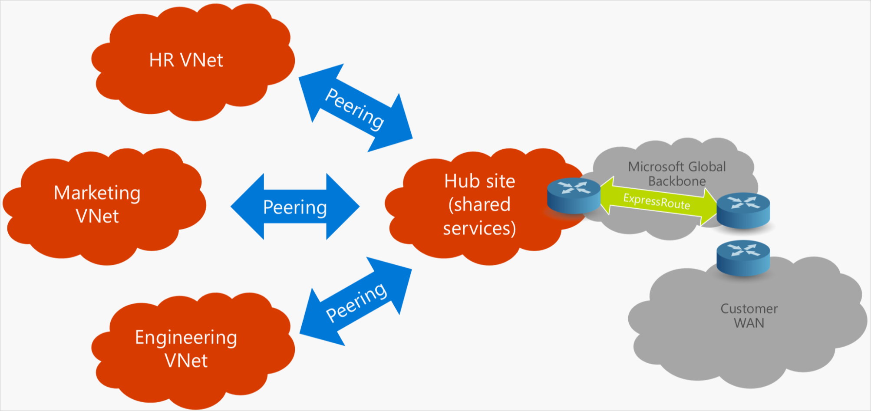
PoC Azure Administration - Networking
Transit VNet with Gateway Sharing
https://azure.microsoft.com/en-us/blog/networking-to-and-within-the-azure-cloud-part-3/

Slide 42
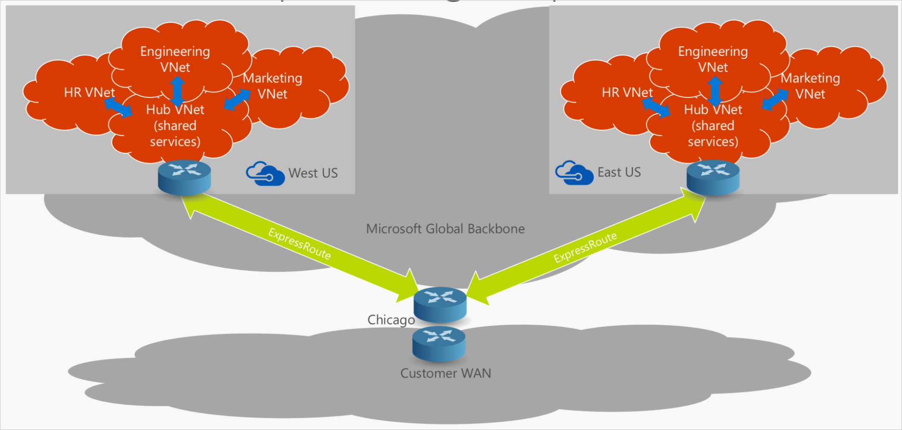
PoC Azure Administration - Networking
Transit VNet with Gateway Sharing, 1 ExpressRoute circuit in 2 regions
https://azure.microsoft.com/en-us/blog/networking-to-and-within-the-azure-cloud-part-3/

Slide 43
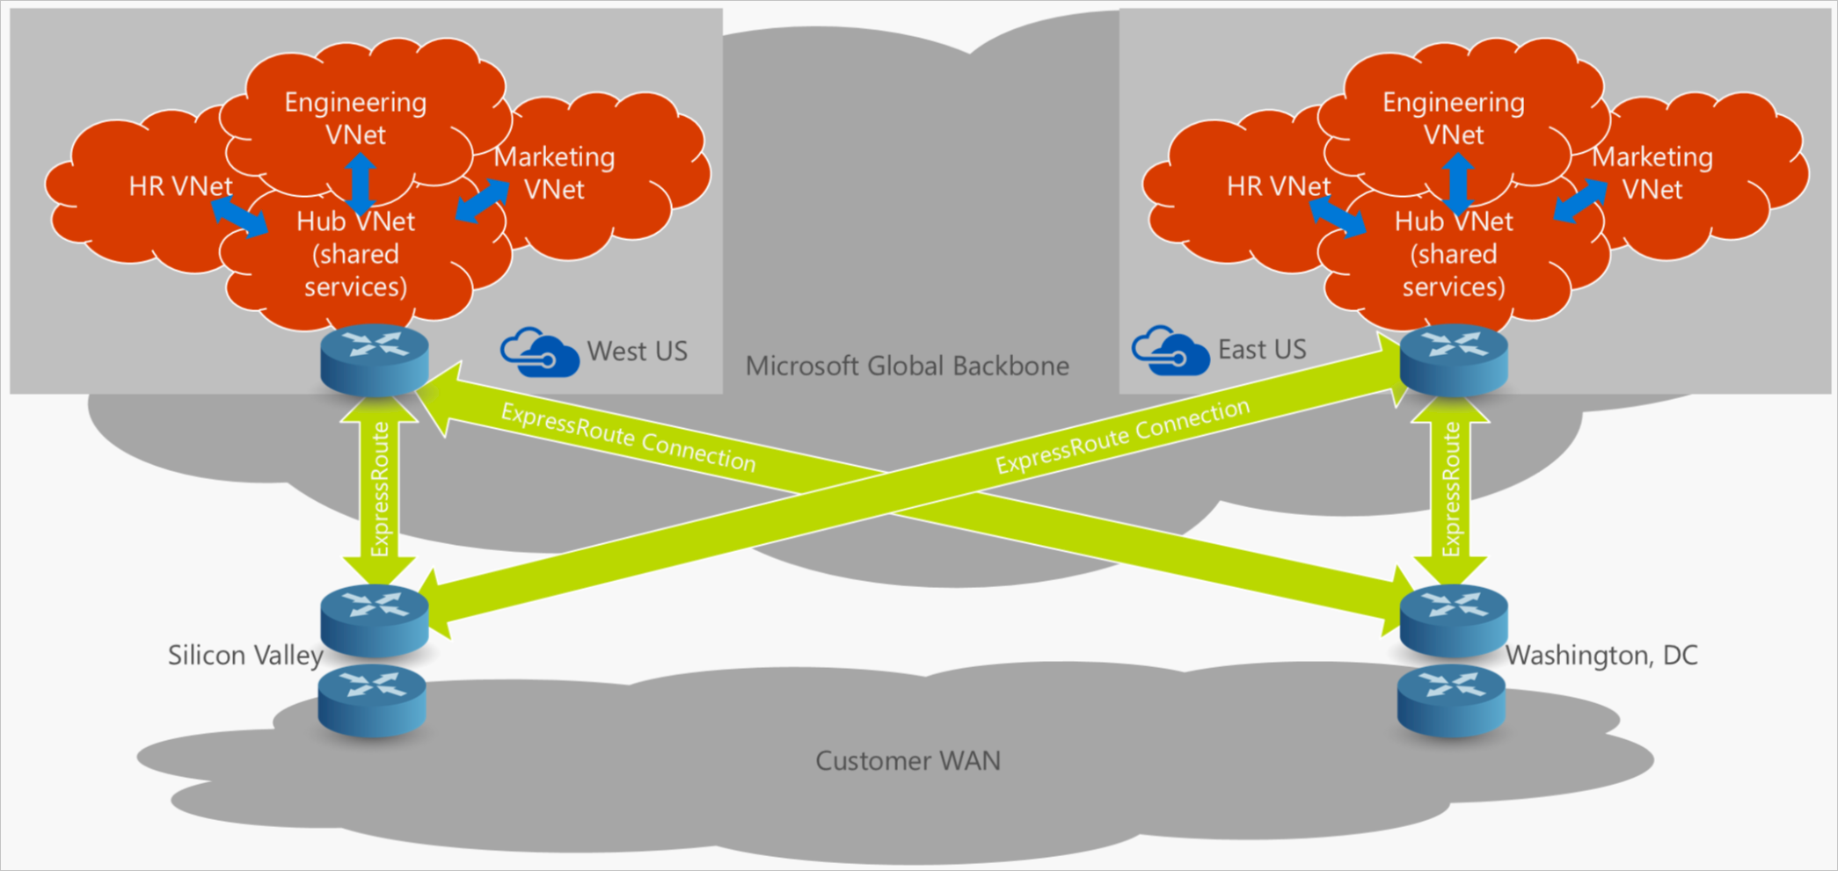
PoC Azure Administration - Networking
Transit VNet with Gateway Sharing, 2 ExpressRoute circuits in 2 regions
https://azure.microsoft.com/en-us/blog/networking-to-and-within-the-azure-cloud-part-3/

Slide 44
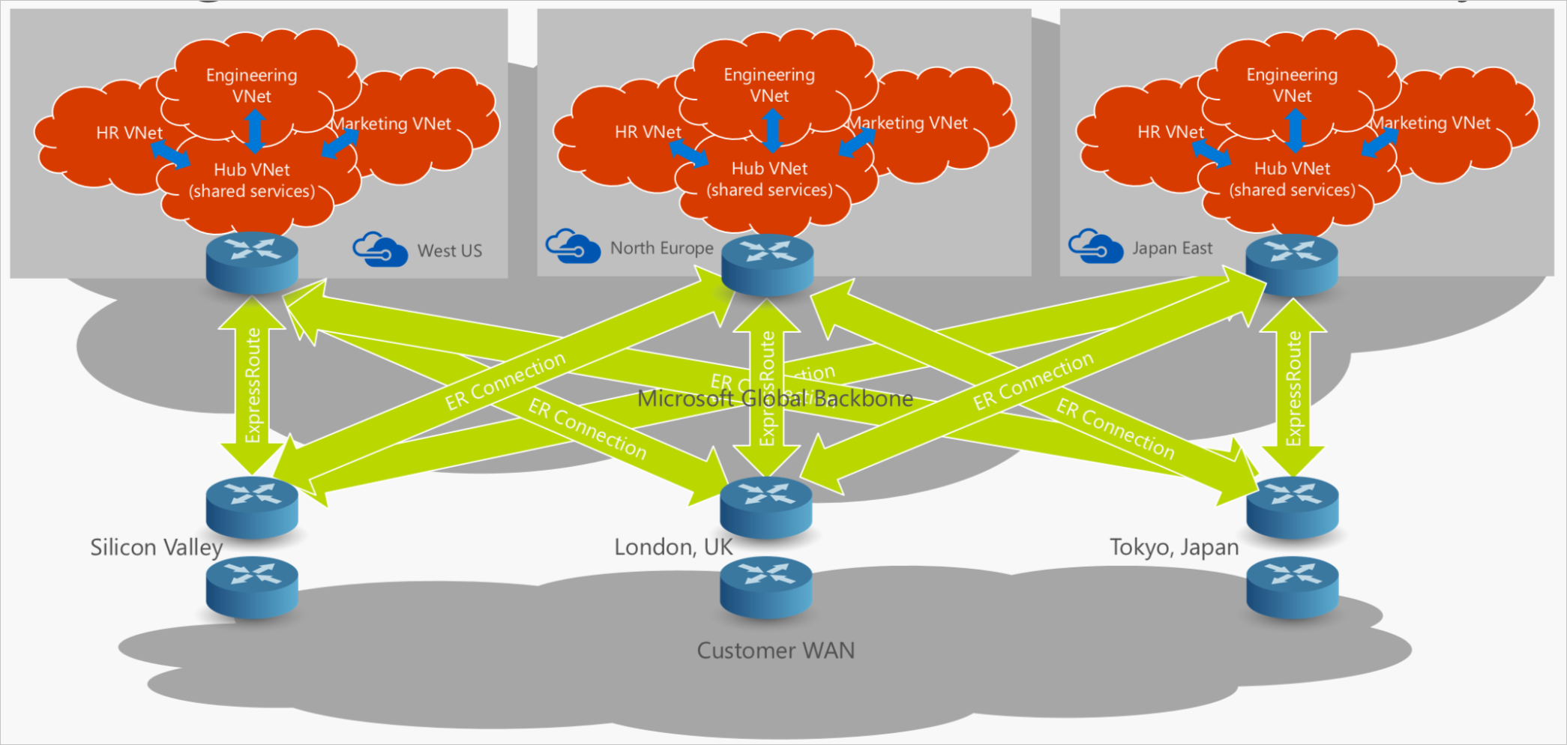
PoC Azure Administration - Networking
Transit VNet with Gateway Sharing, 3 ExpressRoute circuits in 3 regions
https://azure.microsoft.com/en-us/blog/networking-to-and-within-the-azure-cloud-part-3/

Slide 45
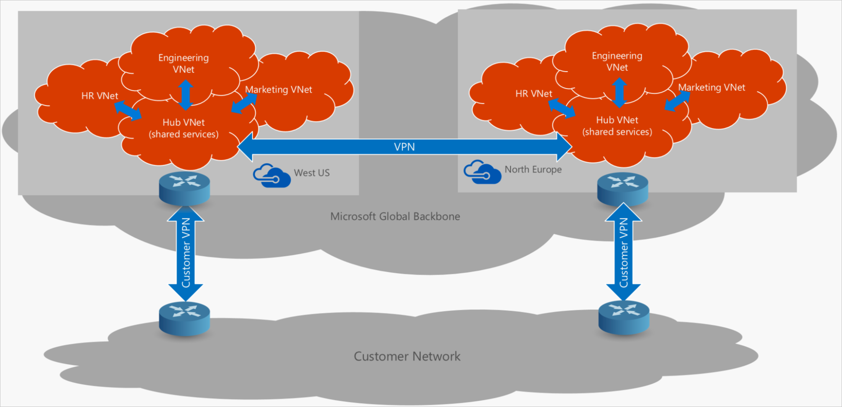
PoC Azure Administration - Networking
Transit VNet with BGP Enabled VPN Gateway Sharing and VPN Transit Routing
https://azure.microsoft.com/en-us/blog/networking-to-and-within-the-azure-cloud-part-3/

Slide 46
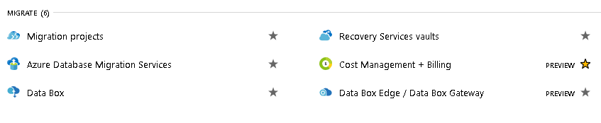
PoC Azure Administration - Migrate
Import/Export/Migrate a MV On-Premise to/from Azure
Import/Export/Migrate a SQL Server / MySQL database On-Premise to/from Azure

Slide 47
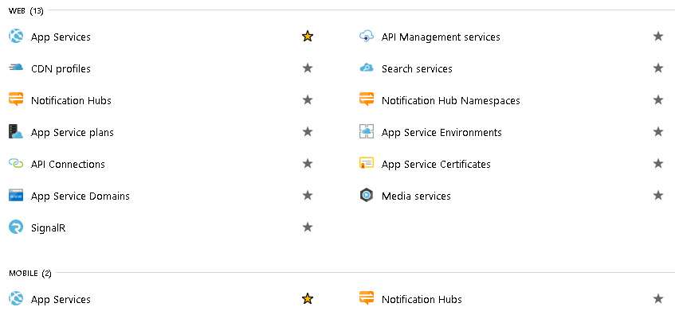
PoC Azure Administration – Web/Mobile
Develop an App Service (.NET/PHP) with an API which connects to a Cosmos DB with Redis Cache and multimedia file serve from CDN

Slide 48
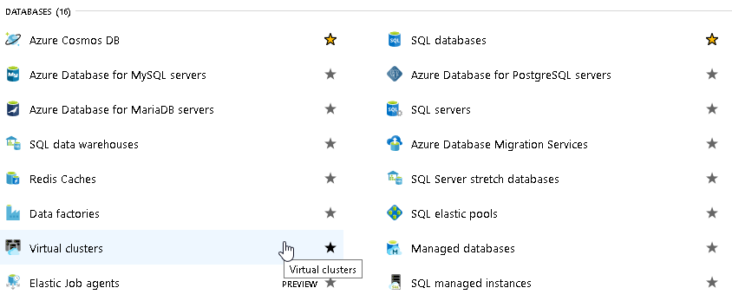
PoC Azure Administration - Databases
Develop an App Service (.NET/PHP) with an API which connects to a Cosmos DB with Redis Cache and multimedia file serve from CDN

Slide 49
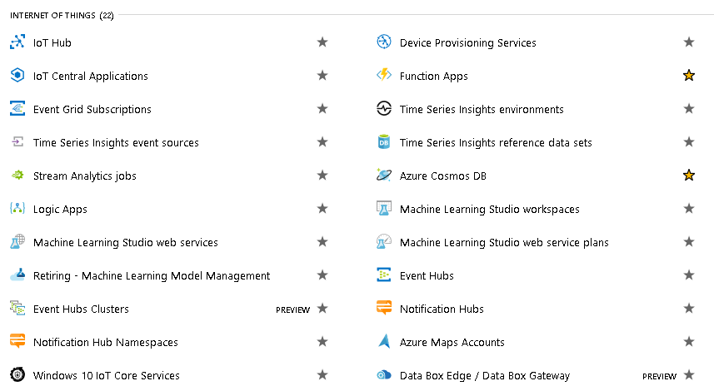
PoC Azure Administration – IoT
(ServerLess)
(Stream)
(Push)
Develop an App Service (.NET/PHP) with an API which connects to a Cosmos DB with Redis Cache and multimedia file serve from CDN

Slide 50
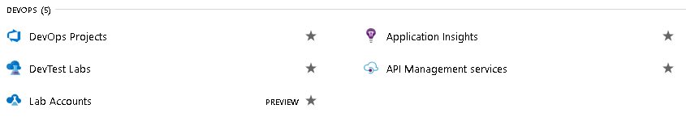
PoC Azure Administration - DevOps
Develop an App Service (.NET/PHP) with an API which connects to a Cosmos DB with Redis Cache and multimedia file serve from CDN

Slide 51
PoC Azure Related Links
- Microsoft Learn Portal
https://docs.microsoft.com/en-us/learn/
https://docs.microsoft.com/en-us/learn/azure/
https://github.com/MicrosoftLearning
- Microsoft Hands On Lab
https://www.microsoft.com/handsonlabs
https://www.microsoft.com/handsonlabs/selfpacedlabs
- Azure Documentation
https://portal.azure.com
https://docs.microsoft.com/en-us/azure/
- Azure Citadel (Lab Section: e.g. Functions, Course Number Before #20533)
https://azurecitadel.com/
https://github.com/azurecitadel
- Azure Code Samples:
https://azure.microsoft.com/en-us/resources/samples/?sort=0
- Official Github Repository for PowerShell Scripts
https://github.com/Azure/azure-powershell
- Azure REST API Browser
https://docs.microsoft.com/en-us/rest/api/?view=Azure
- Official Microsoft Azure YouTube Channel
https://www.youtube.com/user/windowsazure
- Official Microsoft Developer YouTube Channel
https://www.youtube.com/channel/UCsMica-v34Irf9KVTh6xx-g
- Download the Azure SDK's for .NET, PowerShell, CLI and other languages
https://azure.microsoft.com/en-us/downloads/

