Slide 1

Site Reliability Engineering
Organizational & Operational Framework
(a.k.a. “Work Mode”)
May 2019
Olaf Reitmaier Veracierta

Slide 2
Agenda
Introduction
Weakness / Strengths
Changes
Culture of Service
Bi-Modality Awareness
Ways of Working
Organization
Innovation
Communication
Planning
Trust & Visibility
Round Robin (Q&A)

Slide 3

Introduction

Slide 4
Purpose
Clarify expectations from company leaders
Align all the people then address technology issues
Allow collaborators to share concerns (at the end, take notes)
Propose a set of criteria used to follow-up teamwork
Opportunity to be honest, positive and share ideas
Put everyone in the same (new) page, no excuses
Avoid repeating this information several times

Slide 5
Site Reliability Engineering
Vision
Be recognized as an expert and reliable group of people which offers the best in class knowledge and support over the core IT infrastructure.
Mission:
Ensure the continuous and secure operation and support of the network, compute, storage, backup, messaging, logging and monitoring platforms of the core IT infrastructure enabling the critical business application and services.
Notes:
The original text for something knows as “Mission” was:
Ensure that the On-Premise and Cloud platforms of the Core IT infrastructure are secure and highly available.
Monitor and optimize infrastructure systems performance taking both proactive and reactive measures to correct and prevent issues affecting business continuity.
Optimize costs of the whole IT infrastructure wherever is possible while embracing proven technology best practices and standards.

Slide 6

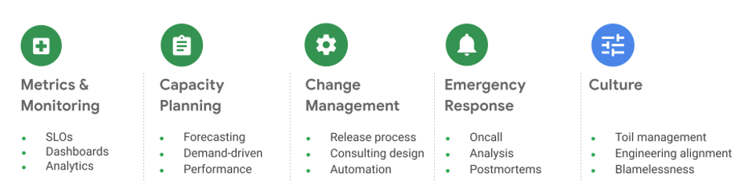
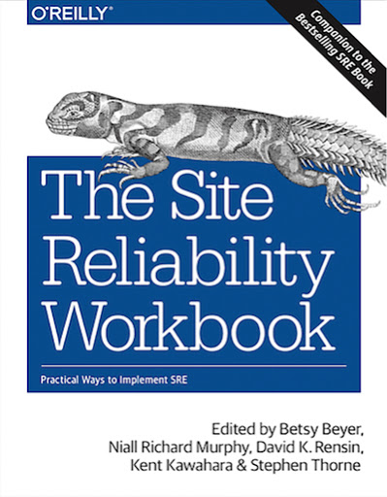
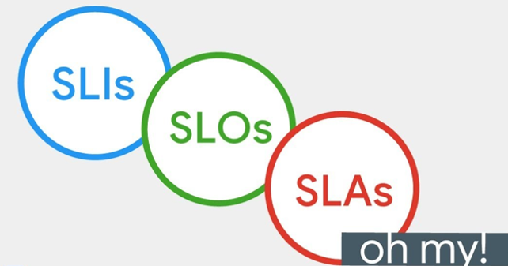

Site Reliability Engineering
“Reliability”
https://sre.google/books/
Notes:
The original text for something knows as “Mission” was:
Ensure that the On-Premise and Cloud platforms of the Core IT infrastructure are secure and highly available.
Monitor and optimize infrastructure systems performance taking both proactive and reactive measures to correct and prevent issues affecting business continuity.
Optimize costs of the whole IT infrastructure wherever is possible while embracing proven technology best practices and standards.

Slide 7
Weakness & Strengths

Slide 8



Strengths
KNOWLEDGE
PASSIONATE
COMPROMISE
++ Assertiveness ++ Resolution

Slide 9



Weakness
Whom
Where
What
When
ACCOUNTABILITY
(TRACEABILITY)
COMMUNICATION
(WORKFLOWS)
Why
Who
VERSATILITY
(STRATEGY)
-- Scalability
Notes:
Accountability: ETA, Achievement, Next Steps.
Communication: Transmiter (Responsible)/Receptor, Formal/Informal
Versatility: Vision, Business Changes, Resistance (Both Sides C-Level and Others)
Scalability to do more innovation and automation while keep running up the legacy

Slide 10
Changes

Slide 11
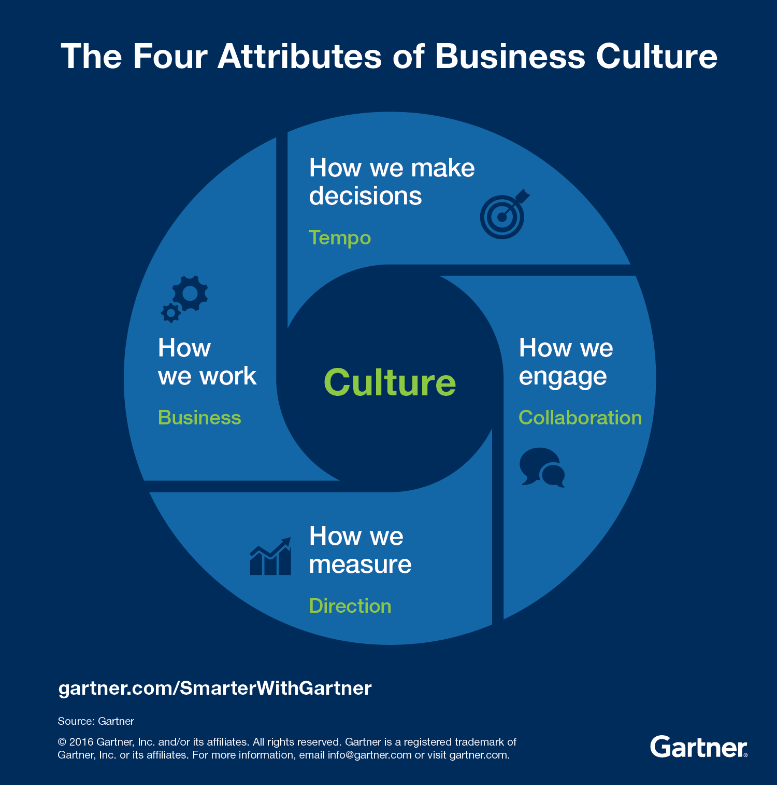




The Company / Business Culture
Blindness?
Start with You
Macro
Micro
Vicious Cycle: I really like a different future, but why change if everything is ok the way it is. The (other) people has to change.
Safety
Circle

Slide 12


Every:
Business
Customer
Organization
Employee
Has:
Opportunities
Values
Risks
Rules Standards
Everybody has a movie
Criteria (dis-)alignment

Slide 13




Change
CULTURE
(OF SERVICE)
BI-MODAL
(VERSATILITY)
Incremental
Iterative
Agreed
WAYS OF WORKING
(ME / YOU / ALL)
LEGACY
(HR / IT)

Slide 14
Change | Culture of Service

Slide 15

User Experience => Every Interaction Counts
Customers ⬄ Team / Group / Member / Partner (Internal & External)

Slide 16


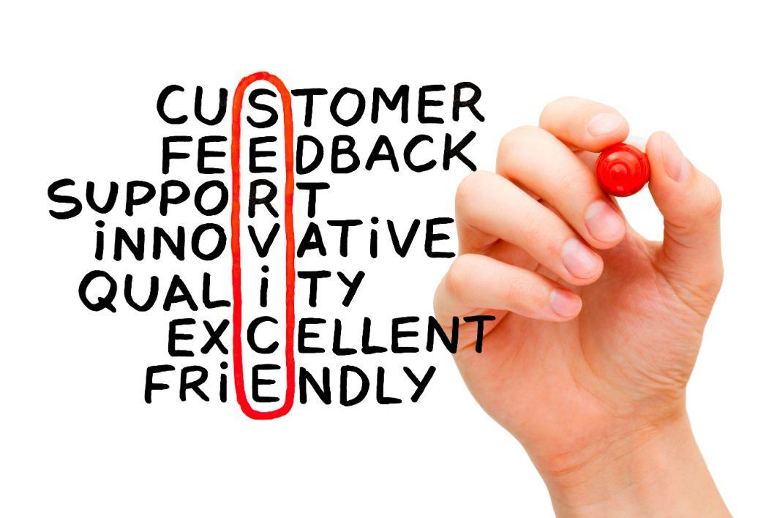
Service Delivery Orientation
Inefficient
Kind
Efficient
Kind
Developers
DevOps
SysOps
Inefficient
Unkind
Efficient
Unkind

Slide 17



Emotional Intelligence
KEY FOR PEOPLE RELATIONS
KEY FOR WORK RELATIONS
Conflict <=> Negotiation
Tension <=> Nothing
Conflict != Fight
TRI-ONE BRAIN
SYSTEM 1/2

Slide 18
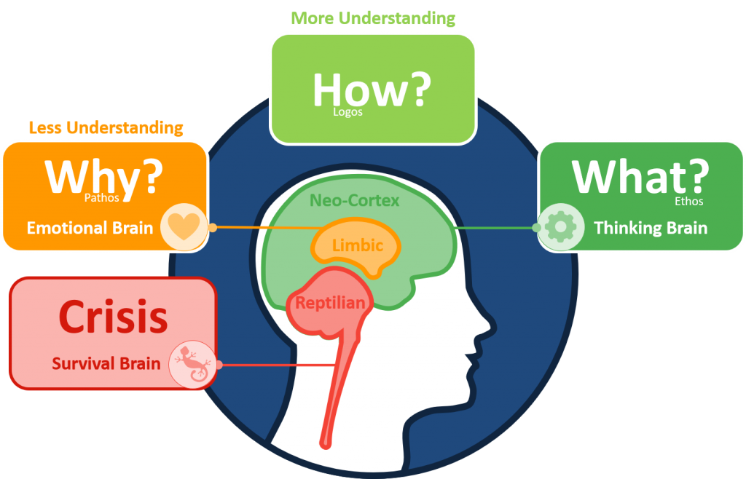
Triune Brain (Thinking/(Re-)Acting)
With time habits (good/bad) becomes reptilian bias, without noticing you loose reasoning skills and ability to change at all.
Notes:
An easy read about Triune (Tri-One) brain can be read here:
https://en.wikipedia.org/wiki/Triune_brain
This is a simple metaphor to explain more complex brain mechanisms.

Slide 19
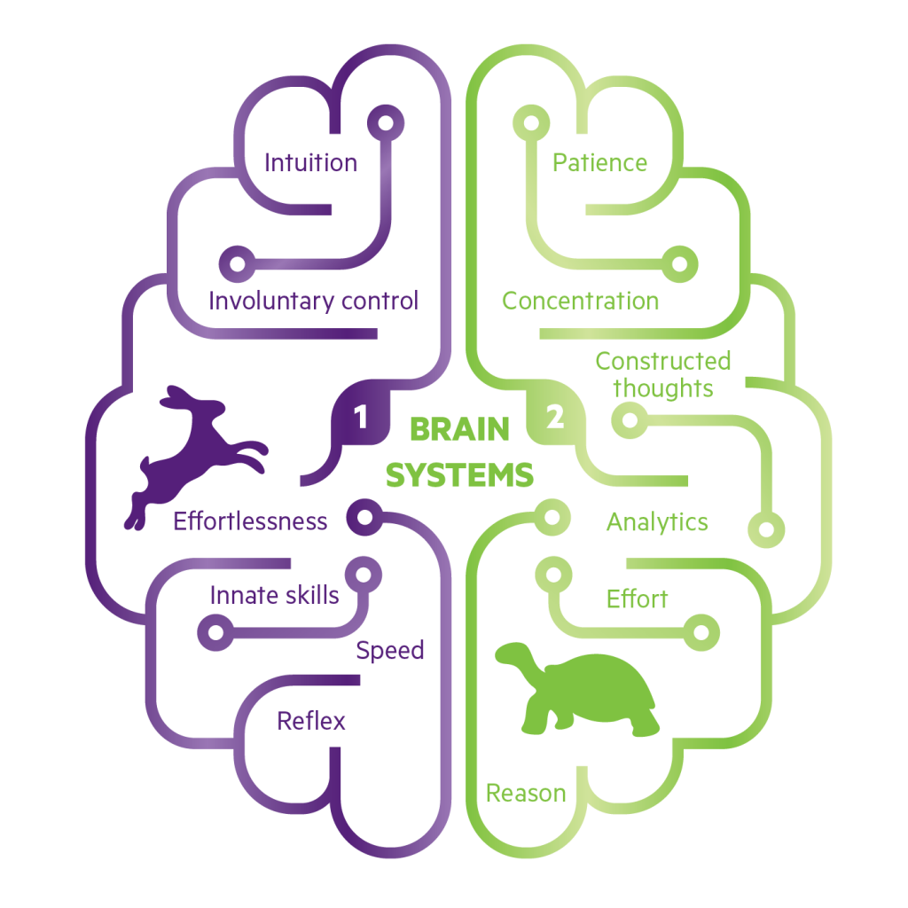
System 1 and 2 (Thinking/(Re-)Acting)
Stimulation -> Time -> Reaction
“People gather together with people that make the work easier”.
Notes:
Please see the book thinking, fast and slow:
https://en.wikipedia.org/wiki/Thinking,_Fast_and_Slow
https://en.wikipedia.org/wiki/Daniel_Kahneman
Phrase taken from this curious article:
http://www.computerworld.com/article/2527153/it-management/opinion--the-unspoken-truth-about-managing-geeks.html

Slide 20


Empathy
“Put yourself in the other shoes”
“Ask for reciprocity about it”

Slide 21
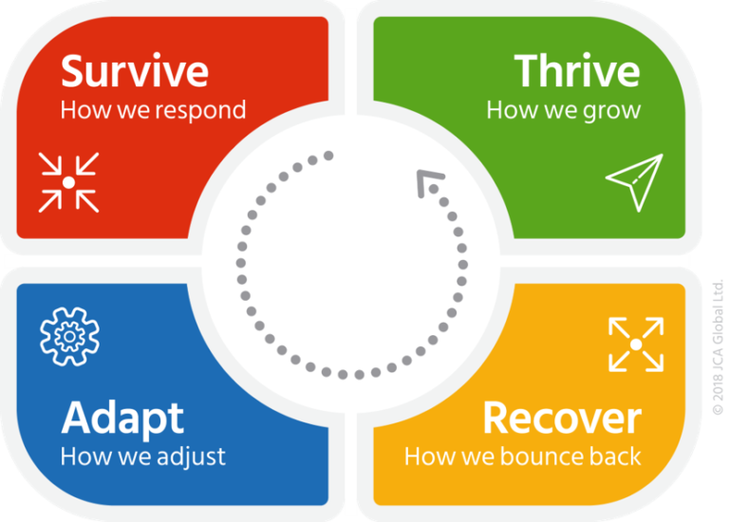
Resilience
Goals / Challenges / Opportunities
Difficulties
Capacity to recover or thrive from any kind of difficulties in work and personal life
Self – Esteem / Empathy / Positiveness

Slide 22
Change | Bi-Modality Awareness

Slide 23
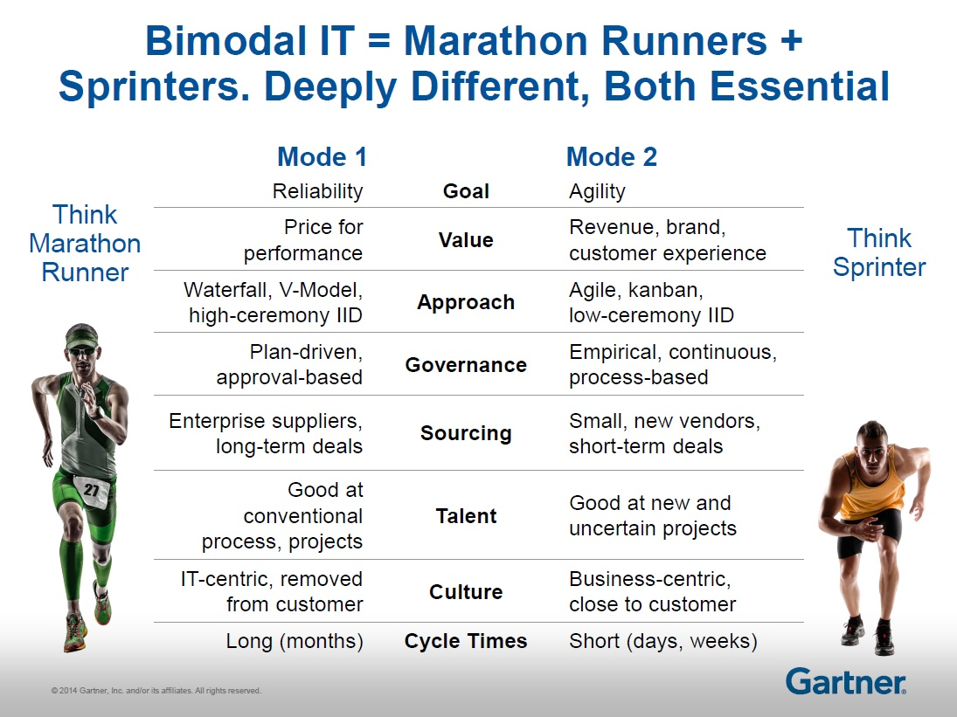

IT
Bussiness
Sys/Ops
Dev
Infrastructure
Code
Maintenance, Support
Innovation
Mr. No
Mr. Yes
IaaCode, Cloud, DevOps

Slide 24
Infrastructure vs. Code
Still slow, really slow, transition…
Infrastructure | Code
Hardware / Software | Software
Static / Inmutable / Un-versioned | Dynamic / Mutable / Versioned
Moore’s Law (Faster) | Wirth’s Law (Slower)
Extrinsic Documentation | Intrinsic Documentation
Administrator Driven (Indirect) | User Driven (Direct)
Virtualization
Software Defined Anything
Cloud Native Solutions
Serverless

Slide 25
Changes | Way of Work

Slide 26
Changes | Way of Work | Organization

Slide 27




Technician vs. Engineer vs. Manager
Solves different problems
From technical to the business language
Doing, thinking or organizing people (Hardly done in parallel by the same person)
From nothing to a book of knowledge

Slide 28
Managers (aka Coachs)
Deliver:
Helps team members
Drive the team to improve
Support team good/bad times
Organization, planification and auditing of the work progress
Expects:
Proactive progress reporting
Active participation in solutions
Answers for follow-up question
Ensure the job is done in time

Slide 29



Performance
Classification
Autonomy
Seniority
Delegation
Operation
Infrastructure
Code
Legacy
Documentation
Training
(Re-)usability
Auditability

Slide 30




Autonomy (Freedom to innovate)
You work within a team (not alone) for good & bad
You implement and support high-available solutions (whenever is possible)
You foster automation instead of manual task (wherever is possible)
You look for strategic approval (specially for new projects / scope changes)

Slide 31





Seniority
Years doing same stuff → Changing on a daily basis
Just being different → Making the difference
Smart person → Smart team
A lot of Power → Responsibilities
Learning → Teaching (New senior engineers will need it!)

Slide 32



Delegation Knowing what are your responsibilities is important We are here because somebody let us make mistakes Having time for innovation needs delegation and teaching to someone to be able to scale
Senior
Complex Tasks
Semi-Senior
Medium Tasks
Entry
Basic Tasks

Slide 33



2nd in Command (Backup)
RESPONSIBILITIES MATRIX
COUPLE OF YOUR SELECTION (HIRE A NEW MEMBER?)
PROMOTES SHARING OF CRITICAL DOCUMENTATION AND KNOWLEDGE

Slide 34
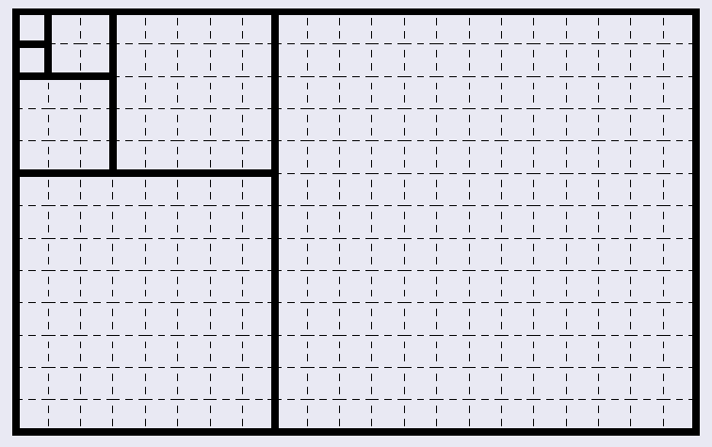


Update Responsibility Matrix
Infrastructure:
Network
Compute
Storage
Management Systems
Security/Identity Devices/Systems
Backup System and Disaster Recovery
Monitoring / Alerting (NPM, ITM, APM)
Supporting Business Applications

Slide 35





Documentation (The Critical One)
Alive (always change)
Challenging for everyone (a lot of reasons)
Boring because it is not for you but for others
Needed for delegation to others (i.e. newcomers, leftovers when vacation, sickness, renounce).
Important when companies growth up in time
Reduce tribal knowledge
Raise quality levels
Allow auditing

Slide 36



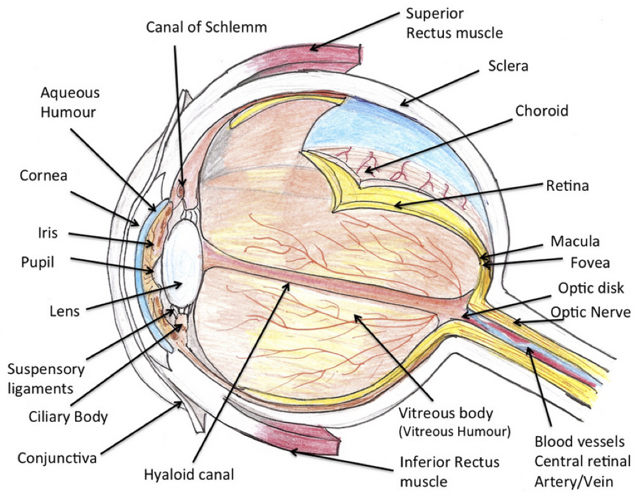
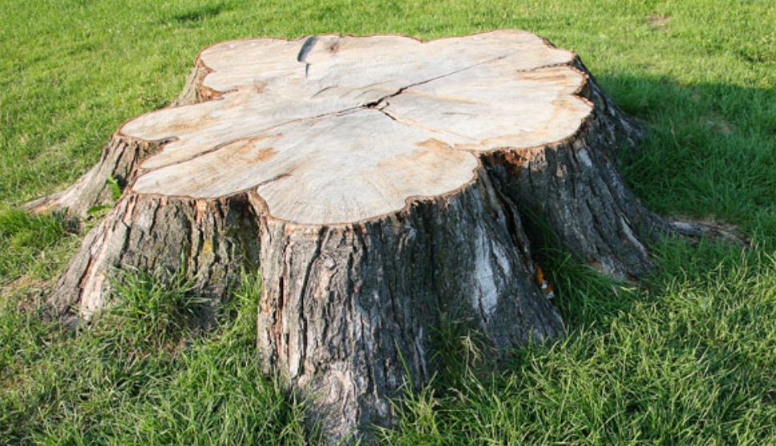

Documentation: Layered / Trimmed / Useful
Abstraction
Update -> Critical
Archive -> Obsolete
Focused on Training
Discoverable (Searchable)
KPI

Slide 37





Documentation (Workshops)
Resume: purpose, technology/vendor websites, external articles/references.
Architecture: high level (at least) visual representation of the platform or system (i.e. draw.io, dot/graphviz).
Assets: resources inventory labeling (not naming), links (URL) and credentials (e.g. Vault, SSO).
How-To’s: about (re-)install and configure with focus on critical and tricky in-house customizations.
Basic administration and troubleshooting: standard procedures, know errors with brief solution explained, references to article/tickets and similars.

Slide 38
Changes | Way of Work | Innovation

Slide 39

Legacy
There was, there is and there will be
It’s a matter of time, but it is important
It is not neither bad nor good is just legacy
Innovation is needed, but maintenance also
99% of the things are legacy since its go live

Slide 40






Innovation (& Investigation)
Must be focused
Value (Customer)
Should be planned (End/Start)
Trackable (Timeframe)
Must be a process (Success/Failure)
Measured (Deliverable)

Slide 41
Changes | Way of Work | Communication

Slide 42
Communication
Notify:
Live changes with enough anticipation to customers
Absence with anticipation (book and or block calendar)
Delay/Leave to/from office to the team members
If you are working and applying changes on weekend
Avoid:
Doing unplanned changes not related to live issues on “Fridays”
Implementing new features near days you are on vacations (freeze)
Mixing informal/formal communication (e.g. me/x-team, misunderstanding, rumors)
Overlapping vacations with your 2nd in command (a.k.a. my backup)

Slide 43




Estimated Time Ahead (ETA)
BROADCAST INFORMATION START, PROGRESS, END, EVIDENCE
REPORT CONTINUOUSLY DON’T EXPECT TO BE FOLLOW-UP
RESPONSE QUESTIONS TO EASY CLARIFY FOLLOW-UP
APPLY TO EVERYTHING: INCIDENT, PROBLEMS, REQUIREMENTS.

Slide 44
Communication (Too many channels?)
@Email
Many formals communications and calendaring
Request to chats will be converted to tickets (as needed)
#Slack
Live Issues and News
Daily/Weekly Slack-Up Trial (instead of Daily Stand-Up)
JIRA (Tickets/Wiki)
Kanban Board: Task/Requirements (Internal/External)
Wiki: For publishing critical infrastructure information
Phone Calls / WhatsApp
Only for emergencies

Slide 45
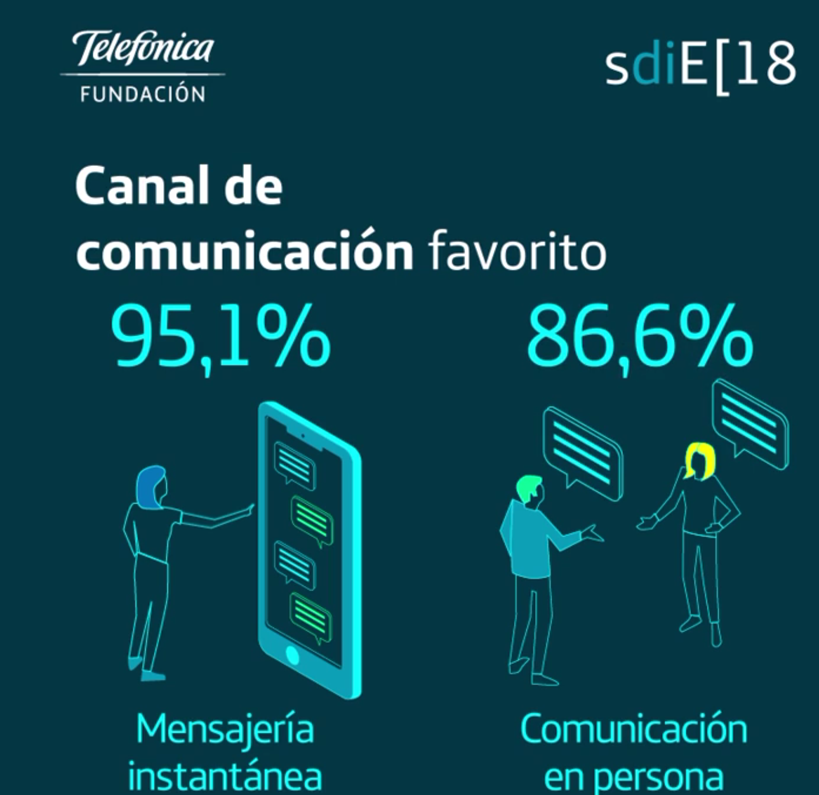
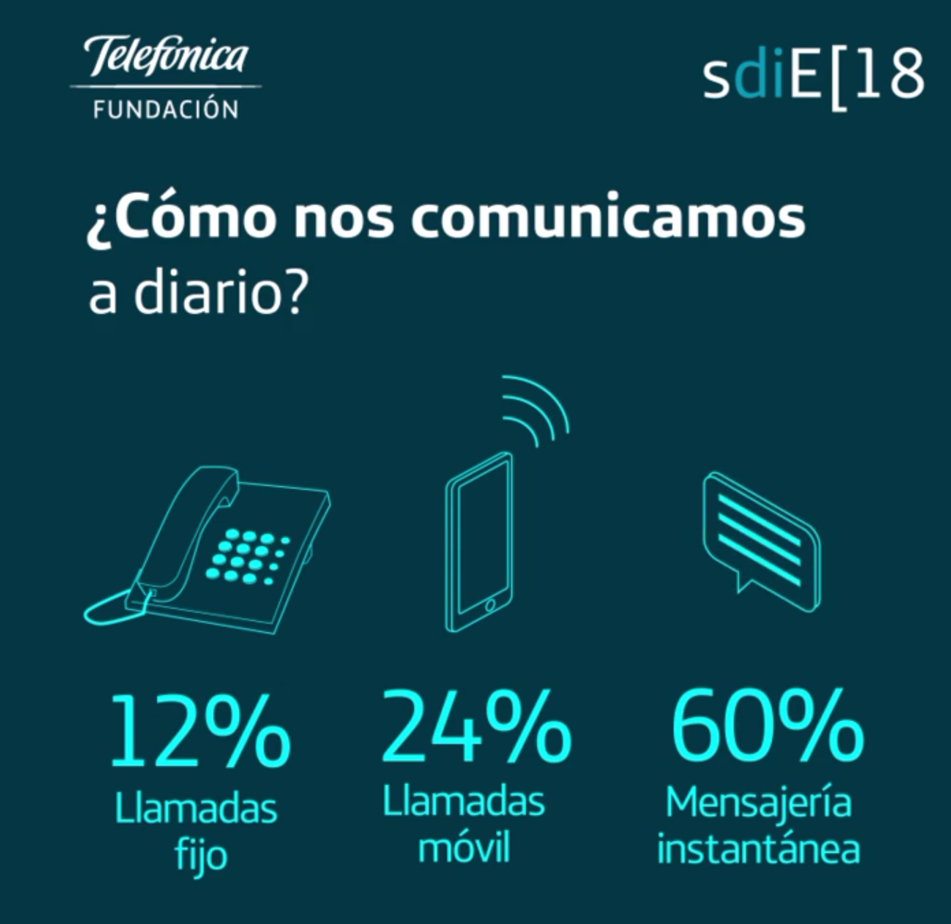
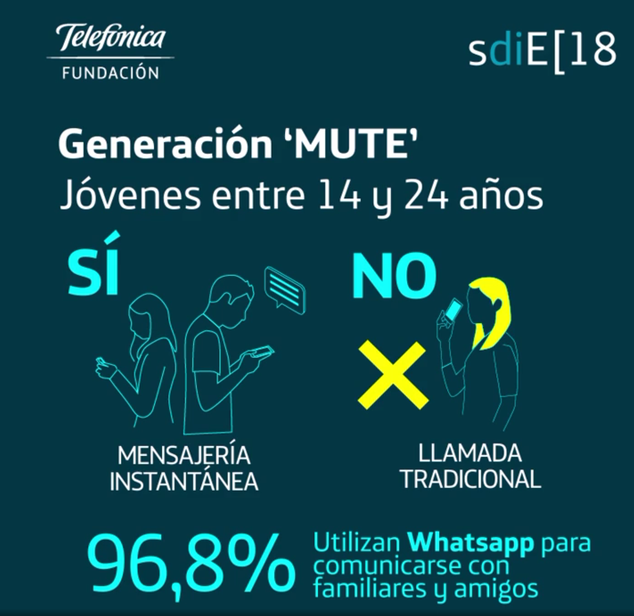
Mute Generation / Work Comm. Channel
Favorite Comm. Channel (IM)
Daily Comm. Channel (IM)
Family Comm. Channel (IM)

Slide 46

So let’s Slack-Up!
(Trial) Broadcast to slack channel instead of verbal stand-up.
Daily/Weekly basis at the start of the day before 10 A.M.
Reminder for achievements/contributions to OKR’s:
Maintenance
Innovation & Optimization
Support (Only if not already a JIRA Ticket)
Low, Lowest, Medium, High, Highest.
Undesired/Unplanned requests (e.g. C-Level Urgencies, Last-Minute-Request)
Help to track easily your progress and risks (red flags).
Promote team awareness of issues and progress.
How it looks? https://slack.com/intl/en-de/slack-tips/run-daily-standups-or-check-ins
Notes:
Depending on the work you do, it could be daily, weekly (fixed day of the week) or both. You must agree the frequency with the manager.
It allows us to share information in one place about the progress of the most relevant work which is critical for the team success or may disturb it.
It helps to avoid annoying questions from manager about delays, new issues, delivery date and real status of the work because the lack or imbalance of lack information.
For example, It make sense to do it daily for newcomers that need advice, but also when a senior are working in too many projects or in some special project.
At the end is a matter of balance not frequency.

Slide 47
Changes | Way of Work | Planning

Slide 48
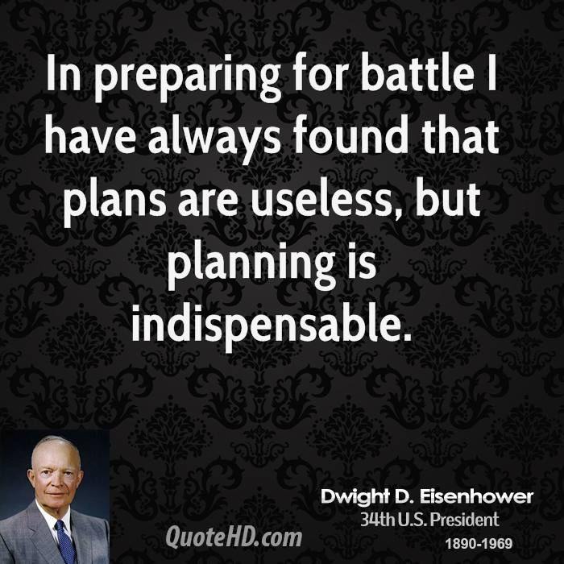
Planning
Objectives and Key Results (OKRs)

Slide 49



Planning (OKR)
Maintenance Projects (30%)
Maintenance plans
Preventive monitoring
Optimization & Innovation Projects (20%)
Cost-efficiency driven plans
Security oriented driven plans
New technologies / features try-out / deployment plans
Support Projects (50%)
New requirements
Reactive incident response
Known errors handling
Problems troubleshooting

Slide 50
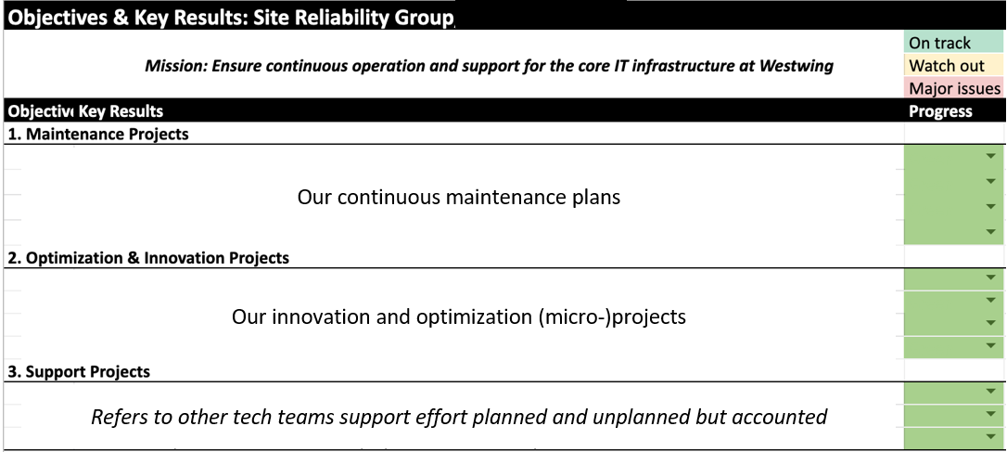
Initiatives: Pick up selection to improve operation?

Slide 51
Individual Planning / Report-Up
 | URGENT | NOT URGENT
IMPORTANT | DO Live Issue Slack until fixed Do the post-mortem documentation OKR’s Slack-Up w/Manager | DECIDE Non-Live Issue Ask-for/Open ticket Slack-Up w/Manager Clarify expectations third parties (e.g. ETA, Termin) Move to Initiatives
NOT IMPORTANT | DELEGATE Teach fishing Assign a less senior 2nd in Cmd. (Backup)? Manager | DELETE Don’t confuse it with Innovation at OKR’s Stop thinking on it

Slide 52
Estimated Time Ahead (ETA)
Never Ending Story
Unexpected Additions/Drops
For critical infrastructure is important
Challenge for most of the tech teams
Different for innovation, maintenance and support

Slide 53
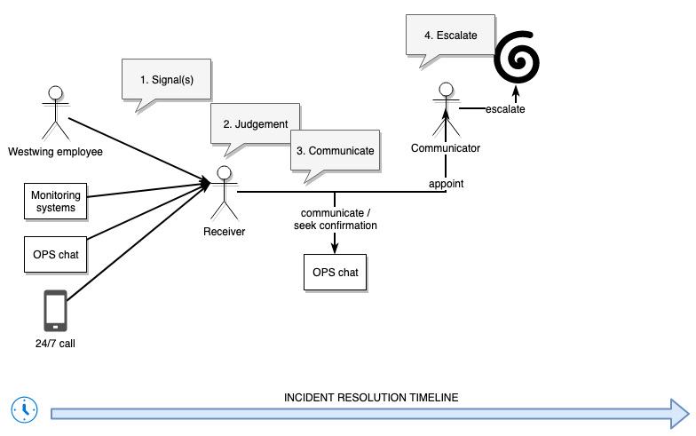

IT Incident Response Plan (Overview)
Alerts: Person, Call, E-Mail, #Slack, SMS, without standard classification (severity).
Follow-up on slack Operational (OPS) channel (chat).
Direct Responsible Individual (DRI) take care of him/her alerts.
Meeting everyone involved in Situational Room.
SLA defined in terms of maximum downtime in hours per system / application.
Spiral Escalation to Eng. Mgr., Head/Director, CTO, CEO.
<45 minutes

Slide 54
IT Incident Response Insights
Report +
Escalate
24/7 Emergency Handling - Contacts
Technology Team Cloud Support - Contacts
On-Premise Datacenter Emergency - Contacts
Formal Mailing Lists for the Business / Technology Teams
SLI
(Observe)
Pro vs. Re-Act
Incident Response Plan - Responsibilities
DevOps & Site Reliability Teams – Responsibilities
Physical / IT Security & Legal Teams - Responsibilities
(Local) IT Support Teams - Responsibilities
SLO
(Oversee)
Account + Adjust
Calls, Chats, Alerts, Tickets
Incident / Problems / Changes (ITIL’s way)
Stability & Post-Mortem Meetings (Agile way)
SLA
(Own)

Slide 55
Progress (Follow-Up/Report-Up)
Tickets New/Completed (JIRA -> slack channel)
Daily/Weekly Slack-Up (You -> slack channel)
Individual Daily Pin Pointing (On Your Desk)
Bi-Weekly One-To-One (Room / Walk / Lunch)
Monthly Retrospective (Last Friday of the Month Afternoon)

Slide 56
Trust & Visibility

Slide 57




Trust & Visibility
Trust ring mitigates business hi-jacking
Critical credential and access levels should be shared (i.e. OneLogin) with key team members and C-Level (Breaking the glass)
Access should cover all infrastructure assets, platforms and systems
Monitoring tools and central consoles alerts for infrastructure must be broadcasted in communication channels (i.e. slack, e-mail)

