Slide 1
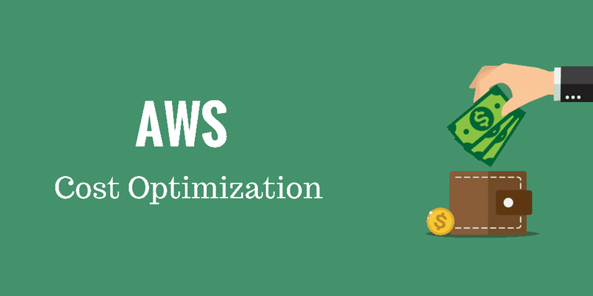
Instance Characteristics
EC2 Purchase Options
RI Flexibility Factor
RI Coverage
Saving Plans Coverage
Spot Risks
Spot Recommendations
Risks
June, 2021.
Olaf Reitmaier Veracierta

Slide 2
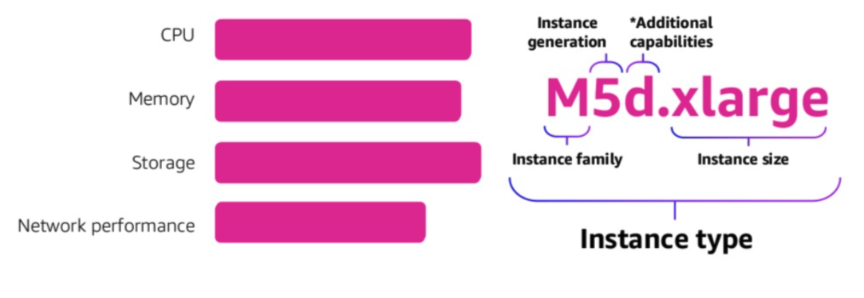
AWS EC2 Instance Characteristics

Slide 3
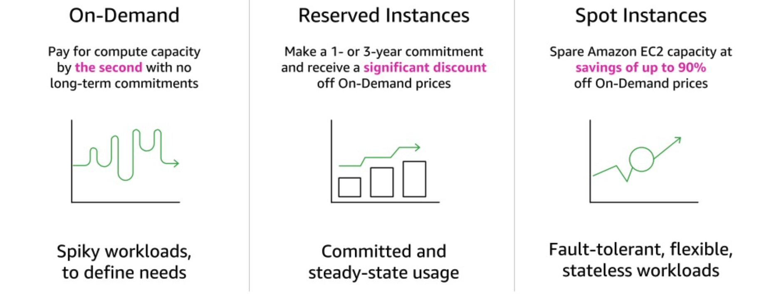
AWS EC2 Purchase Options
Dedicated Instances – Instance (hr) running on single-tenant hosts (account isolation).
Dedicated Hosts – Physical host (hr) fully dedicated for you (hardware isolation).
Capacity Reservations – Reserve capacity for EC2 in a specific AZ for any duration.

Slide 4
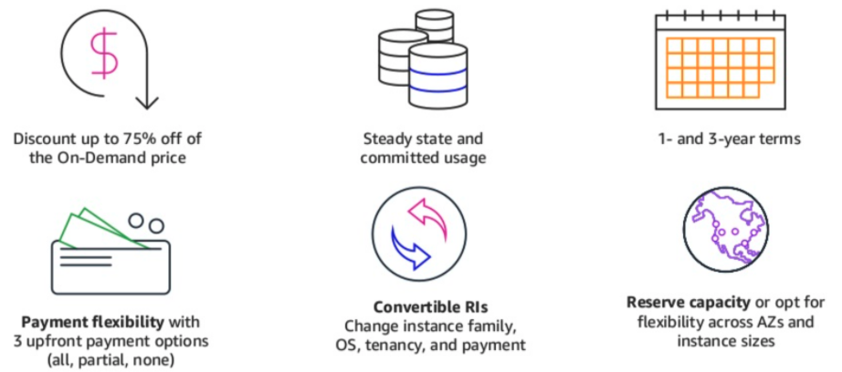
AWS EC2 Reserved Instances

Slide 5
AWS EC2 RI vs. Savings Plans
Reserved Instances
EC2, RDS, ElastiCache, ElasticSearch, RedShift
Specific instance family/size/region(/az) (e.g. r5, db.r5)
EC2 specify family (e.g. r5, db.r5)
Any size/region/tenancy/os
EC2
Saving Plans
EC2, Fargate and Lambda
Any family/type/region/tenancy/os
Compute
SageMaker
https://console.aws.amazon.com/cost-management/home#/dashboard

Slide 6
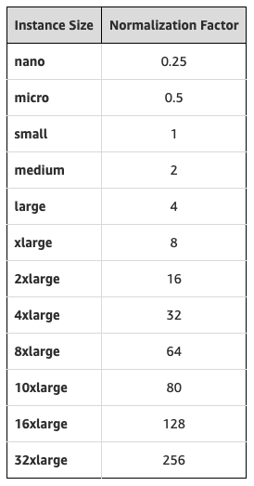
AWS EC2 RI - Flexibility Factor
It means that:
1 large = 4 small
1 large = 8 nano
1 xlarge = 8 small
1 2xlarge = 2 xlarge
And so on...
https://aws.amazon.com/blogs/aws/new-instance-size-flexibility-for-ec2-reserved-instances/

Slide 7
AWS EC2 RI - Visibility and Coverage
1. Reservations are only visible (Cost Explorer) and applicable (Coverage) in purchasing account!
Root Account
RDS RI: 1x db.t3.xlarge 9 x db.r5.xlarge
Root Account ⇔ Payment Account
2. Recommendations,
Purchase Granularity,
Avoid Fragmentations
Member Accounts
A Account
B Account
C Account
...
...
RDS RI: 1 x db.t3.small
RDS: db.t3.small
RDS: db.t3.xlarge
RDS: db.r5.2xlarge
db.r5.8xlarge
Fully Covered / Partially Covered / Not Covered! / Unused!
https://docs.aws.amazon.com/AWSEC2/latest/UserGuide/ec2-reserved-instances.html

Slide 8
AWS EC2 Saving Plans - Visibility and Coverage
1. Saving Plans are only visible (Cost Explorer) and applicable (Coverage) in purchasing account!
Root Account
EC2 SP: 2 $/hr (1st) 3 $/hr (2nd)
Root Account ⇔ Payment Account
2. Recommendations,
Purchase Granularity,
Avoid Fragmentations
Member Accounts
A Account
B Account
C Account
...
...
EC2 SP: 1 $/hr (3rd)
EC2: 1 $/hr
EC2: 2 $/hr
EC2: 3 $/hr
2 $/hr
Fully Covered / Partially Covered / Not Covered! / Unused!
https://docs.aws.amazon.com/savingsplans/latest/userguide/sp-applying.html

Slide 9
AWS EC2 Spot Risk - Scenario A
A
B
C
A
B
C
30% On-Demand 70% Spot
A
B
C
Daily/Stable
Spikes on Spot

Slide 10
AWS EC2 Spot Risk - Event A
A
B
C
A
C
30% On-Demand 70% Spot
A
B
C
A
C
22% On-Demand 44% Spot --- 66% Alive
A
B
C
AZ B Down
A
C
(B)
(B)
~ 34% Unknown
(B)
AWS Service Priority: On-Demand > Spot

Slide 11
AWS EC2 Spot Risk - Event B
A
C
A
C
22% On-Demand 22% Spot --- 44% Alive
22% On-Demand 44% Spot
A
C
A
C
2x Spots Terminated
A
C
(A)
(C)
(B)
(B)
(B)
(B)
~ 66% Unknown
~ 30% Unknown
(B)
(B)
AWS Service Priority: On-Demand > Spot

Slide 12
AWS EC2 Spot Risk - Same Outcome...
A
C
22% On-Demand 22% Spot --- 44% Alive
A
C
(A)
(C)
(B)
(B)
~ 66% Unknown
(B)
Events: A=>B ⇔ B=>A ⇒ ~66% Unknown

Slide 13
AWS EC2 Spot Recommendations
Production:
User facing applications: >= 60% on-demand
Other: >= 30% on-demand
Non-Production:
Any: 100 % spot
All, be prepared for:
Test killing all your EC2 Spot in one AZ.
Test killing/rebooting all your EC2 Spot/On-Demand in one AZ.

Slide 14
AWS EC2 Spot When to Use Them
You can use Spot Instances for various fault-tolerant and flexible applications. Examples include stateless web servers, API endpoints, big data and analytics applications, containerized workloads, CI/CD high performance and high throughput computing (HPC/HTC), rendering workloads, and other flexible workloads.
Spot Instances are not suitable for workloads that are inflexible, stateful, fault-intolerant, or tightly coupled between instance nodes. Spot Instances are also not recommended for workloads that are intolerant of occasional periods when the target capacity is not completely available. We strongly warn against using Spot Instances for these workloads or for attempting to fail-over to On-Demand Instances to handle interruptions.
https://docs.aws.amazon.com/whitepapers/latest/cost-optimization-leveraging-ec2-spot-instances/when-to-use-spot-instances.html

Slide 15
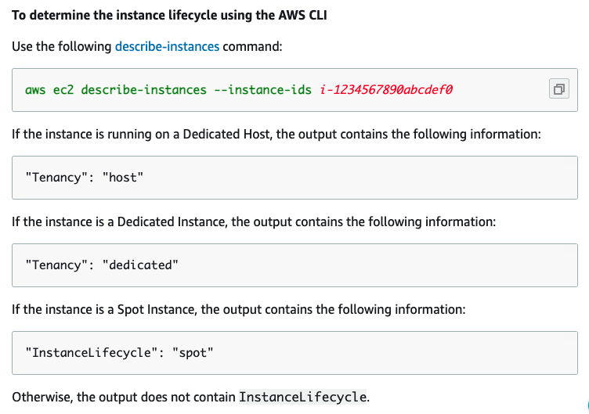
AWS EC2 Lifecycle

Slide 16
AWS EC2 Lifecycle (Kubernetes)
kubectl get nodes -o custom-columns=NAME:.metadata.name,ACC:.metadata.labels.application,TYPE:.metadata.labels.node_type,LIFECYCLE:".metadata.labels.aws\.io/lifecycle" --sort-by .metadata.labels.application
Lifecycle Normal ⬄ On-Demand

