Slide 1
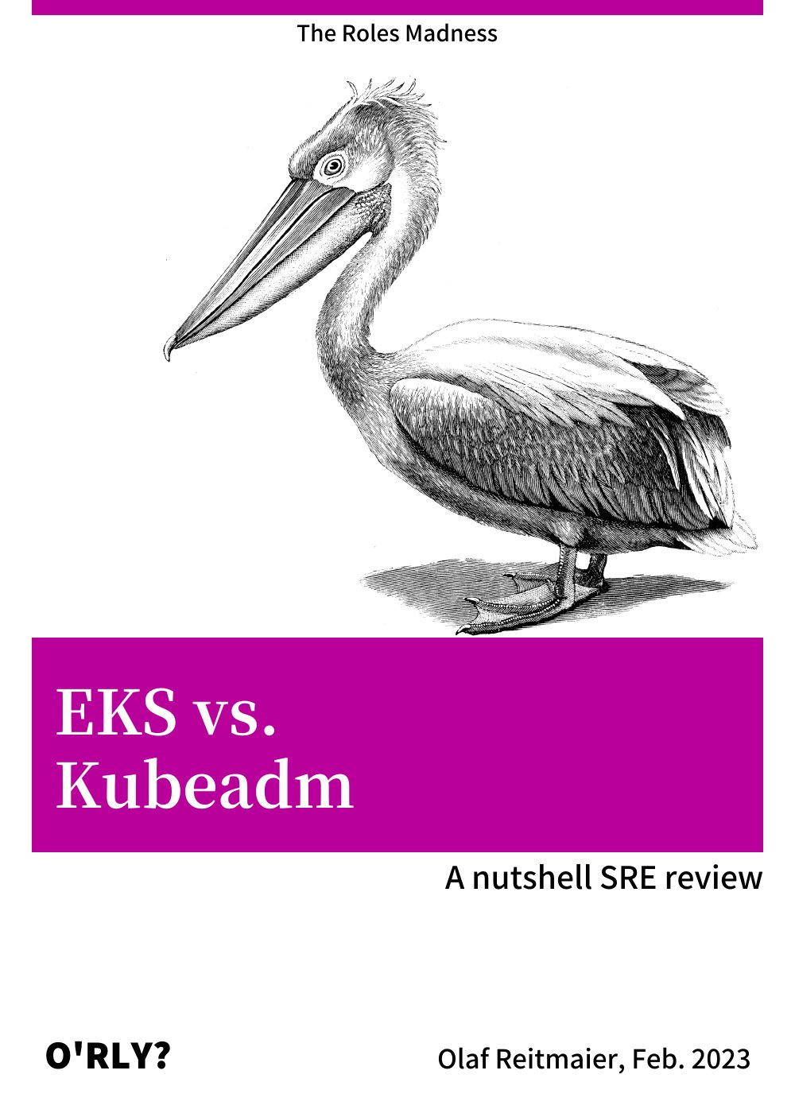

Notes:
https://orly.nanmu.me/

Slide 2
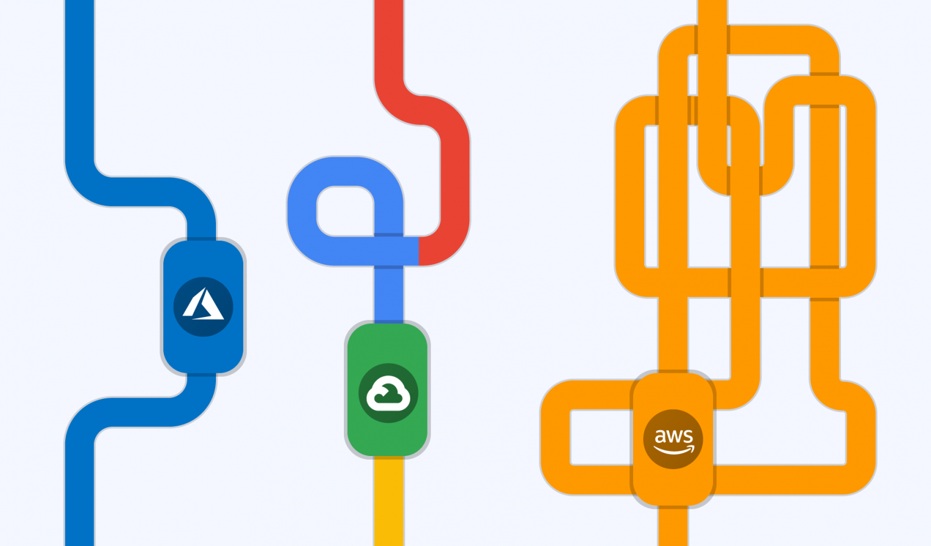

Agenda
IAM Roles
The old easy way
The old hard way
The KIAM way
The IRSA way
NFS on K8s Options:
A) The Kubeadm Way
B) The EKS Way

Slide 3
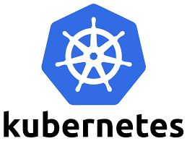
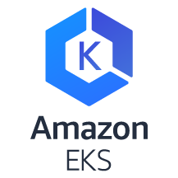
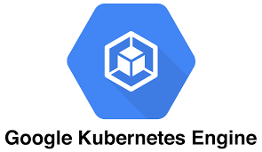
Before we start… the sources…
❌ Medium.com “look-at-me” posts.
❌ Vendor marketing mumbo-jumbo.
✅ Peer reviewed CS publications.
✅ K8s failure stories (https://k8s.af/).
✅ Golang code review.
✅ Memes.

Slide 4
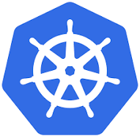
The Old Easy Way
EC2: Y Role: X
AWS STS API
On your Amazon EC2 workloads, you MUST retrieve session credentials using the method described below.
These credentials should enable your workload to make AWS API requests, without needing to use sts:AssumeRole to assume the same role that is already associated with the instance.
https://docs.aws.amazon.com/AWSEC2/latest/UserGuide/iam-roles-for-amazon-ec2.html
assumeRole role:X attached to Y # me
return {ID, Key}
Attached
AWS EC2 MD API
Application Pod
✅
169.254.169.254 /iam/security-credentials/role:X
DNAT: None
Iptables (OS Level)
AWS Account K8s Worker: Y
Notes:
https://docs.aws.amazon.com/AWSEC2/latest/UserGuide/iam-roles-for-amazon-ec2.html
https://docs.aws.amazon.com/STS/latest/APIReference/welcome.html
https://docs.aws.amazon.com/STS/latest/APIReference/API_AssumeRole.html

Slide 5
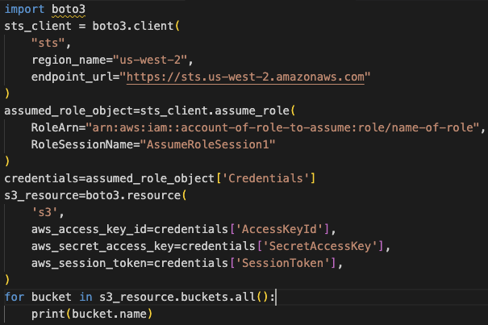
The Old Hard Way
On your Amazon EC2 workloads, you CAN retrieve session credentials using the method described below.
These credentials should enable your workload to make AWS API requests, without needing to use sts:AssumeRole to assume the same role that is already associated with the instance.
https://docs.aws.amazon.com/AWSEC2/latest/UserGuide/iam-roles-for-amazon-ec2.html
AWS STS API
EC2: Y Role: X
Attached
AWS EC2 MD API
assumeRole role:X attached to Y # me
return {ID, Key}
Kiam Agent (Proxy)
Application Pod
✅
sts.amazon.com /iam/security-credentials/role:X
❌
Iptables (OS Level)
DNAT: sts.amazon.com => None DNAT: 169.254.169.254 => <Kiam-Agent-IP>
AWS Account K8s Worker: Y
Notes:
https://docs.aws.amazon.com/AWSEC2/latest/UserGuide/iam-roles-for-amazon-ec2.html
https://docs.aws.amazon.com/STS/latest/APIReference/welcome.html
https://docs.aws.amazon.com/IAM/latest/UserGuide/id_roles_use_switch-role-api.html

Slide 6
The KIAM Way (Kubeadm)
AWS EC2 MD API
AWS STS API
using role:SuperPower from account:Main assumeRole role:X on account:Other
return sts: {ID, Key}
Root (Parent) Account Worker
(Master)
Account: Other => Role: X
Kiam Server (Proxy)
Role: SuperPower
AWS EC2 MD API
Kiam Agent (Proxy)
Application Pod
(...)/role:X
169.254.169.254 /iam/security-credentials/role:X
❗
Iptables (OS Level)
Other Account Worker
DNAT: 169.254.169.254 => <Kiam>
https://github.com/uswitch/kiam/blob/master/cmd/kiam/iptables.go

Slide 7
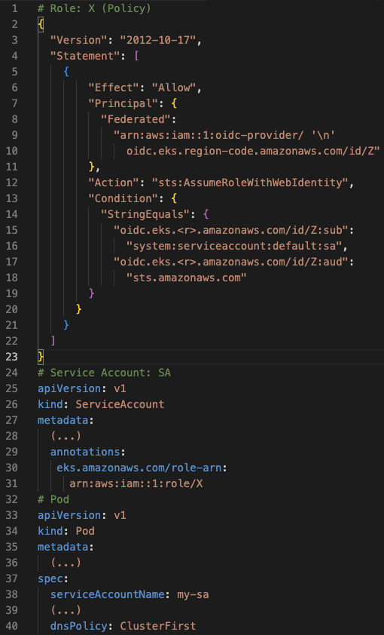

The IRSA Way
(AWS EKS)
Account: 1
using EKS-Cluster-OIDC-Magic assumeRole role:X who trusts me
return sts: {ID, Key}
EKS
CP
Acc: 1
Role: X
Trust
EKS Cluster OIDC EP: Z
KubeAPI
😎
AWS STS API
AWS EC2 MD API
Use: SA
Kubelet
Add
Application Pod
EKS Worker
assumeRole role:X
return {ID, Key}
Account IDP Prov(s)
SSO OIDC Provider
assumeRole role:<Role>
return {ID, Key}
MFA!
Notes:
https://levelup.gitconnected.com/using-iam-roles-to-allow-the-pods-in-aws-eks-to-read-the-aws-s3-bucket-be493fbdda84
https://docs.aws.amazon.com/eks/latest/userguide/enable-iam-roles-for-service-accounts.html
https://docs.aws.amazon.com/eks/latest/userguide/associate-service-account-role.html
https://kubernetes.io/docs/reference/access-authn-authz/service-accounts-admin/

Slide 8
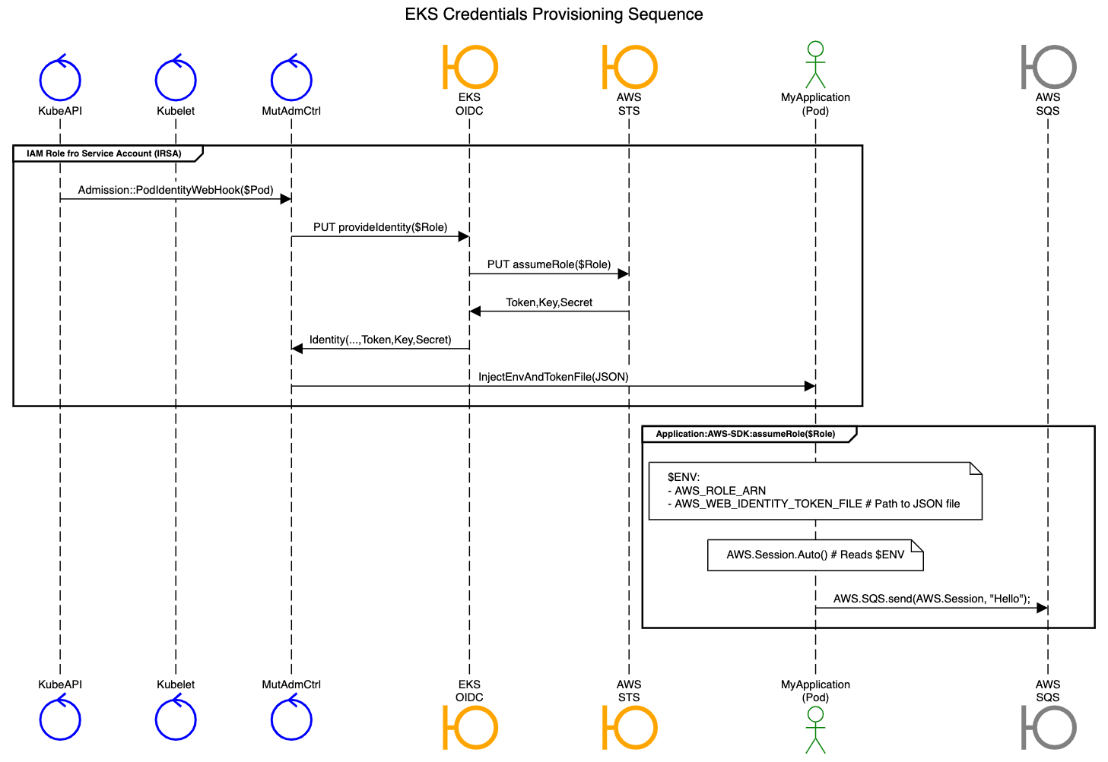

The IRSA Way
(AWS EKS)
EKS Cluster OIDC Magic
In-Depth
Notes:
https://aws.amazon.com/blogs/opensource/introducing-fine-grained-iam-roles-service-accounts/
https://github.com/aws/amazon-eks-pod-identity-webhook/

Slide 9
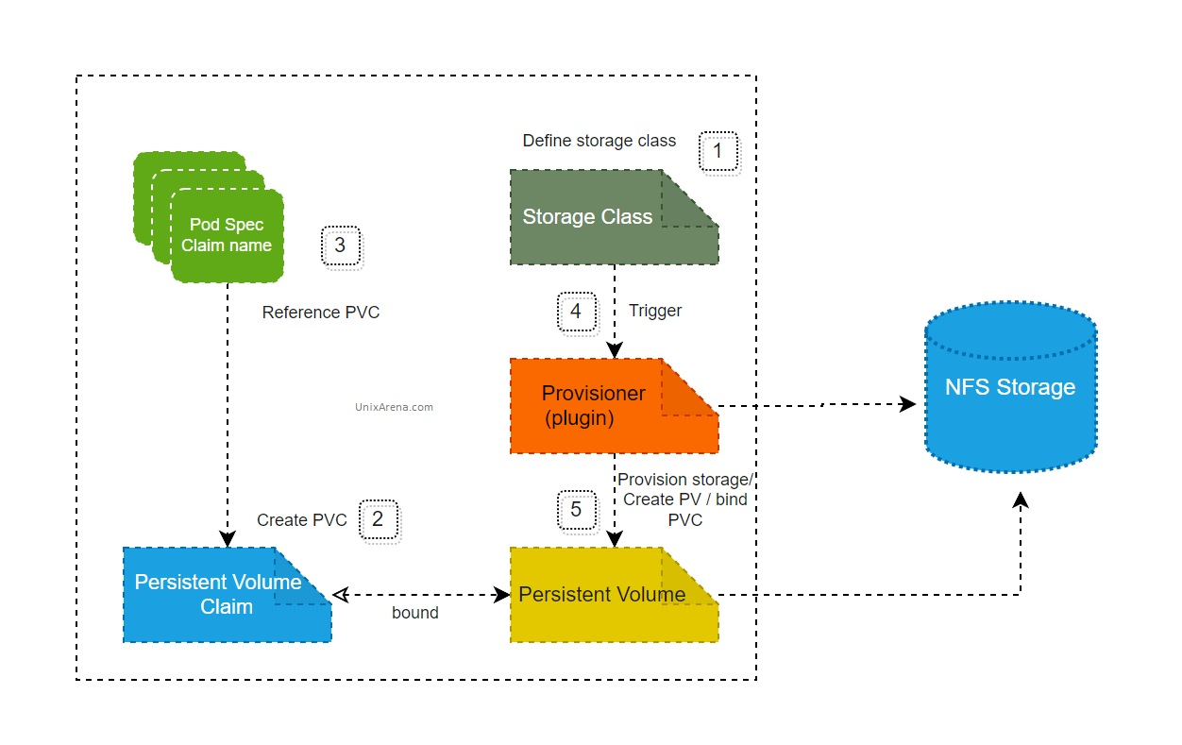
NFS on Kubernetes
Notes:
https://kubernetes.io/docs/concepts/storage/persistent-volumes/
https://kubernetes.io/docs/concepts/storage/volumes/#nfs
https://www.unixarena.com/2022/04/kubernetes-storage-dynamic-nfs-client-provisioner.html/
https://www.exxactcorp.com/blog/Troubleshooting/deploying-dynamic-nfs-provisioning-in-kubernetes
https://quay.io/repository/external_storage/nfs-client-provisioner?tab=tags&tag=latest (Legacy?)

Slide 10
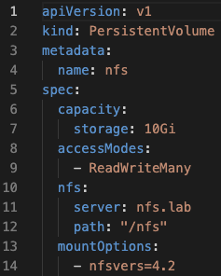
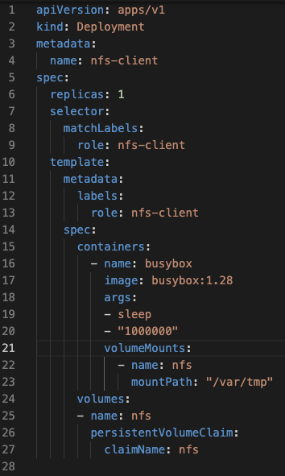
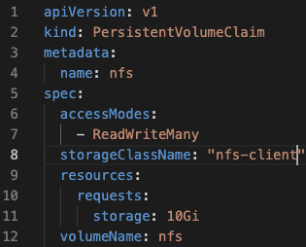
NFS on Kubeadm
AWS EFS endpoint without access policy (roles) only rely on Sec. Group open to VPC CIDR (No roles/auth same as in DUS Data Center).
Test mount -t from your Mac (Allow VPN first).
nfs-common & nfs-utils => AMI.
Helm: NFS Subdir External Provisioner (SIG) - I don’t like SIGs but Jenkins can be fully down or?!
+YAML: pv, pvc.
+YAML: app pod (client).
Deploy.
Notes:
No IAM rol but Sec. Group: https://docs.aws.amazon.com/efs/latest/ug/creating-using-create-fs.html#creating-using-fs-part1-console
To test mount -t on your Mac: https://docs.aws.amazon.com/efs/latest/ug/how-it-works.html#auth-access-intro
https://docs.aws.amazon.com/efs/latest/ug/how-it-works.html#how-it-works-backups
https://fabianlee.org/2022/01/12/kubernetes-nfs-mount-using-dynamic-volume-and-storage-class/
https://github.com/kubernetes-sigs/nfs-subdir-external-provisioner

Slide 11
NFS on AWS EKS
Full AWS
Standard
Non-AWS
Standard
The EKS Way
The EKS Way
EKS Cluster
EKS Cluster
Legacy / Risk of Incompatiblity
EKS OIDC
KIAM
NFS provisioner in EKS flavor with IARS support.
❗
EFS_CSI_Driver
EFS_CSI_Driver
Container Storage Interface (CSI)
EKS works! but ✅ terraform, 💅 eksctl or 👮 AWS CLI: https://docs.aws.amazon.com/eks/latest/userguide/efs-csi.html
Notes:
https://docs.aws.amazon.com/eks/latest/userguide/efs-csi.html

Slide 12
The End

Slide 13
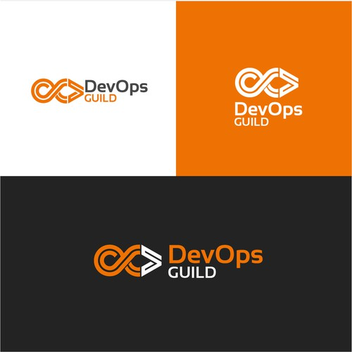
Notes:
https://en.99designs.fr/brand-identity-pack/contests/create-devops-guild-logo-winner-produce-more-via-1115986

