Slide 1
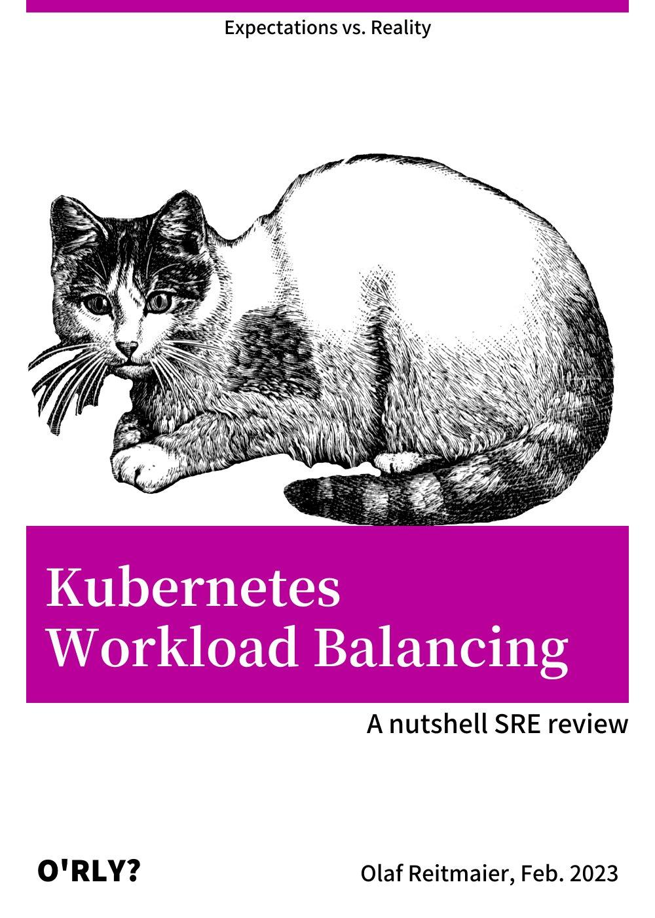

Lobby
Notes:
https://orly.nanmu.me/ (Image)
https://en.99designs.fr/brand-identity-pack/contests/create-devops-guild-logo-winner-produce-more-via-1115986 (Image)

Slide 2
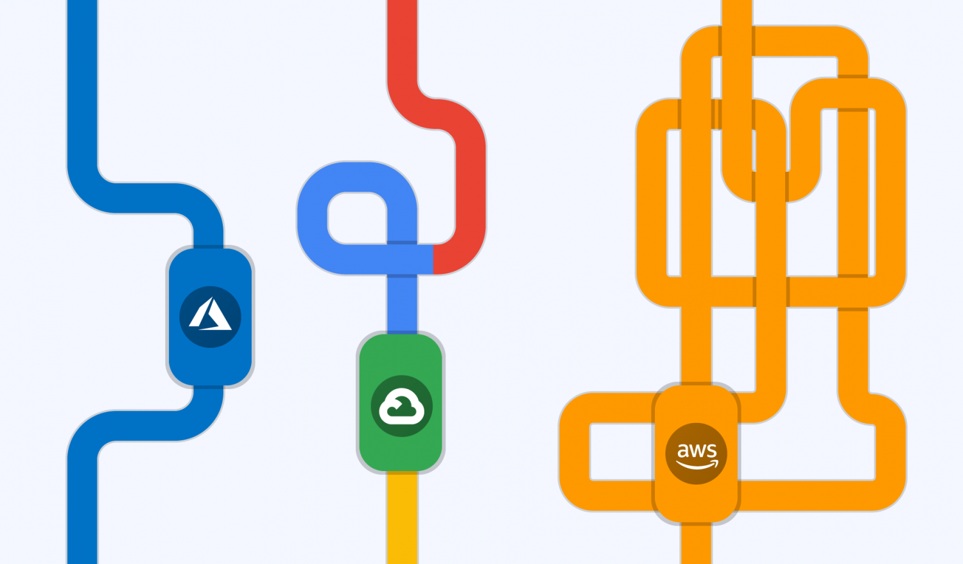

Agenda
K8s Scheduler
Architecture
Decision Tree
Best Fit Algorithm
Filtering Sub-Algorithm
Scoring Sub-Algorithm
Expectations vs. Reality
Job Scheduling Problem
Google’s Guys Solutions
Other Proposed Solutions
Key Takeaways

Slide 3



Before we start… the sources…
❌ Medium.com “look-at-me” posts.
❌ Vendor marketing mumbo-jumbo.
✅ Peer reviewed CS publications.
✅ K8s failure stories (https://k8s.af/).
✅ Golang code review.
✅ Memes.

Slide 4
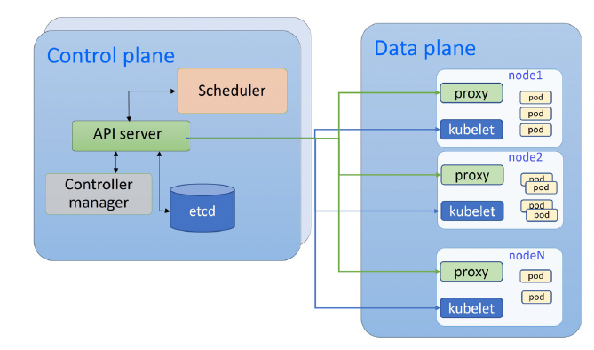
Kubernetes Scheduler
Kube Scheduler is responsible for selecting the worker node and provision the pod on the target node according to well-known pre-defined rules.
Notes:
https://github.com/kubernetes/kubernetes/tree/master/pkg/scheduler
https://kubernetes.io/docs/concepts/scheduling-eviction/kube-scheduler/
https://dl.acm.org/doi/full/10.1145/3539606 (Image)

Slide 5
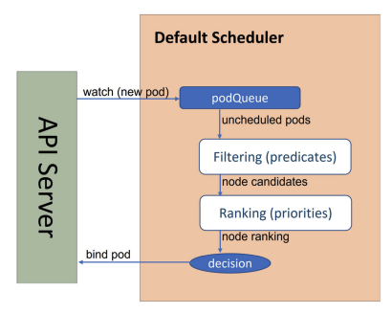
Scheduler Decision Tree
Metrics Server
Scheduling Policies:
Deprecated since Kubernetes >= v1.23
Best Fit Algorithm:
YAML rules specification.
Predicates => Filtering => Candidates
Priorities => Scoring => Ranking
func schedulePod
https://github.com/kubernetes/kubernetes/blob/e4c8802407fbaffad126685280e72145d89b125e/pkg/scheduler/schedule_one.go#L335
Notes:
https://kubernetes.io/docs/reference/scheduling/policies/
https://www.cncf.io/blog/2022/03/28/kubernetes-scheduler-introduction/
https://github.com/kubernetes/kubernetes/tree/master/pkg/scheduler
https://kubernetes.io/docs/concepts/scheduling-eviction/kube-scheduler/
https://kubernetes.io/docs/concepts/scheduling-eviction/scheduling-framework/
https://dl.acm.org/doi/full/10.1145/3539606 (Image)

Slide 6

Filtering Algorithm => Candidates
✅ General predicates:
e.g. PodFitsResources，PodFitsNodeSelector
✅ Storage predicates:
e.g. NoDiskConflict，MaxCSIVolumeCount
✅ Compute predicates:
e.g. PodToleratesNodeTaint
✅ Runtime predicates:
e.g. CheckNodeCondition, CheckNodeMemoryPressure
func findNodesThatFitPod
https://github.com/kubernetes/kubernetes/blob/e4c8802407fbaffad126685280e72145d89b125e/pkg/scheduler/schedule_one.go#L388
Notes:
https://www.cncf.io/blog/2022/03/28/kubernetes-scheduler-introduction/
https://csa-ocp-ger.github.io/unicorn/challenges.scheduling.html
https://github.com/kubernetes/kubernetes/tree/master/pkg/scheduler
https://kubernetes.io/docs/concepts/scheduling-eviction/kube-scheduler/
https://kubernetes.io/docs/concepts/scheduling-eviction/scheduling-framework/

Slide 7
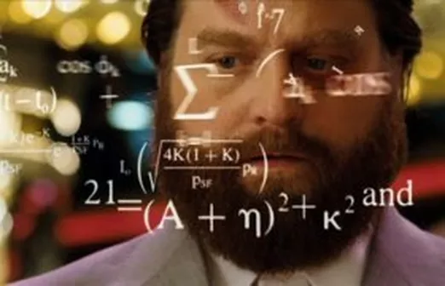
Scoring Algorithm => Ranking
Priority function(s) return(s) a weight from 0-10.
Sum of all priority function result is the final score.
Nodes ranked (sorted) and high(er|est) become the target.
Priority functions (a lot, some examples):
✅ SelectorSpreadPriority: node is in desired topology domain?
✅ CalculateNodeLabelPriority: nodes matches specified label(s)?
✅ *AffinityPriority: node is attracting or repelling?
❗LeastRequestedPriority: node is “least-loaded”?
❗BalancedResourceAllocation: CPU/Memory afterwards? (A bet)
func prioritizeNodes
https://github.com/kubernetes/kubernetes/blob/e4c8802407fbaffad126685280e72145d89b125e/pkg/scheduler/schedule_one.go#L635
Notes:
https://www.cncf.io/blog/2022/03/28/kubernetes-scheduler-introduction/
https://csa-ocp-ger.github.io/unicorn/challenges.scheduling.html
https://github.com/kubernetes/kubernetes/issues/84059
https://github.com/kubernetes-sigs/scheduler-plugins
https://link.springer.com/chapter/10.1007/978-3-030-80879-2_9
http://www.math.uni-magdeburg.de/~werner/sot-sot-lai-werner.pdf
https://github.com/kubernetes/kubernetes/tree/master/pkg/scheduler
https://kubernetes.io/docs/concepts/scheduling-eviction/kube-scheduler/
https://kubernetes.io/docs/concepts/scheduling-eviction/scheduling-framework/

Slide 8
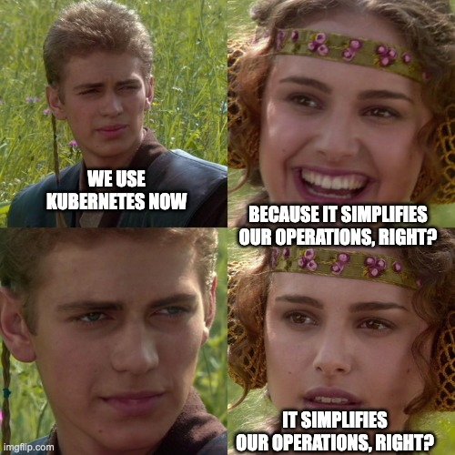
Expectations vs. Reality
Expectation of Rebalance on:
Natural resource usage/demand.
Deployments, Restarts, Terminations.
Vertical/horizontal scaling operations.
Reality at Compute Level:
UNEVEN DISTRIBUTION:
for Node in Cluster.NodeGroup: Node.podCount() != NodeGroup.podCount() / Cluster.nodeCount()
AGGLOMERATION:
HIGH: “Too many pods” => “Overloaded”.
LOW: “Too few pods=> “Underutilized”.
Reality at Storage / Network Level:
TL;TR here, qualify for several long ☕🍩 breaks.
Notes:
https://blogs.vmware.com/cloudhealth/rebalance-fragmented-kubernetes-clusters-reduce-cloud-costs/

Slide 9



Scheduling Problem - Fact 1 of 2
Job Scheduling Uncertainty:
Input assumed for score calculation is changing before calculation is done.
Output should be sort of probability of an unchanged context but in reality it is not.
!=
~=
Dynamic Score
Static Score
Chaos & Entropy
Notes:
https://blogs.vmware.com/cloudhealth/rebalance-fragmented-kubernetes-clusters-reduce-cloud-costs/

Slide 10
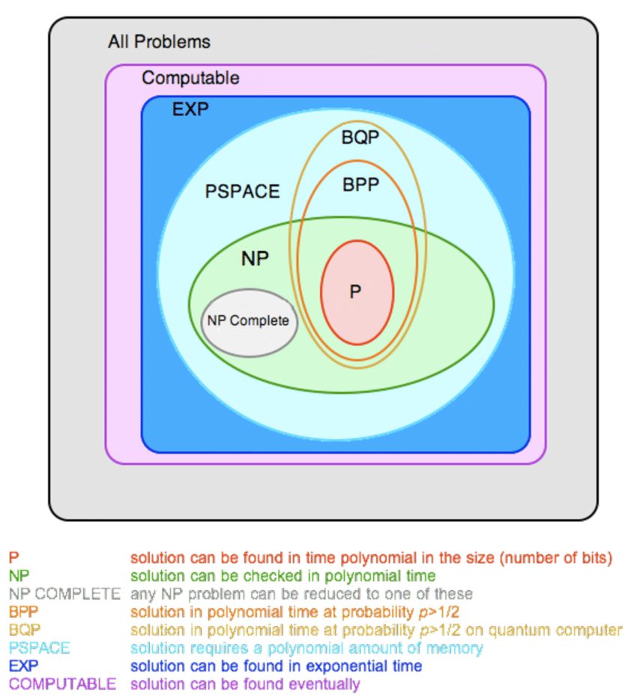
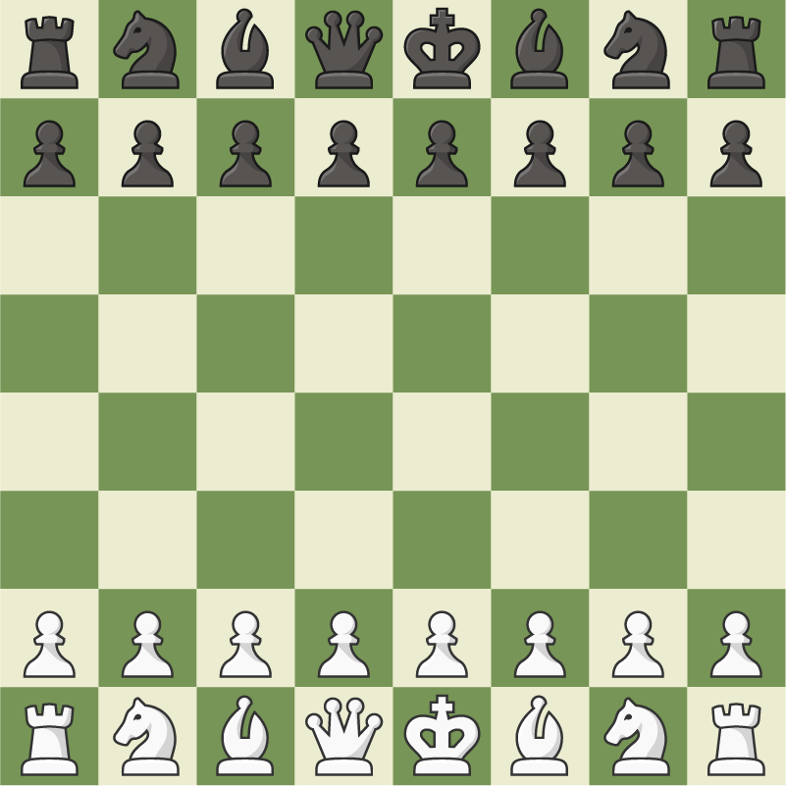


Scheduling Problem - Fact 2 of 2
Optimal Job Scheduling is an Non-deterministic Polynomial Complete (NPC) problem, which means:
✅ The solution can be guessed and verified in P time.
❗There is no particular rule to make the guess.
😲 It’s not known whether any polynomial-time algorithms will ever be found for NPC problems, it remains one of the most important questions in computer science.
It means no efficient P-time algorithm has been found for Job Scheduling, you have to use best-guess solutions.
Note: A chess game ⇔ P problem.
Notes:
https://www.researchgate.net/figure/Venn-Diagram-of-Complexity-Classes-in-Currently-Believed-Structure_fig10_51932027
https://dl.acm.org/doi/abs/10.1145/3539606
https://www.britannica.com/science/NP-complete-problem
https://en.wikipedia.org/wiki/List_of_NP-complete_problems
https://en.wikipedia.org/wiki/Job-shop_scheduling
https://en.wikipedia.org/wiki/Job_shop

Slide 11

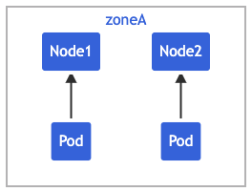
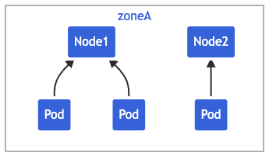
Uneven Distribution
Example: “Heavy Cron Jobs”
“Solution”: Pod Topology Spread Constraints
maxSkew: 1
Distribute pods in an absolute even manner
topologyKey: kubernetes.io/hostname
Use the hostname as topology domain
whenUnsatisfiable: ScheduleAnyway
Always schedule pods even if it can’t satisfy
labelSelector
Only act on Pods that match this selector
Drawbacks:
Static scheduling
Triggered by deployment or failure
Conflicts with other strategies (to come next).
whenUnsatisfiable: ScheduleAnyway
Notes:
https://kubernetes.io/docs/concepts/scheduling-eviction/topology-spread-constraints/

Slide 12
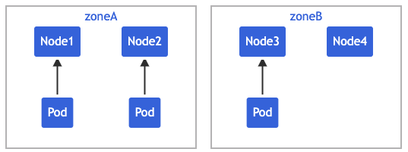
Agglomeration
Example: “Geo Spot Instances”
“Solution”: Inter-Pod affinity and anti-affinity
podAffinity: Attracts pods to a node.
podAntiAffinity: Repels pods from a node.
Drawbacks:
Static scheduling (same story).
Conflicts with the previous Topology Constraints:
requiredDuringSchedulingIgnoredDuringExecution => Only a single Pod per domain.
preferredDuringSchedulingIgnoredDuringExecution => Not enforced (e.g. Termination).
Not for real time rebalancing just for “(...)different topology domains to achieve either high availability or cost-saving”.
On-Demand (us-east-1)
Spot (eu-central-1)
Notes:
https://kubernetes.io/docs/concepts/scheduling-eviction/assign-pod-node/#inter-pod-affinity-and-anti-affinity

Slide 13
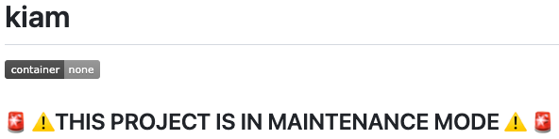



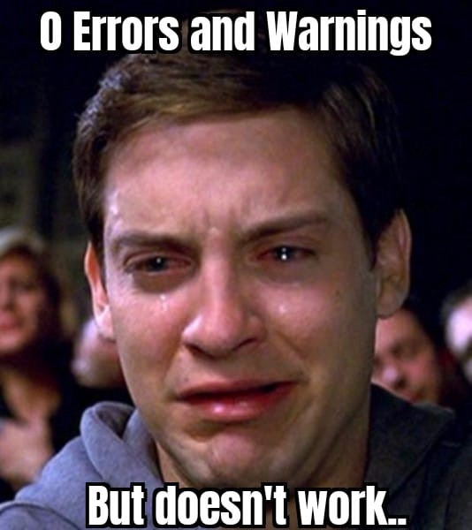



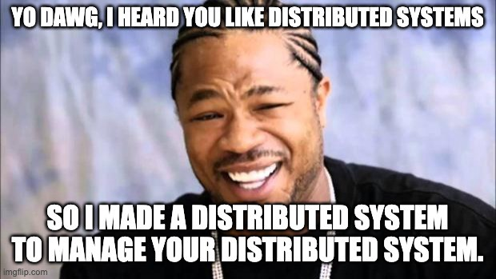

Other Proposals
Descheduler and K8s Plugins are SIGs ( Special Interest Group) projects.
🤡
Descheduler: Promising multi-strategy (re-)scheduling: https://github.com/kubernetes-sigs/descheduler
Winter Soldier by DevTron Labs: Downscale to 0 pods. Conflicts w/AutoScaler? https://github.com/devtron-labs/winter-soldier
Refined Balanced Resource Allocation (New): Promising dynamic metrics for schedulers (China). https://ceur-ws.org/Vol-3304/paper07.pdf
Kube Scheduler Plugins: DYI: Just go and f@#ing write your own stuff? https://github.com/kubernetes/enhancements/tree/master/keps/sig-scheduling/624-scheduling-framework
Low Carbon Kubernetes Scheduler: “Heliotropic multicountry” scheduler to save electricity 🚀 https://ceur-ws.org/Vol-2382/ICT4S2019_paper_28.pdf
Notes:
https://github.com/kubernetes/community/blob/master/README.md#special-interest-groups-sig
https://github.com/kubernetes-sigs/scheduler-plugins
https://github.com/kubernetes/enhancements/tree/master/keps/sig-scheduling/624-scheduling-framework
https://github.com/kubernetes-sigs/descheduler
https://github.com/devtron-labs/winter-soldier
https://ceur-ws.org/Vol-3304/paper07.pdf
https://ceur-ws.org/Vol-2382/ICT4S2019_paper_28.pdf

Slide 14
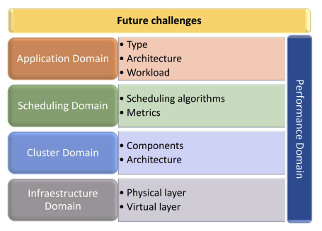
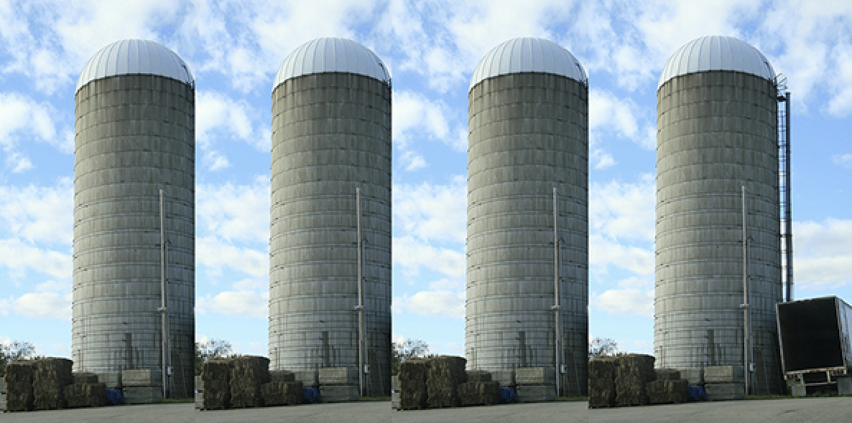
Key Takeaways
Usability ~> Maybe?:
Better suited for steady workloads sets, not high peaky (e.g. node overload => pod unsch.).
Good for HA and cost saving, bad RT balancing.
Worsen unpredicted situations complexity (i.e. YAML hotfix?, inter-dependency)).
Reliability ~> Definitely not!:
No standard solution that fit all app / teams.
Requires a lot of edge cases testing, between co-existent applications (same node group).
No easy way to humanely trace the decisions taken by scheduler (e.g. during live issue).
Too many metric/rules siloed input for decisions:
AWS Auto Scaling (e.g. Fixed, Scheduled). => EC2 On-Demand vs. Spot => AWS guess.
K8s AutoScaler (even without metrics). => “Rescheduler” => Dev/DevOps guess.
Capacity right sizing (i.e. EC2, limits/requests guess)
Costs? Well, is another story of me(gue)ssing AWS RI/SP…
Notes:
https://dl.acm.org/doi/full/10.1145/3539606 (Image)

Slide 15
The End
Notes:
https://orly.nanmu.me/

Slide 16

Notes:
https://en.99designs.fr/brand-identity-pack/contests/create-devops-guild-logo-winner-produce-more-via-1115986

