Slide 1
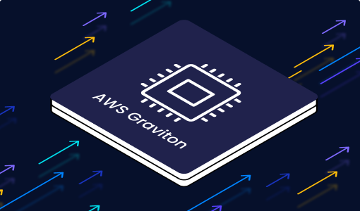
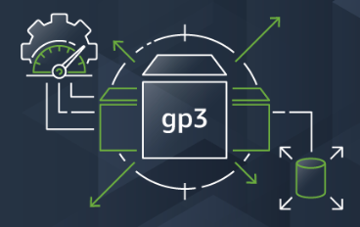
AWS Graviton3 and GP3
Background, Performance and Cost Benefits
July, 2022.
Olaf Reitmaier Veracierta

Slide 2
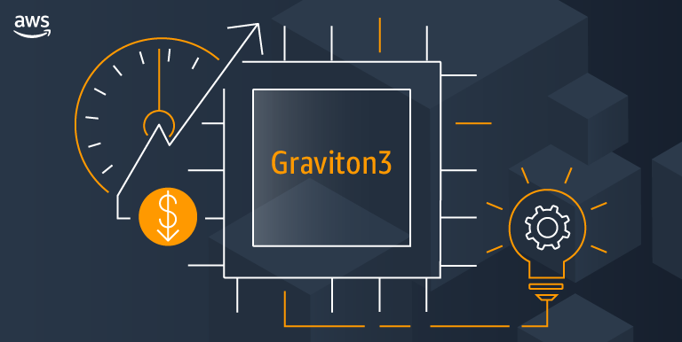

Slide 3
AWS Compute Architecture
AWS Nitro System: Compute (Hypervisor), Network, Storage and Security.
AWS Graviton: Silicon Chip for powerful and efficient modern applications.
AWS Inferentia: Silicon Chip for Machine Learning at Scale, requires Neuron (SDK) and embedded into AWS Deep Learning AMI (DLAMI).
Notes:
https://aws.amazon.com/ec2/nitro/
https://aws.amazon.com/ec2/graviton/
https://aws.amazon.com/machine-learning/inferentia/

Slide 4

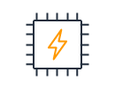


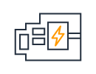

AWS Nitro Architecture (Ecosystem)
Nitro
Enclave
Nitro CPU
Nitro TPM
Nitro
Hypervisor
Nitro Cards
Nitro Storage
(EBS, NVMe, SSD)
Notes:
https://aws.amazon.com/ec2/nitro/

Slide 5
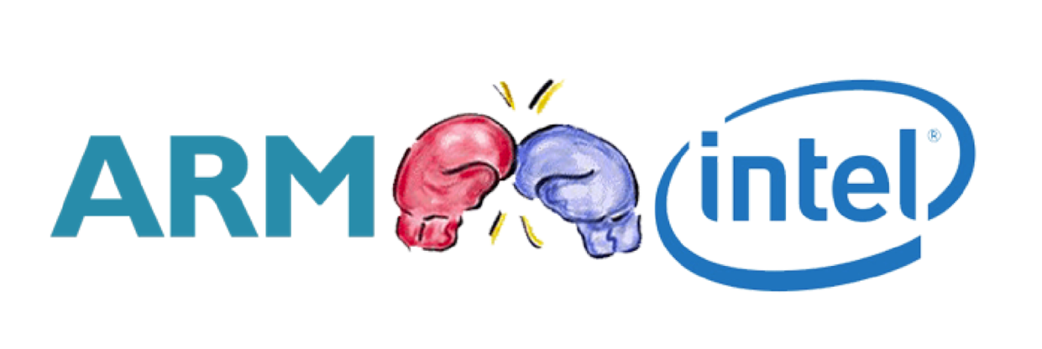
AWS Graviton | Architecture
Custom chip designed by AWS supported by ARM (v8 Compliant)
Project Drivers:
Intel / AMD TCO and ROI at scale (Support & Licensing).
CISC (Intel/AMD) hard vs. RISC (ARM) easy design-change:
More density of hardware per rack on data centers.
Performance, Machine learning and other tweaks.
Security (US Government and Military).
Annapurna Labs (Israeli) acquisition (2015).
Notes:
https://en.wikipedia.org/wiki/Annapurna_Labs

Slide 6
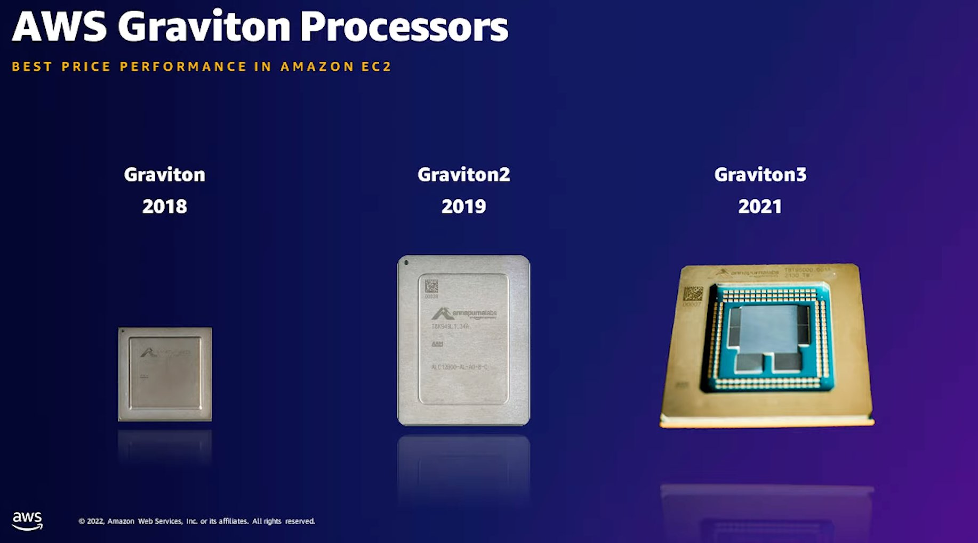

Slide 7
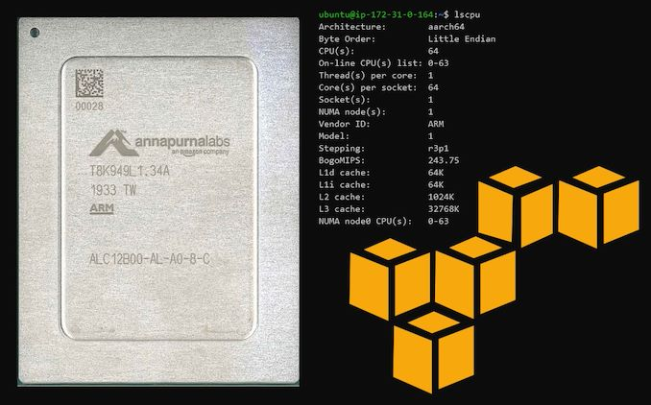
AWS Graviton | How to check?
Notes:
https://www.anandtech.com/show/15578/cloud-clash-amazon-graviton2-arm-against-intel-and-amd (Image)

Slide 8
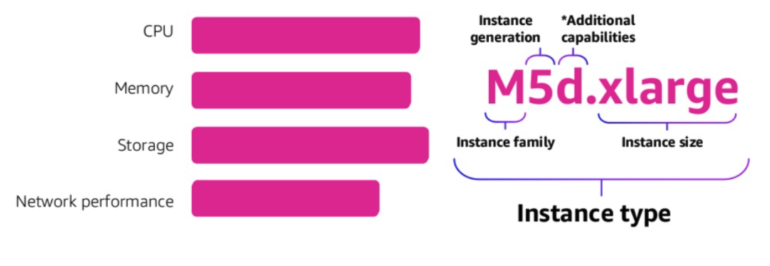
AWS EC2 Instance Characteristics
Family => M
Notes:
https://docs.google.com/presentation/d/1xgPXFcEusiSUcbw_4pqUJNKIhDyOfdvl3gBE7T1FVjk/edit#slide=id.ge00741205c_1_2

Slide 9
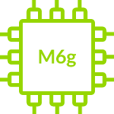
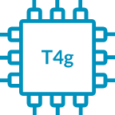

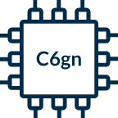

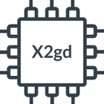
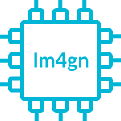
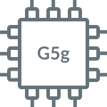
AWS Graviton | EC2 Instance Types
WW = Popular at Westwing
WW
WW
WW
M6g and M6gd (General Purpose)
T4g (Burstable General Purpose)
C6g and C6gd (Compute Optimized)
C6gn (C6 with Enhanced Networking)
WW
R6g and R6gd (Memory Optimized)
X2gd (Enhanced Memory)
Im4gn and Is4gen (Storage Optimized)
G5g (GPU Accelerated)
Notes:
https://www.arm.com/partners/aws

Slide 10
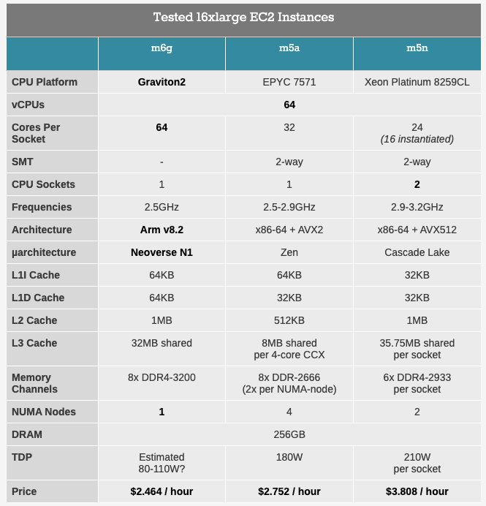
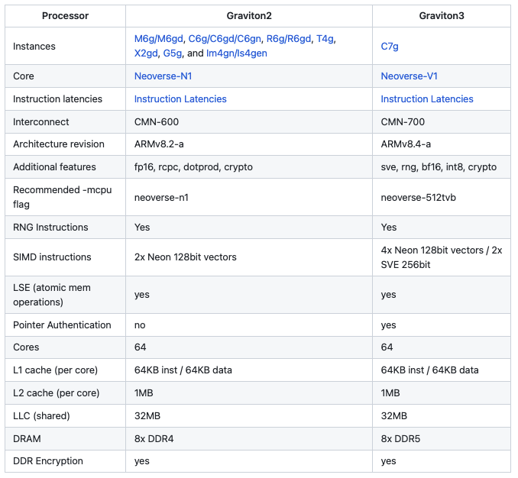
AWS Graviton | Processors
Design Decisions: ARM RISC 64 Bits, 64x Core, 1x NUMA, No SMT, DDR5, 1MB L2 Cache.
Notes:
https://www.anandtech.com/show/15578/cloud-clash-amazon-graviton2-arm-against-intel-and-amd
https://github.com/aws/aws-graviton-getting-started
https://en.wikipedia.org/wiki/Non-uniform_memory_access
https://en.wikipedia.org/wiki/Simultaneous_multithreading
https://www.elektronik-kompendium.de/sites/com/0309291.htm

Slide 11
AWS Graviton Advantages
“Highest performance” in their instance families.
20% lower cost vs. same-sized “comparable instances”.
Up to 40% better price/performance vs. “comparable instances”.
What are “comparable instances”?
Same Compute (vCPU / Memory Size)
Same Network (Type)
Same Storage (Type)
Same workload 😉 … between the lines … the small letters...
AWS on majority of AWS Managed Services “without major tweaks”.
AWS Lambda: You can select to run on Graviton.
Notes:
https://www.densify.com/articles/aws-graviton

Slide 12
AWS Graviton Caveats (1 of 2)
Portability: architecture must be arm64 specific (kernel, libraries, binary).
CloudFormation: Don't hardcode AMI IDs, use AWS Parameter Store.
C/C++: Recompiled, ASM / Intrinsics / AVX Ported (sse2neon), Large-System Extension (LSE) for atomic operations, ML ARM dot-product instructions and half-precision floating-point (float16).
Java: Use Amazon Coretto (flavor of OpenJDK). Some x86-64 ELF Jar must be replaced.
Python: pip pulls packages from PPI some are C/C++ and they are not pre-compiled, so installation (build) can take up to then 10 minutes.
.NET Core: Migration from .NET to .NET core needed.
NodeJS/Ruby: ensure arm64 packages.
Notes:
AWS re:Invent 2020: Deep dive on AWS Graviton2 processor-powered EC2 instances https://www.youtube.com/watch?v=NLysl0QvqXU

Slide 13
AWS Graviton Caveats (2 of 2)
Go: > 1.16, env GOOS=linux and GOARCH=arm64.
PHP: >7.4 (good) > 8 (best), ensure arm64 packages.
HAProxy: compile with CPU=armv81
MySQL: prefer 8.0.23+.
zlib: use zlib-cloudflare instead.
Operating Systems: Amazon Linux 2.26-35 and others (but…).
Kubernetes / Docker: Well, again Kernel, Library, Binaries, …
Read Transition to Graviton for more fun (bugs) with (on) AWS.
Notes:
https://github.com/aws/aws-graviton-getting-started
https://github.com/aws/aws-graviton-getting-started/blob/main/os.md
AWS re:Invent 2020: Deep dive on AWS Graviton2 processor-powered EC2 instances https://www.youtube.com/watch?v=NLysl0QvqXU
https://www.arm.com/-/media/Files/pdf/white-paper/guidelines-for-deploying-nginx-plus-on-aws.pdf
https://www.percona.com/blog/comparing-graviton-performance-to-arm-and-intel-for-mysql
https://www.percona.com/blog/comparing-graviton-arm-performance-to-intel-and-amd-for-mysql-part-2/

Slide 14
AWS Graviton Performance
Your workload can have worst performance on Graviton, due to:
The changes you need to make in under to run under Graviton.
The changes others need to make in under to support you under Graviton.
Trust no one / no online article, I found a lot were wrong or too biased.
Test and prove by yourself your stuff, there is no other way, if you hit a bug you will be hitting it hard as majority of people is on Intel / AMD not ARM.
Run the AWS Graviton Performance Runbook a kind summary to profiling.
Notes:
https://github.com/aws/aws-graviton-getting-started/blob/main/perfrunbook/graviton_perfrunbook.md
https://awsgraviton.devpost.com/project-gallery

Slide 15
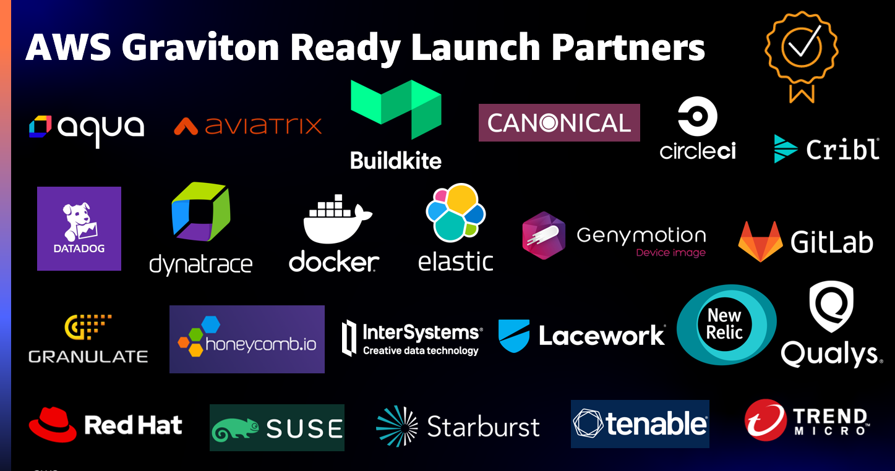
AWS Graviton Ready Program
Notes:
https://aws.amazon.com/blogs/apn/introducing-the-aws-graviton-ready-program-for-graviton-enabled-software-products/

Slide 16
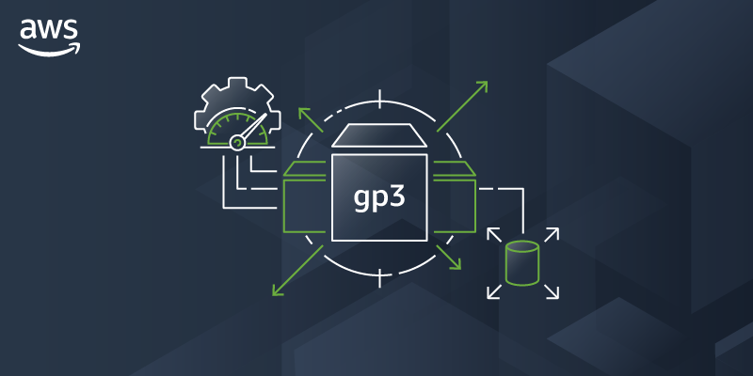

Slide 17
AWS EBS
AWS EBS Volumes Types:
General Purpose SSD (gp2/gp3): most workloads.
Provisioned IOPS SSD (io2/io3): mission-critical, low-latency, or high-throughput workloads
Throughput Optimized HDD (st1): low-cost, frequently accessed, throughput-intensive workloads.
Cold HDD (sc1): lowest-cost, less frequently accessed workloads.
Remember basic concepts:
IOPS: maximum number of IO requests the volume can serve per second (read/write).
Throughput: maximum amount of data that can be read/written per second (bytes).
Notes:
https://docs.aws.amazon.com/AWSEC2/latest/UserGuide/ebs-volume-types.html

Slide 18
AWS GP2 vs. GP3
Storage Volume Size: 1 GiB - 16 TiB
👎 Deal Breaker
👍 Game Changer
GP2 (per Volume):
Range of IOPS 100 to 16k IOPS.
Range of Throughput 128-250 MiB/s.
No control on the IOPS and throughput, they depend on the volume size. To get higher performance you have to use a bigger volume size.
GP3 (per Volume):
Range of IOPS 3k (free of charge) to 16k IOPS.
Range of Throughput 125 MiB - 1000 MiB/s.
Control on the IOPS and throughput independently. However, the volume size, IOPS and throughput still impact each other.
Max. throughput = (max. IOPs) x (avg. IO size).
Max. IOPs = (500) x (provisioned GiB).
e.g. <= 32 GiB volumes can't reach the 16K IOPS limit.
Read: https://aws.amazon.com/blogs/storage/migrate-your-amazon-ebs-volumes-from-gp2-to-gp3-and-save-up-to-20-on-costs/
https://aws.amazon.com/blogs/containers/migrating-amazon-eks-clusters-from-gp2-to-gp3-ebs-volumes/
Notes:
https://aws.amazon.com/blogs/storage/migrate-your-amazon-ebs-volumes-from-gp2-to-gp3-and-save-up-to-20-on-costs/
https://aws.amazon.com/blogs/containers/migrating-amazon-eks-clusters-from-gp2-to-gp3-ebs-volumes/
https://ahmedahamid.com/which-is-better/

Slide 19
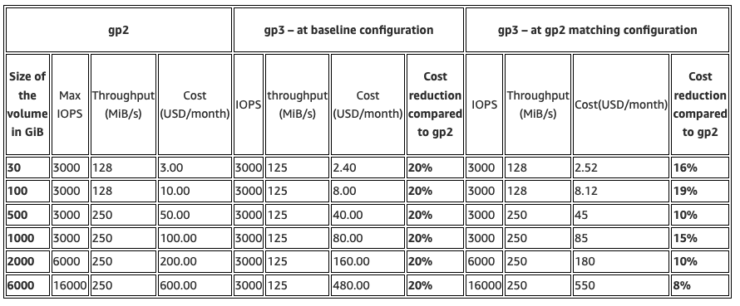
AWS GP2 vs. GP3 | Cost Savings
Tweaking could mean you save less!
Notes:
https://aws.amazon.com/blogs/storage/migrate-your-amazon-ebs-volumes-from-gp2-to-gp3-and-save-up-to-20-on-costs/

