Slide 1
Multimedia
Streaming Architecture
Noviembre, 2016

Slide 2
Audio & Video Delivery
Time:
The question is: ¿Live or not live? «Vivo»
Media:
From: Analog (e.g. Air)
To: Digital (e.g. Internet)
Authoring: Copyleft/Copyright
Protecting: Encrypted or at least secured

Slide 3
A&V Digital Processing
Hardware & Software:
Open vs. Propietary
Encoding:
Audio / Video (Capture/Record)
Analog/Digital (Compression / Lossless / Lossy)
Transcode:
Analog <-> Digital (Format)
Hardware / CPU / GCPU
Transmuxe:
Digital A&V Format Conversion (a.k.a Transcode)
Stream (Digital *Cast):
Server / Client (Playback).
Live Stream => Live (Re)Streaming (LS)
Recorded File => Video On Demand (VOD)

Slide 4
Digital Streaming Technologies

Slide 5
Streaming Technologies
BENEFIT | LIVE STREAMING | PSEUDO STREAMING | PROGRESSIVE DOWNLOAD
Real-time broadcasts | X
Long clips | X | X
Immediate random access to different parts of a movie | X | X
Downloads entire movie |  |  | X
Downloads required part of the movie |  | X
Flv is cached on the local system |  |  | X
Requires a specialized streaming server | X
Requires a web server with php |  | X
Can be stopped by firewalls | X
Consistent high quality playback at any connection speed |  | X | X
Retransmits lost packets |  | X | X
Notes:
http://www.corphealthsys.com/flv/source/documentation/streaming.html

Slide 6
Streaming Technologies
SCENARIO | LIVE STREAMING | PSEUDO STREAMING | PROGRESSIVE DOWNLOAD
Live broadcasts | X
Webtv | X | X
E learning | X | X
Online rich Media presentation | X | X
Movie trailers |  | X | X
Short product training clip |  | X | X
Offline product (cd, dvd) |  |  | X
Notes:
http://www.corphealthsys.com/flv/source/documentation/streaming.html

Slide 7
Streaming Protocols
Internet Based (IP):
UDP (Not Connection Oriented / Datagram)
Real Time Streaming Protocol (RTSP) is a network control protocol designed by RealNetworks (1996) for use in entertainment and communications systems to establishing and controlling media sessions between end points
TCP (Connection Oriented / Packet)
RTMP (Real Time Messaging Protocol) created by Macromedia (Adobe) for Internet stream of Flash Video (FLV ~ H.263 + MP3). Released for public use in 2005
Web Real Time Communication (WebRTC) new project for native zero install any browser open and free video streaming standart for Internet, started in 2011. Supported by all major browsers Chrome, Firefox, Opera, Android & iOS
Others:
MPEG-2 Transport Stream (MPEG-TS) is a standard digital container format for transmission and storage of audio, video, and Program and System Information Protocol (PSIP) data.[3] It is used in broadcast systems such as Digital Video Broadcasting (DVB), ATSC and IPTV
Notes:
https://developer.mozilla.org/es/docs/Web/HTML/Formatos_admitidos_de_audio_y_video_en_html5

Slide 8
Streaming Protocols
Web Based (HTTP):
Progressive Download (Pseudostreaming): web server based method for seek and buffering, Apache/Lighthttpd (mod_[h264|flvx]), Nginx (http_[mp4|flvx]_module, Nimble Streamer and many others).
HTML 5: Most of browsers are comming to support open & standart «video audio» combos: WAVE PCM, MP4 H.264 (AAC o MP3), WebM, Ogg Theora Vorbis, Ogg Opus.
HTTP Live Streaming (HLS) created by Apple for streaming audio to its iPhone, iPad, Mac, Apple TV devices (also PC) since 2009.
Apple VOD formats takes video file from MPEG-4 / QuickTime MOV to H.264 Compression and audio files to AAC or MP3 compression.
Apple LS formats uses MPEG-2 transport streams carrying H.264 video, AAC or MP3 audio.
Dynamic Adaptive Streaming over HTTP (mpeg-DASH) developed by MPEG (Moving Picture Expert Group) is the ISO/IEC 23009-1:2012[14[ since April 2012.
Notes:
https://developer.mozilla.org/es/docs/Web/HTML/Formatos_admitidos_de_audio_y_video_en_html5

Slide 9
Streaming Protocols
Web Based (HTTP):
HTTP Dynamic Streaming (HDS): created by Adobe as part of Flash (>=10.1) using MP4 Fragment Format (ISO/IEC 14496-12:2008) that allows fetch smaller portions of media than HLS. Allows DRM on live or VOD. Improve RTMP Dynamic Streaming (Flash >=6) and HTTP Progresive Download (Flash >=7) from Adobe.
Microsoft Smooth Streaming (MSS): is a pseudo-streaming implementation introduced in 2008 by Microsoft as part of their Silverlight architecture. Microsoft and Akamai works on «www.smoothHD.com».
Notes:
https://developer.mozilla.org/es/docs/Web/HTML/Formatos_admitidos_de_audio_y_video_en_html5

Slide 10
Streaming Protocols
Web Based (HTTP):
SHOUTcast cross-platform proprietary freeware for streaming media (audio/MP3) over the Internet developed by Nullsoft but owned by AOL.
IceCast: cross-platform free software (GPLv2) mantained by the Xiph.Org (www.icecast.org) for streaming the following streams: Ogg (Vorbis, Speex, Flac, Theora), Opus, WebM and MP3.
Notes:
https://en.wikipedia.org/wiki/SHOUTcast
https://es.wikipedia.org/wiki/Icecast

Slide 11
Audio & Video Formats
They can’t be written neither this slide nor this document…
Notes:
https://developer.mozilla.org/es/docs/Web/HTML/Formatos_admitidos_de_audio_y_video_en_html5

Slide 12
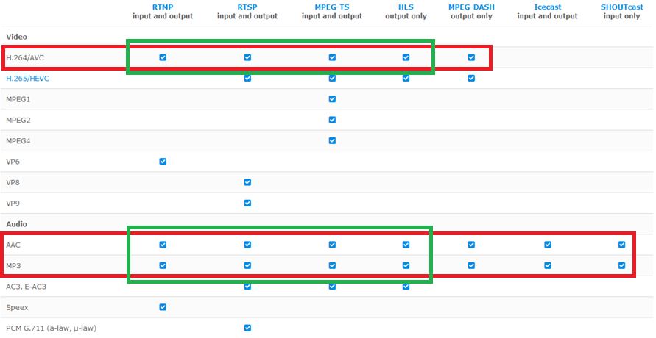
Formats versus Protocols
H.264 + AAC
Notes:
The Definitive Guide to HLS (Optimized Delivery to Every Device)
https://www.encoding.com/http-live-streaming-hls/
Understanding streaming protocols and output file formats
https://www.wowza.com/forums/content.php?621-Understanding-streaming-protocols-and-output-file-formats

Slide 13
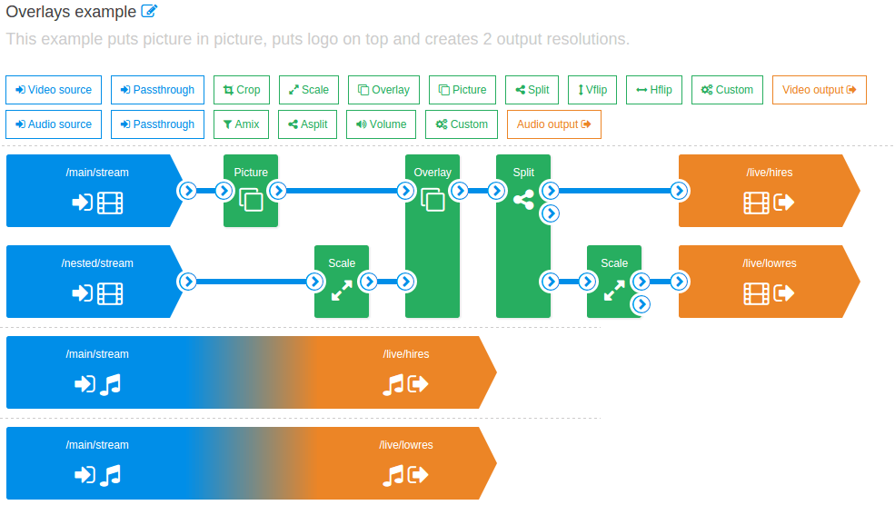
Live Transcoder
Not for free
Stream (Live) != File
Notes:
https://wmspanel.com/nimble

Slide 14
Digital Streaming Architectures

Slide 15
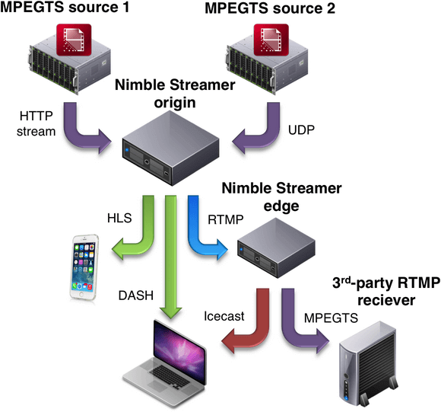
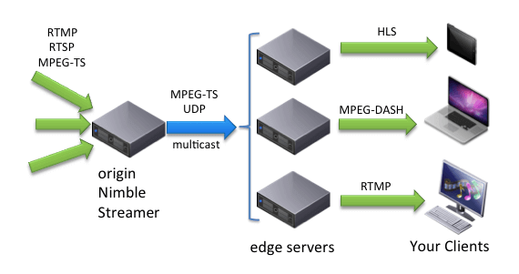
Live Streaming (Transmuxing)
Notes:
https://wmspanel.com/nimble

Slide 16
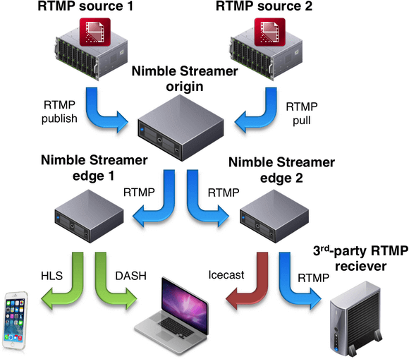
Live Streaming (RTMP)
Re-streaming
Notes:
https://wmspanel.com/nimble

Slide 17
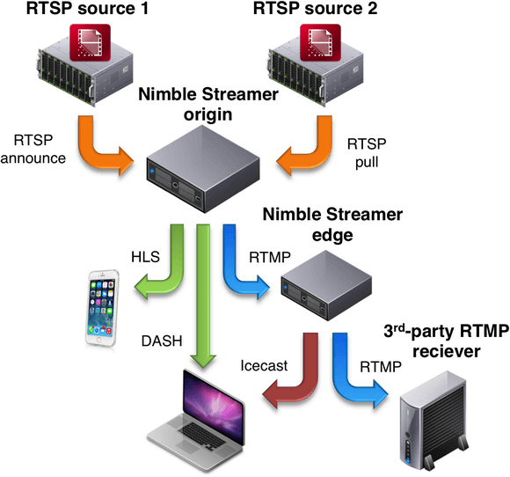
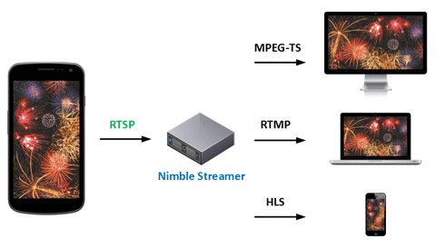
Live Streaming (RTSP)
Notes:
https://wmspanel.com/nimble

Slide 18
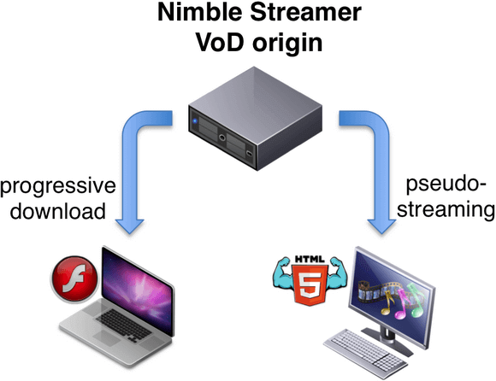
Pseudo Streaming
Buffered
Current Playing
Lineal Download
FTP or HTTP
Keyframes
Play Back & Forward
Range Download
Only HTTP
File formats: mp3, mp4, flv, oga, ogv, wav, webm, mkv
Optimization: flash time marks seek, HTTP range header
Packet loss retransmission: which is not available on live streaming
Notes:
https://wmspanel.com/nimble
https://en.wikipedia.org/wiki/Progressive_download
http://flash.flowplayer.org/plugins/streaming/pseudostreaming.html

Slide 19
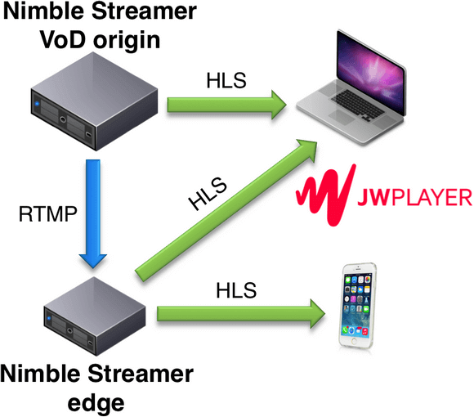
Video On Demand (VOD)
Notes:
https://wmspanel.com/nimble

Slide 20
HTTP Live Streaming (HLS)

Slide 21
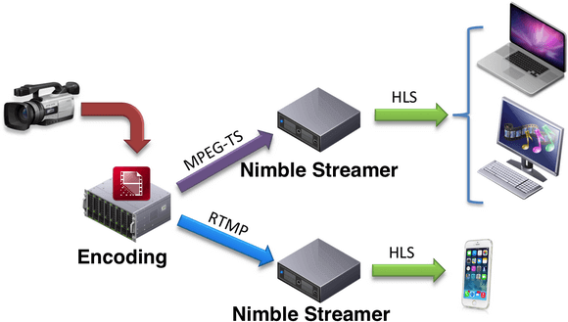
Live Streaming (HLS)
Notes:
https://wmspanel.com/nimble

Slide 22
HLS Benefits & Tips
HLS is not A&V is only the delivery way
Supports (client-driven) adaptive bitrate
Better experience:
No “partial play”
No “Complete download”
Delivered over standard HTTP, so zero firewall blocking policies.
Developer and devices easy integration with simple, text-based manifest format.
No proprietary streaming servers required, so more people streaming & playing back.
Notes:
The Definitive Guide to HLS (Optimized Delivery to Every Device)
https://www.encoding.com/http-live-streaming-hls/
Understanding streaming protocols and output file formats
https://www.wowza.com/forums/content.php?621-Understanding-streaming-protocols-and-output-file-formats

Slide 23
HLS Benefits & Tips
User are dropping major vendors with proprietary standards (i.e. Flash).
Major browsers no longer support plugins (zero install, plug & play, security, licensing).
HLS video is now supported on multicast (RAMP Multicast Engine Startup).
Notes:
The Definitive Guide to HLS (Optimized Delivery to Every Device)
https://www.encoding.com/http-live-streaming-hls/
Understanding streaming protocols and output file formats
https://www.wowza.com/forums/content.php?621-Understanding-streaming-protocols-and-output-file-formats

Slide 24


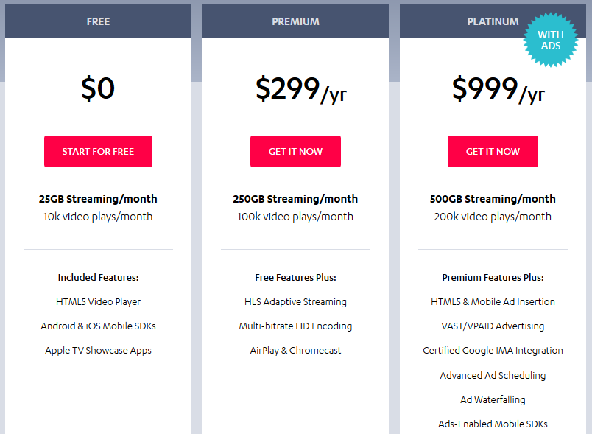

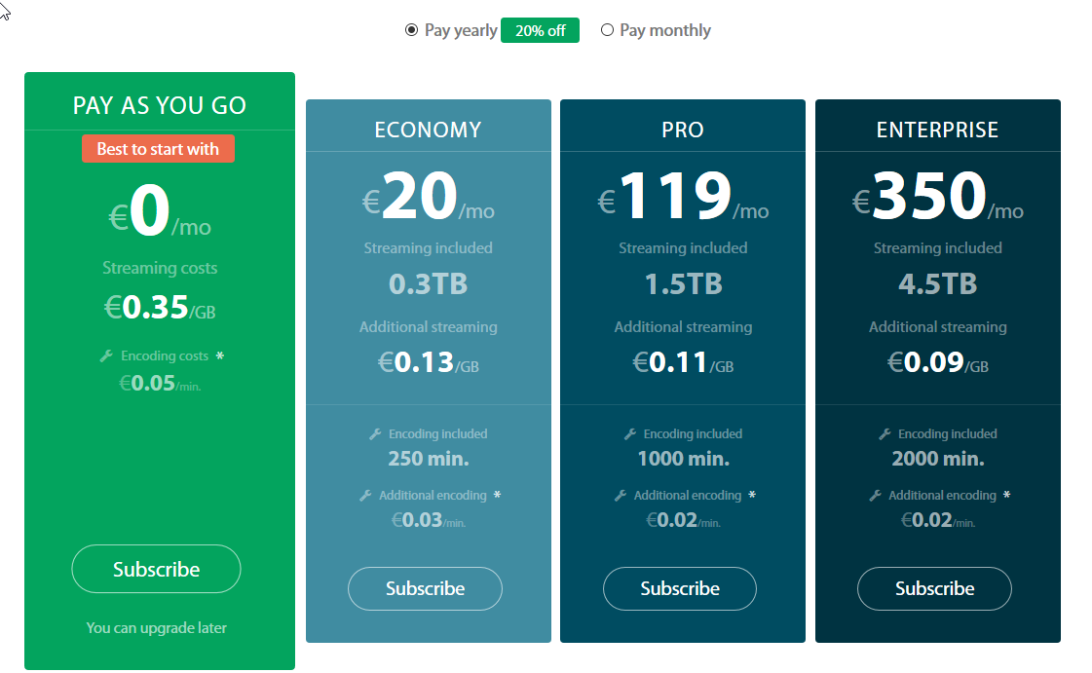
HLS Playback Device Support
Free
Plays (Clics)
Streams (Data)
Notes:
https://www.jwplayer.com/pricing/

Slide 25
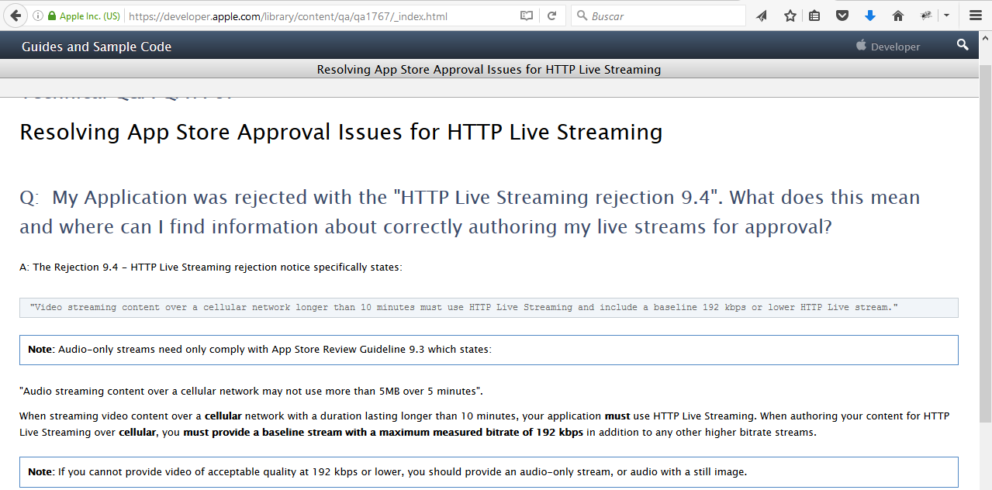

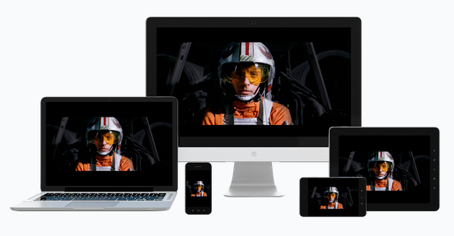
HLS Playback Device Support
5 Minutes App Store Limit
Notes:
Resolving App Store Approval Issues for HTTP Live Streaming
https://developer.apple.com/library/content/qa/qa1767/_index.html

Slide 26
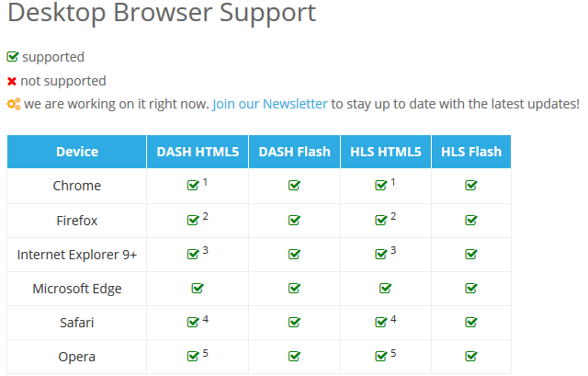
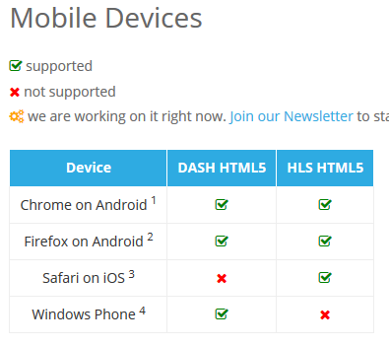

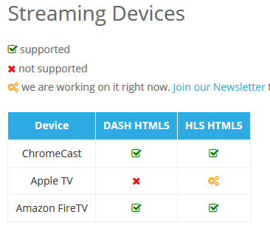
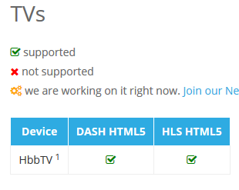
HLS Playback Device Support
Notes:
https://bitmovin.com/player-documentation/player-device-browser-format-support/

Slide 27
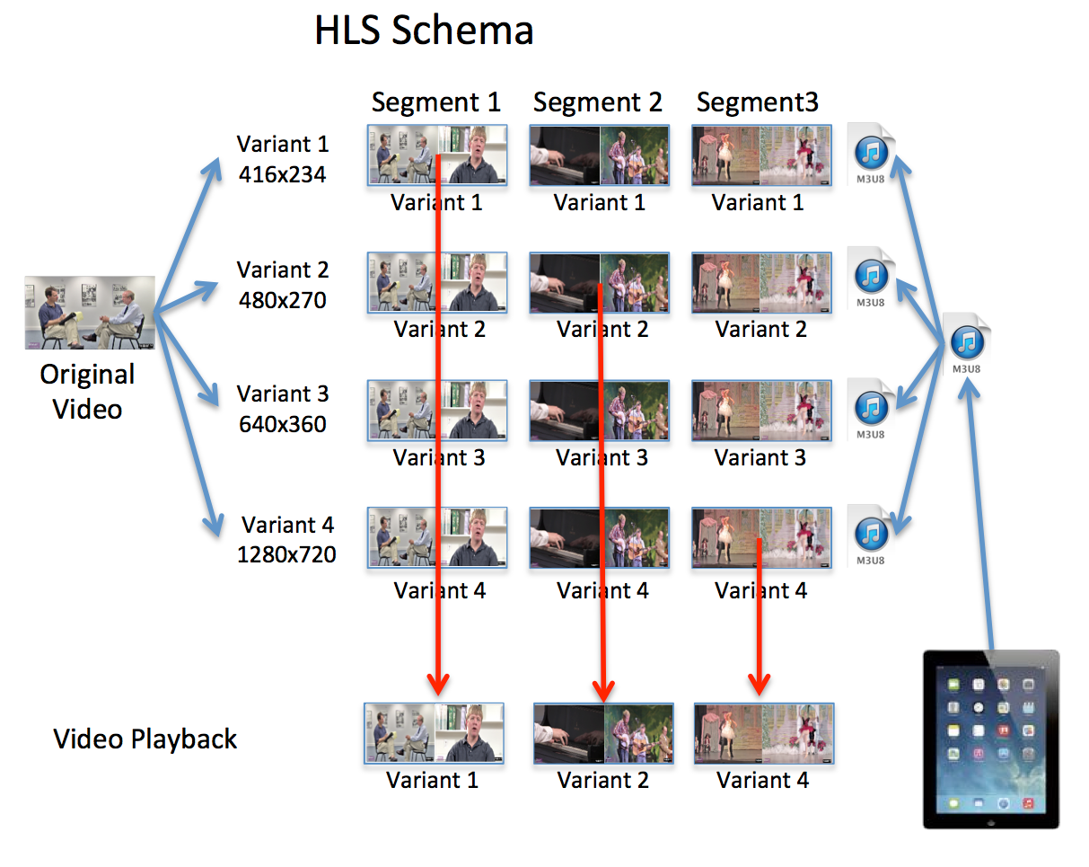
HLS Playback Device Bitrates
Adaptative Bitrate -> Simultaneous Multiple Bitrates (Variants)
Notes:
The Definitive Guide to HLS (Optimized Delivery to Every Device)
https://www.encoding.com/http-live-streaming-hls/
Best Practices for Creating and Deploying HTTP Live Streaming Media for Apple Devices
https://developer.apple.com/library/content/technotes/tn2224/_index.html

Slide 28
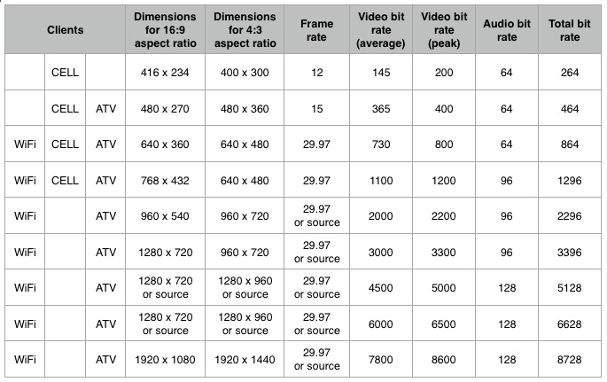
HLS Playback Device Bitrates
Notes:
The Definitive Guide to HLS (Optimized Delivery to Every Device)
https://www.encoding.com/http-live-streaming-hls/

Slide 29
Digital Streaming Architectures (Amazon Web Services)

Slide 30

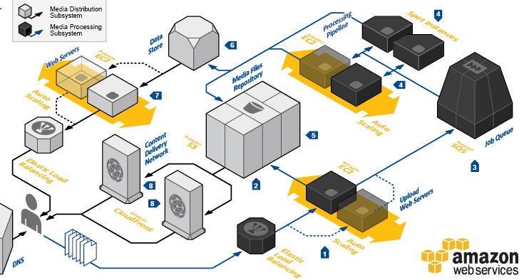
Media Sharing Architecture
Bandwidth vs. Stream Transfer
Security
Compute (Encoding?)
Storage

Slide 31
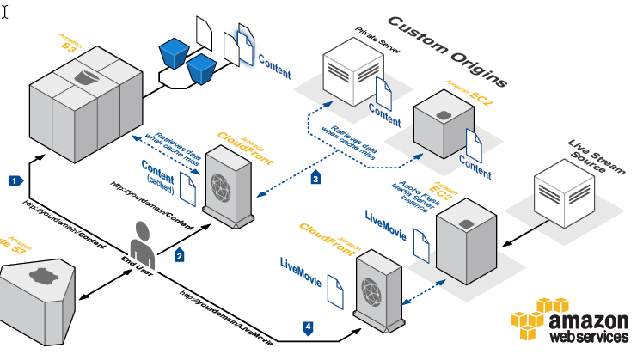

Media Serving Architecture
Bandwidth vs. Stream Transfer
Security
Compute (Encoding?)
Storage

Slide 32
Don’t Forget Security
Hot-linking protection.
Re-streaming protection.
Domain locking geo-location and IP-based.
Digital Right Management / DRM (Google Wildevine, Microsoft Playready, Adobe Flash Access, Apple Fairplay).

Slide 33
Streaming Solutions
Services (Content Delivery Network / CDN)
Akamai, Amazon Web Services (Elastic Transcoder / CloudFront), Azure Media Services, bitmovin, Ustream, Limelight Network, Tata Communications, Brightcove Zencoder, encoding.com, Altitude Multicast+, smoothHD.com
Servers (Streaming Server / SS)
Adobe Media Server, Apache, Elemental Technologies, Helix Universal Server, Darwin SS, Nginx, Nimble Streamer, Red5, Unified Origin, Unreal Media Server, Microsoft IIS w/Smooth Streaming Extension, Wowza Streaming Engine
Notes:
https://en.wikipedia.org/wiki/Flash_Video
https://en.wikipedia.org/wiki/Real-Time_Messaging_Protocol
https://en.wikipedia.org/wiki/HTTP_Live_Streaming
https://en.wikipedia.org/wiki/Dynamic_Adaptive_Streaming_over_HTTP
http://ramp.com/insights/three-things-you-didnt-know-about-multicast-streaming/
https://www.iis.net/downloads/microsoft/smooth-streaming

Slide 34
Contactos
olafrv@gmail.com
www.olafrv.com
@olafrv

