Slide 1


MySQL HA Solutions

Slide 2
MySQL Replication
MySQL Replication w/Linux HA
MySQL Replication w/Galera
MySQL Cluster

Slide 3
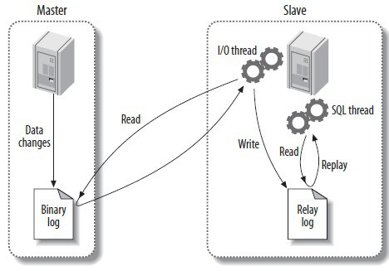
MySQL Replication M-S
Unidirectional
Notes:
http://linoxide.com/how-tos/configure-mariadb-replication-centos-linux/
https://avisheksharma.wordpress.com/2015/01/07/step-wise-guide-to-setup-mysql-replication/

Slide 4
MySQL Replication M-M
Notes:
http://linoxide.com/how-tos/configure-mariadb-replication-centos-linux/
https://avisheksharma.wordpress.com/2015/01/07/step-wise-guide-to-setup-mysql-replication/

Slide 5
MySQL Replication M-M
It is not a cluster is just a replication
(e.g. INSERT / DELETE)
Notes:
http://linoxide.com/how-tos/configure-mariadb-replication-centos-linux/
https://avisheksharma.wordpress.com/2015/01/07/step-wise-guide-to-setup-mysql-replication/

Slide 6
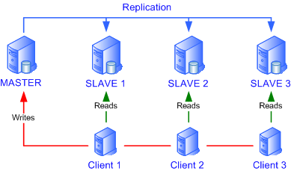
MySQL Replication M-S
Notes:
http://www.netexpertise.eu/en/mysql/mysql-replication.html

Slide 7
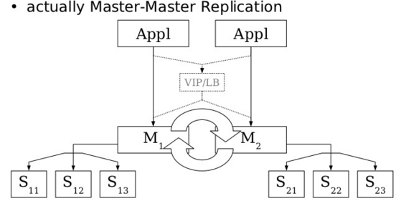
MySQL Replication M-M
Notes:
http://es.slideshare.net/shinguz/ad-presentation-11465655?related=1 (Pág. 11)
https://www.digitalocean.com/community/tutorials/how-to-set-up-mysql-master-master-replication

Slide 8
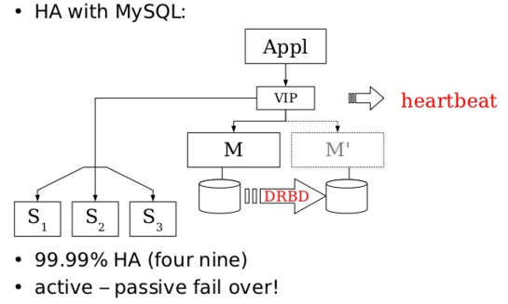
MySQL Replication & Linux HA
Notes:
http://es.slideshare.net/shinguz/ad-presentation-11465655?related=1 (Pág. 10)

Slide 9
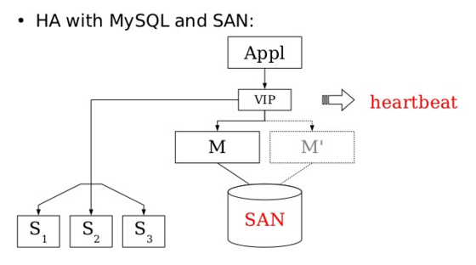
MySQL Replication & Linux HA
Notes:
http://es.slideshare.net/shinguz/ad-presentation-11465655?related=1 (Pág. 11)

Slide 10
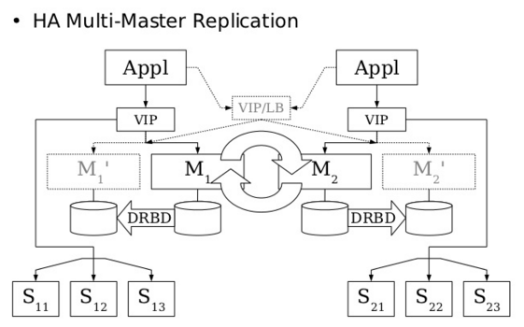
MySQL Replication & Linux HA
Notes:
http://es.slideshare.net/shinguz/ad-presentation-11465655?related=1 (Pág. 13)

Slide 11
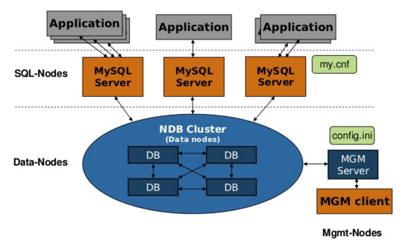
MySQL Cluster
Notes:
http://es.slideshare.net/shinguz/ad-presentation-11465655?related=1 (Pág. 17)

Slide 12
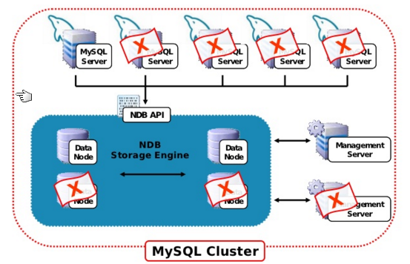
MySQL Cluster
Notes:
http://es.slideshare.net/shinguz/ad-presentation-11465655?related=1 (Pág. 18)

Slide 13
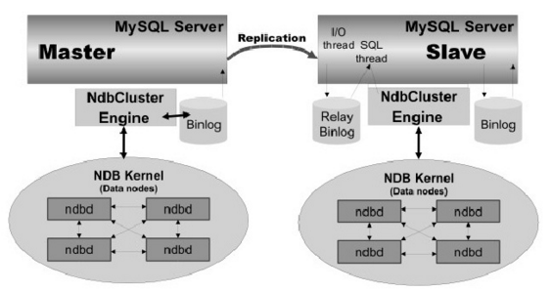
MySQL Cluster
Replication of Clusters
Notes:
http://es.slideshare.net/Wagnerbianchi/mysql-cluster-basics (Pág. 58)

Slide 14

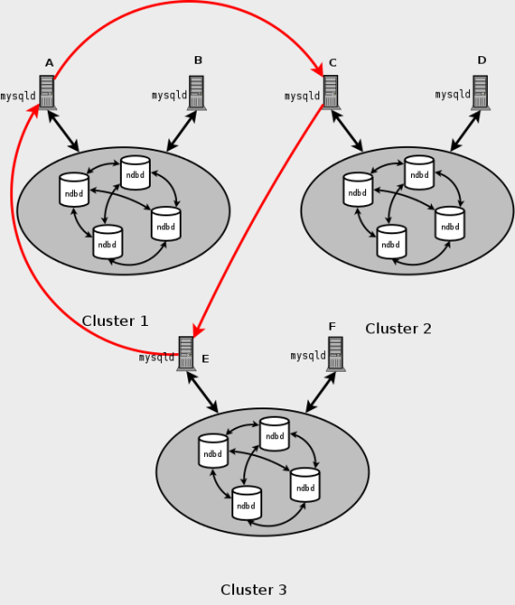
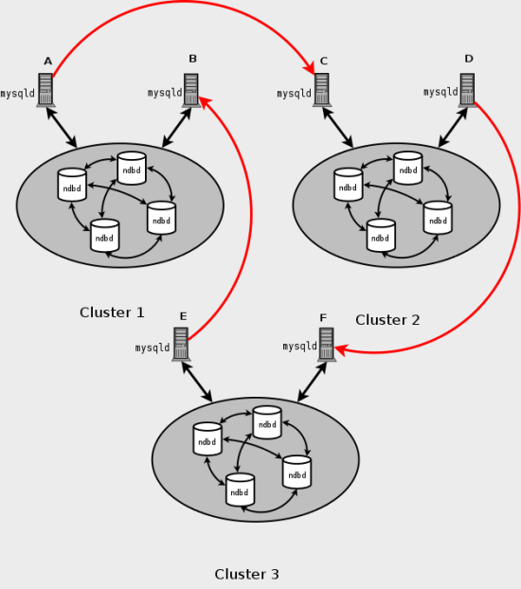
MySQL Cluster
Circular Replication of Clusters
Notes:
http://es.slideshare.net/shinguz/ad-presentation-11465655?related=1 (Pág. 18)

Slide 15
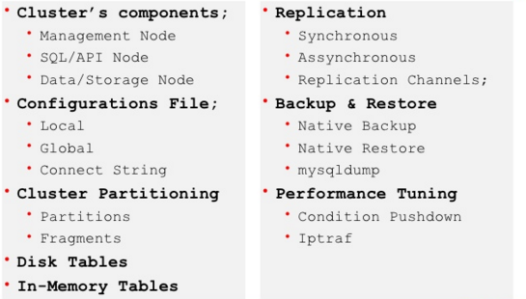
MySQL Cluster
Notes:
http://es.slideshare.net/Wagnerbianchi/mysql-cluster-basics (Pág. 25)

