Slide 1
Managed Cloud Services
Olaf Reitmaier
olafrv@gmail.com
November, 2018

Slide 2
Digital Age Enterprise Needs
Transformación Digital
Agotamiento
Estancamiento
Ictus exponencial
Reinvención
Sortear el impacto de las tendencias digitales y la competencia en el negocio
Negocio
Experiencia del Usuario
Sensación & Motivación
Captación & Retención
Interacción (Canales)
Usuario
/ Cliente
Estudiar y evaluar la experiencia del usuario final a beneficio del negocio
Optimización de Servicios
Justificación CAPEX / OPEX
Tercerización & Alianzas
Regulatorio & Legal
Entorno de TI
Optimizar los modelos de finanzas, operación y servicio del negocio
Continuidad Operativa
Aplicaciones, sistemas y servicios críticos
Monitoreo & Visibilidad
Sitio principal y alterno
Plataforma de TI
Garantizar la continuidad y recuperabilidad de las plataformas que soportan el negocio
Capacidad y Desempeño
Internet y redes privadas
Servidores, aplicaciones y bases de datos
Recursos humanos asociados a TI
Infraestructura de TI
Construir la infraestructura necesaria para soportar el negocio actual y futuro

Slide 3
Digital Age TI Maturity
Propiedad
Arquitectura
Servicio
Tiempo
Tercero
Nube
Hibrida
PaaS
SaaS
Potenciar el Negocio
Negocio
Usuario
/ Cliente
Incidentes y Problemas en
Aplicaciones, Sistemas, Servicios,
Usuarios
Nube
Privada
/ Publica
PaaS
IaaS
Entorno de TI
Propia
IaaS
PaaS
Plataforma de TI
Incidentes y Problemas de
Plataforma
Servidores
Infraestructura de TI
IaaS
Incidentes y Problemas de
Infraestructura

Slide 4

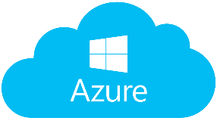
Cloud Service Providers (CSP)
¿Titans?

Slide 5
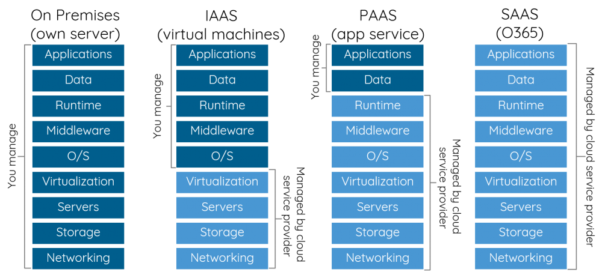
Cloud Services Models

Slide 6
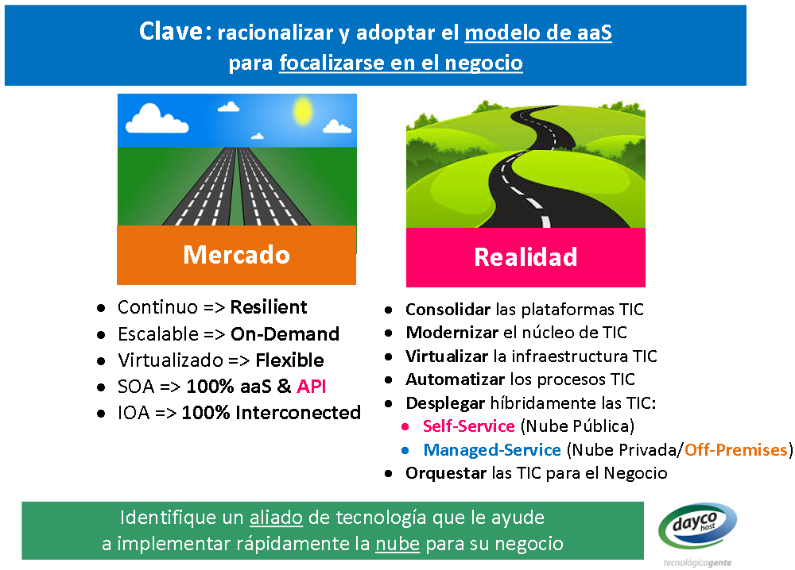
Cloud Services Problems (CSP)?
2014…
…2018

Slide 7
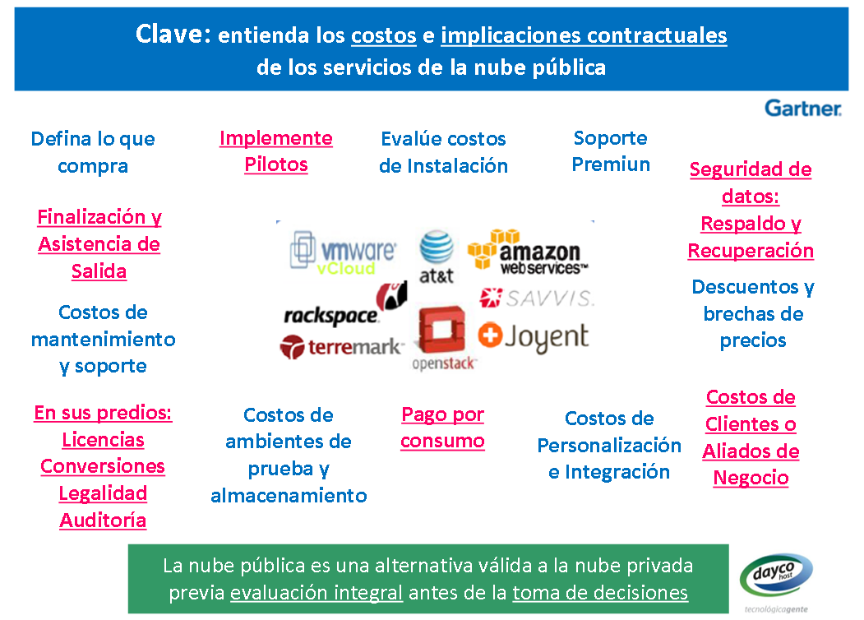
Cloud Services Problems (CSP)?
2014…
…2018

Slide 8

Cloud Services Problems (CSP)?
IaaS
Low Value
SysOps
PaaS
DevOps
SaaS
High Value
CloudArch

Slide 9
Cloud Services Problems (CSP)?
Lack of:
Knowledge & Expertice
Time to Try & Learn The Cloud
Real Cloud Enabled & Native TI (Legacy)
Value Proposition Understanding
Multi-Cloud Connetivity & Integration
Cloud still has TI complexity (Hundred of New Features Every Year)
Missing Real Value Seeding & Harvesting!
2018…
¿Dónde están los humanos?

Slide 10
Cloud Services vs. Real Users
CloudArch:
Architects, Managers, Financials (Billing).
DevOps:
Developers
SysOps:
Systems Administrators & Operators.

Slide 11
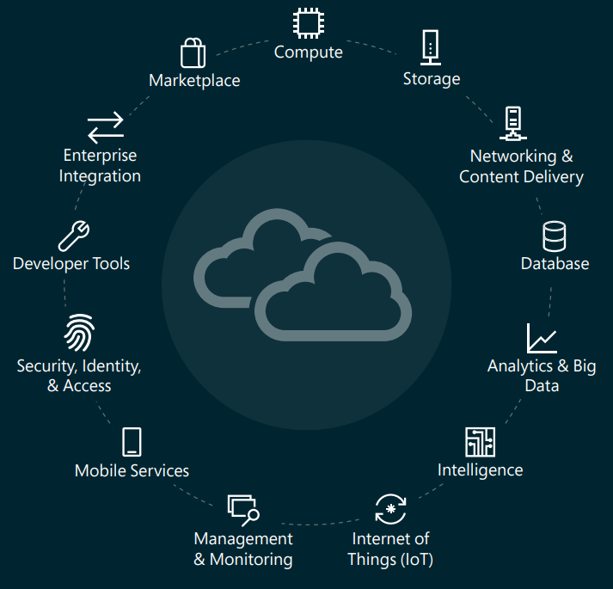

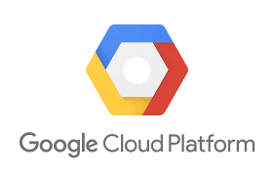
Cloud Service Map (Common)
Certified Software
for the Cloud
(Images)
{ Bring Your Own License }

Slide 12
Cloud Managed Services
Flavors:
Standard
Special Projects
Advisory
Scope (Standard):
User Guide (What)
Specifications (How)
Term & Conditions (Why)

Slide 13
Cloud Managed Services (Standard)
CloudArch:
Design, Sizing, Orchestation, Assesment.
SysOps:
Systems Administration, Migrations, Life Cycle.
DevOps:
Applications Development, Build, Deployment.

Slide 14
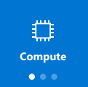

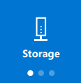
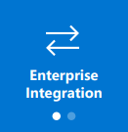
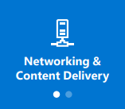
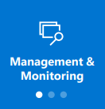
Cloud Managed Services (Standard)
AWS Elastic Computing
Azure Virtual Machines
AWS Elastic Computing
Azure Virtual Machines
AWS Elastic Block Storage
Azure Disk storage
AWS Identity and Access Mgmt.
Azure Active Directory aaS
AWS CloudWatch
Azure Monitor
AWS Virtual Private Cloud
AWS VPN Gateway
AWS DirectConnect
AWS Route 53
AWS WAF / Shield
Azure Virtual Network
Azure VPN Gateway
Azure ExpressRoute
Azure DNS
Azure WAF

Slide 15
Cloud Managed Services (Special Projects)
CloudArch:
Design, Sizing, Orchestation, Assesment.
SysOps:
Systems Administration, Migrations, Life Cycle.
DevOps:
Applications Development, Build, Deployment.

Slide 16
Cloud Managed Services (Advisory)
Cloud Team
AWS Trusted Advisor
Azure Advisor
Trusted Advisory Services
Capacity Planning
Capacity Optimization
Services Health
Security Compliant
Action Plans

Slide 17

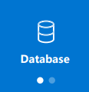
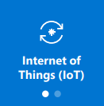
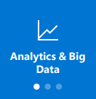
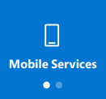
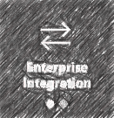


Cloud Managed Services (Special Projects)
Process Logic
Database aaS
Developer Tools
Analytics & Big Data
Internet of Things (IoT)
Mobile Services (AppDev)
Artificial Intelligence (I.A)
AWS Lambda
AWS Functions
AWS/Azure Messaging

Slide 18
Cloud Team
Operation Team
Bussiness Team
Service Team
Cloud Team
SaaS
CloudArch
SysOps
DevOps
PaaS
ManPower
IaaS
Insourcing
Outsourcing
Cloud Ecosystem

Slide 19







Anywhere, Anytime…
Principal
Backup
Internet
Edge
Edge
Perimetral
Security
Perimetral
Security
Agr./Dist.
DCI
Agr./Dist.
Specific
Security
Specific
Security
Access
Access
Users
Users

Slide 20
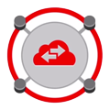

Anywhere, Anytime…
Local
Mega-Clouds
Edge
Internet
Edge
Perimetral
Security
Agr./Dist.
Agr./Dist.
DCI
Specific
Security
Access
Access
Multi-Cloud
Connection
Users
Users
Users

