Slide 1
On-Premise Private Cloud Archicture
Olaf Reitmaier
November 2018
olafr@gmail.com

Slide 2

Agenda
Portafolio & Services
Architecture Integration
Solutions Delivery Approach

Slide 3
Agenda
Portafolio & Services
Architecture Integration
Solutions Delivery Approach

Slide 4


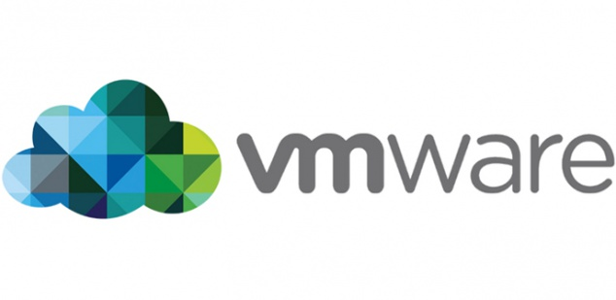






Portfolio & Services
HW/SW Infrastructure Provisioning (Boxed)
Compute
Network (Implicit)
Storage
Backup / Disaster Recovery
Brandend / Certified Solutions (Only)

Slide 5








Hard/Software Defined Data Center
HDDC
SDDC
Security HW
Sec
Net
Com
Sto
Compute HW
Virtualization Layer
(Super-Farm)
Storage HW
Hardware Layer
(Commodity)
Network HW

Slide 6

Hardware Defined Anything (HDx)
HDDC
Vendors
Compute HW
Storage HW

Slide 7

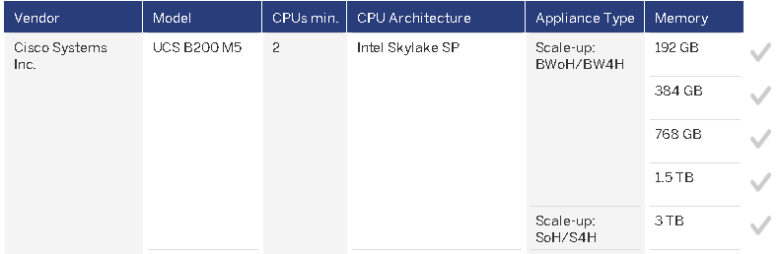
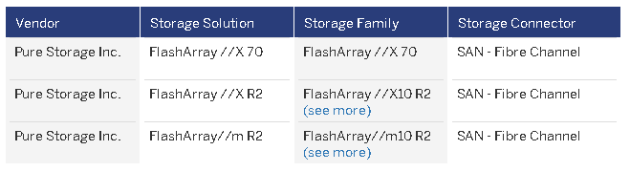
Certified SAP S4/HANA Hardware
https://www.sap.com/dmc/exp/2014-09-02-hana-hardware/enEN/appliances.html#

Slide 8
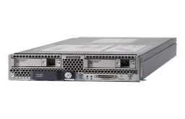
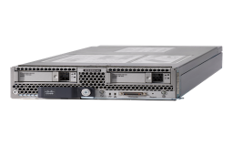

Hardware Architecture
UCS Blade
M5/M4 Series
x8/x4
x8/x4
Compute HW
UCS Chassis
5108
Network HW
UCS Fabric InterConnect 6296UP
FC SAN Switch
MCData / Brocade / Cisco / EMC
Storage HW
PureStorage
FlashArray

Slide 9



Bare Metal Disaster Recovery
B
A
Off-Premise
WAN
On-Premise
C
Off-Premise
WAN or Internet

Slide 10
Agenda
Portafolio & services
Architecture Integration
Solutions Delivery Approach

Slide 11



SOS/DH Architecture Integration
Colocation
Existing
Infrastructure
On-Premise
x8/x4
x8/x4
Internet
Edge
Perimetral
Security
DCI
Agr./Dist.
Access
Specific
Security
Nexus 7K
Network & Storage Connections
Clients

Slide 12
Agenda
Portafolio & services
Architecture Integration
Solutions Delivery Approach

Slide 13
Solution Delivery Approach
…….…
Physical
…….…
Virtual
Private Cloud Deployments

