Slide 1
An Approach To Hyper-Cloud Services Capital and Operational Expenses and Price Estimation
Olaf Reitmaier Veracierta
Updated: November, 2017

Slide 2
Revision History
Version | Details
January, 2016 | Initial Draft
October, 2016 | Opex Calculus
July, 2017 | Overload Mgmt. Techniques
November, 2017 | Virtual Memory/Disk Capacity Concept

Slide 3
CAPEX / OPEX Baseline
CAPEX:
  New items (1st year)
  ROI as One Time Fee (OTF)
OPEX:
  Renuevable items (Starting 2nd year through 1 - 5 years)
  ROI as Recurring Monthly Fee (RMF)
  Includes:
    Software / Hardware:
      Copyrights (LTU, License To Use)
      Life Cycle Support (Upgrade / Replacement)
  Infrastructure: Facilities (E/S/AC) + Security + Monitoring.
  Human resources (Operation + Innovation).

Slide 4
OPEX Variation Factors (I)
OPEX:
  (...)
  Traditional linear depretiation (3 years).
  Technology planned obsolesence (TPO)
    3 - 7 years leap.
    End of sale (New clients).
    End of support (Warranty / Refurbish).
    End of life (Operational Risk / Higher costs).

Slide 5
OPEX Variation Factors (II)
OPEX:
  (...)
  Technology innovation gap (TIG)
    1 – 10 years leap.
    Reduced costs (CAPEX).
    Increased eficiency (OPEX).

Slide 6
OPEX Variation Factors (III)
(Hyper-)Scale economy (HSE)
  Capacity adquisition deals (Massive, Forward, New/Old DC).
  Constant capacity adquisition:
    Per usage (real capacity)
    Per sale (provisioned capacity)
  Minimal legacy expenses (LEGEX)
    Reusing / Mitigation / Innovatio
    Renovation / Modernization
    Disposal / Recycling
  Standarization, Virtualization, Automation & Orchestation.
  Time as a OPEX increment factor.

Slide 7
Tecnology Innovation Gap (TIG)
Optimization (Moore’s Law):
  Predictible.
  Example:
    Higher density disk (HDD).
    Hardware defined storage (HDS).
Modernization (Kick the table):
  Unpredictable.
  Example:
    Solid state disk (SSD).
    Software defined storage (SDS).

Slide 8
Cost Evolution In Time
EARLY RENEW
OTF
OTF
CAPEX
ROI
PROFIT
FEEDBACK
OPEX
EXPENSES
LEGACY
LIFE
RISK
TIG
GO LIVE
NEW
TPO
GO LIVE
LATEST RENEW

Slide 9
Cloud Structured Cost
Install cost.
  On the cloud, Zero install cost. So no OTF.
Service cost.
  On the cloud, a recurring fixed or variable RMF.
  Real Capacity (Installed).
  Virtual Capacity (Oversubcribed), depends on the provisioning method:
    Fixed / No-Oversubscribed / 1:1 (Fixed).
      Posibility of use / Usage quantity
    Thin / Oversubscribed / 1:N (Credit).
      Probability of use / Usage behaviour
    Architecture grow logic (Vertical / Horizontal).

Slide 10
Cloud Structured Cost
Capacity
Real (Installed)
Posible
Real Used
Real Reserved
Virtual (Oversubscribed)
Virtual Used
Probable
Virtual Protective

Slide 11
Cloud Structured Cost
Is not a Combo!
  Is a standard... to overcome digital complexity
  and deliver the solution to more market share.
  Pay for a burger… Pay for a bit...
Standard for:
  Agile assembly and provisioning (less handicraft).
  Enhanced product quality:
    Less humans errors and service pitfalls.
    More service automation opportunities.

Slide 12
Cloud Structured Cost
Service cost (Cont.).
  (...)
  Unused (Idle) Capacity Ratio (UCR):
    Protective capacity is not included.
      Financed by the client / user.
    Useful for negative demand period.
    Masquareded as price discount.
  Market (share/complement) behaviour:
    Offer.
    Demand.

Slide 13
Oversubscription
(Overload Problem)
Overload ocurrs when:
  Oversubscription is used.
  Protective idle capacity is consumed.
  Service degradation or interruption arises.
Overload managment techniques:
  Stealing resources (from underloaded VM).
  Quiescing (shutdown / restart VM).
  Live migration (VM workload balancing).
  Streaming disks (partial disk transfer).

Slide 14
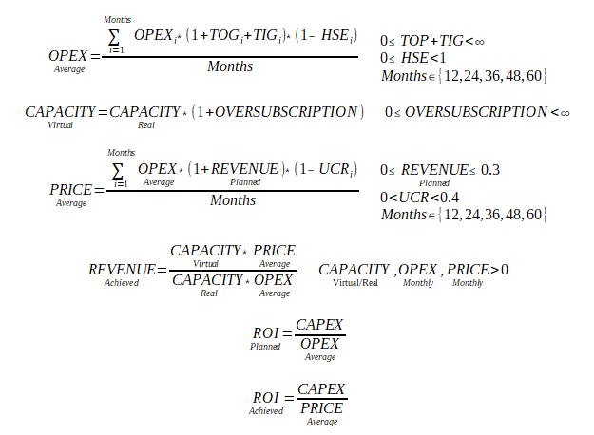
Formulas

Slide 15
Virtual Memory Capacity
Over-Subscription:
  From 1:1 to 1:N (Thin Prov.)
  Overload risks & automation.
  Horizontal scale & logistics.
Heterogeneous Farms Consolidation:
  VMWare CPU policy restrictions.
Resiliency
1 / N
100%
50%
33%
20%

Slide 16
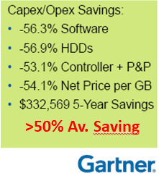
Virtual Disk Capacity
Over-Subscription:
  From 1:1 to 1:N (Thin Prov.).
  Overload risks & automation.
  Horizontal scale & logistics.
Technology Innovation Gap:
  Hardware Defined Storage
    EMC CX*, VNX*, FC SAN.
  Software Defined Storage
    Server, ETH SAN.
TIG>=0.5

