Slide 1


Digital Freelancer:
Managing Freelancing Projects
Project: Working with a Mock Client

Slide 2
Part 1
Project Listing

Slide 3
Sample Project Listing #1: Web Development
Web application development support needed for healthcare application.
Posted 2 hours ago
Hourly: $35.00 - $65.00 Based on experience.
Project Time: 3 months, 25 hours a week.
Project Description:
We are a web development company working with a healthcare client looking to connect patients directly with their doctors. We need someone to be able to take PSD mockup files from our designer and convert them into custom code using HTML, CSS, and JavaScript. We have not decided on which JavaScript library to use, but will be open to working with the one you’re most familiar with. We have the designs for 10 pages and will need them to be completed in 3 months. We are open to working with all levels of experience, but the pay will be adjusted based on your experience.

Slide 4
Part 2
Expression of Interest

Slide 5
Expression of Interest
Please type your initial response to the client below. This should be between 200 - 300 words.
Expression of Interest:
Hello Client,
My name is Ola Galal. Looks like you need to connect patients directly with their doctors by taking PSD mockup files from our designer and convert them into custom code using HTML, CSS, and JavaScript. I would recommend using React JS It is an open-source JavaScript library used to build highly responsive user interfaces. It is declarative and component-based meaning you can reuse components to create complex UIs in a short time. We can also use Selenium and TestNG to test your web app.
I am Master’s degree student specialized in computer science. I love web development!! I have a 3+ years of experience in this filed. During that time, I've developed strong customer service skills and learned about point-of-sale technology, store presentation. I worked for many clients and helped them to deliver their goals. I can have it back to you in few hours. I maintain the highest standards of professionalization. You can check my GitHub profile for more examples: https://github.com/olagalal
Thank you for taking the time to read my expression of interest. Send me a quick message and we can figure out if we are a good fit to work together whenever it's convenient for you.
Kind regards,
Ola Galal

Slide 6
Part 3
Project Management Process

Slide 7
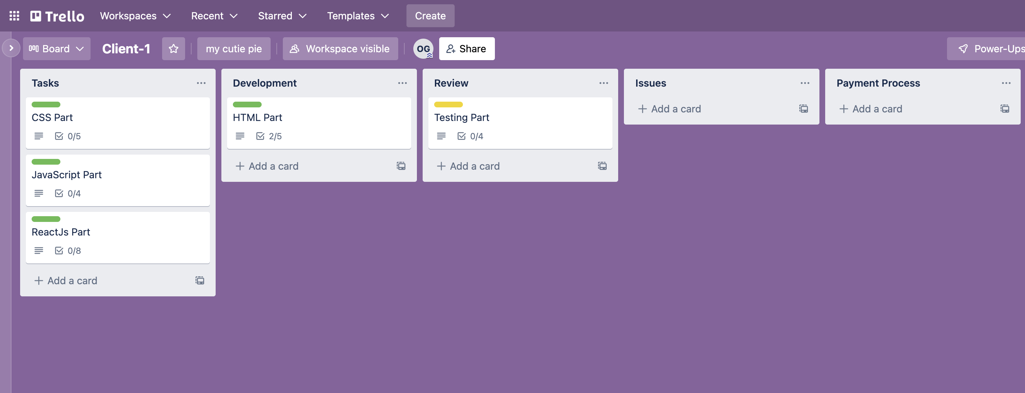
Trello Board
Please include the following information for your Trello board:
A link to your public Trello board should be provided here:
https://trello.com/invite/b/qAktTwQL/c381280f7a16faf421d29077523998fc/client-1
Include a screenshot of the board below:

Slide 8
Part 4
Invoice and Payment Options

Slide 9
Ola Galal
Egypt
Invoice
Recipient:
[Ola Galal / Client Name]
Invoice #: 59347
Date issued: 21 July 2022
Date due: 30 Aug 2022
Services Rendered
Service | Description of Work Done | Hours Spent | Amount Per Hour | Total
Creating the basic structure of the site using HTML | Providing the main parts of our element like (opening, closing taps), the content and the element | 8 | 10 | 80
Control presentation, formatting, and layout using CSS | style and layout of web pages, building blocks, Styling text, CSS layout and solve common problems | 15 | 15 | 225
Work on the interactive elements and their Behavior | create very unique and creative follow-ups for all the elements and work with JavaScript to achieve this. | 22 | 15 | 330
Testing the App | Security, Unit and Integration tests. Report a document with test cases and their results to grantee the quality. | 12 | 15 | 180

Slide 10
Ola Galal
Egypt
Invoice
Services Rendered (continued)
Service | Description of Work Done | Hours Spent | Amount Per Hour | Total
Convert to ReactJS components | Enhance the visuals and the components with a better technology | 10 | 20 | 200
Total Payment Due: 1015$
Payment Options: PayPal: xxxxxx@hotmail.com Link: link.paypal.com

