Slide 1
Growing up as a Tester
PalinQA meetup 2018.04.26
Notes:
I am working for Quince Hungary for more than 3.5 years now. This company did not have a tester before me, and ever since I am the only dedicated tester here. So all layer of the QA role had to picked up by me one by one. Through my story we can discover the layers of this complex role.

Slide 2
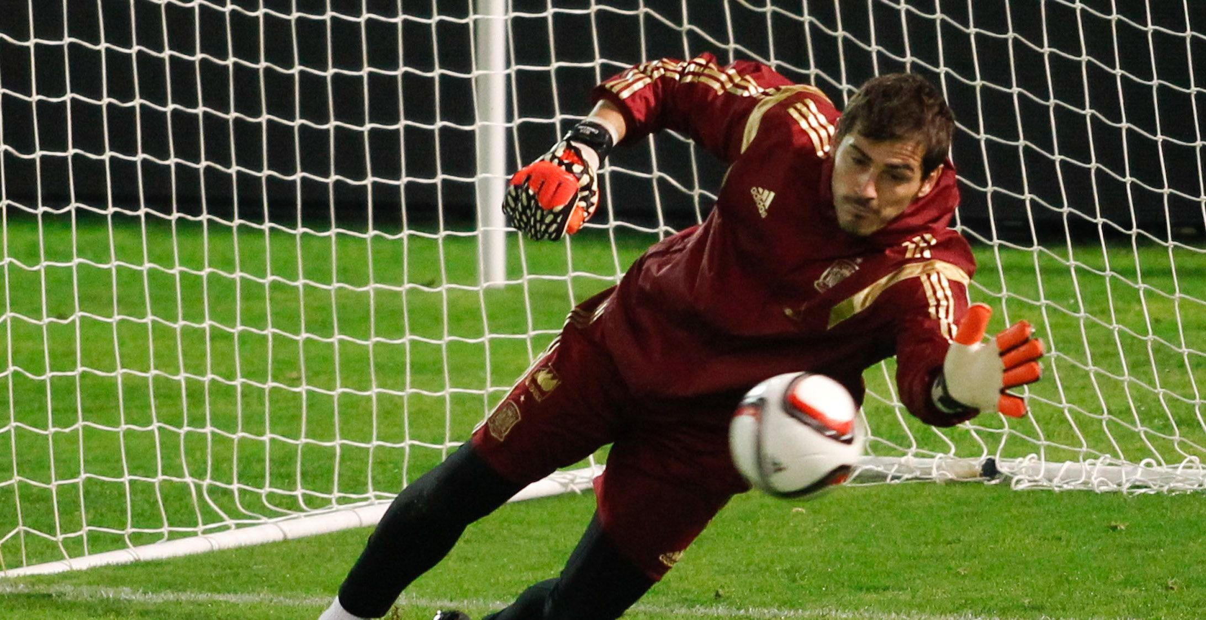
Notes:
“The tester is goalkeeper, like the last defense line between the development and the final product.” That was the metaphore used by one of my bosses.
I used to think that way too, but with time it turned out that the reality is that the role of the testers is way more complex than this. There are many layers of this profession from documentation writing to project management tasks. A tester is never simply a goalkeeper at the end of the software development cycle, he or she has the impact on the whole process.

Slide 3
What is behind this idea?
Waterflow “model” is / was very common
Lack of knowledge on testing tasks
Lack of time and budget

Slide 4
“Testing has to be an integral part of developing software and not a separate phase. When this approach is taken, product quality is owned by everyone on the team. It is easy to state, but hard to put into practice because of long-standing preconceived notions that developers and testers are better kept apart.”— James Sivak

Slide 5
Professional Multitasker
Depending on the company’s mindset (and size), a tester could take more roles.
However even testing feels like this:
Notes:
This is not a “role”, however a really common aspect of testing

Slide 6
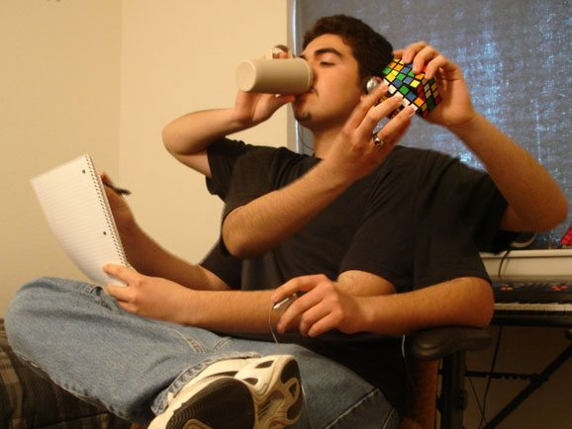

Slide 7
Analyst
Understanding user behaviour for
Better test case design
Better product design
Bug prevention
Optimize testing

Slide 8
Administrator
Maintaining the issue tracker tool, keeping issues up to date
Writing documentation
Tracking test cases’ execution and result

Slide 9
“Project Manager”
Bridge between the developers and the management
Active participation in project planning, feature designing
Often knows more about the project or the product
Making sure the team keeps the process for the product’s sake

Slide 10
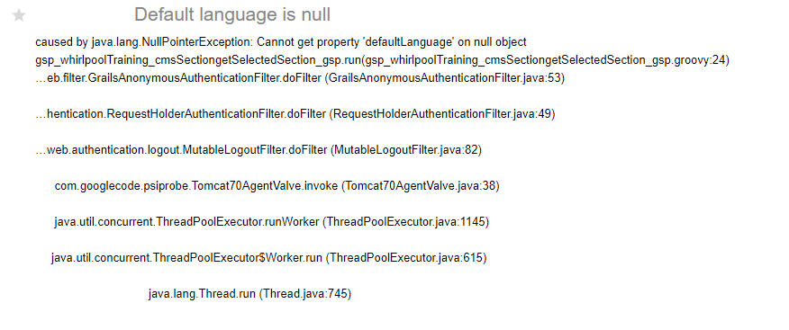
Notes:
This is an extreme example from the time we did not have a tester.

Slide 11
Accounting
Understanding client’s bug report, help them to use the platform better or investigate and report bugs.

Slide 12
The good quality software is the result of teamwork!

Slide 13
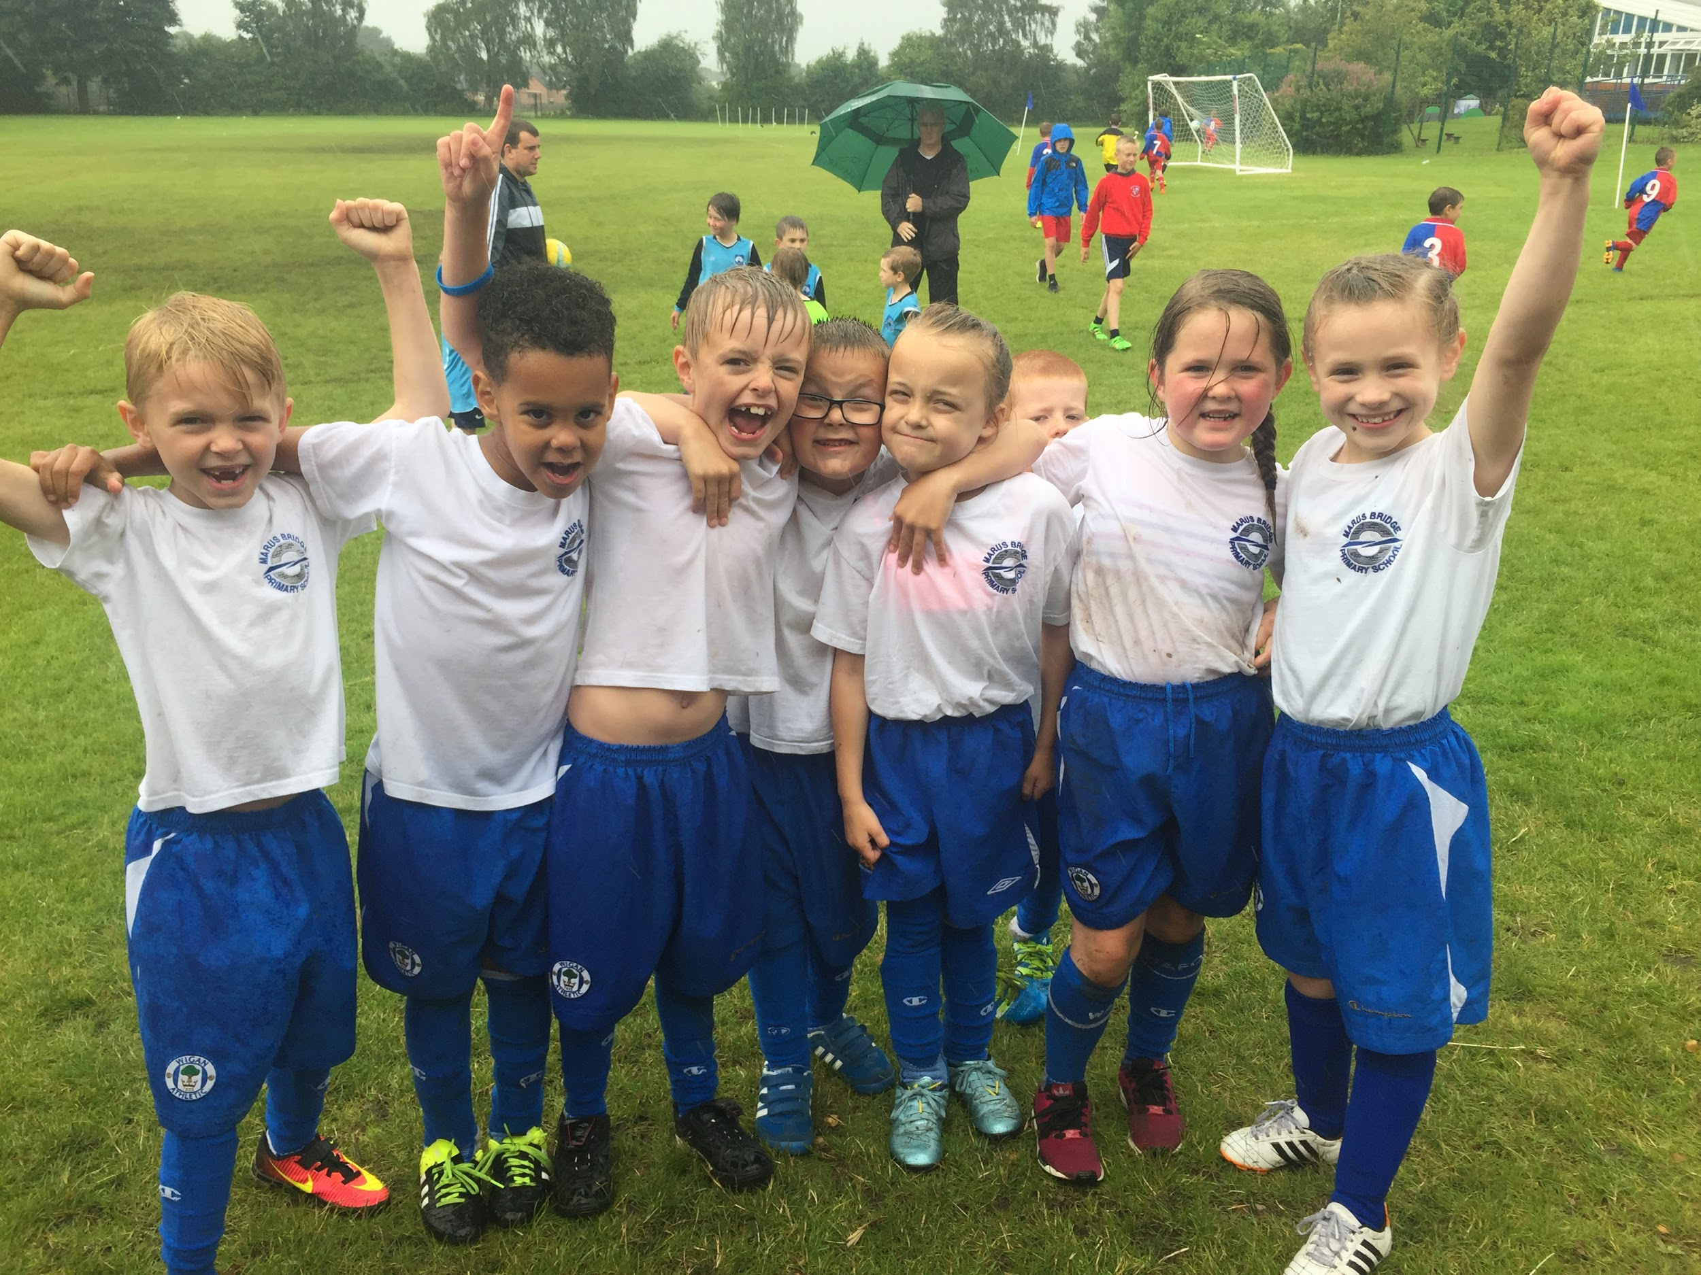
Football wasn’t a bad example after all. :)

Slide 14
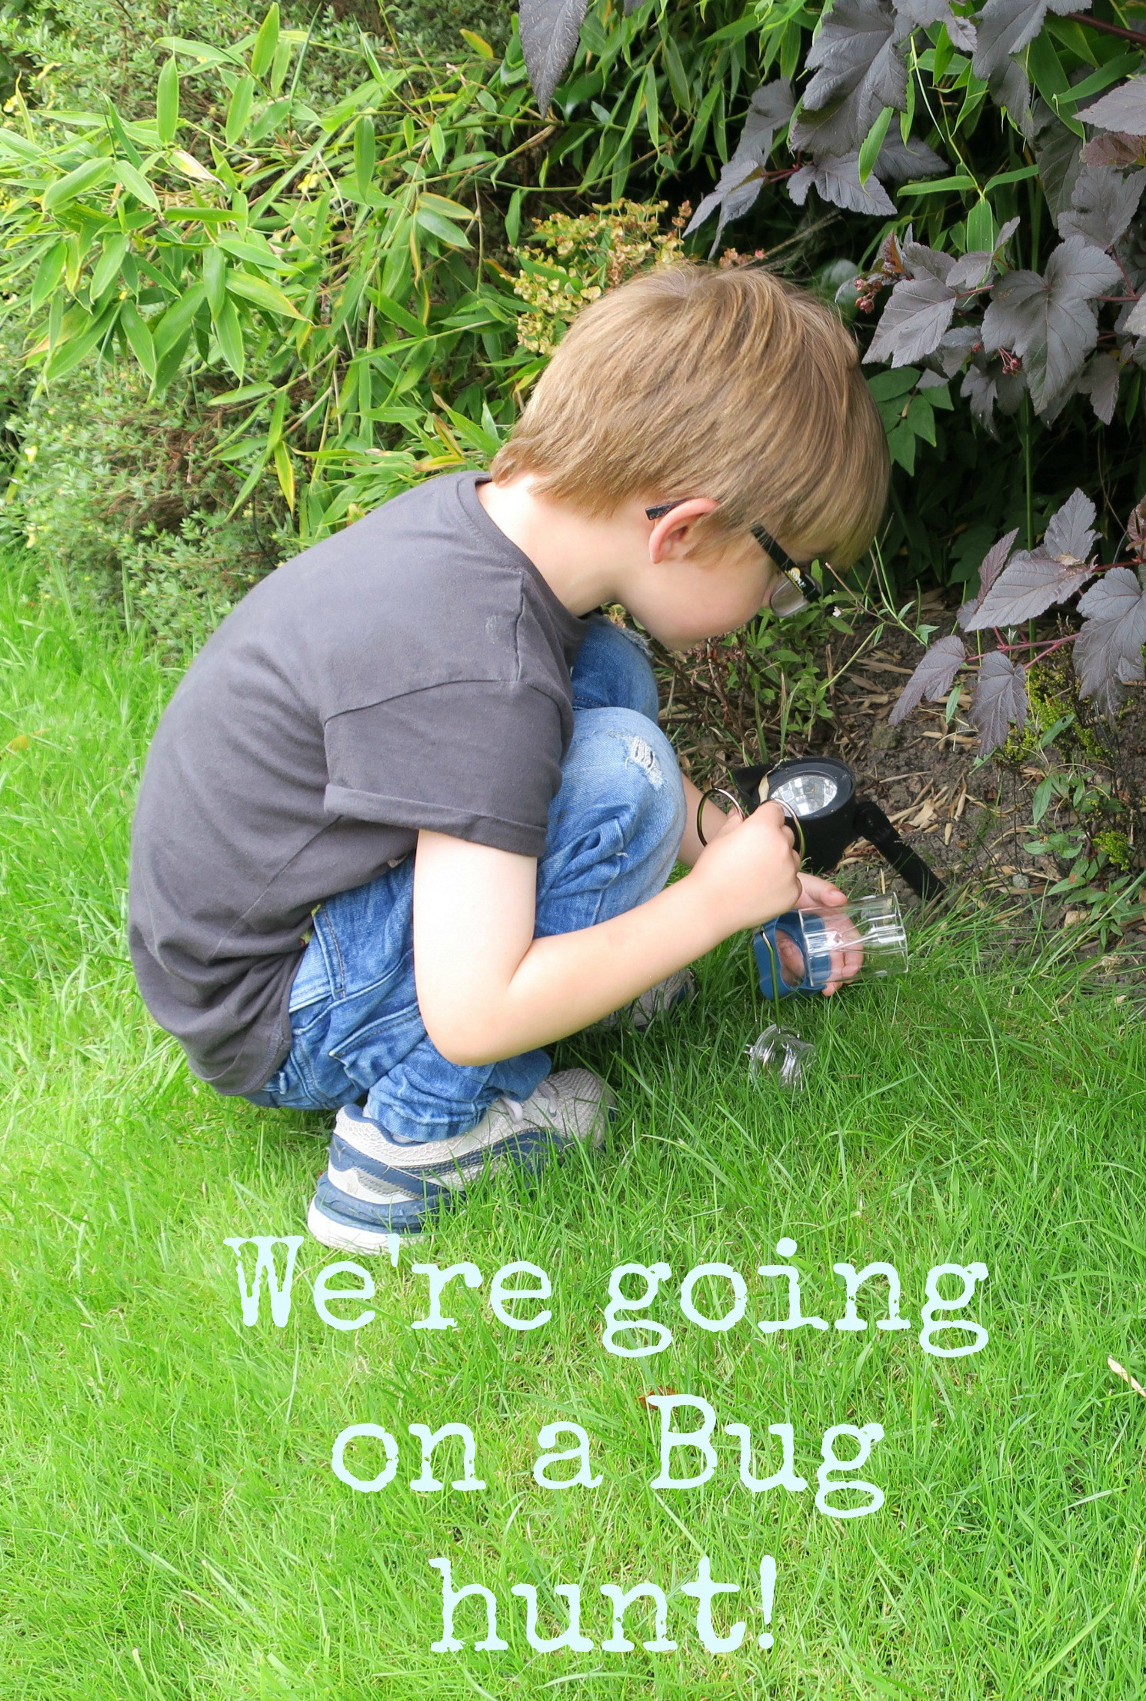
Thank you and good hunting!

