Slide 1

Exploratory Data Analysis
G2M Cab Industry Analysis
Olaide Kashimawo
04-13-2022

Slide 2
Agenda
Problem Statement
Approach
EDA
EDA Summary
Recommendations

Slide 3
Problem Statement
This notebook's main goal is to help stakeholders better understand the market before making investments in the taxi sector using the Go-to-Market (G2M) method.

Slide 4
Data
There have been provided 4 individual data sets. Time period of data is from 31/01/2016 to 31/12/2018.
Below are the list of datasets which are provided for the analysis:
Merge data : 19 features after merging and total data point :359391
 | Data Points | Columns | Memory usuage
Cab Data | 359391 | 3 | 19.2 MB
Customer ID | 49170 | 3 | 1.5 MB
Transaction ID | 440098 | 7 | 10.1 MB
Cities | 20 | 3 | 608.0 Byte

Slide 5
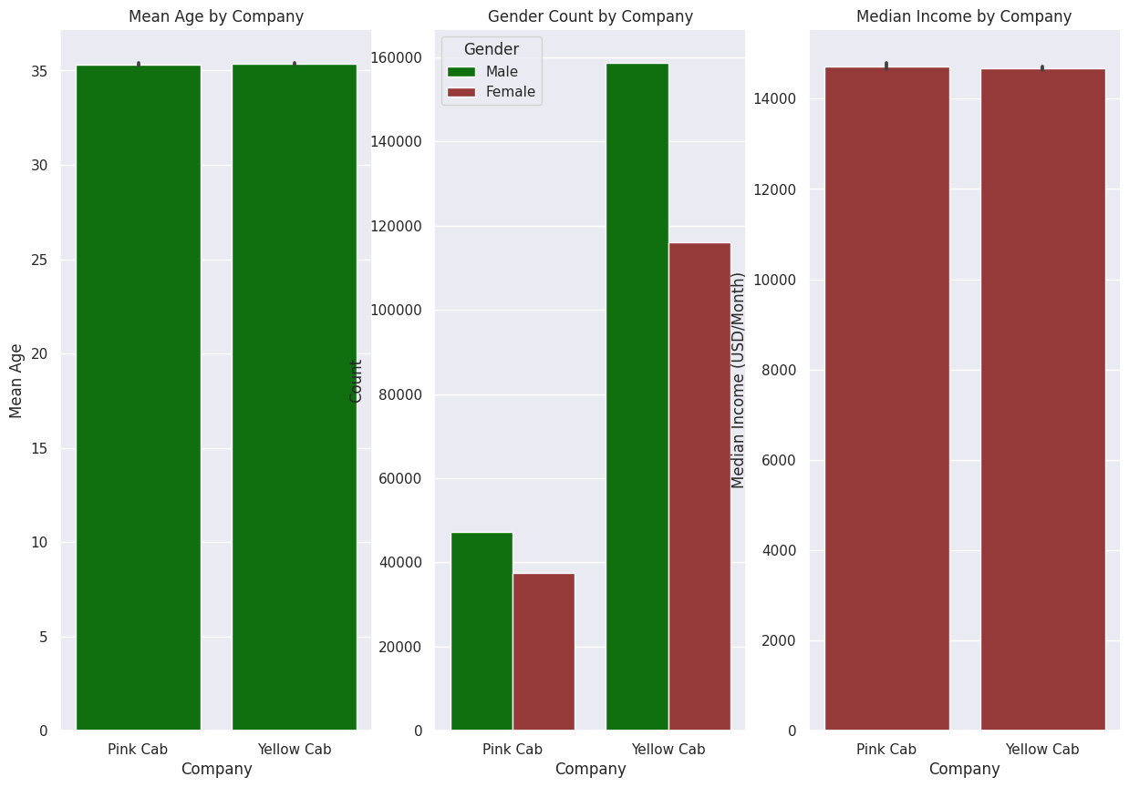
Customer demographics analysis The average age for both the pink and yellow cab is 35. The yellow cab has more male customer. The mean income of both customer is above $14,000.00

Slide 6
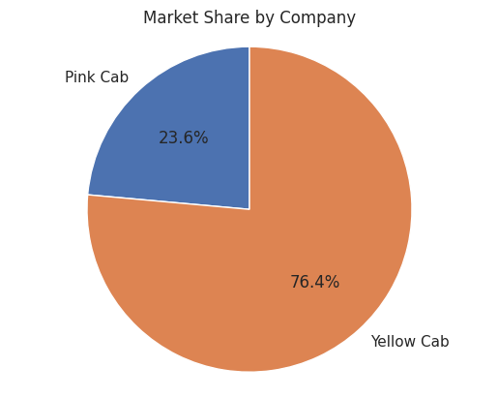
Market Share The yellow cab company has the 76.4% of the market share.

Slide 7
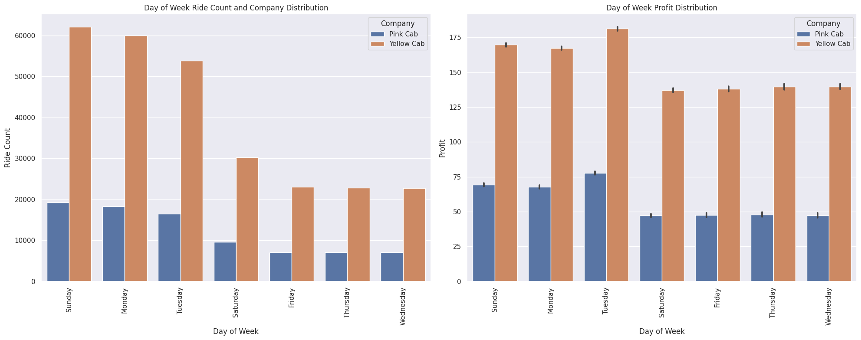
Day of Week ride Count and Company Distribution We cab see on more Yellow cab on Sundays and Monday having more rides, yellow cab take home more profit

Slide 8
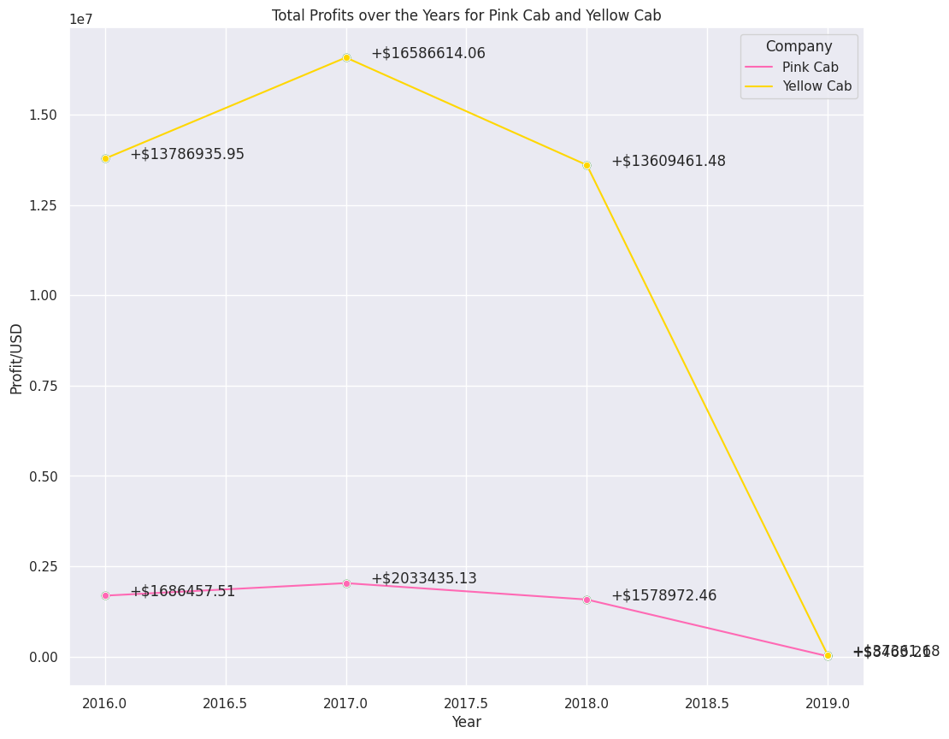
Yearly Profit per company Profit per Company decreases over time in both companies where 2019 recorded the least with Pink Cab $8,463,212,Yellow Cab $3,736,168 and 2017 shows increase in profit for pink with $16,586,614.06 and pink cab had little to no change.

Slide 9
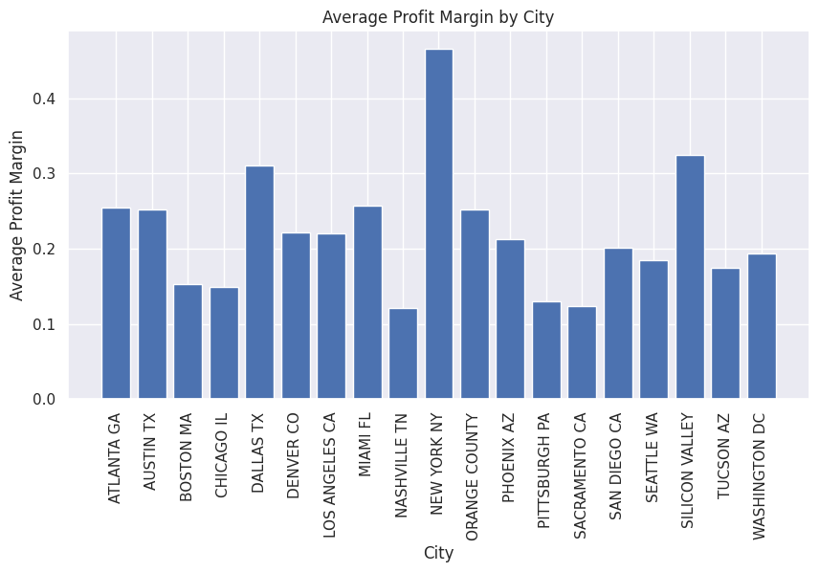
Profit margin per City This gives us a bar chart showing the average profit margin for each city with New York having the highest average profit margin

Slide 10
RECOMMENDATION
Since there is a positive correlation between the population of a city and the number of taxi users, it would be prudent for cab companies to expand their services in cities with a high population density.
The analysis demonstrates that the profit margin increases as the number of consumers rises. To increase profits, taxi companies should concentrate on acquiring and expanding their customer base.
The profit margin differs by city. To optimize profits, cab companies should concentrate their operations in cities with a high profit margin.
Understanding the demographics of their consumers would allow taxi companies to tailor their services and marketing strategies accordingly.

Slide 11
Thank You

