Slide 1
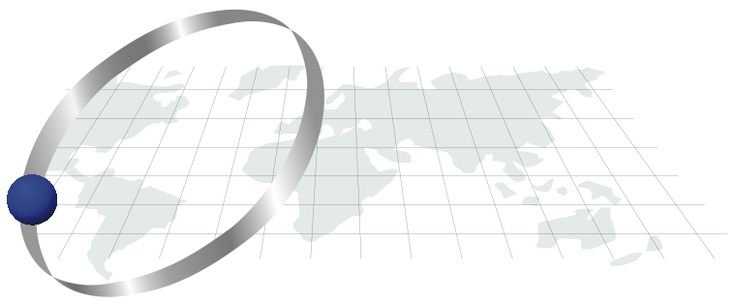
Lab exercises: installing R/ Rstudio, beginning to work with data: filtering, distributions, populations, Data Frames…
Thilanka Munasinghe
Data Analytics
ITWS-4600/ITWS-6600/MATP-4450/CSCI-4960 MGMT4962/6962
Group 1, Lab 1, January 23rd , 2020

Slide 2
Lab tasks
Installations
Exploring data and their distributions
Fitting distributions
Data Frames in R

Slide 3
Objectives for today
Get familiar with:
R (Data Frames)
Distributions
Populations
Fitting
Filtering

Slide 4
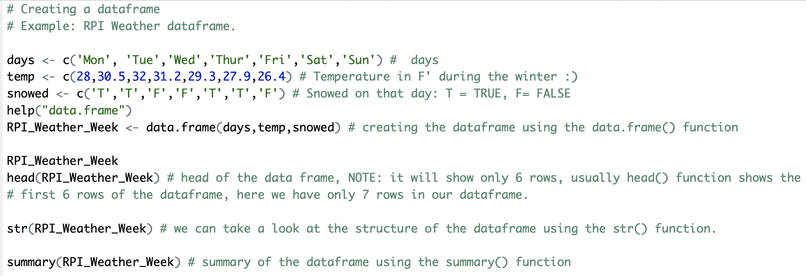
Creating Data Frames in R
Using the data.frames() in R, we can create the data frames
Read the documentation for data.frame in Rstudio,
Using the help(data.frame)

Slide 5
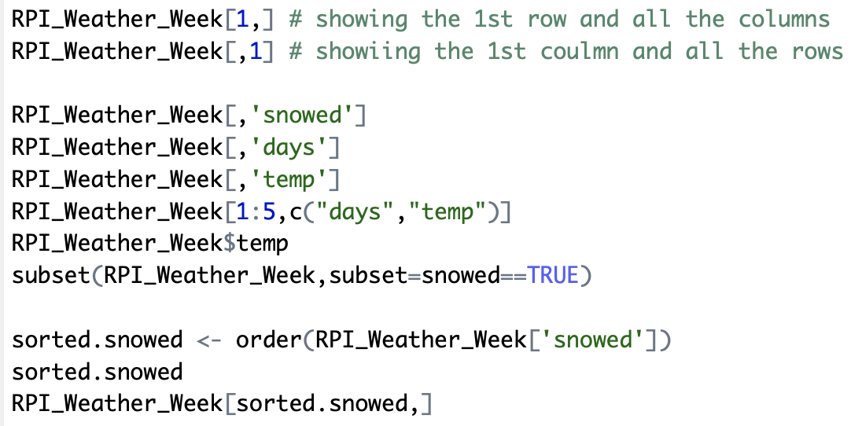
Data frames …

Slide 6
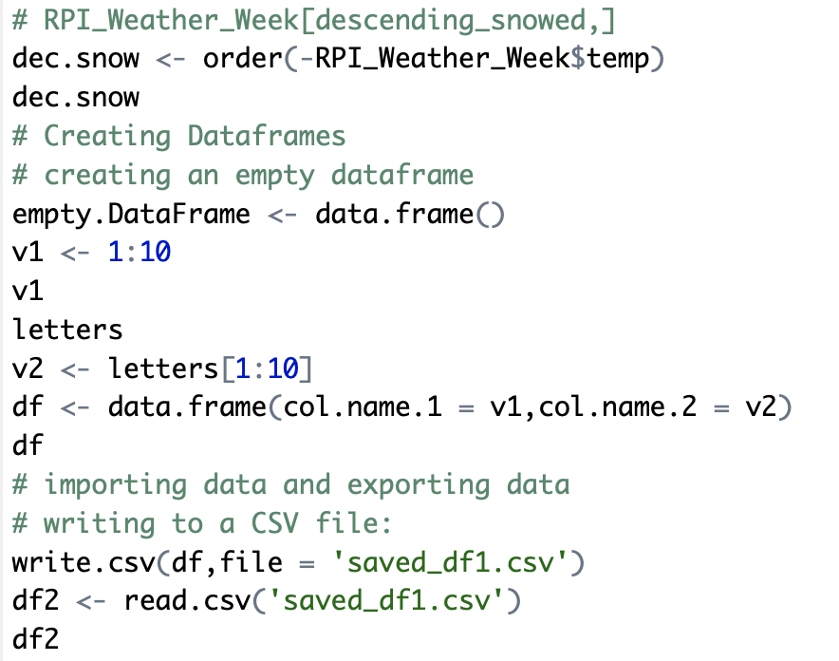

Slide 7
Table: Matlab/R/scipy-numpy
http://hyperpolyglot.org/numerical-analysis
Notes:
So let’s say you have programming experience in Matlab or Jullia and wanted to compare some of the R-functions to what you know. This is a good cross reference with Matlab, Julia etc.

Slide 8
Gnu R
http://lib.stat.cmu.edu/R/CRAN/ - load this first
http://cran.r-project.org/doc/manuals/
http://cran.r-project.org/doc/manuals/R-lang.html
R Studio – (see R-intro.html too) https://www.rstudio.com/products/rstudio/ (desktop version)
Manuals - Libraries – at the command line – library(), or select the packages tab, and check/ uncheck as needed

Slide 9
Reminder: files
http://aquarius.tw.rpi.edu/html/DA/
And some directories under this link
– please search before asking
This is where the files for assignments, lab exercises are
data and code fragments…

Slide 10
Exercises – getting data in
Rstudio
read in csv file (two ways to do this) - GPW3_GRUMP_SummaryInformation_2010.csv
Read in excel file (directly or by csv convert) - 2010EPI_data.xls (EPI2010_all countries or EPI2010_onlyEPIcountries tabs)
Plot some variables
Commonalities among them?
Also for other datasets, enter these in the R command window pane or cmd line
> data()
> help(data)

Slide 11
Files
2010EPI_data.xls – with missing values changed to suit your application (EPI2010_all countries or EPI2010_onlyEPIcountries tabs)
See group1/lab1_data.R
Get the data read in (in e.g. use “EPI_data” for the object (in R))
> EPI_data <- read.csv(”<path>/2010EPI_data.csv")
# Note: replace default data frame name – cannot start with numbers! Munging has begun
# Note: replace <path> with either a directory path or use setwd(“<path>”)
> View(EPI_data)

Slide 12
Tips (in R)
> attach(EPI_data) # sets the ‘default’ object
> fix(EPI_data) # launches a simple data editor – test it!
> EPI # prints out values EPI_data$EPI
[1] NA NA 36.3 NA 71.4 NA NA 40.7 61.0 60.4 NA 69.8 65.7 78.1 59.1 43.9 58.1
[18] 39.6 47.3 44.0 62.5 42.0 NA 55.9 65.4 69.9 NA 44.3 63.4 NA 60.8 68.0 41.3 33.3
[35] 66.4 89.1 73.3 49.0 54.3 44.6 51.6 54.0 NA 76.8 NA NA 86.4 78.1 NA 56.3 71.6
[52] 73.2 60.5 NA 69.2 68.4 67.4 69.3 62.0 54.6 NA 70.6 63.8 43.1 74.7 65.9 NA 78.2
[69] NA NA 56.4 74.2 63.6 51.3 NA 44.4 NA 50.3 44.7 41.9 60.9 NA NA 54.0 NA
[86] NA 59.2 NA 49.9 68.7 39.5 69.1 44.6 NA 48.3 67.1 60.0 41.0 93.5 62.4 73.1 58.0
[103] 56.1 72.5 57.3 51.4 59.7 41.7 NA NA 57.0 51.1 59.6 57.9 NA 50.1 NA NA 63.7
[120] NA 68.3 67.8 72.5 NA 65.6 NA 58.8 49.2 65.9 67.3 NA 60.6 39.4 76.3 51.3 42.8
[137] NA 51.2 33.7 NA NA 80.6 51.4 65.0 NA 59.3 NA 37.6 NA 40.2 57.1 NA 66.4
[154] 81.1 68.2 NA 73.4 45.9 48.0 71.4 NA 69.3 65.7 NA 44.3 63.1 NA 41.8 73.0 63.5
[171] NA NA 48.9 NA 67.0 61.2 44.6 55.3 69.4 47.1 42.3 69.6 NA NA 51.1 32.1 69.1
[188] NA NA NA 57.3 68.2 74.5 65.0 86.0 54.4 NA 64.6 NA 40.8 36.4 62.2 51.3 NA
[205] 38.4 NA NA 54.2 60.6 60.4 NA NA 47.9 49.8 58.2 59.1 63.5 42.3 NA NA 62.9
[222] NA NA 59.0 NA NA NA 48.3 50.8 47.0 47.8
> tf <- is.na(EPI) # records True values if the value is NA
> E <- EPI[!tf] # filters out NA values, new array

Slide 13
Exercise 1: exploring the distribution
> summary(EPI) # stats
Min. 1st Qu. Median Mean 3rd Qu. Max. NA's
32.10 48.60 59.20 58.37 67.60 93.50 68
> fivenum(EPI,na.rm=TRUE)
[1] 32.1 48.6 59.2 67.6 93.5
> stem(EPI) # stem and leaf plot
> hist(EPI)
> hist(EPI, seq(30., 95., 1.0), prob=TRUE)
> lines(density(EPI,na.rm=TRUE,bw=1.)) # or try bw=“SJ”
> rug(EPI)
#Use help(<command>), e.g. > help(stem)
See group1/lab1_summary.R

Slide 14
Save your plots, name them.
Save the commands you used to generate them.

Slide 15
Exercise 1: fitting a distribution beyond histograms
Cumulative density function?
> plot(ecdf(EPI), do.points=FALSE, verticals=TRUE)
Quantile-Quantile?
> par(pty="s")
> qqnorm(EPI); qqline(EPI)
Make a Q-Q plot against the generating distribution by: x<-seq(30,95,1)
> qqplot(qt(ppoints(250), df = 5), x, xlab = "Q-Q plot for t dsn")
> qqline(x)

Slide 16
Exercise 1: fitting a distribution
Your exercise: do the same exploration and fitting for another 2 variables in the EPI_data, i.e. primary variables (DALY, WATER_H, …)
Try fitting other distributions – i.e. as ecdf or qq-

Slide 17
Comparing distributions
> boxplot(EPI,DALY)

Slide 18
qqplot(EPI,DALY)

Slide 19
But there is more
Your exercise – intercompare: EPI, ENVHEALTH, ECOSYSTEM, DALY, AIR_H, WATER_H, AIR_EWATER_E, BIODIVERSITY ** (subject to possible filtering…)
Note 2010 and 2016 datasets….

Slide 20
Distributions
See archive “alldist.zip” or individual files in /distribution
Excel files for different distributions…
Expanded in the folder: e.g. lognorm.xls
In R:
> help(distributions)

Slide 21
Exercise 2: filtering (populations)
Conditional filtering:
> EPILand<-EPI[!Landlock]
> Eland <- EPILand[!is.na(EPILand)]
> hist(ELand)
> hist(ELand, seq(30., 95., 1.0), prob=TRUE)
Repeat exercise 1…
Also look at: No_surface_water, Desert and High_Population_Density
Your exercise: how to filter on EPI_regions or GEO_subregion?
E.g. EPI_South_Asia <- EPI[<what is this>]

Slide 22
GPW3_GRUMP – repeat…
The reading in, then exploration/summary, plots, histograms, distributions, filtering, tests….

Slide 23
water_treatment
water-treatment.csv

Slide 24
Objectives for this lab are:
Get familiar with:
Distributions
Populations
Fitting
Creating Data Frames in R.

