Slide 1
CONCEPT AND MVP DESIGN
CONVVA African SME Commerce Platform
One commerce record coordinating products, stock, orders, payment and delivery across channels
Status: Concept / MVP design
Domain: SME commerce and retail technology
Role: Founder and Product Business Analyst

Slide 2
The problem and what discovery found
Business problem
What the analysis found
Small merchants manage products, stock and orders across social media, messaging and separate tools, creating duplication, overselling and weak fulfilment visibility.
1
Merchants repeat product updates across social and messaging channels
2
Stock is checked after customers order
3
Payment and delivery status sit apart from the order
CONVVA | Olalekan Ajimoti, Business Analyst portfolio
02

Slide 3
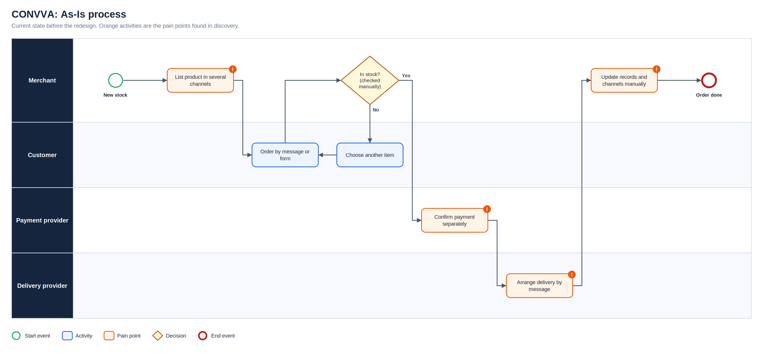
As-Is process
Full-resolution SVG is in the Diagrams folder
CONVVA | Olalekan Ajimoti, Business Analyst portfolio
03

Slide 4
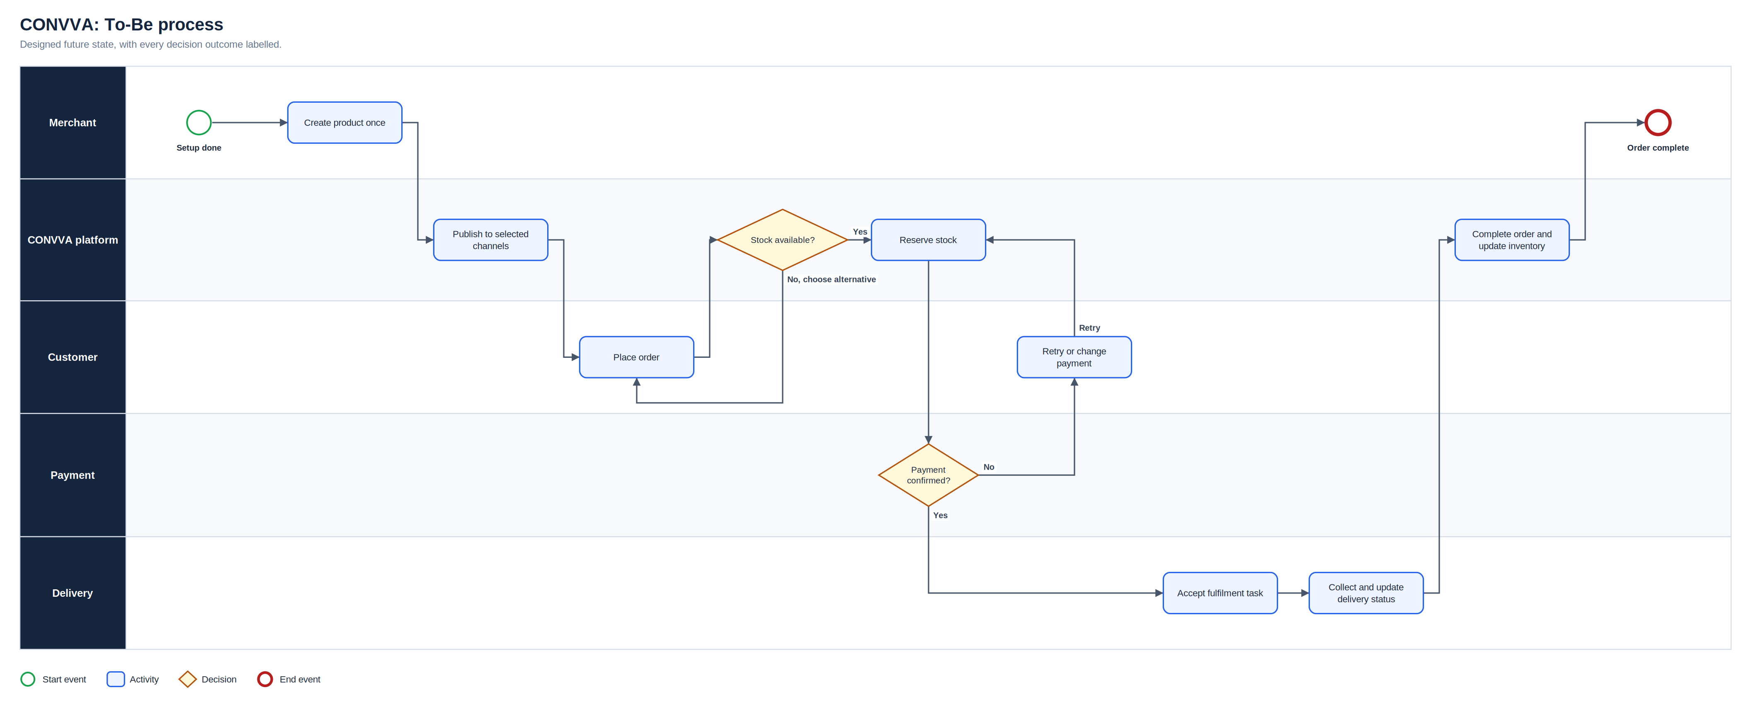
To-Be process
Full-resolution SVG is in the Diagrams folder
CONVVA | Olalekan Ajimoti, Business Analyst portfolio
04

Slide 5
Proposed operating-model change
Area | Before | After
Catalogue | Products recreated per channel | One record publishes to selected channels
Inventory | Checked manually after ordering | Reserved at order, released if unpaid
Order control | Status spread across messages | One timeline for payment, fulfilment and delivery
Setup | Many tools configured separately | Guided wizard with test transaction
CONVVA | Olalekan Ajimoti, Business Analyst portfolio
05

Slide 6
How success will be measured
No live outcomes are claimed for this case
Measure | Current evidence status | How it will be used
Stock-mismatch cancellations | Defined for MVP | Target near zero
Setup completion | Defined for MVP | Without support contact
Order age by stage | Defined for MVP | Spot fulfilment bottlenecks
CONVVA | Olalekan Ajimoti, Business Analyst portfolio
06

Slide 7
Recommendations and key risks
Recommended next actions
Risks with a named owner
Interview ten merchants across two cities
Prototype the setup wizard and test with five merchants
Confirm provider APIs per launch country
Start with one social channel plus storefront
R-01
Channel stock becomes inconsistent
Single inventory source and sync alerts
R-02
Failed payment appears complete
Confirmed payment states only
R-03
Setup is too complex for merchants
Guided wizard and usability tests
R-04
Provider outage blocks fulfilment
Exception queue and fallback provider
CONVVA | Olalekan Ajimoti, Business Analyst portfolio
07

