Slide 1
CONCEPT AND MVP DESIGN
IndulgeApp Diaspora Community Platform
Community discovery balancing local relevance, verification, privacy and moderation
Status: Concept / MVP design
Domain: Community technology and diaspora services
Role: Founder and Product Business Analyst

Slide 2
The problem and what discovery found
Business problem
What the analysis found
People discover communities, trusted information and events through fragmented social channels, while group leaders lack connected engagement and event tools.
1
Diaspora users search across many social channels
2
Group legitimacy is hard to judge
3
Leaders manage content, events and payments in separate tools
IndulgeApp | Olalekan Ajimoti, Business Analyst portfolio
02

Slide 3
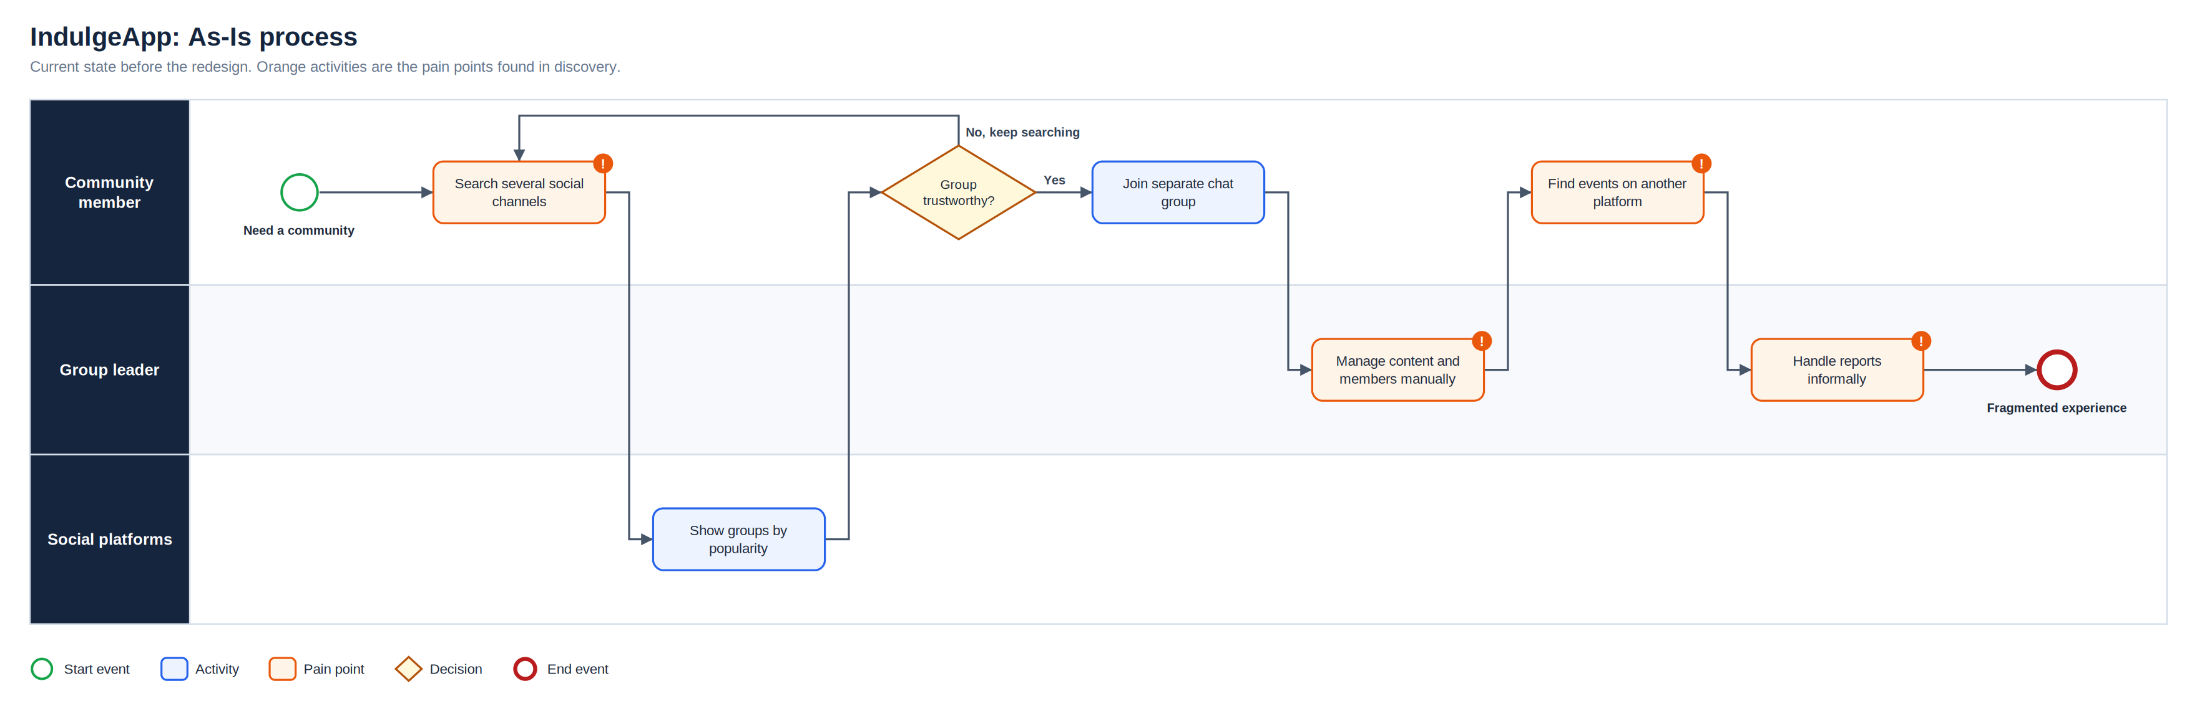
As-Is process
Full-resolution SVG is in the Diagrams folder
IndulgeApp | Olalekan Ajimoti, Business Analyst portfolio
03

Slide 4
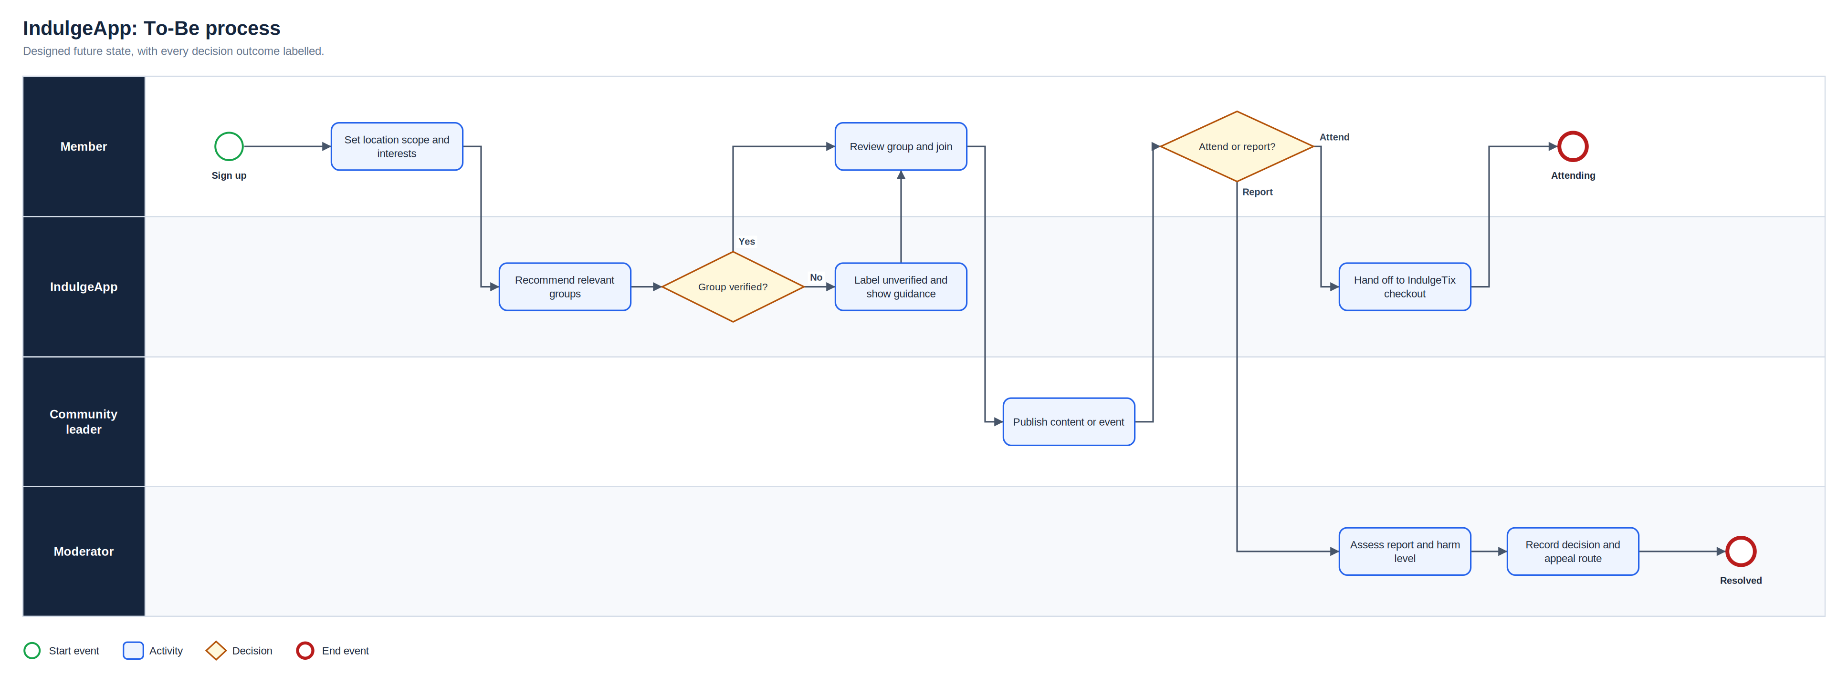
To-Be process
Full-resolution SVG is in the Diagrams folder
IndulgeApp | Olalekan Ajimoti, Business Analyst portfolio
04

Slide 5
Proposed operating-model change
Area | Before | After
Discovery | Search across many platforms | Groups recommended by chosen area and interest
Trust | Verification unclear | Approved status with evidence and expiry
Events | Promotion and ticketing elsewhere | Groups link members to event checkout
Safety | Reports handled informally | Evidence, owner, decision and appeal recorded
IndulgeApp | Olalekan Ajimoti, Business Analyst portfolio
05

Slide 6
How success will be measured
No live outcomes are claimed for this case
Measure | Current evidence status | How it will be used
Join rate by verification | Defined for MVP | Test whether badges build trust
Report resolution time | Defined for MVP | High-harm within 24 hours
Group-to-event conversion | Defined for MVP | Validate the IndulgeTix link
IndulgeApp | Olalekan Ajimoti, Business Analyst portfolio
06

Slide 7
Recommendations and key risks
Recommended next actions
Risks with a named owner
Run discovery interviews with group leaders in two cities
Prototype privacy settings and test comprehension
Draft the moderation playbook before launch
Pilot event links with IndulgeTix organisers
R-01
Location data exposes users
Minimum precision and privacy defaults
R-02
False verification
Evidence review and expiry
R-03
Harmful content or group
Reporting and moderation workflow
R-04
Recommendations create filter bubbles
User controls and monitoring
IndulgeApp | Olalekan Ajimoti, Business Analyst portfolio
07

