Slide 1
DELIVERED WORK
BOZ Jewelry Retail and E-commerce Transformation
Retail service redesign connecting customer enquiries, custom orders and internal delivery visibility
Status: Delivered
Domain: Retail and e-commerce
Role: IT Project Manager, E-commerce and Digital Systems

Slide 2
The problem and what discovery found
Business problem
What the analysis found
Fragmented delivery updates, repetitive customer enquiries and inconsistent custom-order requirement capture reduced visibility and created friction in the customer journey.
1
Repeated WhatsApp questions consumed customer-service capacity
2
Custom-order details were captured inconsistently, causing disputes and rework
3
Project updates sat across separate channels and documents
BOZ Jewelry | Olalekan Ajimoti, Business Analyst portfolio
02

Slide 3
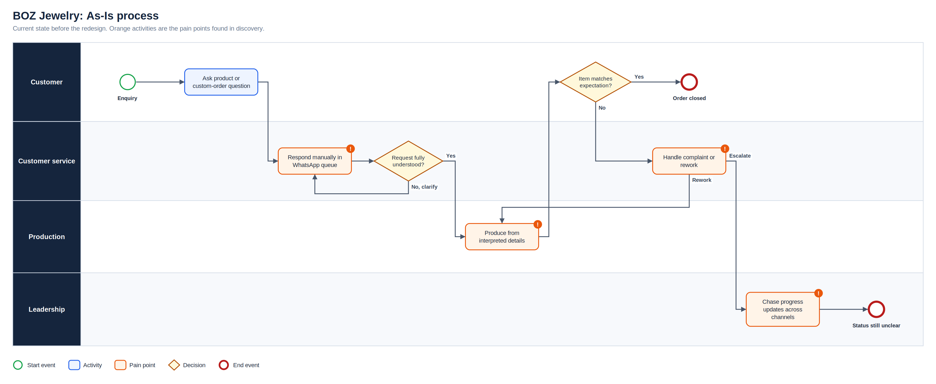
As-Is process
Full-resolution SVG is in the Diagrams folder
BOZ Jewelry | Olalekan Ajimoti, Business Analyst portfolio
03

Slide 4
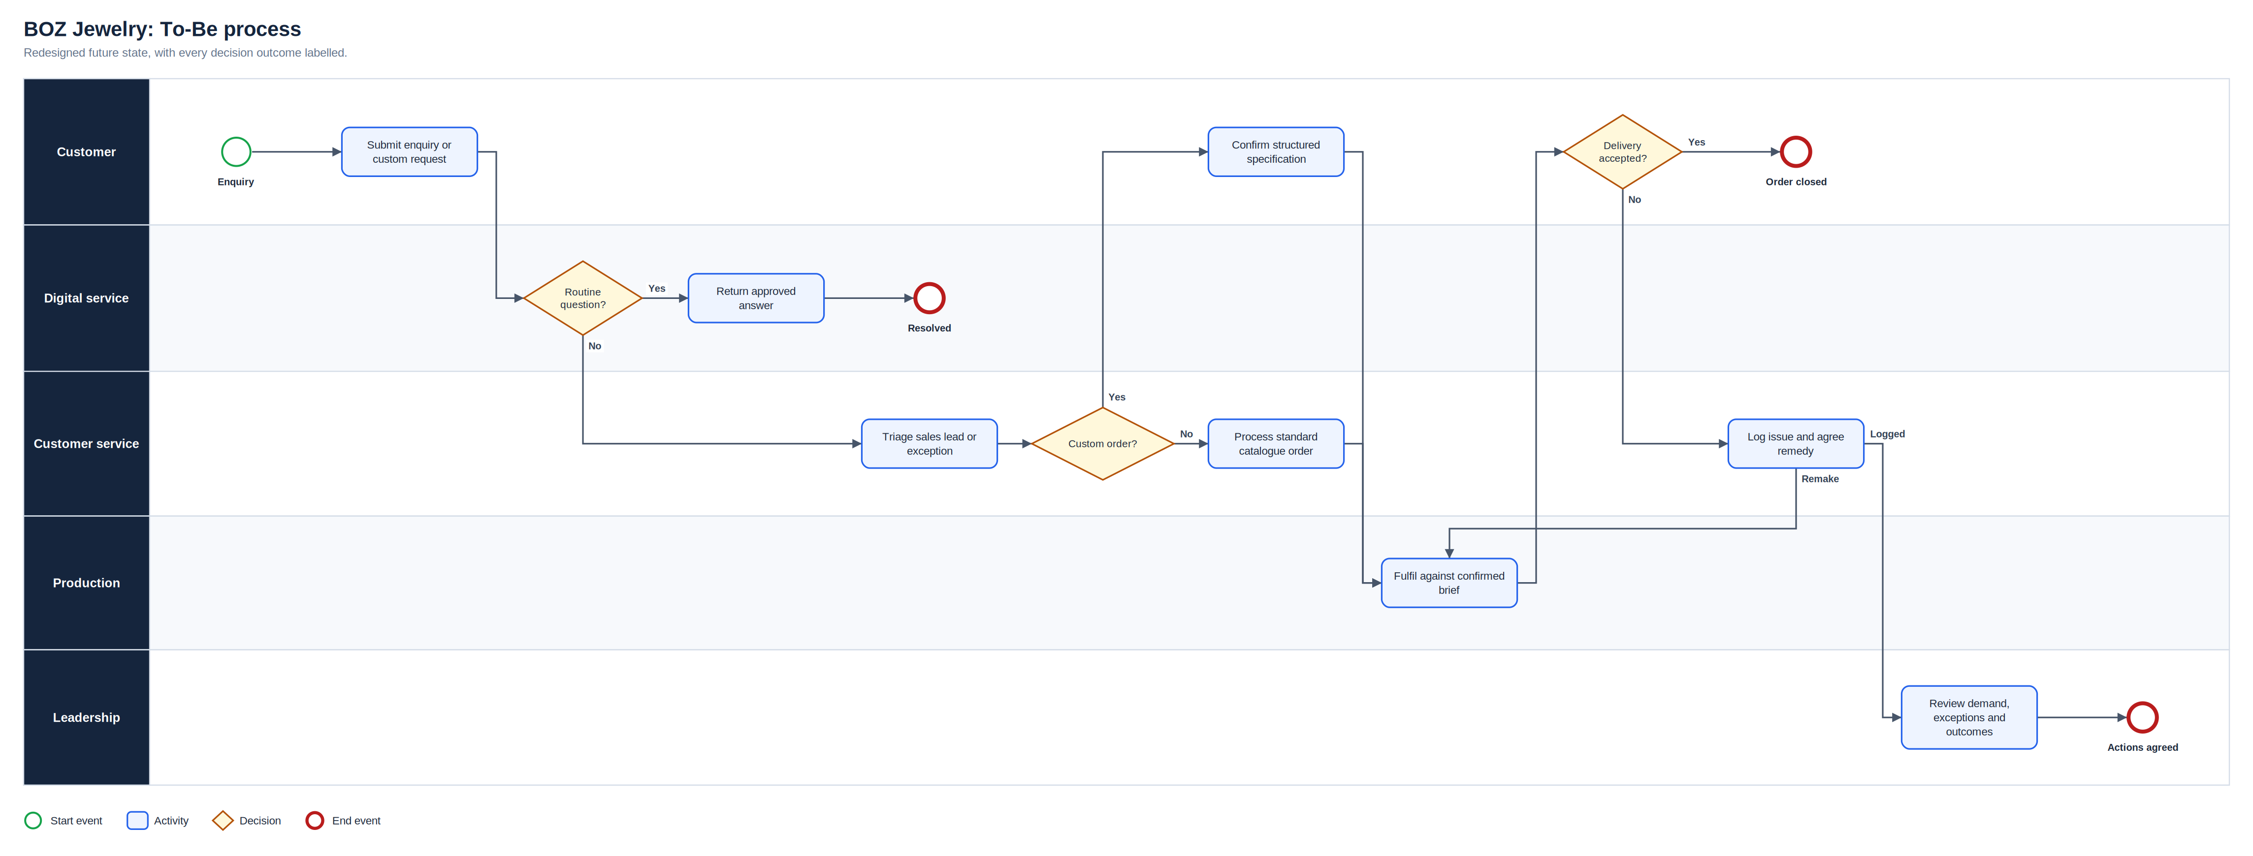
To-Be process
Full-resolution SVG is in the Diagrams folder
BOZ Jewelry | Olalekan Ajimoti, Business Analyst portfolio
04

Slide 5
What changed
Area | Before | After
Customer support | Every enquiry entered the same manual queue | Routine questions answered consistently; sales and exceptions go to people
Custom orders | Requirements interpreted differently | Confirmed specification is the reference before fulfilment
Delivery governance | Updates were fragmented | Owners, dependencies, risks and decisions visible on one board
Collaboration | Files and communication dispersed | Microsoft 365 gave controlled shared access by role
BOZ Jewelry | Olalekan Ajimoti, Business Analyst portfolio
05

Slide 6
Reported outcomes
Figures reported by the organisation after the changes; underlying commercial data is not published
60%
25%
increase in engagement (reported)
uplift in digital performance (reported)
BOZ Jewelry | Olalekan Ajimoti, Business Analyst portfolio
06

Slide 7
Recommendations and key risks
Recommended next actions
Risks with a named owner
Track enquiry containment and reasons for human escalation
Measure custom-order remakes against confirmed specifications
Review access groups whenever roles change
Feed customer feedback into catalogue and content decisions
R-01
Users revert to fragmented communication
Demonstrations and one agreed channel per purpose
R-02
Custom requirements are misunderstood
Structured capture and customer confirmation
R-03
Automated answers become inaccurate
Approved content and escalation route
R-04
Permissions expose information incorrectly
Role-group access and access tests
BOZ Jewelry | Olalekan Ajimoti, Business Analyst portfolio
07

