Slide 1
DELIVERED WORK
The Ecommerce Boss Event Operations Automation
Automation replaced repeated copying while keeping manual control for exceptions
Status: Delivered across client engagements
Domain: E-commerce, events and digital services
Role: Founder and Lead Business Analyst

Slide 2
The problem and what discovery found
Business problem
What the analysis found
Disconnected forms, spreadsheets and email exchanges caused duplicate entry, unclear ownership, inconsistent hand-offs and limited status visibility for client events.
1
Forms, spreadsheets and email created duplicate entry
2
Ownership changed informally through chat
3
Failed messages or integrations were hard to see
The Ecommerce Boss | Olalekan Ajimoti, Business Analyst portfolio
02

Slide 3
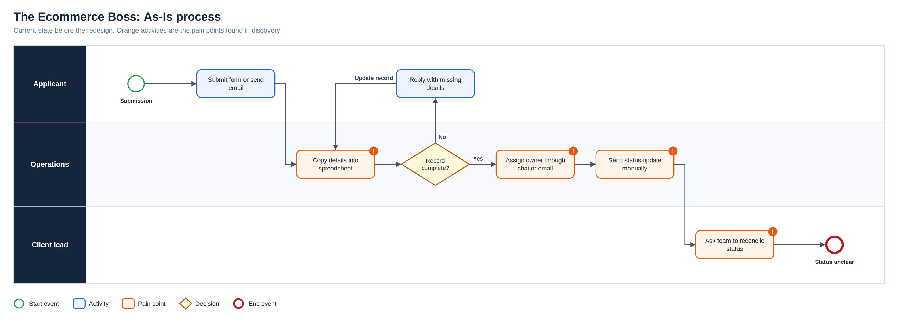
As-Is process
Full-resolution SVG is in the Diagrams folder
The Ecommerce Boss | Olalekan Ajimoti, Business Analyst portfolio
03

Slide 4
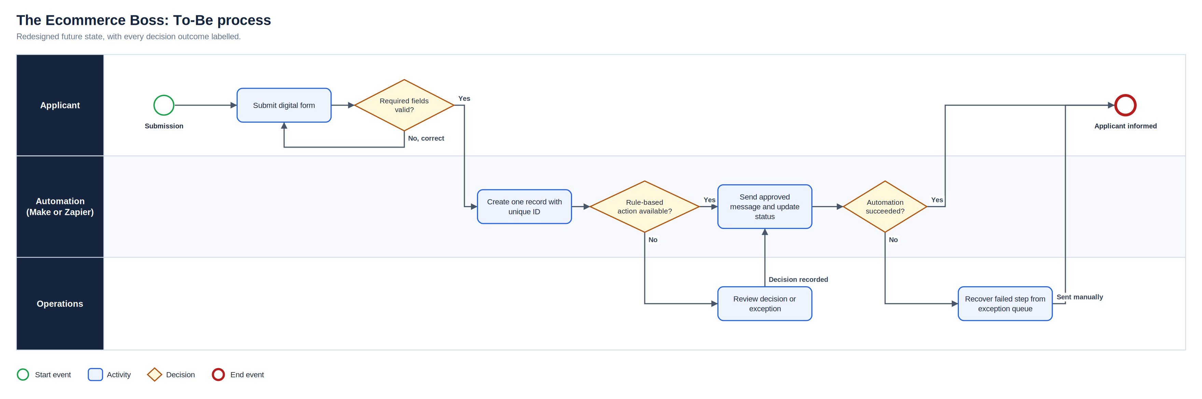
To-Be process
Full-resolution SVG is in the Diagrams folder
The Ecommerce Boss | Olalekan Ajimoti, Business Analyst portfolio
04

Slide 5
What changed
Area | Before | After
Data capture | Information copied between tools | One validated record created from each submission
Ownership | Work assigned through messages | Owner and next action recorded against status
Communication | Updates written repeatedly | Approved messages triggered by decisions
Exceptions | Failures could stay hidden | Failed steps enter a manual recovery queue
The Ecommerce Boss | Olalekan Ajimoti, Business Analyst portfolio
05

Slide 6
Evidence and measures
What is evidenced today and what to track next
Measure | Current evidence status | How it will be used
Duplicate entry | Removed for automated routes | Sample-check monthly
Unowned records | Visible in a dedicated view | Target zero at weekly review
Exception age | Highlighted after 48 hours | Track closure time per event
The Ecommerce Boss | Olalekan Ajimoti, Business Analyst portfolio
06

Slide 7
Recommendations and key risks
Recommended next actions
Risks with a named owner
Sample-check records for duplicates each month
Keep templates under client approval
Review the exception queue at every status meeting
Revisit the options matrix when volumes grow
R-01
Duplicate records
Unique IDs and duplicate flags
R-02
Automation sends the wrong message
Trigger tests and approved templates
R-03
Client cannot maintain the solution
Options assessment and handover guide
R-04
Failures go unnoticed
Exception queue and ageing highlight
The Ecommerce Boss | Olalekan Ajimoti, Business Analyst portfolio
07

