Slide 1

PRODUCT IN DEVELOPMENT
IndulgeTix Event Ticketing Platform
One product model connecting event setup, ticket ownership, venue access and settlement
Status: Product development
Domain: Event technology and payments
Role: Founder and Product Business Analyst

Slide 2
The problem and what discovery found
Business problem
What the analysis found
Organisers need connected event setup, ticket ownership, scanning and settlement, while attendees need reliable purchase, transfer and refund journeys.
1
Promotion, orders, guest lists and entry control often sit in separate tools
2
Transfers and refunds can break ownership traceability
3
Settlement needs reconciliation of tickets, fees, refunds and payouts
IndulgeTix | Olalekan Ajimoti, Business Analyst portfolio
02

Slide 3
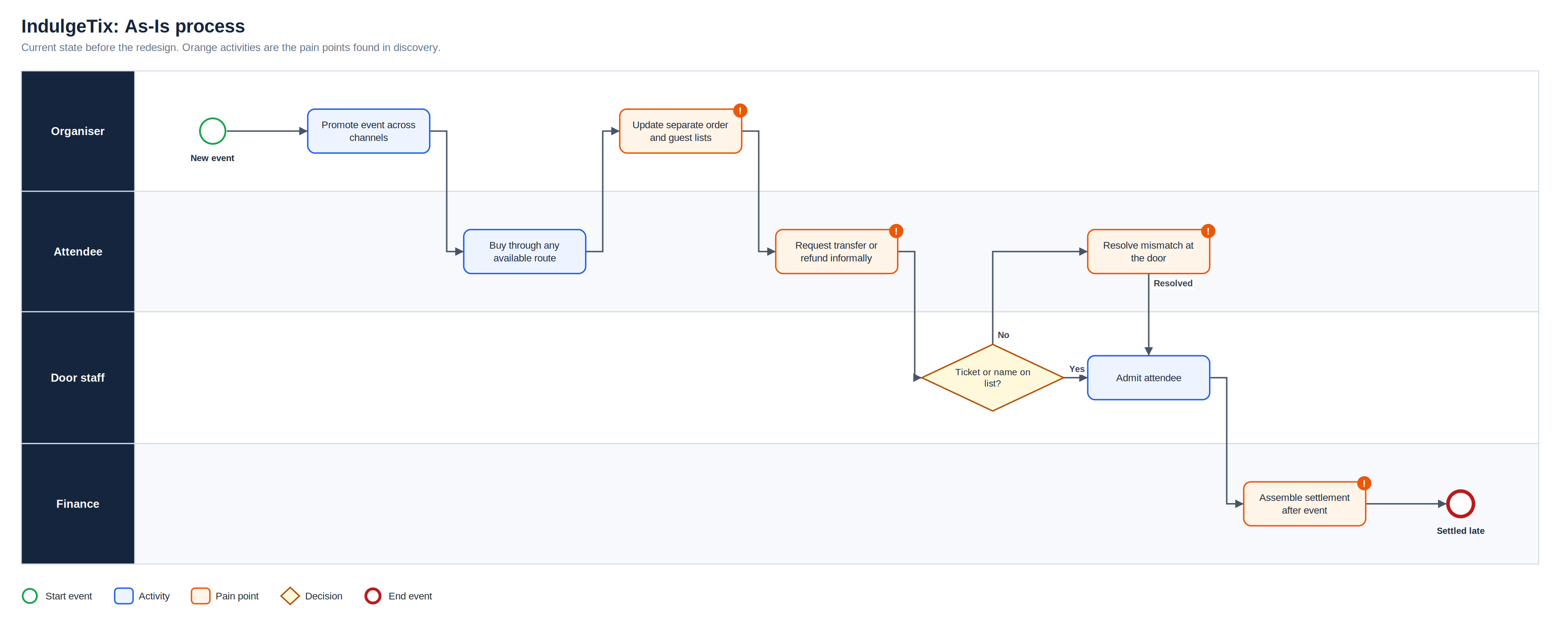
As-Is process
Full-resolution SVG is in the Diagrams folder
IndulgeTix | Olalekan Ajimoti, Business Analyst portfolio
03

Slide 4
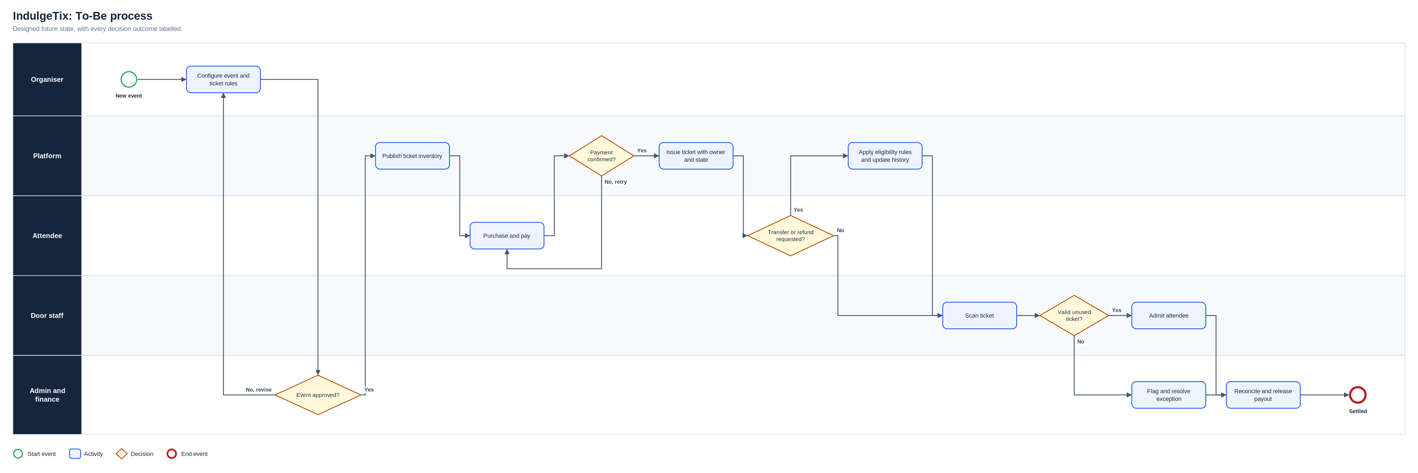
To-Be process
Full-resolution SVG is in the Diagrams folder
IndulgeTix | Olalekan Ajimoti, Business Analyst portfolio
04

Slide 5
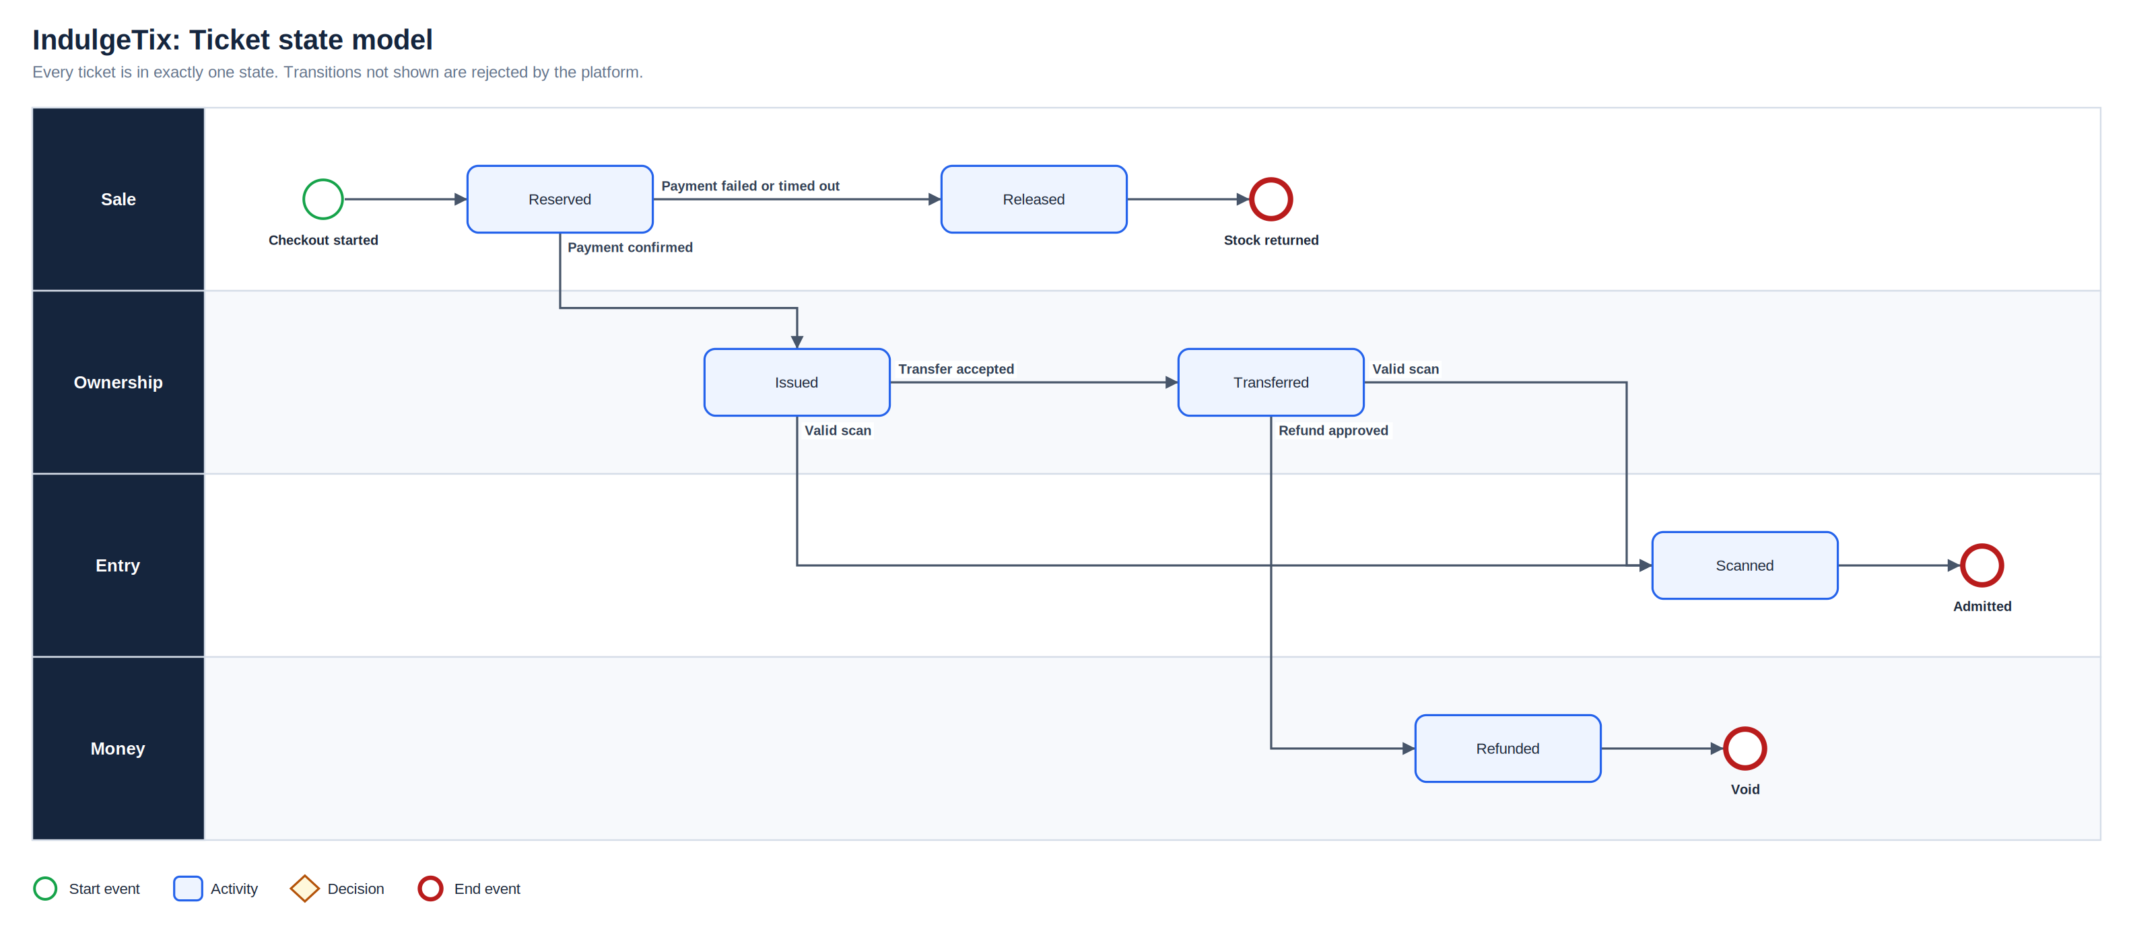
Ticket state model
Full-resolution SVG is in the Diagrams folder
IndulgeTix | Olalekan Ajimoti, Business Analyst portfolio
05

Slide 6
Proposed operating-model change
Area | Before | After
Ticket control | Orders and guest lists held separately | One ticket record with owner and state
Transfers and refunds | Handled by message | Eligibility rules and audit history
Entry | Name checks at the door | Real-time scan validation
Settlement | Assembled after the event | Reconciled before payout
IndulgeTix | Olalekan Ajimoti, Business Analyst portfolio
06

Slide 7
How success will be measured
No live outcomes are claimed for this case
Measure | Current evidence status | How it will be used
Duplicate-scan attempts | Defined, pilot not yet run | Target zero admitted duplicates
Settlement variance | Defined, pilot not yet run | Payout only at zero or explained variance
Transfer completion | Defined | Monitor abandoned transfers
IndulgeTix | Olalekan Ajimoti, Business Analyst portfolio
07

Slide 8
Recommendations and key risks
Recommended next actions
Risks with a named owner
Pilot with one organiser and one venue before wider launch
Test scanner offline mode at a real door
Agree refund policy templates with organisers
Review settlement variance after every pilot event
R-01
Duplicate ticket ownership
State model and audit log
R-02
Duplicate entry
Real-time scan validation
R-03
Settlement variance
Pre-payout reconciliation
R-04
Refund or transfer abuse
Eligibility and permission rules
IndulgeTix | Olalekan Ajimoti, Business Analyst portfolio
08

