Slide 1

DELIVERED WORK
Creatrix Empire Marketing Operations and Performance Analysis
A multidisciplinary campaign workflow connected creative delivery with performance evidence
Status: Delivered
Domain: Digital marketing, media and entertainment
Role: Digital Marketing Analyst and Delivery Lead

Slide 2
The problem and what discovery found
Business problem
What the analysis found
Client and internal-brand campaigns needed clearer specialist ownership, cleaner hand-offs and optimisation based on consistent evidence rather than reach alone.
1
Specialists could work in isolation from campaign objectives
2
Late assets and unclear approvals created rework
3
Reach, engagement, traffic and conversion were interpreted inconsistently
Creatrix Empire | Olalekan Ajimoti, Business Analyst portfolio
02

Slide 3
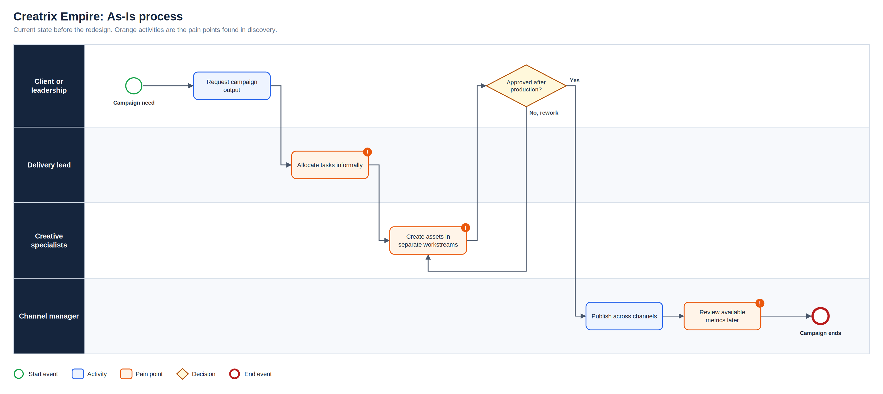
As-Is process
Full-resolution SVG is in the Diagrams folder
Creatrix Empire | Olalekan Ajimoti, Business Analyst portfolio
03

Slide 4
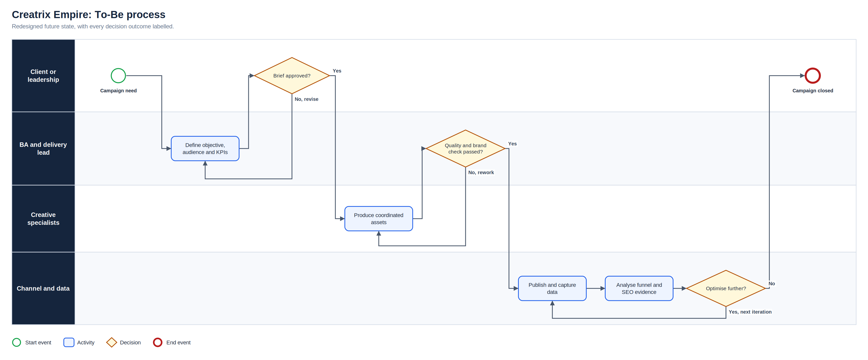
To-Be process
Full-resolution SVG is in the Diagrams folder
Creatrix Empire | Olalekan Ajimoti, Business Analyst portfolio
04

Slide 5
What changed
Area | Before | After
Campaign brief | Requests focused on outputs | Objective, audience and KPI defined first
Team workflow | Ad hoc specialist allocation | Visible ownership, dependencies and approvals
Measurement | Channel metrics reviewed separately | Consolidated reach, engagement, traffic and conversion
Optimisation | Lessons stayed within campaigns | Recommendations shaped targeting, content and SEO
Creatrix Empire | Olalekan Ajimoti, Business Analyst portfolio
05

Slide 6
Reported outcomes
Figures reported by the organisation after the changes; underlying commercial data is not published
45%
~150%
increase in engagement (reported)
growth in organic traffic (reported)
Creatrix Empire | Olalekan Ajimoti, Business Analyst portfolio
06

Slide 7
Recommendations and key risks
Recommended next actions
Risks with a named owner
Keep one KPI dictionary across accounts
Record the decision taken for every recommendation
Track revision counts to expose briefing gaps
Review SEO priorities quarterly
R-01
Unclear brief causes rework
Brief approval gate
R-02
Metrics use inconsistent definitions
KPI dictionary
R-03
Late assets delay campaign
Dependency tracking on task board
R-04
Optimisation based on reach alone
Balanced KPI review
Creatrix Empire | Olalekan Ajimoti, Business Analyst portfolio
07

