Slide 1
DELIVERED WORK
MyTicketSeller Event Ticketing Platform
From a first API in November 2024 to a live multi-currency ticketing platform with refunds, team access and dispute evidence
Status: Live
Domain: Event technology and payments
Role: Founder, Product Owner and Business Analyst

Slide 2
The problem and what discovery found
Business problem
What the analysis found
Organisers selling to Nigerian and diaspora audiences needed to take payment in more than one currency, get paid reliably and control who enters. Early builds were split across separate codebases, payment callbacks were unreliable and revenue was reported in blended currencies.
1
Buyers saw “payment failed” after a successful charge, retried and were charged twice
2
Foreign-currency sales were mis-converted and blended, so organisers could not trust their earnings
3
Anyone with the organiser login ran the door; scanning was not limited to the organiser's own events
MyTicketSeller | Olalekan Ajimoti, Business Analyst portfolio
02

Slide 3
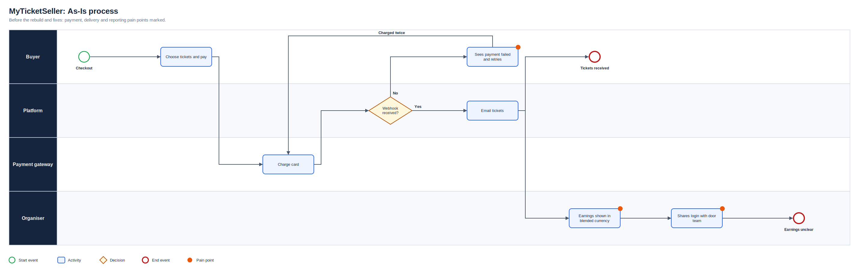
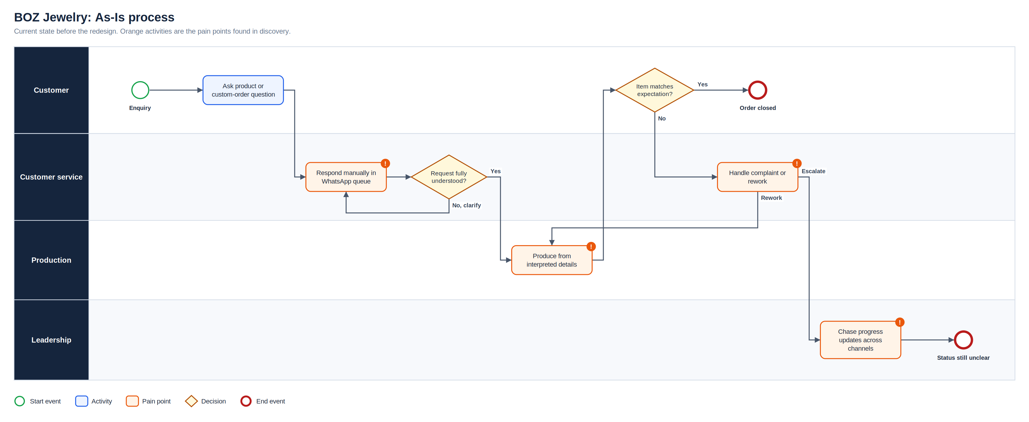
As-Is process
Full-resolution SVG is in the Diagrams folder
MyTicketSeller | Olalekan Ajimoti, Business Analyst portfolio
03

Slide 4
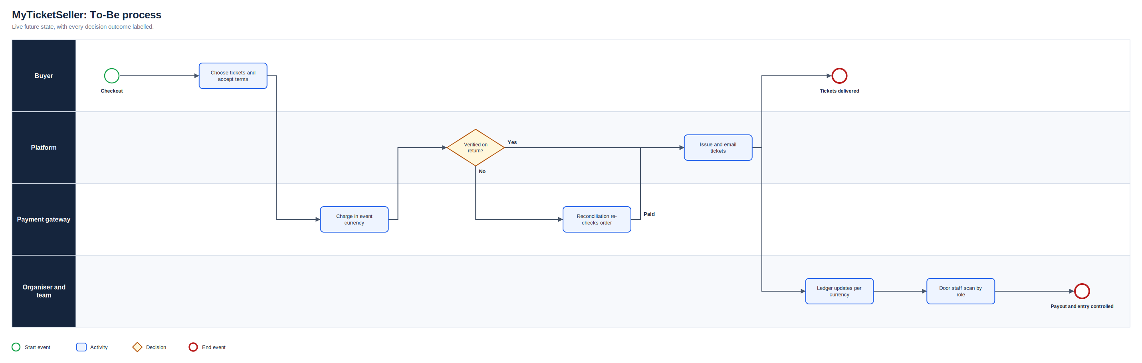
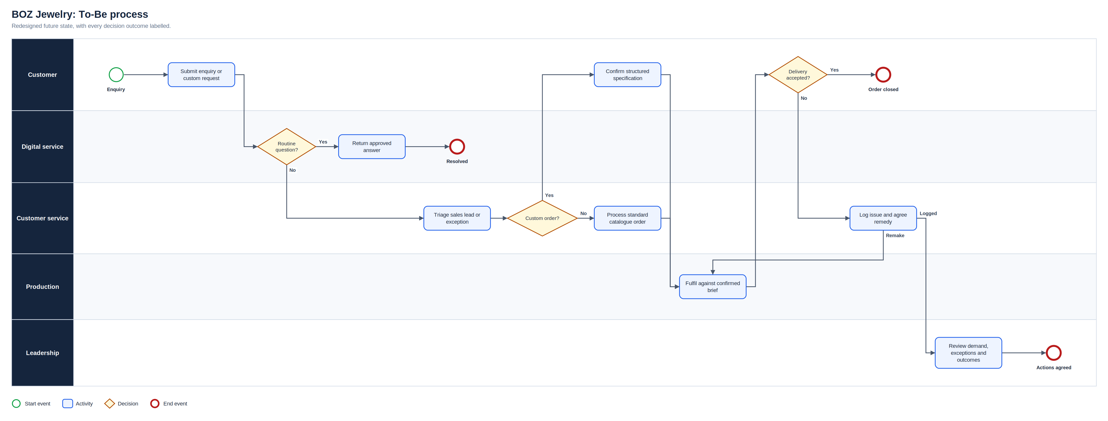
To-Be process
Full-resolution SVG is in the Diagrams folder
MyTicketSeller | Olalekan Ajimoti, Business Analyst portfolio
04

Slide 5
What changed
Area | Before | After
Payments | Tickets depended on one webhook; failures prompted repeat payments | Return-page verification plus reconciliation; tickets arrive near instantly
Revenue | Currencies blended and mis-converted | Per-currency ledger, wallets and payouts with visible fees
Event access | One shared login ran the door | Owner-only scanning with door staff, viewer and manager roles
Protection | Refunds, disputes and secrets handled ad hoc | Verified refund webhooks, evidence PDF, security audit fixes
MyTicketSeller | Olalekan Ajimoti, Business Analyst portfolio
05

Slide 6
Delivered outcomes
Figures come from the project's code history; commercial data is not published
4 → 1
90+
separate codebases consolidated into one live platform
owner-led changes shipped in 10 weeks (Jul to Sep 2026)
MyTicketSeller | Olalekan Ajimoti, Business Analyst portfolio
06

Slide 7
Recommendations and key risks
Recommended next actions
Risks with a named owner
Track the share of orders that need reconciliation, per gateway
Report refund and dispute rates by event and currency
Compare consented conversion by channel before scaling paid ads
Keep a written rule for every fee, currency and payout decision
R-01
Payment callbacks arrive late or not at all
Verify on return page and reconcile pending orders
R-02
Currency errors misstate organiser earnings
Per-currency ledger and display rules
R-03
Security gaps left by rapid early builds
Audit: remove debug endpoints, move secrets, rate limit auth
R-04
Chargebacks lost without evidence
Log terms consent and export evidence per dispute
MyTicketSeller | Olalekan Ajimoti, Business Analyst portfolio
07

