Slide 1
DELIVERED WORK
Komfort Place Signature Digital Growth
A premium spa in Lekki, Lagos moved from social-media enquiries to a measured website-to-WhatsApp booking funnel
Status: Live
Domain: Wellness and hospitality
Role: Digital Product Lead and Business Analyst

Slide 2
The problem and what discovery found
Business problem
What the analysis found
Bookings arrived through social-media messages with no website funnel, no way to see which service or page produced a booking, no answer for questions outside opening hours and little local search presence.
1
Booking intent was lost between discovering a service and starting a WhatsApp conversation
2
Nobody could see which page, service or button produced a booking enquiry
3
Local searches such as “massage in Lekki” surfaced competitors, not the spa
Komfort Place Signature | Olalekan Ajimoti, Business Analyst portfolio
02

Slide 3
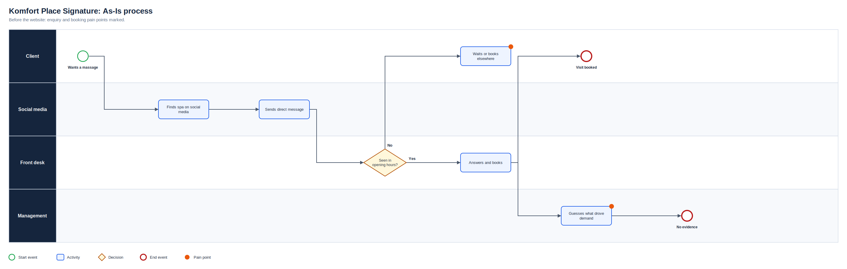
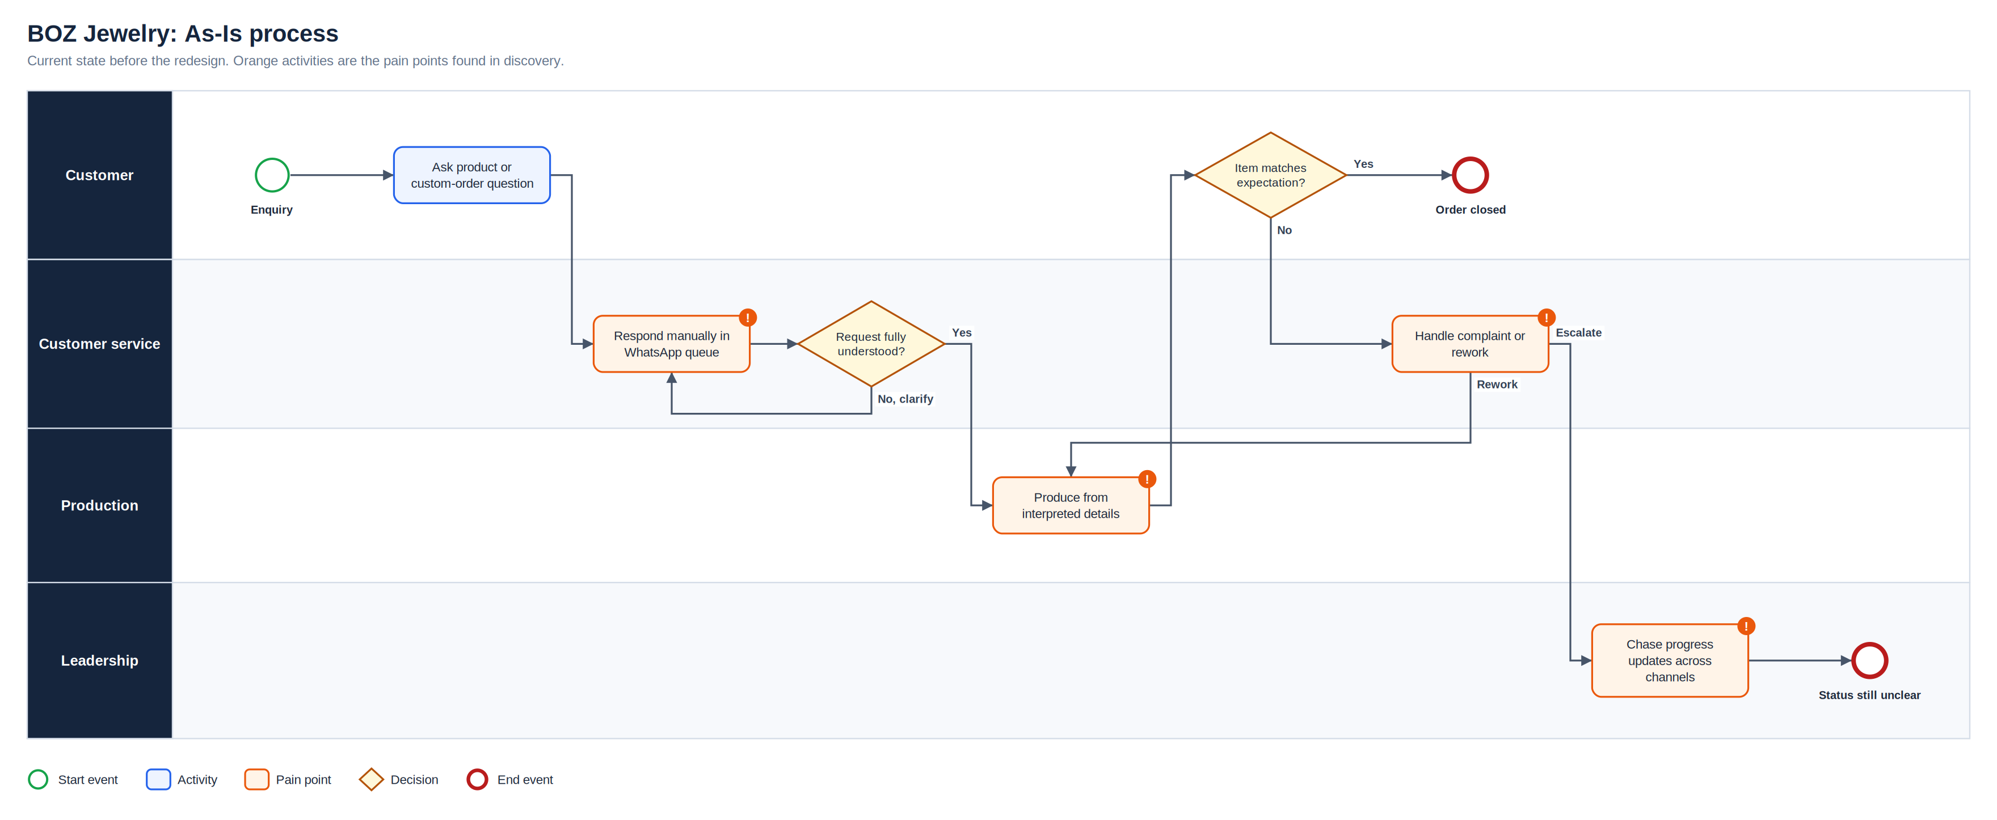
As-Is process
Full-resolution SVG is in the Diagrams folder
Komfort Place Signature | Olalekan Ajimoti, Business Analyst portfolio
03

Slide 4
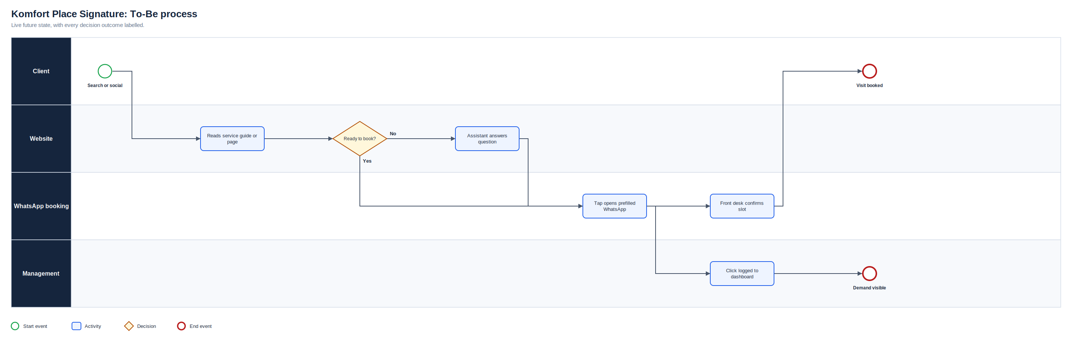
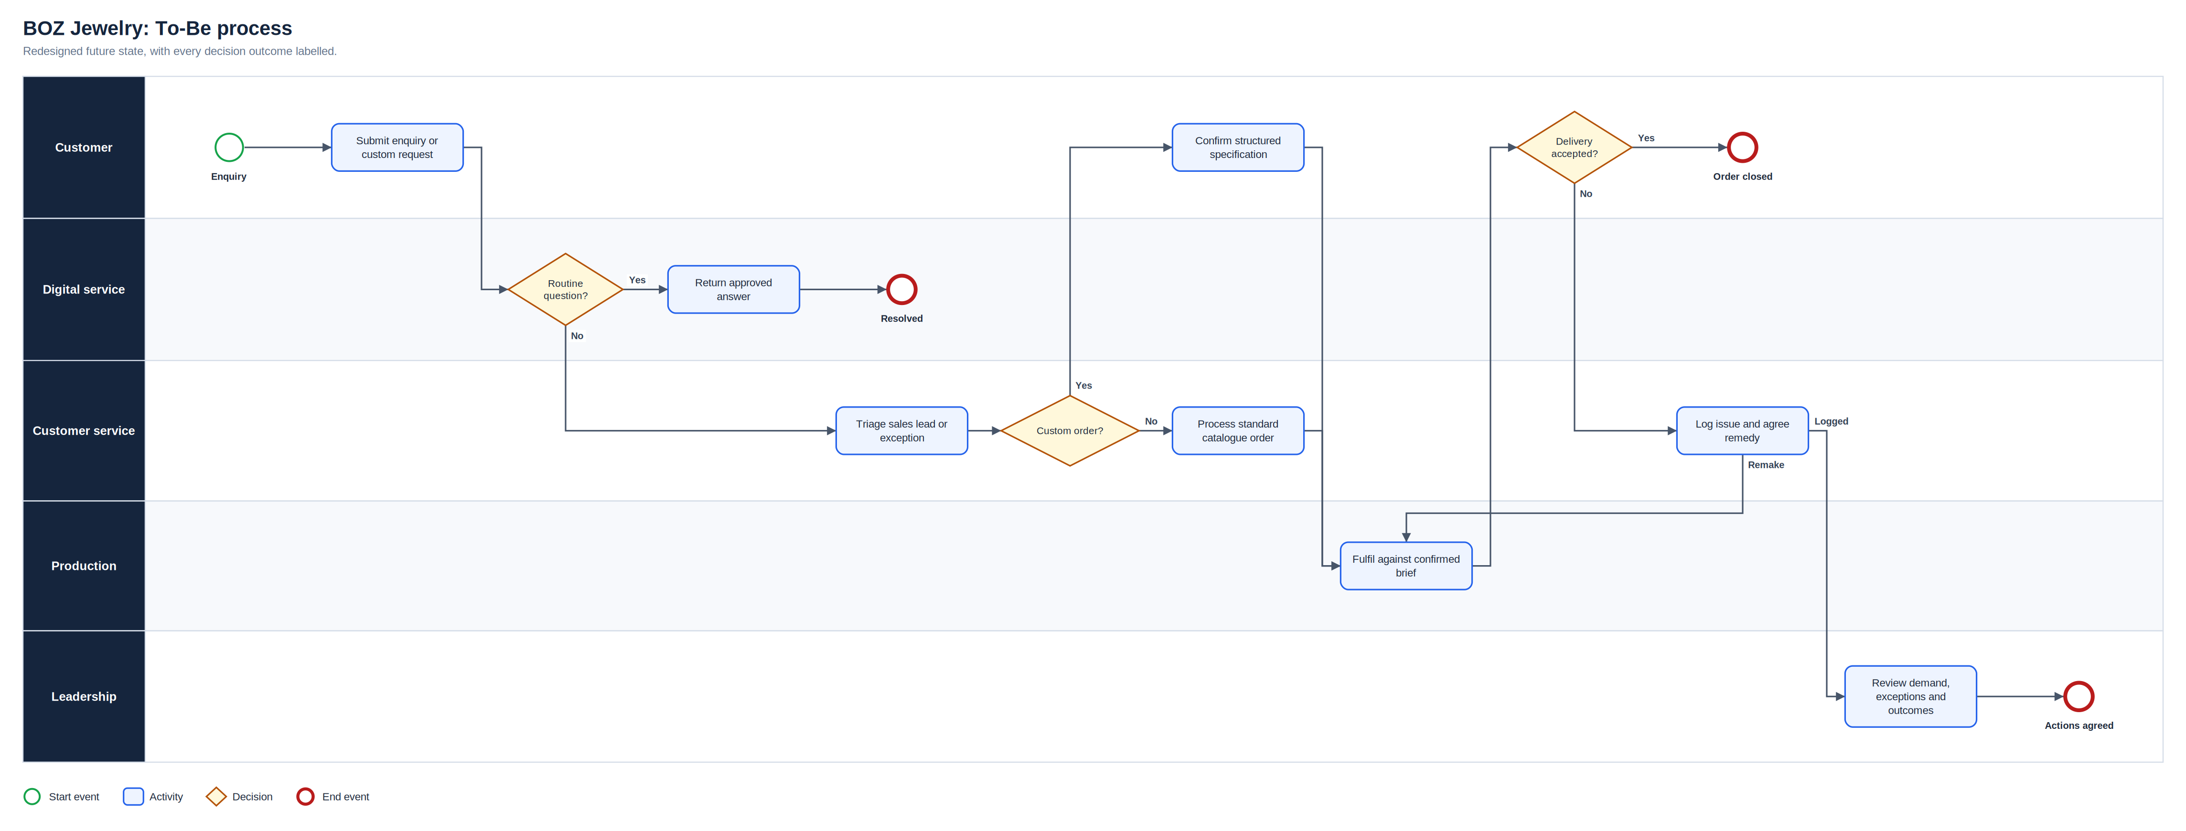
To-Be process
Full-resolution SVG is in the Diagrams folder
Komfort Place Signature | Olalekan Ajimoti, Business Analyst portfolio
04

Slide 5
What changed
Area | Before | After
Booking | Visitors had to find the spa on social media and message manually | One-tap WhatsApp booking on every page, prefilled with the service
Out of hours | Questions waited until opening time | Assistant answers approved questions and hands off to booking
Measurement | No data on what drove enquiries | First-party click and page-view dashboard, plus consented GA4 and Meta
Visibility | Little local search presence | Full SEO layer and a library of local service guides
Komfort Place Signature | Olalekan Ajimoti, Business Analyst portfolio
05

Slide 6
Delivered outcomes
Figures come from the project's build history; booking and revenue data are not published
14
4 months
local search guides published with full SEO markup
from first build to a measured booking funnel (May to Aug 2026)
Komfort Place Signature | Olalekan Ajimoti, Business Analyst portfolio
06

Slide 7
Recommendations and key risks
Recommended next actions
Risks with a named owner
Report booking taps per page and service every week
Match WhatsApp bookings back to the button that started them
Retire guides that attract traffic but no booking taps
Review assistant answers monthly against current prices
R-01
Content breaches search or ad policy
Review before publishing; withdraw non-compliant posts
R-02
Assistant gives a wrong price or availability
Approved content only and handoff to WhatsApp
R-03
Roster changes leave the site out of date
One roster list drives every page and prompt
R-04
Declined consent reduces third-party data
First-party click analytics as the baseline
Komfort Place Signature | Olalekan Ajimoti, Business Analyst portfolio
07

