Slide 1

DELIVERED WORK
The Ecommerce Boss SME Consulting
Business analysis for small businesses and SMEs: turning “we need a website” into agreed goals, prioritised scope and measurable results
Status: Ongoing (2024 to present)
Domain: SME digital services: marketing operations and web development
Role: Business Analyst

Slide 2
The problem and what discovery found
Business problem
What the analysis found
Small-business owners arrive with a solution already in mind, such as a new website or more sales from social media. Underneath there is usually no agreed goal, enquiries scattered across direct messages, forms and spreadsheets, and no way to see what marketing or the website actually returns, all on a tight budget.
1
Requests arrive as solutions (“build me a website”) before anyone has agreed the goal
2
Leads and customers live across DMs, forms and spreadsheets, so follow-ups are missed
3
Owners cannot see what their marketing or website returns, so budget decisions are guesswork
The Ecommerce Boss | Olalekan Ajimoti, Business Analyst portfolio
02

Slide 3
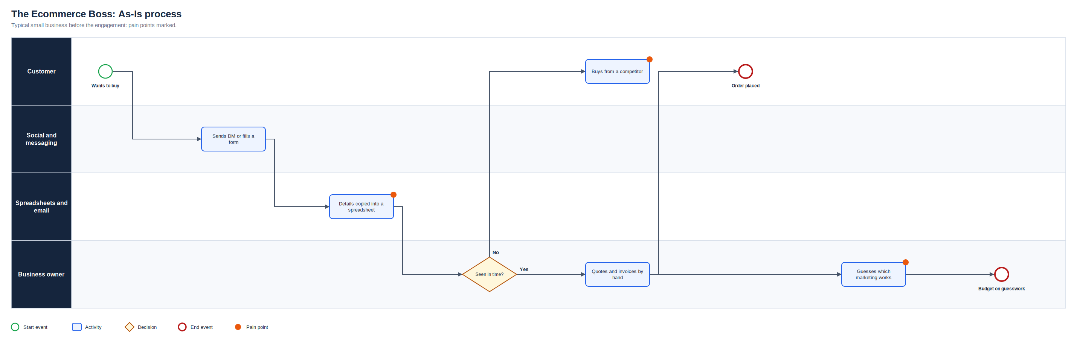
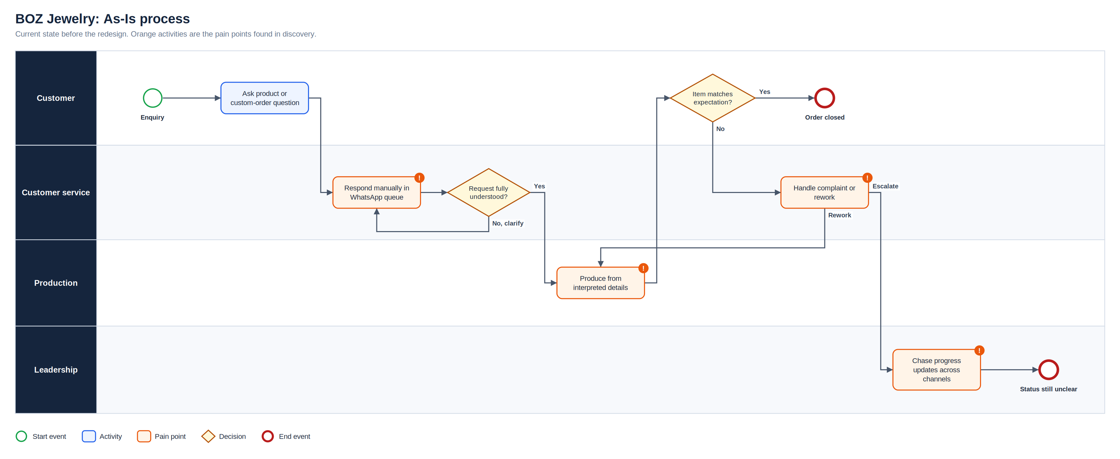
As-Is process
Full-resolution SVG is in the Diagrams folder
The Ecommerce Boss | Olalekan Ajimoti, Business Analyst portfolio
03

Slide 4
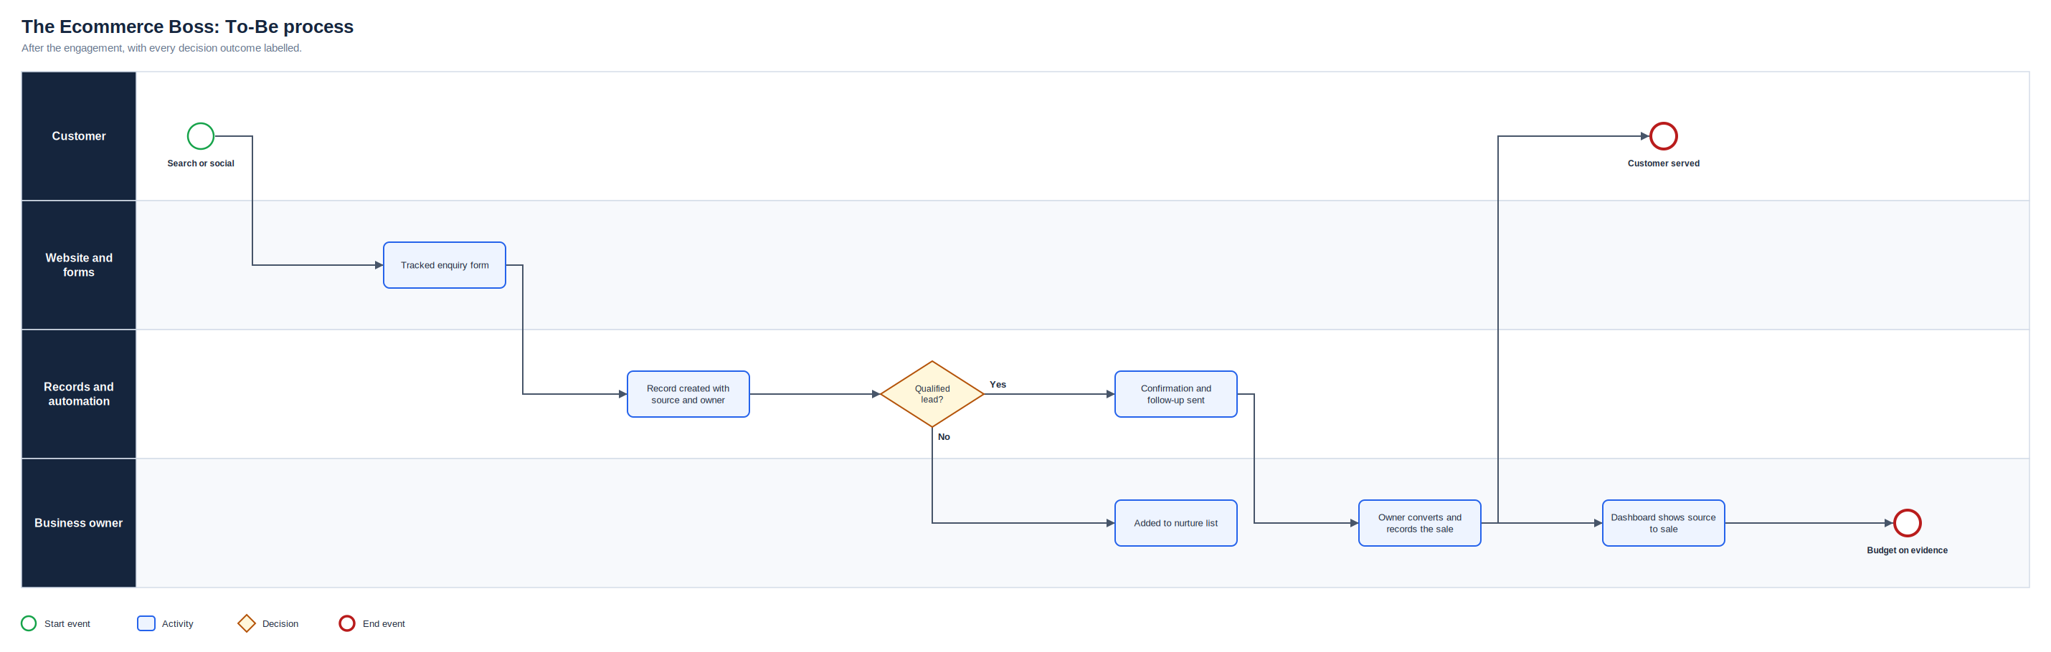
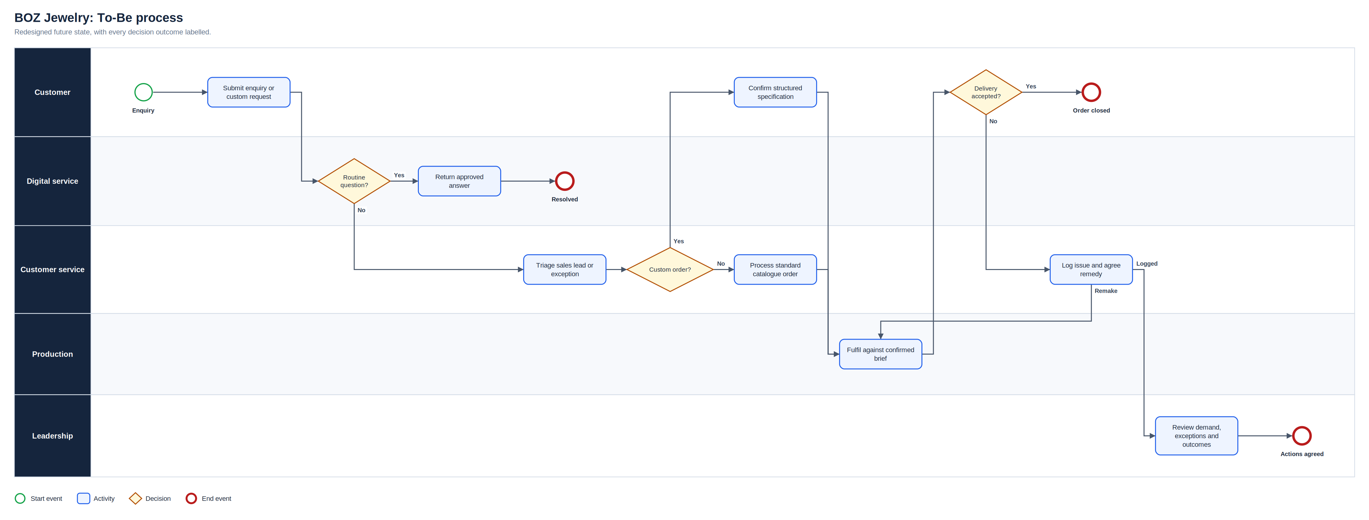
To-Be process
Full-resolution SVG is in the Diagrams folder
The Ecommerce Boss | Olalekan Ajimoti, Business Analyst portfolio
04

Slide 5
What changed
Area | Before | After
Starting point | A request for a website or more sales | An agreed goal, success measure and prioritised scope
Enquiries | Scattered across DMs, forms and spreadsheets | One record per enquiry with source, status and owner
Follow-up | Manual, and often missed | Automated confirmations and reminders
Decisions | Budget spent on guesswork | Performance by channel, tracked with consent
The Ecommerce Boss | Olalekan Ajimoti, Business Analyst portfolio
05

Slide 6
Delivered outcomes
Client results belong to each business and are not published
5 steps
1 record
repeatable engagement model: discover, define, build, test, hand over
per client for every enquiry, replacing DMs and spreadsheets
The Ecommerce Boss | Olalekan Ajimoti, Business Analyst portfolio
06

Slide 7
Recommendations and key risks
Recommended next actions
Risks with a named owner
Agree one success measure with every owner at the start
Keep a shared change log so scope stays inside budget
Review performance by channel with each client monthly
Turn repeated fixes into reusable templates across clients
R-01
Scope grows beyond a fixed small-business budget
MoSCoW prioritisation and a change log agreed with the owner
R-02
Owner has little time for discovery and testing
Short, structured sessions and clear decision points
R-03
Tools are abandoned after handover
Simple tools, training and a written guide
R-04
Poor data quality in legacy spreadsheets
Validation at intake and a one-off clean-up
The Ecommerce Boss | Olalekan Ajimoti, Business Analyst portfolio
07

