Slide 1

DELIVERED WORK
NaijaFoodFestival Multi-user Registration Service
Three distinct journeys replaced a single registration concept
Status: Delivered
Domain: Events and hospitality
Role: Product Owner and Business Analyst, HunterTV Africa

Slide 2
The problem and what discovery found
Business problem
What the analysis found
A single registration concept did not reflect the different information, approval and communication needs of attendees, vendors and volunteers.
1
Attendees, vendors and volunteers had different data and decision needs
2
A generic route risked irrelevant fields and missing approvals
3
Organisers needed one view of status and exceptions
NaijaFoodFestival | Olalekan Ajimoti, Business Analyst portfolio
02

Slide 3
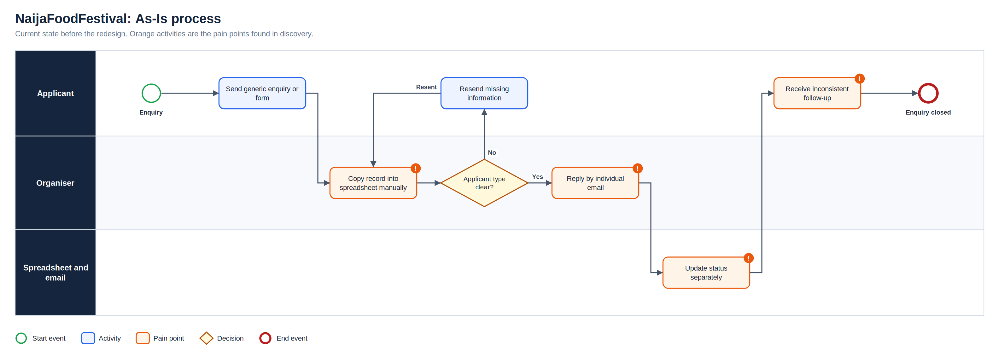
As-Is process
Full-resolution SVG is in the Diagrams folder
NaijaFoodFestival | Olalekan Ajimoti, Business Analyst portfolio
03

Slide 4
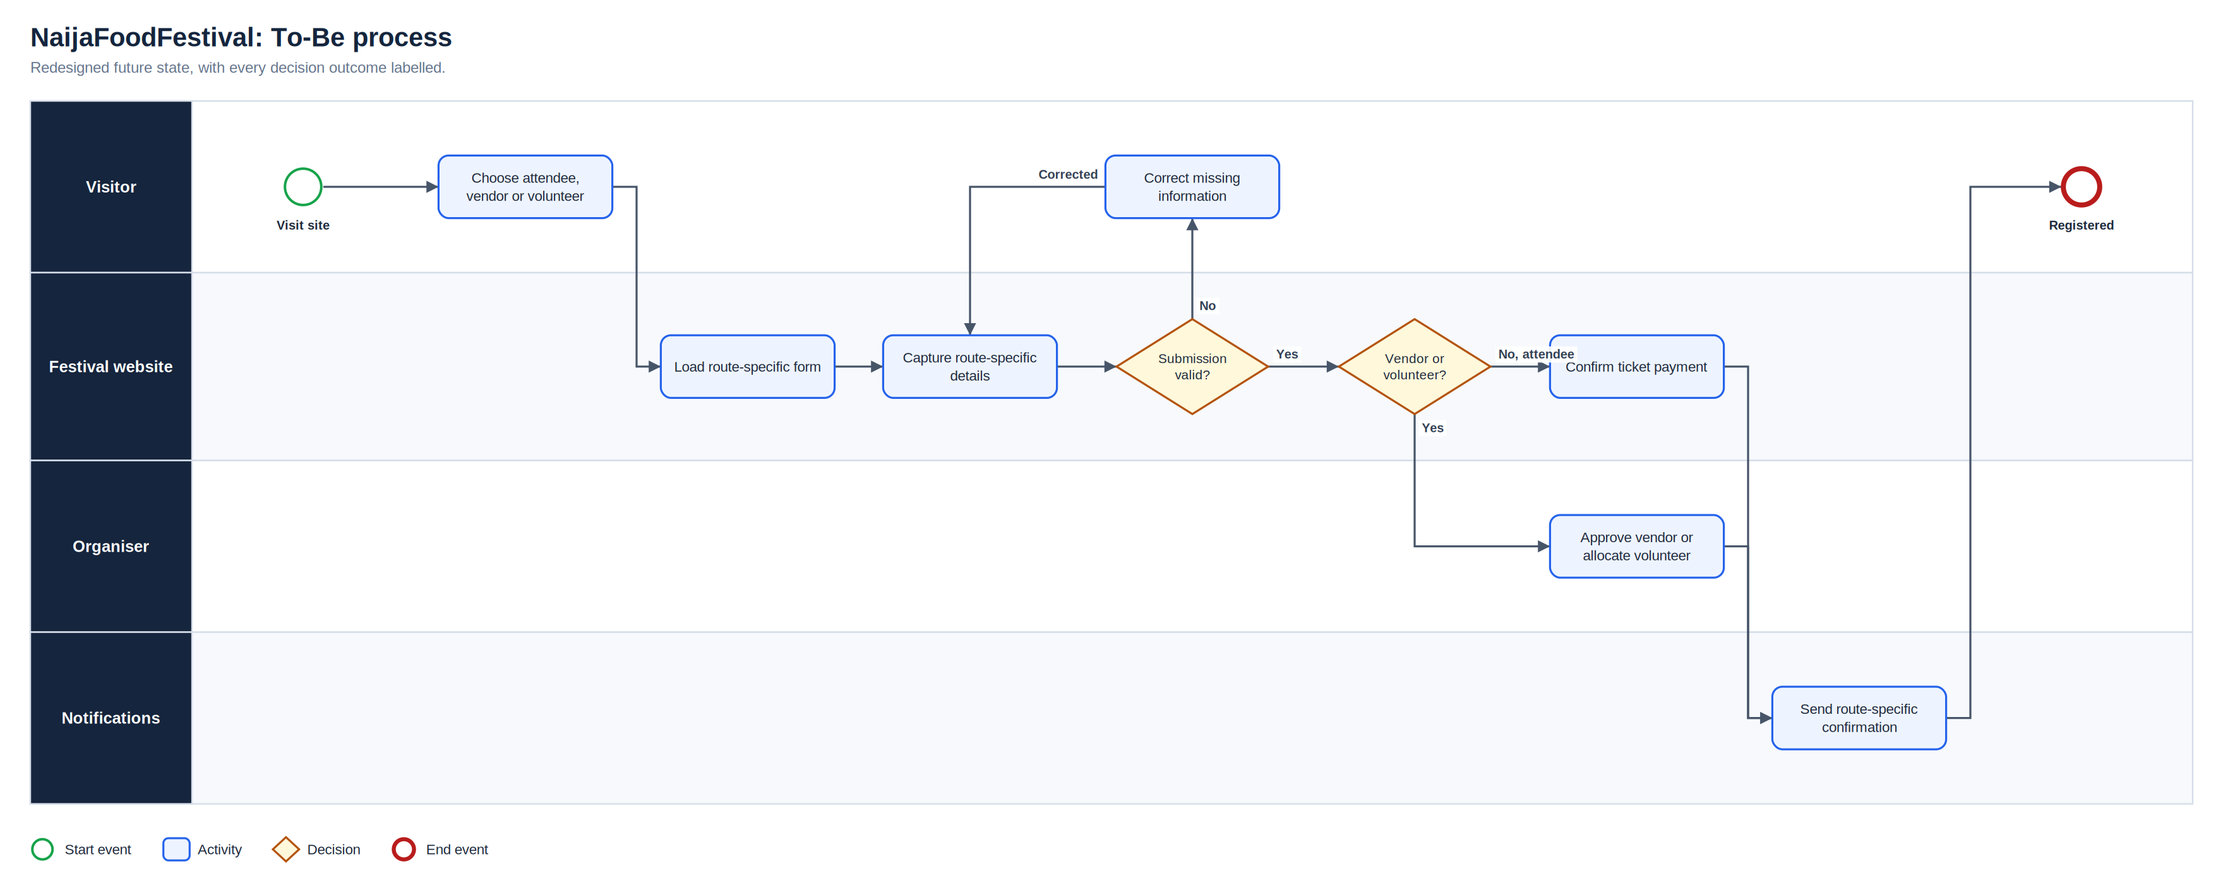
To-Be process
Full-resolution SVG is in the Diagrams folder
NaijaFoodFestival | Olalekan Ajimoti, Business Analyst portfolio
04

Slide 5
What changed
Area | Before | After
Attendees | Generic registration | Purchase journey with confirmation and event updates
Vendors | No clear decision path | Evidence review, decision status and decision email
Volunteers | Availability managed informally | Availability capture, allocation and briefing
Organisers | Manual reconciliation | Central route, status, owner and next action
NaijaFoodFestival | Olalekan Ajimoti, Business Analyst portfolio
05

Slide 6
Evidence and measures
What is evidenced today and what to track next
Measure | Current evidence status | How it will be used
User journeys | Three distinct routes delivered | Report completion by route
Pre-launch validation | End-to-end test cycle completed | Repeat before each season
Exception age | To be tracked from Season 2 | Target same-week resolution
NaijaFoodFestival | Olalekan Ajimoti, Business Analyst portfolio
06

Slide 7
Recommendations and key risks
Recommended next actions
Risks with a named owner
Report completion and drop-off by route each season
Keep message templates under change control
Review vendor rules with organisers before applications open
Retain the pre-launch test pack as a regression suite
R-01
One form collects irrelevant information
Separate routes by purpose
R-02
Email and record status diverge
Send only after status update; trigger tests
R-03
Vendor approval rules are incomplete
Decision checkpoint with organisers
R-04
Ticketing or email service is unavailable
Fallback communication and manual list
NaijaFoodFestival | Olalekan Ajimoti, Business Analyst portfolio
07

