Slide 1
VERDASO
CONCEPT AND MVP DESIGN
Verdaso ESG Evidence Infrastructure
Source-proof evidence capture with human validation and versioned framework mapping
Status: Concept / MVP design
Domain: ESG, compliance and sustainability technology
Role: Founder and Product Business Analyst

Slide 2
The problem and what discovery found
Business problem
What the analysis found
SMEs hold ESG evidence in photos, PDFs and spreadsheets without source context, so reports are slow to assemble and hard for auditors to trust.
1
Evidence files are separated from their source context
2
AI extraction errors can become accepted facts
3
Framework changes break comparability between periods
Verdaso | Olalekan Ajimoti, Business Analyst portfolio
VERDASO
02

Slide 3
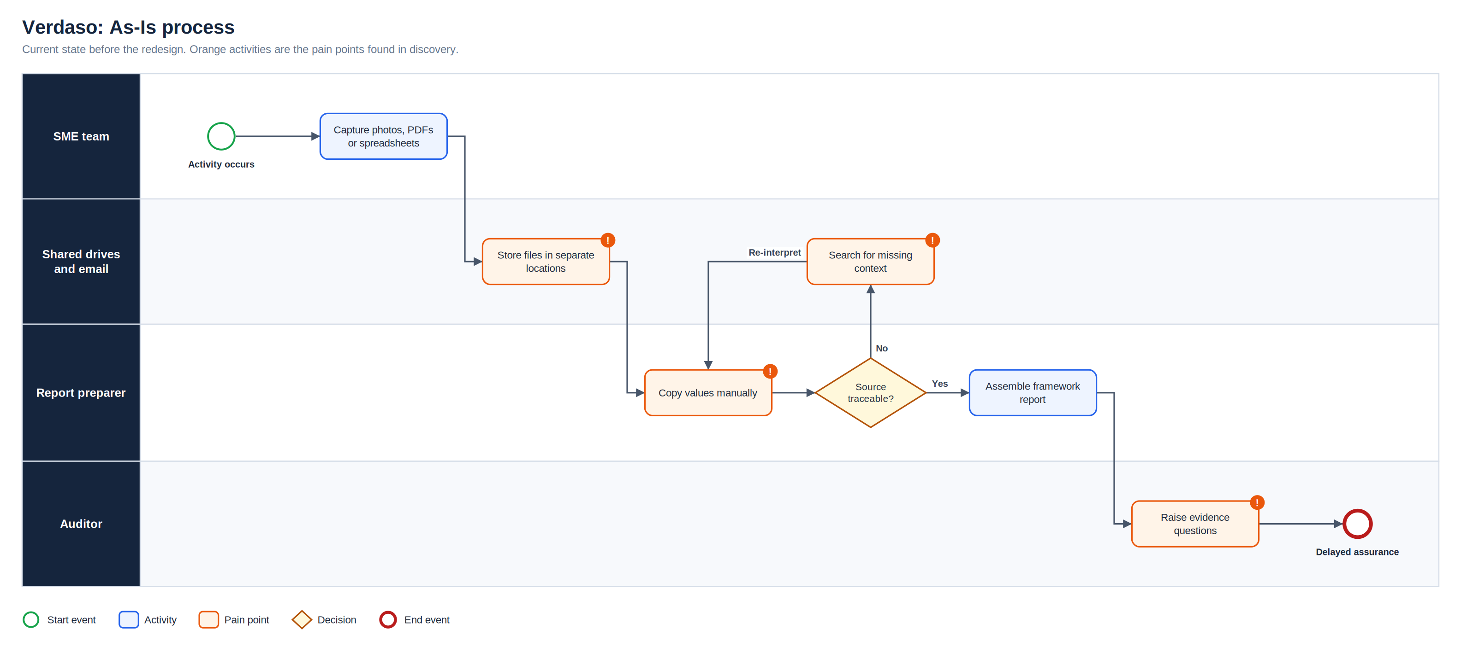
As-Is process
Full-resolution SVG is in the Diagrams folder
Verdaso | Olalekan Ajimoti, Business Analyst portfolio
VERDASO
03

Slide 4
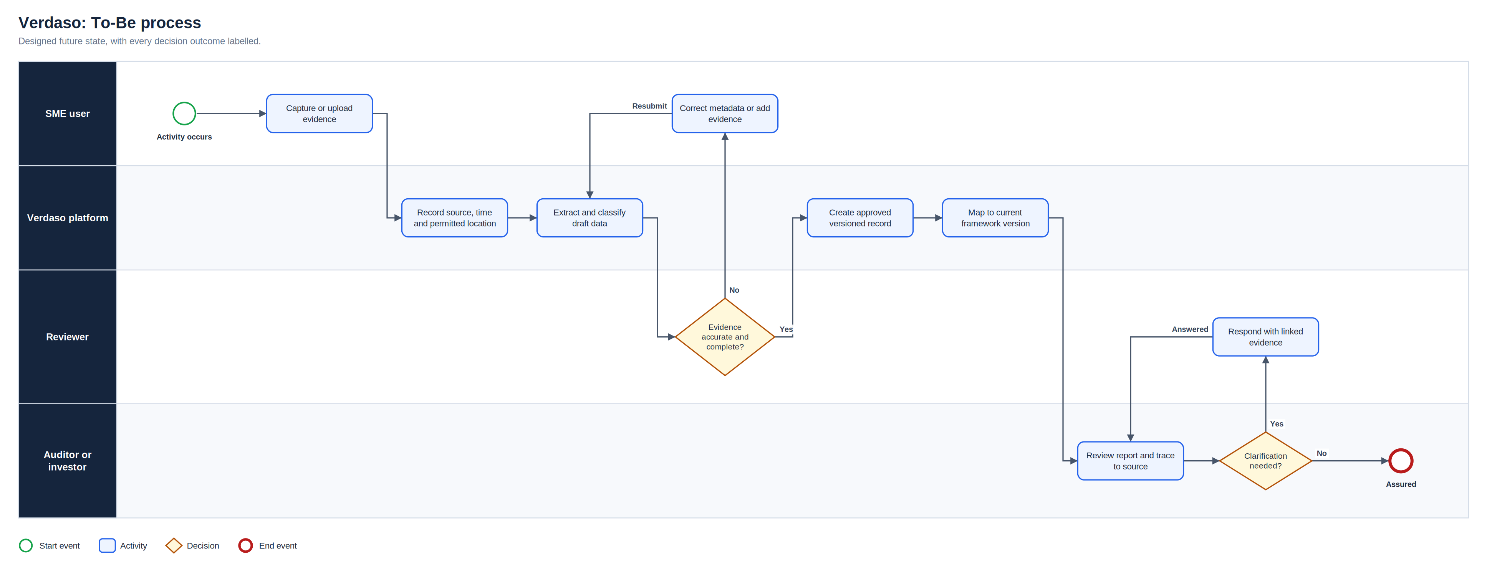
To-Be process
Full-resolution SVG is in the Diagrams folder
Verdaso | Olalekan Ajimoti, Business Analyst portfolio
VERDASO
04

Slide 5
Proposed operating-model change
Area | Before | After
Capture | Files saved anywhere | Source, time and location recorded on capture
Validation | Values copied by hand | AI draft plus human approval
Corrections | Overwritten | Appended with reason and approver
Reporting | Framework version unclear | Versioned mappings printed on output
Verdaso | Olalekan Ajimoti, Business Analyst portfolio
VERDASO
05

Slide 6
How success will be measured
No live outcomes are claimed for this case
Measure | Current evidence status | How it will be used
Source-link completeness | Defined for MVP | Target 100% for approved records
Extraction correction rate | Defined for MVP | Monitor model quality
Auditor query time | Defined for MVP | Compare with manual baseline
Verdaso | Olalekan Ajimoti, Business Analyst portfolio
VERDASO
06

Slide 7
Recommendations and key risks
Recommended next actions
Risks with a named owner
Interview two auditors on acceptable digital evidence
Run a data protection impact assessment before any GPS capture
Start with one framework and one sector
Measure correction rates before automating further
R-01
AI misclassifies evidence
Mandatory human validation
R-02
Location data creates privacy risk
Purpose limitation and precision control
R-03
Immutable record blocks lawful correction
Append-only correction model
R-04
Framework requirements change
Effective-dated mappings
Verdaso | Olalekan Ajimoti, Business Analyst portfolio
VERDASO
07

