Slide 1
TRANSFERABLE ANALYSIS
AI Evaluation Quality and Consistent Judgement
Criteria-based judgement with evidence, version control and calibration
Status: Delivered evaluation work
Domain: Artificial intelligence services
Role: AI Evaluation Contractor

Slide 2
The problem and what discovery found
Business problem
What the analysis found
Evaluating AI outputs at scale needs consistent interpretation of criteria, clear separation of evidence from assumption, and safe adaptation when guidance changes.
1
Criteria can be applied from memory rather than current guidance
2
Evidence and inference get mixed in rationales
3
Guidance updates mid-project cause drift
AI Evaluation | Olalekan Ajimoti, Business Analyst portfolio
02

Slide 3
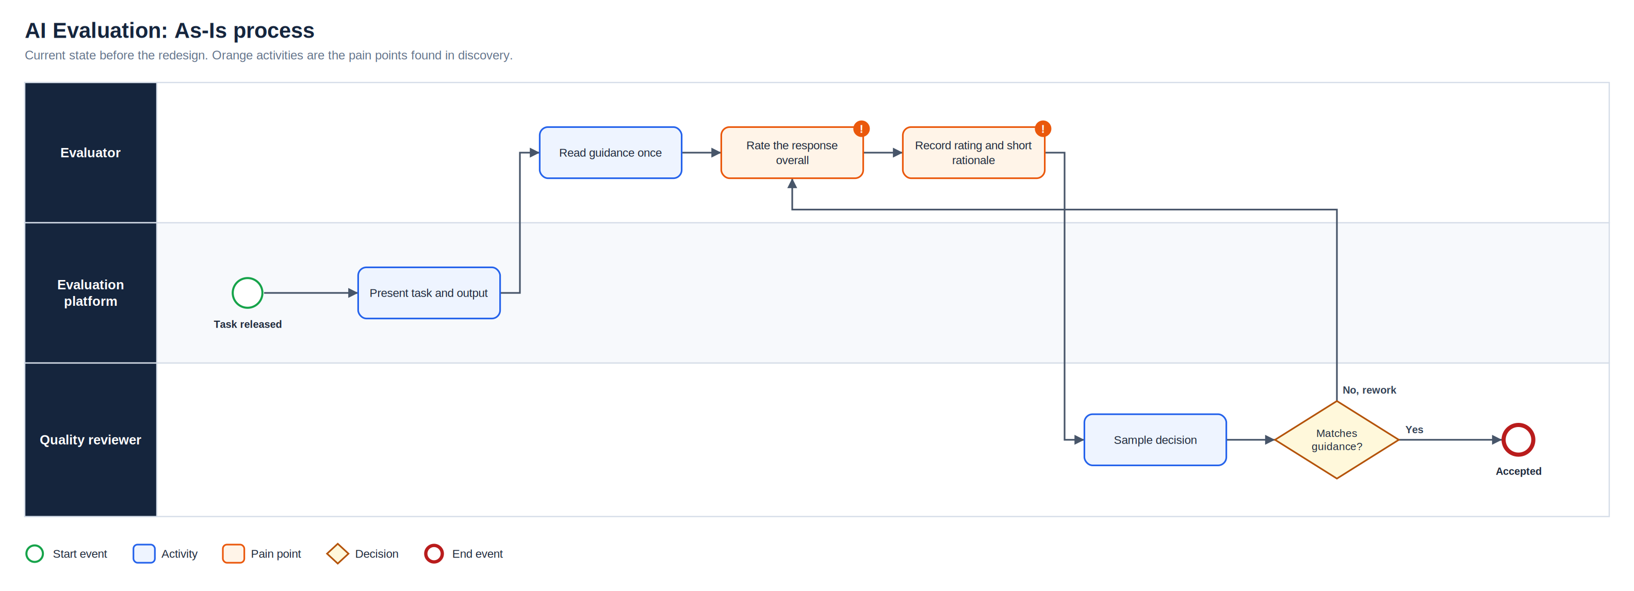
As-Is process
Full-resolution SVG is in the Diagrams folder
AI Evaluation | Olalekan Ajimoti, Business Analyst portfolio
03

Slide 4
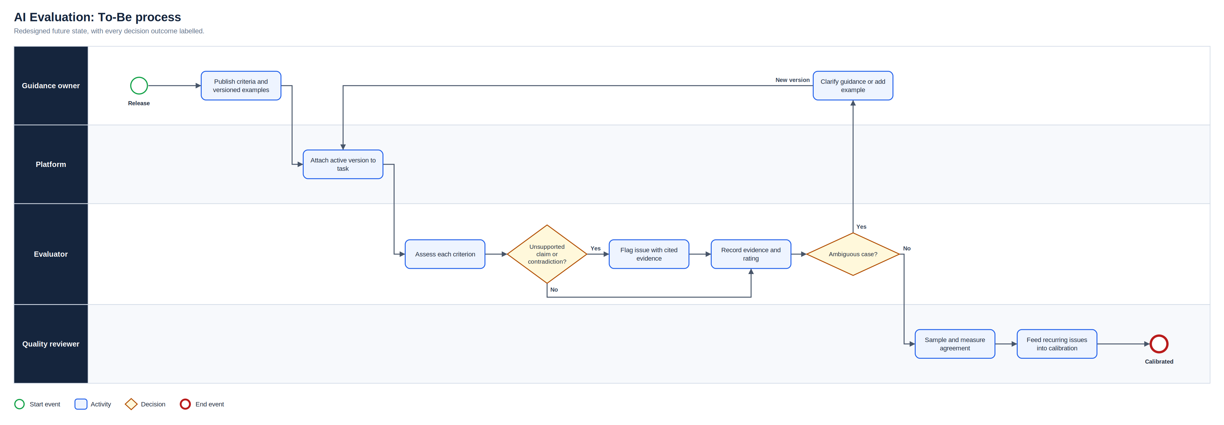
To-Be process
Full-resolution SVG is in the Diagrams folder
AI Evaluation | Olalekan Ajimoti, Business Analyst portfolio
04

Slide 5
What changed
Area | Before | After
Criteria | Read once, applied from memory | Active version on every task
Assessment | Overall impression | Each criterion rated separately
Rationale | Short and general | Cites the specific evidence
Ambiguity | Guessed | Escalated to guidance owner
AI Evaluation | Olalekan Ajimoti, Business Analyst portfolio
05

Slide 6
How success will be measured
No live outcomes are claimed for this case
Measure | Current evidence status | How it will be used
Agreement with reviewers | Tracked by the platform | Target stable or rising
Rework after guidance change | Observed | Should fall after calibration
Escalations resolved | Observed | Feed into examples
AI Evaluation | Olalekan Ajimoti, Business Analyst portfolio
06

Slide 7
Recommendations and key risks
Recommended next actions
Risks with a named owner
Check the guidance version before every batch
Keep a personal log of edge cases and rulings
Cite evidence for every negative rating
Escalate early rather than guess
R-01
Criteria interpreted inconsistently
Worked examples and calibration
R-02
Guidance changes midstream
Version control and change notes
R-03
Unsupported assumption affects rating
Evidence checklist
R-04
Sensitive content exposed
Confidentiality controls
AI Evaluation | Olalekan Ajimoti, Business Analyst portfolio
07

