Slide 1
TRANSFERABLE ANALYSIS
Healthcare Facilities Request Handling
Impact-based triage, named escalation and recurrence review for facilities requests
Status: Generalised operational analysis
Domain: Healthcare support services
Role: Facilities and quality support

Slide 2
The problem and what discovery found
Business problem
What the analysis found
Facilities requests in a healthcare setting can arrive without impact context, stall on access or resource constraints, and recur without anyone seeing the pattern.
1
Requests often lack location, timing or impact detail
2
Access and resource constraints are not visible to supervisors
3
Recurring issues are handled one at a time
Healthcare Facilities Requests | Olalekan Ajimoti, Business Analyst portfolio
02

Slide 3
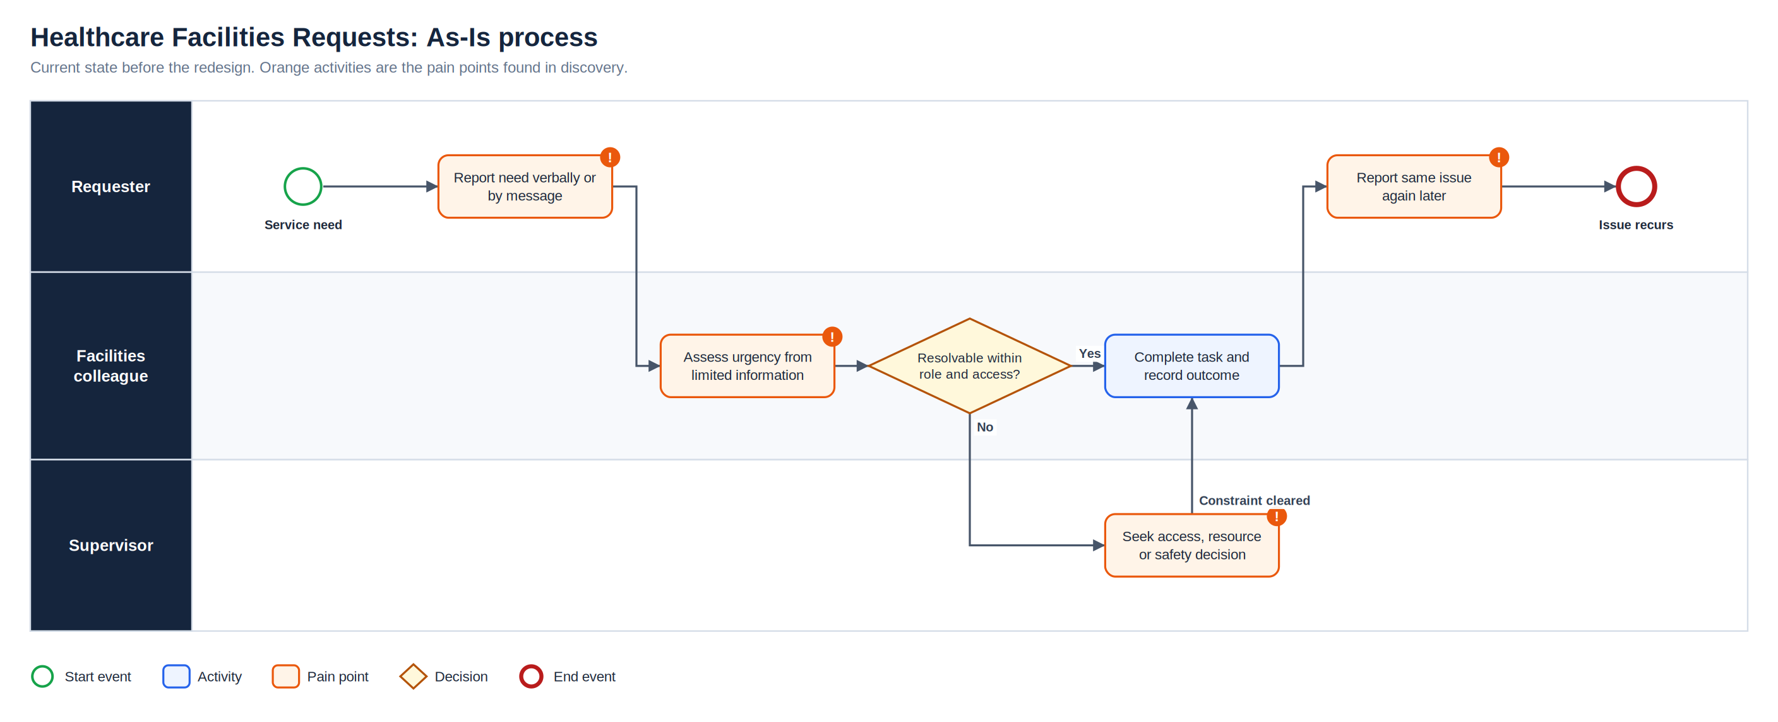
As-Is process
Full-resolution SVG is in the Diagrams folder
Healthcare Facilities Requests | Olalekan Ajimoti, Business Analyst portfolio
03

Slide 4
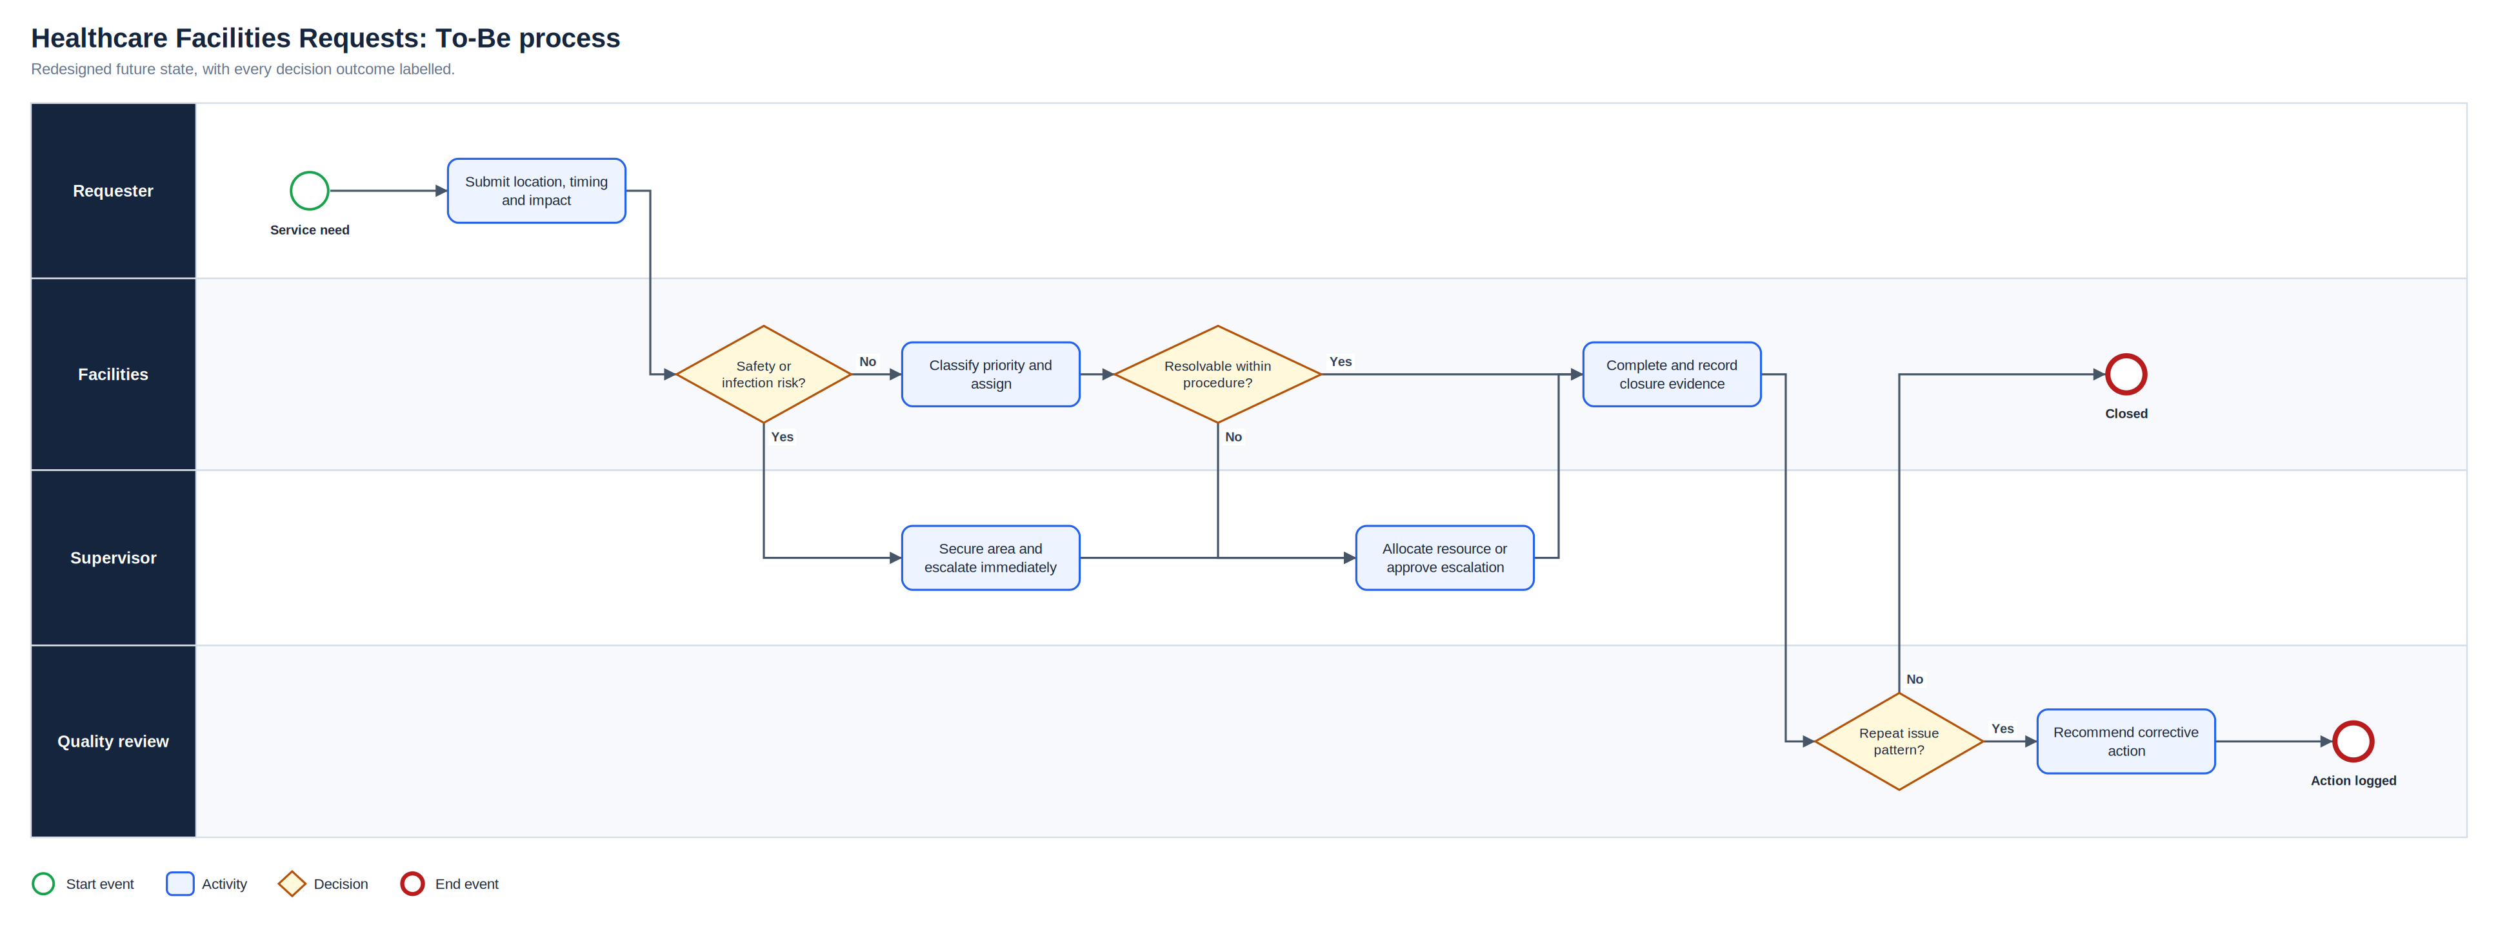
To-Be process
Full-resolution SVG is in the Diagrams folder
Healthcare Facilities Requests | Olalekan Ajimoti, Business Analyst portfolio
04

Slide 5
What changed
Area | Before | After
Intake | Verbal or informal messages | Location, timing and impact captured
Priority | Judged from limited detail | Safety flag and impact classification
Escalation | Constraint handled ad hoc | Named owner and target date
Recurrence | Seen one at a time | Monthly pattern review
Healthcare Facilities Requests | Olalekan Ajimoti, Business Analyst portfolio
05

Slide 6
How success will be measured
No live outcomes are claimed for this case
Measure | Current evidence status | How it will be used
Response by priority | Illustrative measure | Check against local standards
Escalation age | Illustrative measure | Review at supervisor huddle
Repeat rate | Illustrative measure | Target decreasing trend
Healthcare Facilities Requests | Olalekan Ajimoti, Business Analyst portfolio
06

Slide 7
Recommendations and key risks
Recommended next actions
Risks with a named owner
Use impact questions at intake
Review escalations daily
Group repeats monthly by location
Keep patient data out of request records
R-01
Urgent issue misprioritised
Impact criteria and safety flag
R-02
Record lacks evidence
Required intake fields
R-03
Sensitive information disclosed
No patient data in requests
R-04
Recurring issue stays local
Monthly recurrence review
Healthcare Facilities Requests | Olalekan Ajimoti, Business Analyst portfolio
07

