Slide 1
SIDONPAY
Business Intelligence &
Customer Segmentation
Week 4 — Turning Transaction Data into Business Decisions
Prepared by Ahmed · Data Analyst/Scientist Intern · Team Beta

Slide 2
EXECUTIVE OVERVIEW
Business Health at a Glance
6.36M
571,961
83.1%
0.129%
Total Transactions
Active Customers
Value from 35% of Customers
Overall Fraud Rate
The headline: SIDONPAY's transaction value is highly concentrated. Protecting and growing the High-Value Power Users segment matters more than any other single lever.
SIDONPAY · Team Beta · Week 4
2

Slide 3
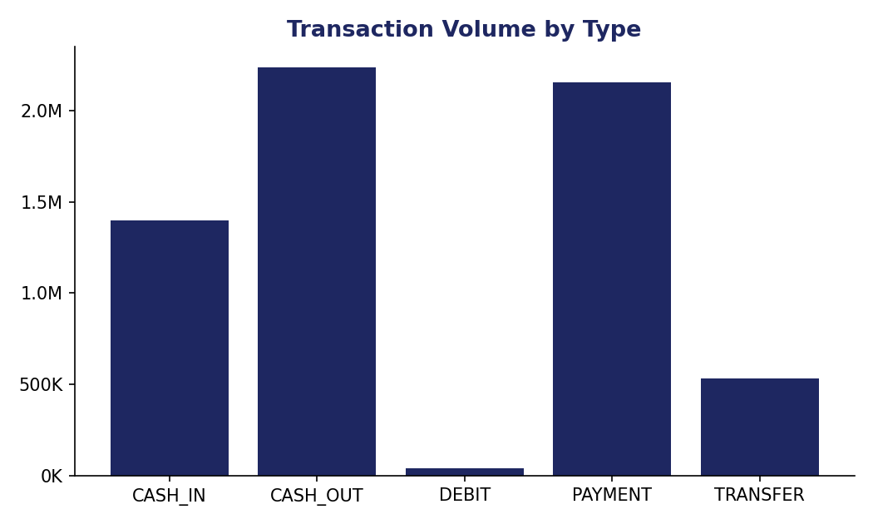
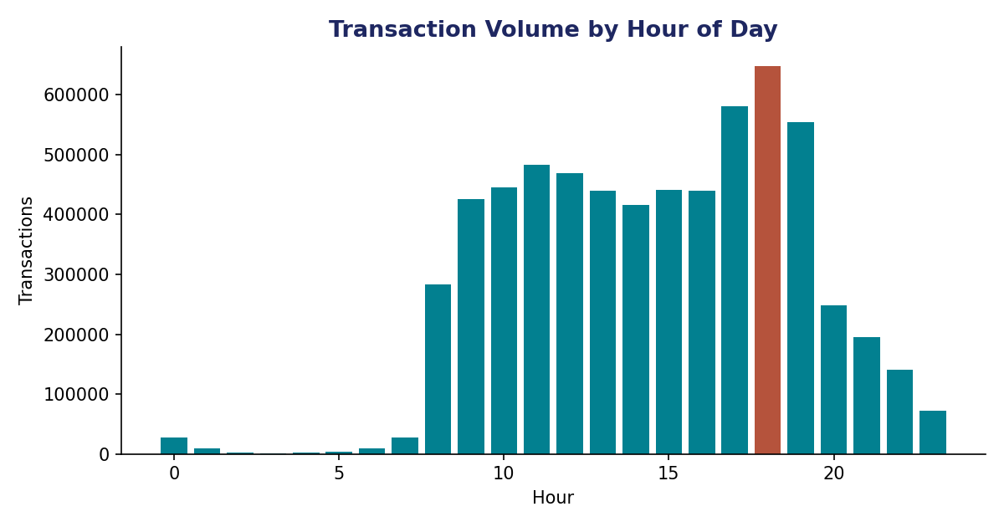
CUSTOMER BEHAVIOR
How Customers Use the Platform
CASH_OUT and PAYMENT dominate volume. Activity peaks sharply at 18:00 — 522x the quietest hour — meaning infrastructure must be sized for the evening peak, not the daily average.
SIDONPAY · Team Beta · Week 4
3

Slide 4
METHODOLOGY NOTE
What Actually Counts as a “Customer”?
The Problem
1
99.85% of sending-account IDs (nameOrig) appear only once across 6.36M transactions — not a durable customer identity.
The Fix
2
Receiving accounts (nameDest) show real repeat behavior — 571,961 unique customers, some receiving 100+ transactions.
Why It Matters
3
Segmentation is only valid when it's built on accounts that actually recur — so this analysis segments recipients, not senders.
SIDONPAY · Team Beta · Week 4
4

Slide 5
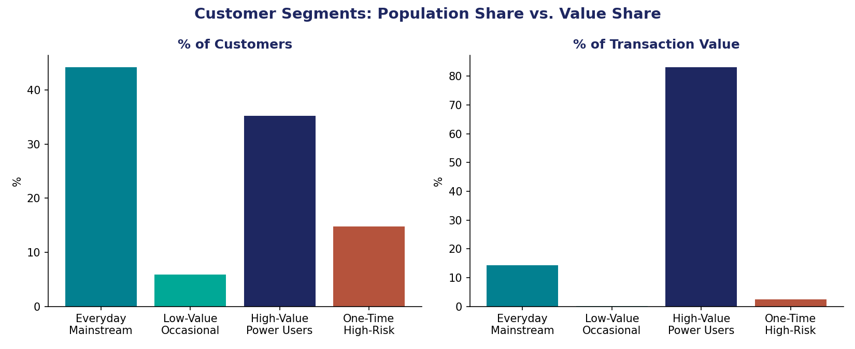
CUSTOMER SEGMENTATION
Four Segments, Very Different Value
Everyday Mainstream
44.2% of customers · 14.3% of value
High-Value Power Users
35.2% of customers · 83.1% of value
One-Time High-Risk
14.8% of customers · 2.63% fraud rate
Low-Value Occasional
5.9% of customers · 0.1% of value
SIDONPAY · Team Beta · Week 4
5

Slide 6
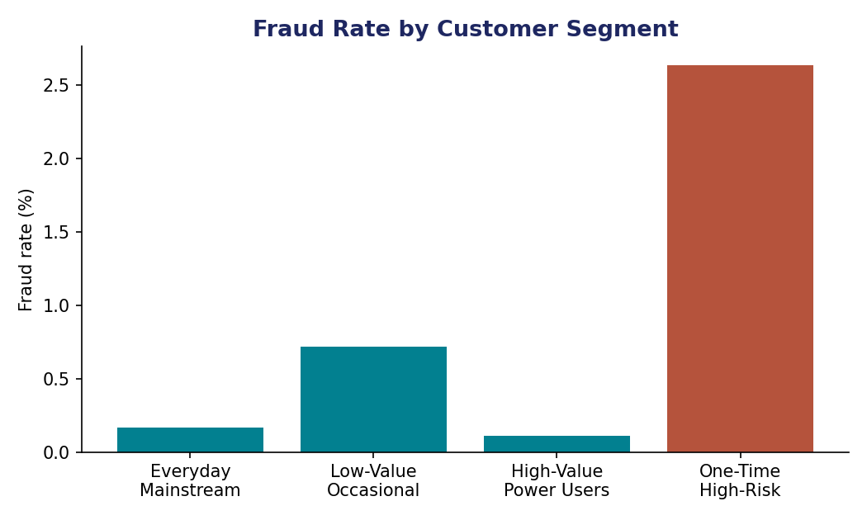
PRIORITY SEGMENT
High-Value Power Users: Protect This Group
WHO THEY ARE
35.2% of customers — highest transaction frequency (~15/month), highest average balance, heavy CASH_OUT usage.
WHY THEY MATTER
They drive 83.1% of all transaction value — and carry the LOWEST fraud rate of any segment (0.11%).
RECOMMENDATION
Build loyalty/premium tiers and dedicated support for this group — protecting their experience matters more than any other single product decision.
Notice: risk and value move in OPPOSITE directions across segments — the highest-value customers are also the safest.
SIDONPAY · Team Beta · Week 4
6

Slide 7
RECOMMENDATIONS
What Each Team Should Do Next
EXECUTIVE
PRODUCT
Track business health by Power User retention, not just total user count — that's where 83% of value lives.
Build a premium tier for Power Users; keep onboarding frictionless for the Everyday Mainstream majority.
MARKETING
RISK
Re-engage Low-Value Occasional users; target evening peak hours (17:00–19:00) for promotions.
Trigger enhanced KYC on the One-Time High-Risk profile: first-time recipient + near-zero balance + large TRANSFER.
SIDONPAY · Team Beta · Week 4
7

Slide 8
KEY TAKEAWAY
Value and risk are concentrated, not evenly spread — SIDONPAY's strategy should treat its customer base as four distinct groups, not one.
Ahmed · Data Analyst/Scientist Intern · Team Beta · Submission: Mon 27 Sept 2026

