Slide 1
SIDONPAY
Funnel Analysis Framework
Simulated Customer Journey — Week 6
Prepared by Ahmed · Data Analyst/Scientist Intern · Team Beta

Slide 2
WHY THIS MATTERS
Designing the Journey Before Users Exist
SIDONPAY has no real user data yet — the platform is pre-launch. This week builds the analytical framework product teams need in place before data starts flowing: map the journey, define the metrics, simulate believable data, and practice spotting bottlenecks.
Awareness
→
Sign-Up
→
Verification
(KYC)
→
First
Transaction
→
Repeat
Usage
Five stages, as defined in the Week 6 brief — each with its own intention, actions, and success factors.
SIDONPAY · Team Beta · Week 6
2

Slide 3
STAGE 1 OF 5
Awareness
Key Metrics
1
User Intention
Impressions, click-through rate, installs, cost per install, install-to-open rate.
Potential user learns SIDONPAY exists and could solve a real problem.
Required Actions
See an ad/referral, read enough to decide it's worth trying, download the app.
Success / Failure Factors
Clear, specific messaging beats generic fintech marketing. Trust signals matter most here — zero commitment yet.
SIDONPAY · Team Beta · Week 6
3

Slide 4
STAGE 2 OF 5
Sign-Up
Key Metrics
2
User Intention
Sign-up start & completion rate, avg. time to complete, OTP success rate.
Create an account quickly, without feeling over-committed too soon.
Required Actions
Enter phone/email, set password/PIN, confirm OTP, accept terms.
Success / Failure Factors
Every extra field costs conversions. OTP delivery reliability is a common silent failure point.
SIDONPAY · Team Beta · Week 6
4

Slide 5
STAGE 3 OF 5
Verification (KYC)
Key Metrics
3
User Intention
KYC start/completion rate, time to completion (median & p90), rejection rate.
Unlock real functionality — expects the “verify in minutes” promise to hold.
Required Actions
Submit ID, selfie/liveness check, BVN/NIN or address proof by tier.
Success / Failure Factors
Historically fintech's most fragile step. Document quality, lighting, and manual review queues all add delay.
SIDONPAY · Team Beta · Week 6
5

Slide 6
STAGE 4 OF 5
First Transaction
Key Metrics
4
User Intention
Verified-to-transacting rate, time to first transaction, transaction type/value mix.
Experience the product's actual value — send money, pay a bill, fund the account.
Required Actions
Fund wallet, choose transaction type, confirm and complete.
Success / Failure Factors
A gap often opens between 'verified' and 'activated' if there's no immediate use case ready.
SIDONPAY · Team Beta · Week 6
6

Slide 7
STAGE 5 OF 5
Repeat Usage
Key Metrics
5
User Intention
30-day repeat rate, time between 1st & 2nd transaction, churn after first transaction.
Come back — a second transaction is the real signal the product stuck.
Required Actions
Return within 30 days, initiate a second transaction.
⚠ HIGHEST-RISK STAGE
Real transaction data from Week 4 of this internship showed only 0.15% of accounts had more than one transaction in a month. This simulation's 35% repeat-usage target is already optimistic — retention must be actively designed for, not assumed.
Success / Failure Factors
SIDONPAY's largest risk: real Week 4 data showed 99.85% of accounts had only ONE transaction ever.
SIDONPAY · Team Beta · Week 6
7

Slide 8
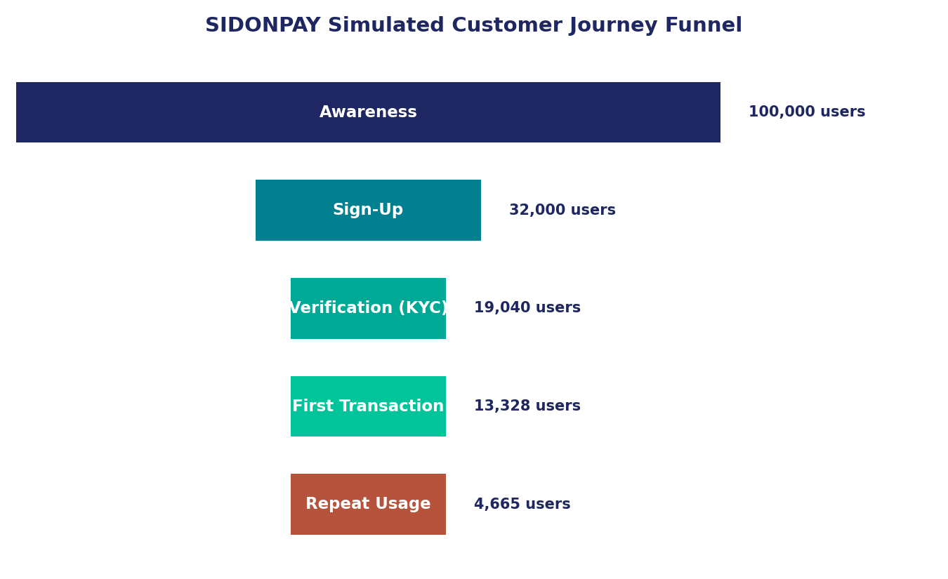
SIMULATED DATA
100,000 Users Through the Funnel
Conversion by Stage
Sign-Up
68.0%
32.0% conversion
drop-off
KYC Verified
40.5%
59.5% conversion
drop-off
First Transaction
30.0%
70.0% conversion
drop-off
Repeat Usage
65.0%
35.0% conversion
drop-off
Overall Awareness → Repeat Usage: 4.67% (4,665 of 100,000)
SIDONPAY · Team Beta · Week 6
8

Slide 9
ANALYSIS
The Two Biggest Leaks
1
Awareness → Sign-Up (68% drop)
A top-of-funnel marketing/UX problem. 32% conversion is plausible for a new fintech app — room to improve through clearer pre-download messaging, but not an alarm.
2
First Transaction → Repeat Usage (65% drop)
The urgent one. This simulation's 35% repeat rate is already optimistic — real Week 4 data showed just 0.15% of accounts transacted more than once. If reality tracks closer to that, retention becomes SIDONPAY's single biggest risk.
SIDONPAY · Team Beta · Week 6
9

Slide 10
RECOMMENDATIONS
How Analytics Can Close the Gaps
Awareness → Sign-Up
Sign-Up → KYC
A/B test onboarding copy; track install-to-open rate by channel to find which sources bring engaged users, not just installs.
Instrument step-level drop-off within KYC itself (upload vs. selfie vs. review wait) so Design knows exactly what to fix first.
KYC → First Transaction
First Txn → Repeat Usage
Track time-to-first-transaction as a core activation KPI; trigger a funding nudge for verified users inactive after 48 hours.
Make 30-day repeat rate the platform's north-star metric from day one. Learn which first actions predict repeat usage.
SIDONPAY · Team Beta · Week 6
10

Slide 11
KEY TAKEAWAY
This framework isn't about predicting exact numbers — it's about knowing what to measure the moment real users arrive.
Ahmed · Data Analyst/Scientist Intern · Team Beta · Submission: Mon 5 Oct 2026

