Slide 1
Bank Churn Prediction
DSA Artificial Intelligence and Machine Learning Project
Semilore Olaniran

Slide 2
Study Background
Customer churn refers to when a client stops using a company's services.
In the banking industry, retaining customers is critical for profitability.
Understanding and predicting churn enables proactive strategies such as service improvements, or customer support outreach aimed at improving customer retention and loyalty

Slide 3
Problem Statement
Despite efforts to improve customer experience, many banks still struggle to accurately identify customers likely to churn in time to act.
Banks face significant financial losses when customers churn, especially high value clients.
A data driven churn prediction model offers a scalable and efficient solution

Slide 4
Aims and Objective
Aim
Objective
This study aims to develop a machine learning model that predicts whether a customer is likely to churn, using customer data from a bank dataset gotten from kaggle.
The Objective is to assist the bank in minimizing customer churn through timely and targeted interventions.

Slide 5
Dataset Overview
Dataset Source: Kaggle (https://www.kaggle.com/code/thomaskonstantin/bank-churn-data-exploration-and-churn-prediction/input)
Contains 10,127 rows and 23 features.
Target Variable: Attrition_Flag (Churn vs. Existing Customer)
Features include age, income, transaction amount, credit limit, etc.
CLIENTNUM & Naive_Bayes_Classifier columns were removed from the dataset

Slide 6
Exploratory Data Analysis
Analyzed distribution of age,gender, card_category, education_level transaction amounts, and card usage.
Correlation matrix used to identify strongly related features, especially features that have a strong relationship with target_variable and could optimize model performance.
Categorical features such as Education_Level,Income_category, Card_category and gender do not have strong correlation with the target variable
The Categorical features were therefore excluded from the final feature selection for training and testing as adding them affected the model performance.
Visualizations included histograms, boxplots, countplots and heatmaps.

Slide 7
Data Preprocessing
Missing values handled using SimpleImputer.
Categorical features encoded using OneHotEncoder.
Numerical features scaled using StandardScaler.
Class imbalance addressed with SMOTE (Synthetic Minority Over-sampling Technique).

Slide 8
Model Building
Algorithms Used: Logistic Regression, Random Forest, LGBMClassifier.
Used Imbalanced-Learn pipeline to combine preprocessing and modeling.
Out of 20 features, 9 were selected for training to optimize model performance

Slide 9
Model Evaluation
Metrics: Accuracy, Precision, Recall, F1-score, ROC AUC.
Confusion matrix and classification report used for evaluation.
ROC Curve plotted to visualize model performance.

Slide 10
Results
Best Model: LightGBM Classifier
Achieved over 96% accuracy on test data.
High recall for churned customers, important for retention strategies.

Slide 11
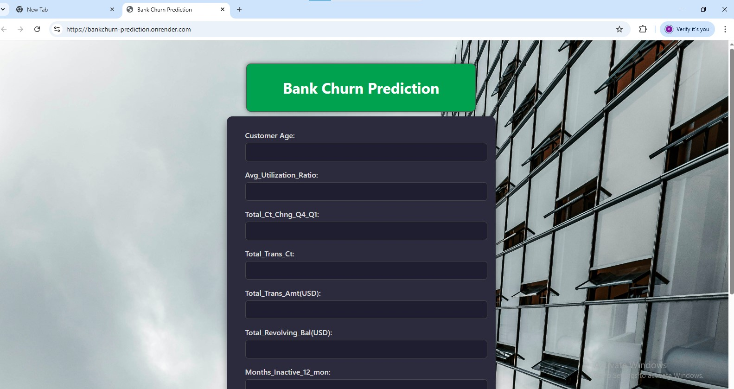
Flask app
The markup and styling was done using html and css

Slide 12
Conclusion & Recommendations
The model effectively identifies customers likely to churn.
Can help banks proactively retain high-risk customers.

Slide 13
References
Dataset: Kaggle - Bank Churn Prediction Dataset
Libraries: scikit-learn, imbalanced-learn, pandas, seaborn, matplotlib,lightgbm

