Slide 1
COME104-DISCRETE MATHEMATICS
LECTURE 6

Slide 2
Functions

Slide 3
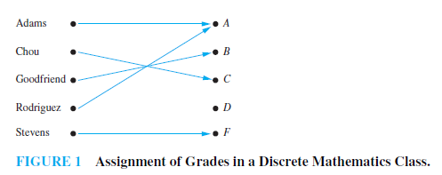
Introduction
In many instances we assign to each element of a set a particular element of a second set (which may be the same as the first).
For example, suppose that each student in a discrete mathematics class is assigned a letter grade from the set {A,B,C,D, F}. And suppose that the grades are A for Adams, C for Chou, B for Goodfriend, A for Rodriguez, and F for Stevens.
This assignment of grades is illustrated in Figure 1. This assignment is an example of a function.

Slide 4
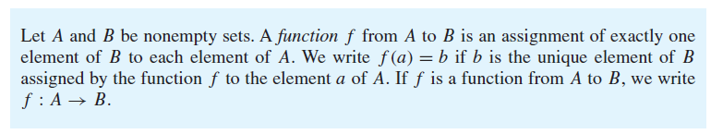
Definition

Slide 5
Functions (cont.)
Note: f associates with each x in A one and only one y in B.
A is called the domain and
B is called the codomain.
If f(x) = y
y is called the image of x under f
x is called a preimage of y
(note there may be more than one preimage of y but there is only one image of x).
The range of f is the set of all images of points in A under f. We denote it by f(A).

Slide 6
Functions (cont.)
If S is a subset of A then
f(S) = {f(s) | s in S}.
Example:
• f(a) = Z
• the image of d is Z
• the domain of f is A = {a, b, c, d}
• the codomain is B = {X, Y, Z}
• f(A) = {Y, Z}
• the preimage of Y is b
• the preimages of Z are a, c and d
• f({c,d}) = {Z}
A
B
a
X
b
c
Y
Z
d

Slide 7
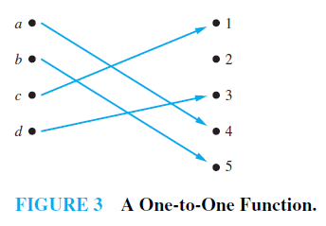
One-to-one (injective) Functions
A function f is said to be one-to-one, or an injunction, if and only if
f(a)=f(b) implies that a=b for all a and b in the domain of f.
f is one-to-one (injective) if f maps every element of A to a unique element in B. In other words no element of B are mapped to by two or more elements of A.
A function is said to be injective if it is one-to-one

Slide 8
Example
Determine whether the function f from {a, b, c, d} to {1, 2, 3, 4, 5} with f (a) = 4, f (b) = 5, f (c) = 1, and f (d) = 3 is one-to-one.

Slide 9
Answer
Determine whether the function f from {a, b, c, d} to {1, 2, 3, 4, 5} with f (a) = 4, f (b) = 5, f (c) = 1, and f (d) = 3 is one-to-one.
Solution: The function f is one-to-one because f takes on different values at the four elements of its domain.
One to one:
If and only if f(a)=f(b) implies that a=b for all a and b in the domain of f.
It is one-to-one because no two values in the domain are assigned the same function value.

Slide 10

Example
Determine whether the function f (x) = $x^{2}$ from the set of integers to the set of integers is one-to-one.

Slide 11
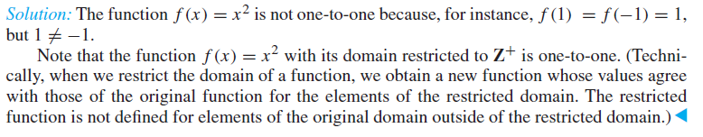

Answer
Determine whether the function f (x) = $x^{2}$ from the set of integers to the set of integers is one-to-one.
One to one: If and only if f(a)=f(b) implies that a=b for all a and b in the domain of f.
f(1)=f(-1)
1≠-1
two values in the domain are assigned to the same function value.

Slide 12
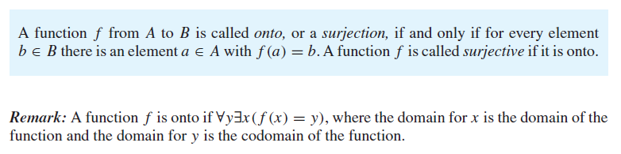
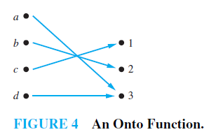
Onto (Surjective) Functions
f is onto (surjective)if every element of B is mapped to by some element of A. In other words, nothing is left out.

Slide 13
Example
Let f be the function from {a, b, c, d} to {1, 2, 3} defined by
f (a) = 3, f (b) = 2, f (c) = 1, and f (d) = 3.
Is f an onto function?

Slide 14
Answer
Let f be the function from {a, b, c, d} to {1, 2, 3} defined by f (a) = 3, f (b) = 2, f (c) = 1, and f (d) = 3. Is f an onto function?
Because all three elements of the codomain are images of elements in the domain, we see that f is onto.
Note that if the codomain were {1, 2, 3, 4}, then f would not be onto.

Slide 15

Example
Is the function $f\left(x\right)=x^{2}$ from the set of integers to the set of integers onto?

Slide 16

Answer
Is the function $f\left(x\right)=x^{2}$ from the set of integers to the set of integers onto?
Solution: The function f is not onto because there is no integer x with $x^{2}$=-1, for instance.

Slide 17
Example
Is the function f (x) = x + 1 from the set of integers to the set of integers onto?

Slide 18
Answer
Is the function f (x) = x + 1 from the set of integers to the set of integers onto?
Solution: This function is onto, because for every integer y there is an integer x such that f(x)=y
To see this, note that f(x)=y if and only if x+1=y, which holds if and only if x=y-1.

Slide 19
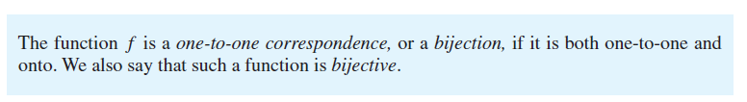
Bijective Functions

Slide 20
Example
Let f be the function from {a, b, c, d} to {1, 2, 3, 4} with f (a) = 4, f (b) = 2, f (c) = 1, and f (d) = 3. Is f a bijection?

Slide 21
Answer
Let f be the function from {a, b, c, d} to {1, 2, 3, 4} with f (a) = 4, f (b) = 2, f (c) = 1, and f (d) = 3. Is f a bijection?
The function f is one-to-one and onto.
It is one-to-one because no two values in the domain are assigned the same function value.
It is onto because all four elements of the codomain are images of elements in the domain. Hence, f is a bijection.

Slide 22
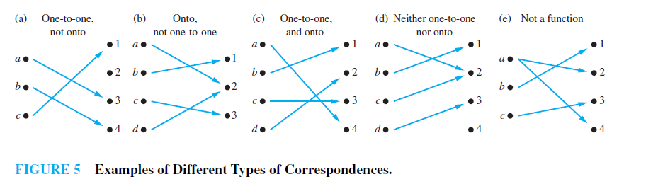
Examples
f is one-to-one (injective) if f maps every element of A to a unique element in B. In other words no element of B are mapped to by two or more elements of A.
f is onto (surjective)if every element of B is mapped to by some element of A. In other words, nothing is left out.

Slide 23
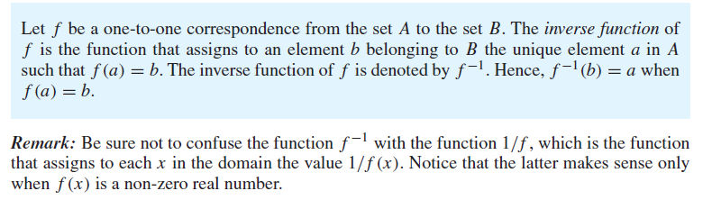
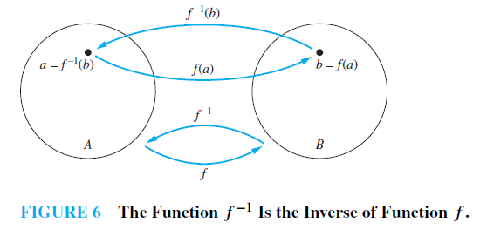
Inverse function
Now consider a one-to-one correspondence f from the set A to the set B. Because f is an onto function, every element of B is the image of some element in A. Furthermore, because f is also a one-to-one function, every element of B is the image of a unique element of A. Consequently, we can define a new function from B to A that reverses the correspondence given by f . This leads to Definition.

Slide 24
Inverse function
If a function f is not a one-to-one correspondence, we cannot define an inverse function of f . When f is not a one-to-one correspondence, either it is not one-to-one or it is not onto.
If f is not one-to-one, some element b in the codomain is the image of more than one element in the domain.
If f is not onto, for some element b in the codomain, no element a in the domain exists for which f (a) = b.
Consequently, if f is not a one-to-one correspondence, we cannot assign to each element b in the codomain a unique element a in the domain such that f (a) = b (because for some b there is either more than one such a or no such a).
A one-to-one correspondence is called invertible because we can define an inverse of this function.
A function is not invertible if it is not a one-to-one correspondence, because the inverse of such a function does not exist.

Slide 25
Example
Let f be the function from {a, b, c} to {1, 2, 3} such that f (a) = 2, f (b) = 3, and f (c) = 1.
Is f invertible, and if it is, what is its inverse?

Slide 26

Answer
Let f be the function from {a, b, c} to {1, 2, 3} such that f (a) = 2, f (b) = 3, and f (c) = 1.
Is f invertible, and if it is, what is its inverse?
A
B
f is an onto function, every element of B is the image of some element in A.
f is a one-to-one function, every element of B is the image of a unique element of A.
a
1
b
2
c
3

Slide 27
Example
Z = all integers = {. . , -3, -2, -1, 0, 1, 2, 3, 4, . .}

Slide 28
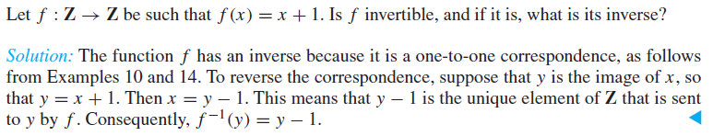
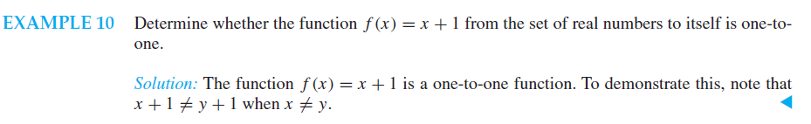
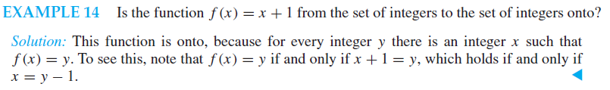
Answer

Slide 29
Example
R = is the set of all real numbers (all decimals)

Slide 30
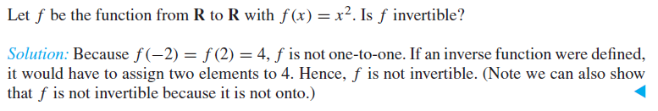
Answer
f is one-to-one (injective) if f maps every element of A to a unique element in B. In other words no element of B are mapped to by two or more elements of A.
f(-2)=4
f(2)=4
-2
4
2

Slide 31
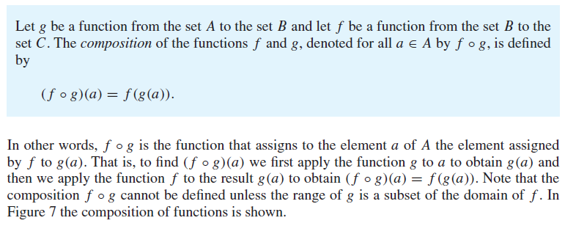
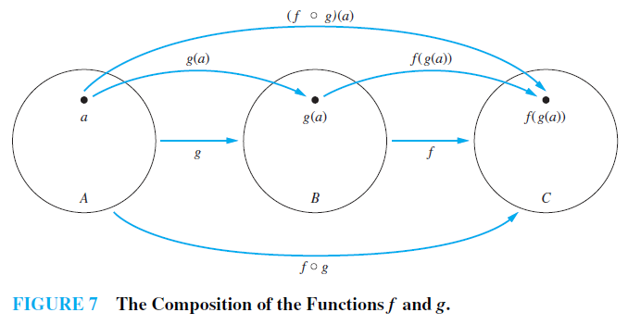
Composition

Slide 32
Example
Let g be the function from the set {a,b,c} to itself such that g(a)=b, g(b)=c, and g(c)=a.
Let f be the function from the set {a,b,c} to the set {1,2,3} such that f(a)=3, f(b)=2, and f(c)=1.
What is the composition of f and g ?
a
a
b
b
c
c
a
1
b
2
c
3

Slide 33
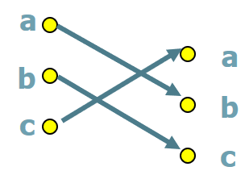
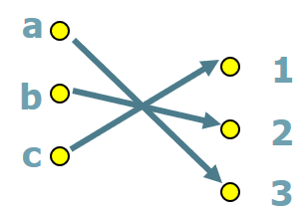
Answer
The composition of fog is defined by
(fog)(a)=f(g(a))
=f(b)
=2
(fog)(b)=f(g(b))
=f(c)
=1
(fog)(c)=f(g(c))
=f(a)
=3
g(a)=b, g(b)=c, g(c)=a.
f(a)=3, f(b)=2, f(c)=1.
a
g(a)
f(g(a))
a
a
b
1
b
c
2
c
3

Slide 34
Example
Let f and g be the functions from the set of integers to the set of integers defined by f(x)=2x+3 and g(x)=3x+2.
What is the composition of f and g?
What is the composition of g and f?

Slide 35
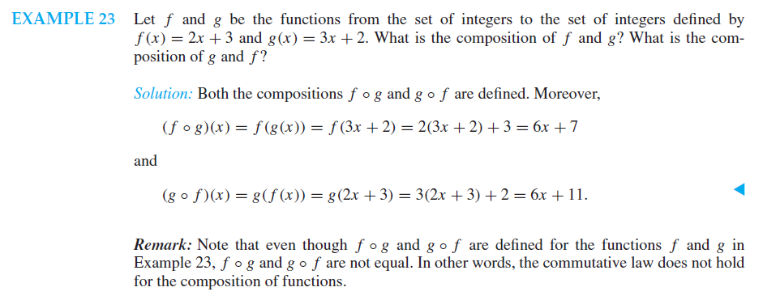
Answer

Slide 36

Example
Let f(x)=3x-4 and g(x)=$x^{2}+$3. Compute both compositions fog and gof.

Slide 37
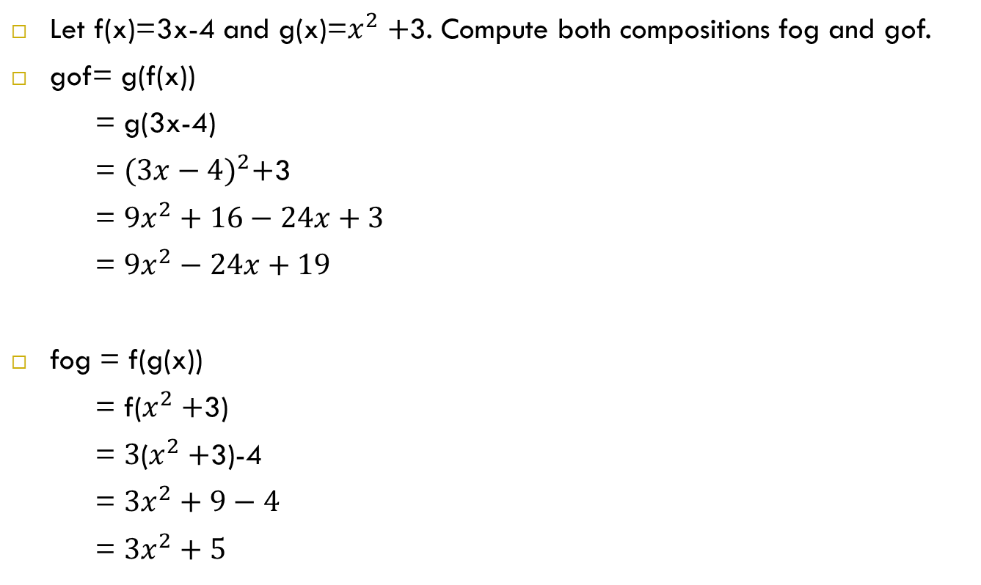
Answer
Let f(x)=3x-4 and g(x)=$x^{2}+$3. Compute both compositions fog and gof.
gof= g(f(x))
= g(3x-4)
= ${(3x−4)}^{2}+$3
= ${9x}^{2}+16−24x+3$
= ${9x}^{2}−24x+19$
fog = f(g(x))
= f($x^{2}+$3)
= $3$($x^{2}+$3)-4
= ${3x}^{2}+9−4$
= ${3x}^{2}+5$

Slide 38
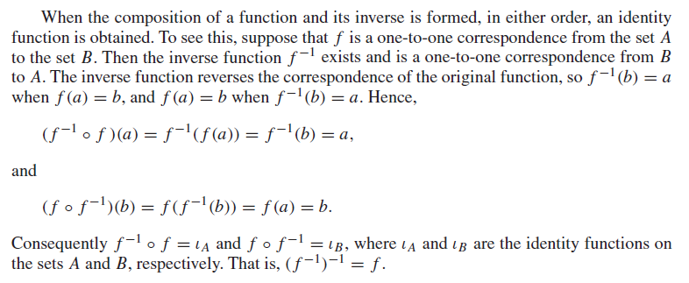
Composition

Slide 39
References
Discrete Mathematics for Computing, Rod Haggarty.
Discrete Mathematics and Its Applications, Kenneth H. Rosen

