Slide 1
COME104-DISCRETE MATHEMATICS
LECTURE 7

Slide 2
Review

Slide 3
Example
1) Which of the following statements is the negation of the statements “4 is odd or -9 is positive”?
a) 4 is even or -9 is not negative b) 4 is odd or -9 is not negative c) 4 is even and -9 is negative d) 4 is odd and -9 is not negative

Slide 4
Answer
1) Which of the following statements is the negation of the statements “4 is odd or -9 is positive”? a) 4 is even or -9 is not negative b) 4 is odd or -9 is not negative c) 4 is even and -9 is negative d) 4 is odd and -9 is not negative
Answer: c Explanation: Using De Morgan’s Law ~(A V B) <-> ~A ∧ ~B

Slide 5
Example
2) Let P: We should be honest., Q: We should be dedicated .,R: We should be overconfident. Then ‘We should be honest or dedicated but not overconfident.’ is best represented by:
a) ~P V ~Q V R b) P ∧ ~Q ∧ R c) P V Q ∧ R d) P V Q ∧ ~R

Slide 6
Answer
2) Let P: We should be honest., Q: We should be dedicated .,R: We should be overconfident. Then ‘We should be honest or dedicated but not overconfident.’ is best represented by:
a) ~P V ~Q V R b) P ∧ ~Q ∧ R c) P V Q ∧ R d) P V Q ∧ ~R
Answer: d Explanation: The third part of statement is negated, hence negation operator is used, for (‘or’ –V) is used and for (’but’- ∧).

Slide 7
Example
3) The statement, “At least one of your friends is perfect”. Let P (x) be “x is perfect” and let F (x) be “x is your friend” and let the domain be all people.
∀x (F (x) → P (x))
∀x (F (x) ∧ P (x))
∃x (F (x) ∧ P (x))
∃x (F (x) → P (x))

Slide 8
Answer
3) The statement, “At least one of your friends is perfect”. Let P (x) be “x is perfect” and let F (x) be “x is your friend” and let the domain be all people.
∀x (F (x) → P (x))
∀x (F (x) ∧ P (x))
∃x (F (x) ∧ P (x))
∃x (F (x) → P (x))
Answer: c
Explanation: For some x, x is friend and funny.

Slide 9
Example
4) The compound statement A-> (A->B) is false, then the truth values of A, B are respectively a) T, T b) F, T c) T, F d) F, F

Slide 10
Answer
4) The compound statement A-> (A->B) is false, then the truth values of A, B are respectively a) T, T b) F, T c) T, F d) F, F
Answer: c Explanation: For implications to be false hypothesis should be true and conclusion should be false.
A-> (A->B) is False; A is True (A->B) is False
(A->B) is False; A is True B is False
P | Q | P → Q
T T F F | T F T F | T F T T

Slide 11
Example
5) Let A: All badminton player are good sportsperson. B: All person who plays cricket are good sportsperson.
Let X denotes set of all badminton players, Y of all cricket players, Z of all good sportsperson. Then which of the following statements is correct?
a) Z contains both X and Y b) Z contains X and Y is outside c) X contains Y and Z d) None of the mentioned

Slide 12
Answer
5) Let A: All badminton player are good sportsperson. B: All person who plays cricket are good sportsperson.
Let X denotes set of all badminton players, Y of all cricket players, Z of all good sportsperson. Then which of the following statements is correct?
a) Z contains both X and Y b) Z contains X and Y is outside c) X contains Y and Z d) None of the mentioned
Answer: a Explanation: X and Y are subset of Z.

Slide 13
Example
6) Let C = {1,2,3,4} and D = {1, 2, 3, 4} then which of the following hold not true in this case
a) C – D = D – C b) C U D = C ∩ D c) C ∩ D = C – D d) C – D = Φ

Slide 14
Answer
6) Let C = {1,2,3,4} and D = {1, 2, 3, 4} then which of the following hold not true in this case
a) C – D = D – C b) C U D = C ∩ D c) C ∩ D = C – D d) C – D = Φ
Answer: c Explanation: C ∩ D = {1, 2, 3, 4} ≠ Φ.

Slide 15
Example
7) If in sets A, B, C, the set B ∩ C consists of 8 elements, set A ∩ B consists of 7 elements and set C ∩ A consists of 7 elements then the minimum element in set A U B U C will be
a) 8 b) 14 c) 22 d) 15

Slide 16
Answer
7) If in sets A, B, C, the set B ∩ C consists of 8 elements, set A ∩ B consists of 7 elements and set C ∩ A consists of 7 elements then the minimum element in set A U B U C will be
a) 8 b) 14 c) 22 d) 15
Answer: a Explanation: For minimum elements set B and C have 8 elements each and all of the elements are same, Also set A should have 7 elements which are already present in B and C. Thus A U B U C ≡ A ≡ B.
A
B
7
1
C

Slide 17
Example
8) If A has 4 elements B has 8 elements then the minimum and maximum number of elements in A U B are respectively
a) 4, 8 b) 8, 12 c) 4, 12 d) None of the mentioned

Slide 18
Answer
8) If A has 4 elements B has 8 elements then the minimum and maximum number of elements in A U B are respectively
a) 4, 8 b) 8, 12 c) 4, 12 d) None of the mentioned
Answer: b Explanation: Minimum would be when 4 elements are same as in 8, maximum would be when all are distinct.
A
B
A
B
4
4
4
8

Slide 19
Example
9) What is the Cartesian product of A = {1, 2} and B = {a, b}?
a) {(1, a), (1, b), (2, a), (b, b)} b) {(1, 1), (2, 2), (a, a), (b, b)} c) {(1, a), (2, a), (1, b), (2, b)} d) {(1, 1), (a, a), (2, a), (1, b)}

Slide 20
Answer
9) What is the Cartesian product of A = {1, 2} and B = {a, b}?
a) {(1, a), (1, b), (2, a), (b, b)} b) {(1, 1), (2, 2), (a, a), (b, b)} c) {(1, a), (2, a), (1, b), (2, b)} d) {(1, 1), (a, a), (2, a), (1, b)}
Answer: c Explanation: A subset R of the Cartesian product A x B is a relation from the set A to the set B.

Slide 21
Example
10) The bit string for the set {2, 4, 6, 8, 10} (with universal set of natural numbers less than or equal to 10) is ____________________ a) 0101010101 b) 1010101010 c) 1010010101 d) 0010010101

Slide 22
Answer
10) The bit string for the set {2, 4, 6, 8, 10} (with universal set of natural numbers less than or equal to 10) is ____________________ a) 0101010101 b) 1010101010 c) 1010010101 d) 0010010101
Answer: a Explanation: The bit string for the set has a one bit in second, fourth, sixth, eighth, tenth positions, and a zero elsewhere.

Slide 23
Example
Prove the following statement using direct proof:
“If the sum of any two integers is even, then their difference is even.”

Slide 24
Answer
Prove the following statement using direct proof:
“If the sum of any two integers is even, then their difference is even.”
Suppose m and n are integers so that m+n is even.
By definition of even, m+n=2k for some integer k.
Subtracting n from both sides gives m=2k-n
Thus
m-n = (2k-n)-n by substitution
= 2k-2n combining common terms
= 2(k-n) by factoring out 2
(k-n) is an integer because it is a difference of integers.
Hence, (m-n) equals 2 times an integer, and so by definition of even number, (m-n) is even

Slide 25

Example
Use mathematical induction to prove that
$1^{2}+2^{2}+3^{2}+…+k^{2}=\frac{k(k+1)(2k+1)}{6}$

Slide 26
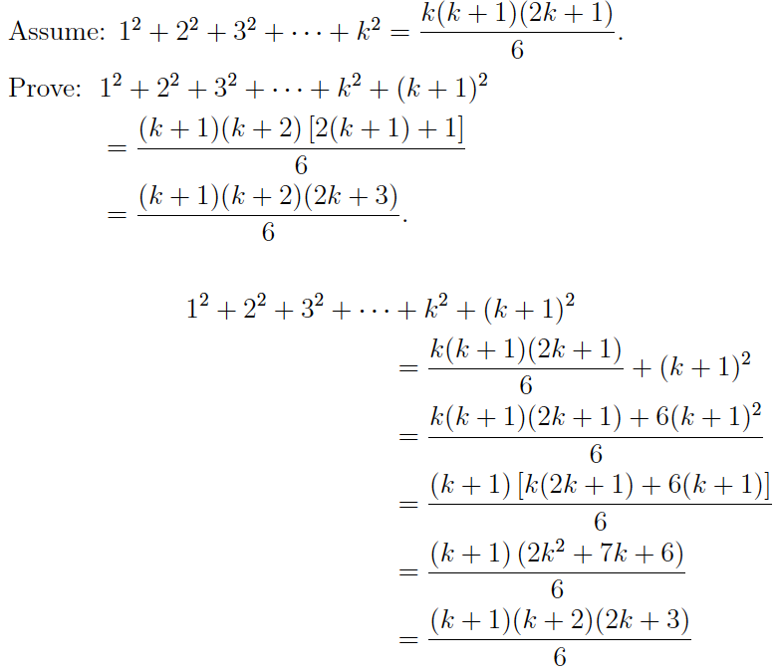
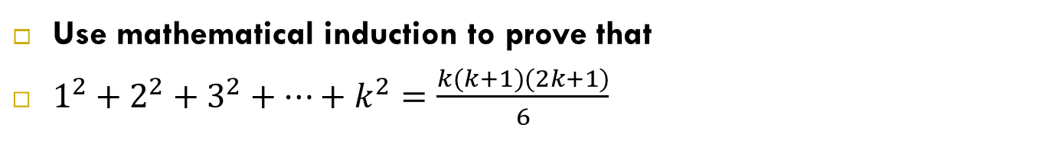
Answer
Use mathematical induction to prove that
$1^{2}+2^{2}+3^{2}+…+k^{2}=\frac{k(k+1)(2k+1)}{6}$

Slide 27
Example
If f is a function on a set A= {1,2,3,4,5} such that
f= { (1,2),(2,3),(3,4),(4,x),(5,5,)}.
If f is a bijective function the x is
(a) 5 (b) 3 (c) 1 (d) None of these

Slide 28
Answer
If f is a function on a set A= {1,2,3,4,5} such that
f= { (1,2),(2,3),(3,4),(4,x),(5,5,)}.
If f is a bijective (satisfies both the injective (one-to-one function) and surjective function (onto function) properties)
(a) 5 (b) 3 (c) 1 (d) None of these
Answer: c
A
B
1
1
2
2
3
3
4
4
5
5
f is one-to-one (injective) if f maps every element of A to a unique element in B. In other words no element of B are mapped to by two or more elements of A.
f is onto (surjective)if every element of B is mapped to by some element of A. In other words, nothing is left out.

Slide 29
Relations

Slide 30
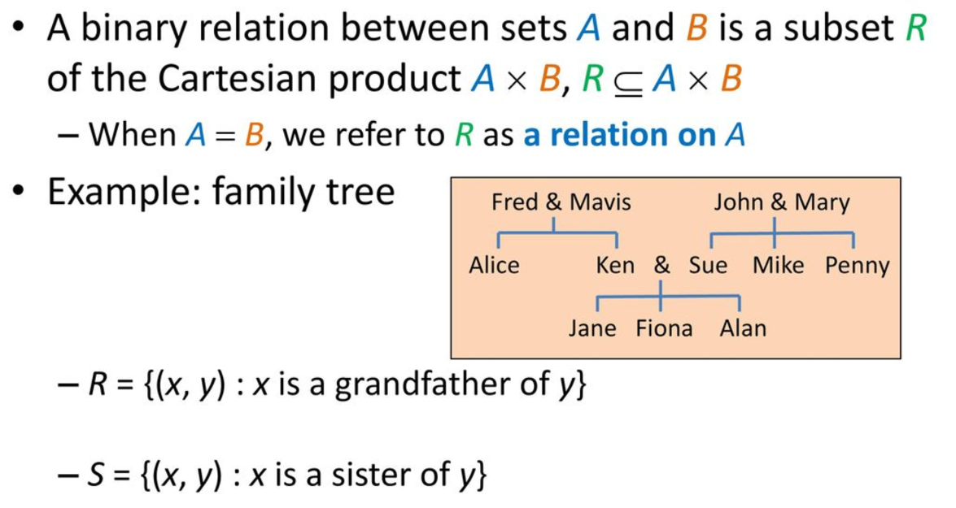
Binary Relations

Slide 31
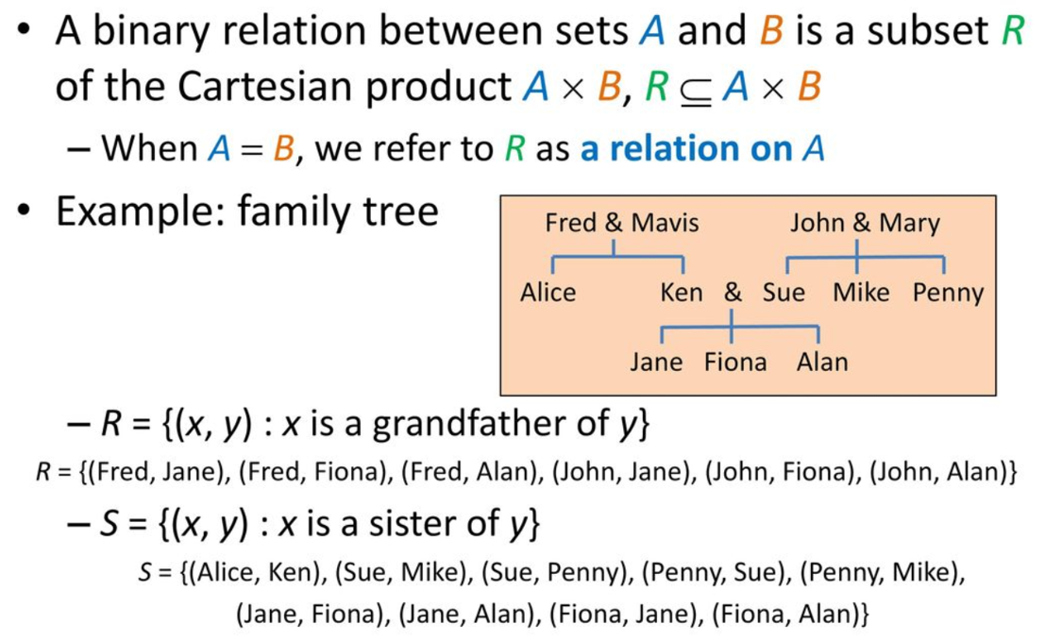
Binary Relations

Slide 32
Example
Write down the ordered pairs belonging to the following binary relations between A={1,3,5,7} and B={2,4,6}
U={(x,y): x+y=9}
V={(x,y): x<y}

Slide 33
Solution
Write down the ordered pairs belonging to the following binary relations between A={1,3,5,7} and B={2,4,6}
a) U={(x,y): x+y=9}
U contains the ordered pairs (3,6), (5,4) and (7,2)
b) V={(x,y): x<y}
V contains the ordered pairs (1,2), (1,4), (1,6), (3,4), (3,6) and (5,6)

Slide 34
Example
The following defines a relation on A={1,2,3,4,5,6}
R={(x,y): x is a divisor of y}
Write down the ordered pairs belonging to R.
Note: dividend ÷ divisor = quotient
Example: in 12 ÷ 3 = 4, 3 is the divisor.

Slide 35
Solution
The following defines a relation on A={1,2,3,4,5,6}
R={(x,y): x is a divisor of y}
Write down the ordered pairs belonging to R.
R contains the pairs (1,1), (1,2), (1,3), (1,4), (1,5), (1,6), (2,2), (2,4), (2,6), (3,3), (3,6), (4,4), (5,5) and (6,6)

Slide 36
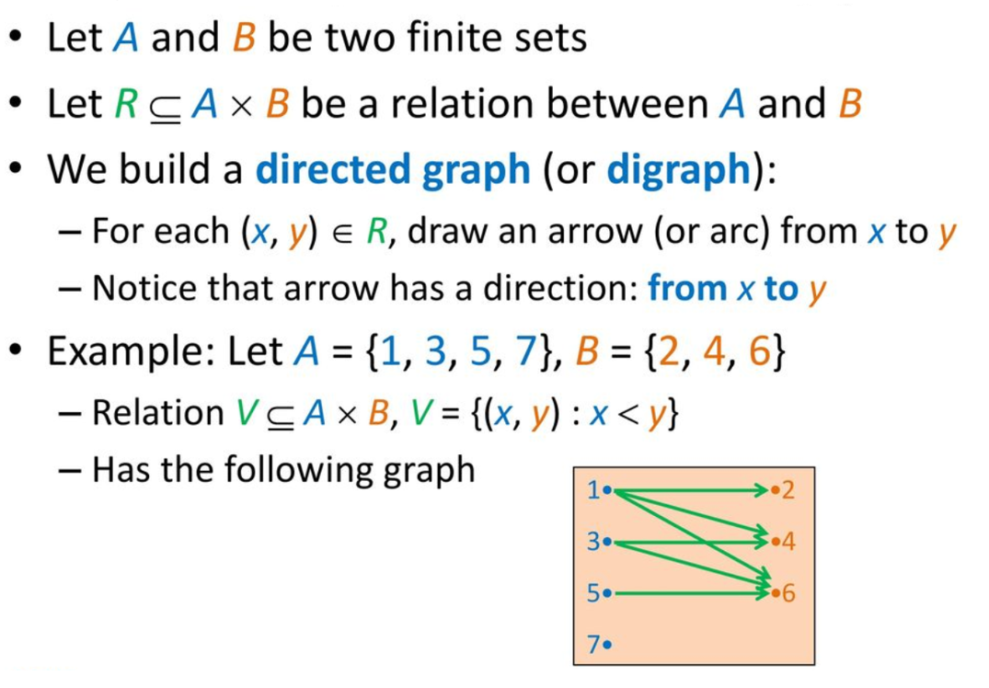
Graph Representation

Slide 37
Example
The following defines a relation on A={1,2,3,4,5,6}
R={(x,y): x is a divisor of y}
Draw the directed graph representation of the relation R.

Slide 38
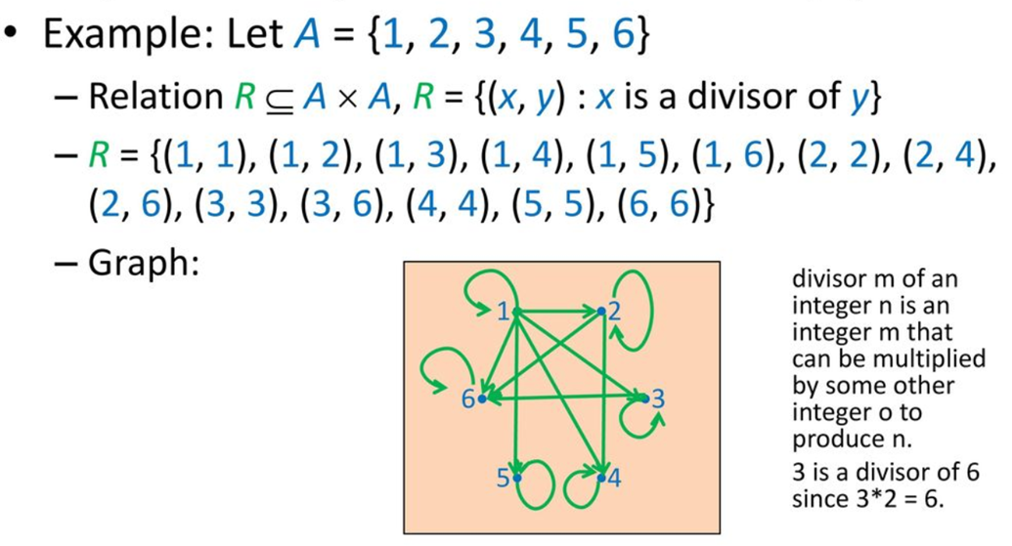
Solution

Slide 39
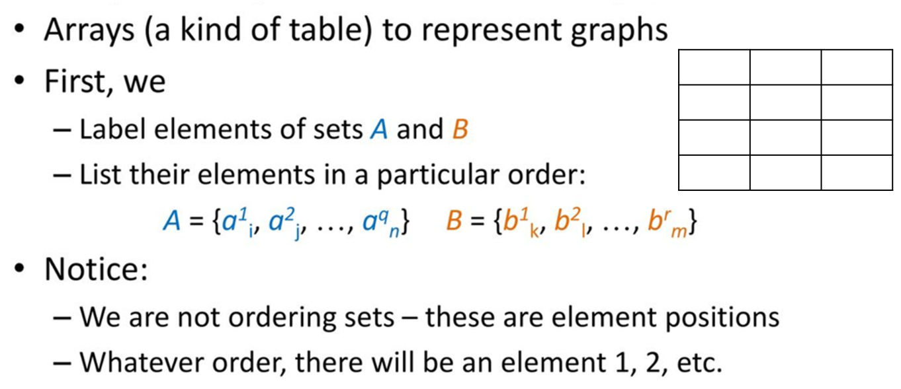
Array Representation

Slide 40
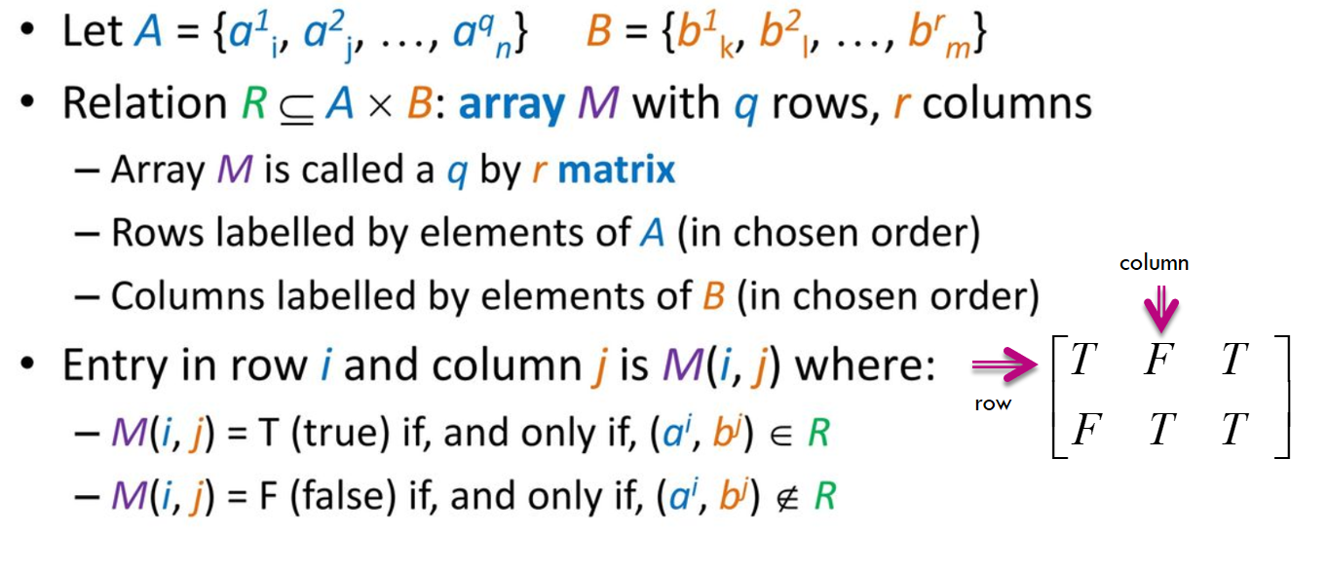
Array Representation

Slide 41
Example
A={1,3,5,7} and B={2,4,6}
U={(x,y): x+y=9}
Draw the matrix representation of the relation R.

Slide 42
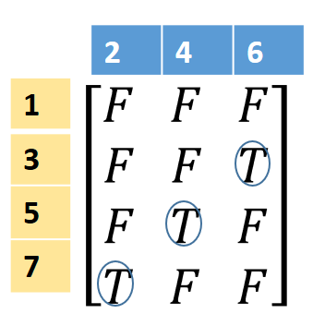
Solution
A={1,3,5,7} and B={2,4,6}
U={(x,y): x+y=9}
U contains the ordered pairs (3,6), (5,4) and (7,2)

Slide 43
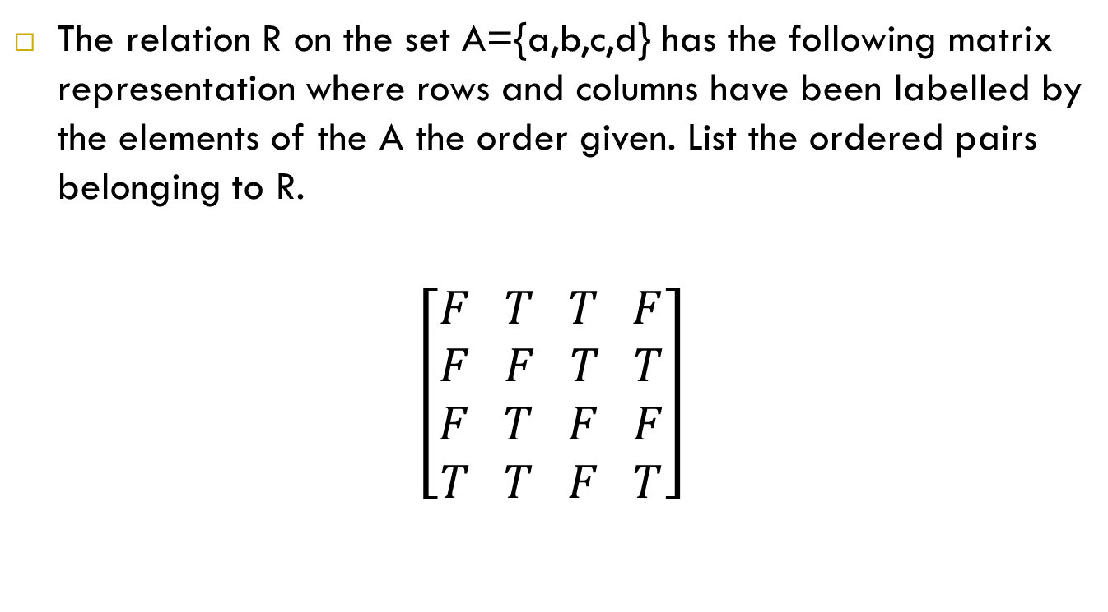
Example
The relation R on the set A={a,b,c,d} has the following matrix representation where rows and columns have been labelled by the elements of the A the order given. List the ordered pairs belonging to R.
$$\left[\begin{aligned}F T T F \\ F F T T \\ F T F F \\ T T F T\end{aligned}\right]$$

Slide 44
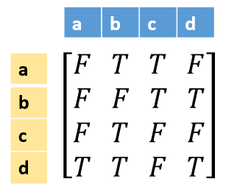
Solution
The relation R on the set A={a,b,c,d} has the following matrix representation where rows and columns have been labelled by the elements of the A the order given. List the ordered pairs belonging to R.
R contains the ordered pairs (a,b), (a,c), (b,c), (b,d), (c,b), (d,a), (d,b), (d,d)

Slide 45
Example
Write down the matrix representation of the relation R
R contains the pairs (1,1), (1,2), (1,3), (1,4), (1,5), (1,6), (2,2), (2,4), (2,6), (3,3), (3,6), (4,4), (5,5) and (6,6)

Slide 46
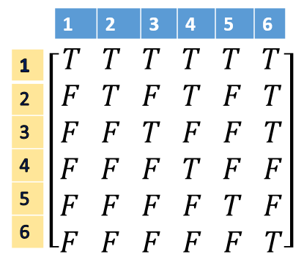
Solution
R contains the pairs (1,1), (1,2), (1,3), (1,4), (1,5), (1,6), (2,2), (2,4), (2,6), (3,3), (3,6), (4,4), (5,5) and (6,6)

Slide 47
Example
A={a, e, c, g} and B={b, f, d}
Relation V ⊆ A x B, V={(x,y): x<y in the alphabet}
Write down the matrix representation of the relation R

Slide 48

Solution
A={a, e, c, g} and B={b, f, d}
Relation V ⊆ A x B, V={(x,y): x<y in the alphabet}
b | f | d
a
e
c
g
$$\left[\begin{aligned}\begin{matrix}T & T T \\ F & T F\end{matrix} \\ F T T \\ F F F\end{aligned}\right]$$

Slide 49
References
Discrete Mathematics for Computing, Rod Haggarty.
https://slideplayer.com/slide/13068301/
Discrete Mathematics and Its Applications, Kenneth H. Rosen

