Slide 1
SE202-SOFTWARE desIgn and archItecture LECTURE 6

Slide 2
Strategy Design Pattern
Concept
Suppose there is an application where you have multiple algorithms and each of these algorithms can perform a specific task. A client can dynamically pick any of these algorithms to serve its current need.
The strategy pattern suggests that you implement these algorithms in separate classes. When you encapsulate an algorithm in a separate class, you call it a strategy. An object that uses the strategy object is often referred to as a context object. These “algorithms” are also called behaviors in some applications.
Computer world Example
Suppose that you have a list of integers and you want to sort them. You do this by using various algorithms; for example, Bubble Sort, Merge Sort, Quick Sort, Insertion Sort, and so forth. So, you can have a sorting algorithm with many different variations. Now you can implement each of these variations (algorithms) in separate classes and pass the objects of these classes in client code to sort your integer list.

Slide 3
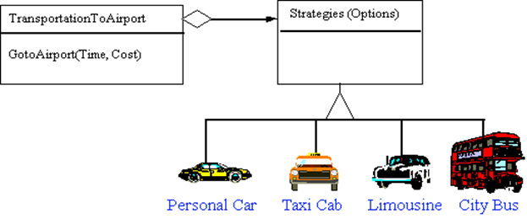
Strategy Design Pattern
Modes of transportation to an airport is an example of a Strategy. Several options exist,
driving one's own car,
taking a taxi,
an airport shuttle,
a city bus, or
a limousine service.
Any of these modes of transportation will get a traveler to the airport, and they can be used interchangeably.
The traveler must chose the Strategy based on tradeoffs between cost, convenience, and time.
http://sce2.umkc.edu/csee/leeyu/class/CS590L-03/Presentation/Pattern/Strategy.ppt

Slide 4
Strategy Design Pattern
Strategy
declares an interface common to all supported algorithms.
Context uses its interface to call the algorithm defined by a ConcreteStrategy.
ConcreteStrategy
implements a specific algorithm using the Strategy interface.
Context
is configured with a ConcreteStrategy object.
maintains a reference to a Strategy object.
may define an interface for Strategy to use to access its
Java Design Patterns by Rohit Joshi

Slide 5
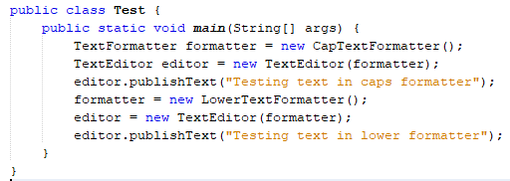
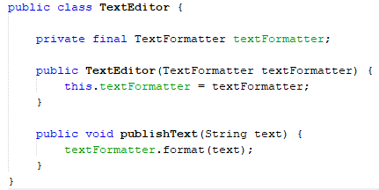


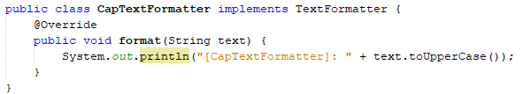
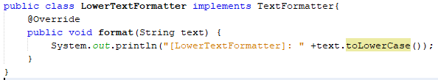
Example

Slide 6
Example
I want to design a social media application which allows me to connect to my friends on all three social platforms i.e. Facebook, Google Plus, Twitter.
Now I want that client should be able to tell the name of friend and desired platform – then my application should connect to him transparently.
More importantly, if I want to add more social platforms into application then application code should accommodate it without breaking the design.
Which design pattern do you recommend ?
https://howtodoinjava.com/design-patterns/behavioral/strategy-design-pattern/

Slide 7
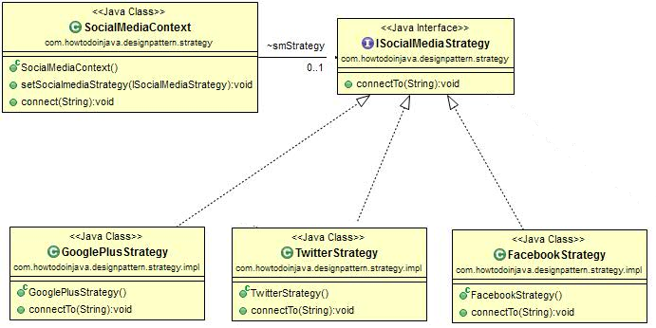
Solution: Strategy Design Pattern
// connectTo(friendName:String): prints name of the friend and social media platform
Test Program:
// Add your friend «Lokesh» to facebook platform
// Add your friend «Lokesh» to twitter platform
// Add your friend «Lokesh» to googleplus platform
https://howtodoinjava.com/design-patterns/behavioral/strategy-design-pattern/

Slide 8
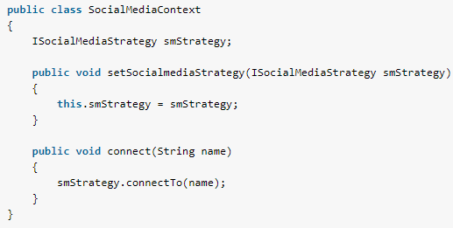

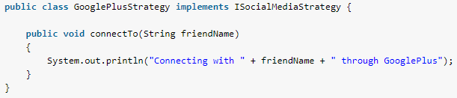
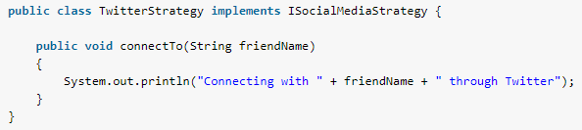
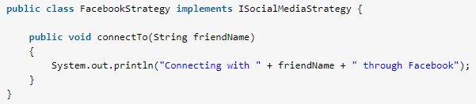
https://howtodoinjava.com/design-patterns/behavioral/strategy-design-pattern/

Slide 9
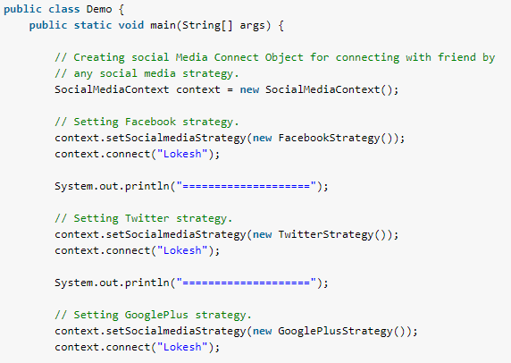
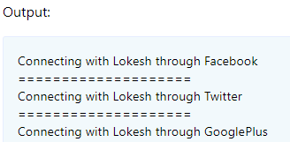
https://howtodoinjava.com/design-patterns/behavioral/strategy-design-pattern/

Slide 10
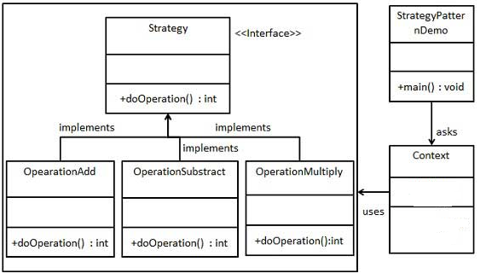
Example
The class diagram is an example of strategy design pattern but in the diagram data fields and methods of «Context» class is missing. Complete the missing parts and implement the following class hierarchy.
Demo Program:
Do following operations
// 10+5
// 10-5
// 10*5
https://www.tutorialspoint.com/design_pattern/strategy_pattern.htm

Slide 11

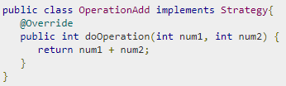
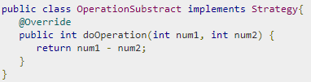
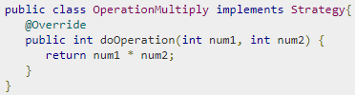
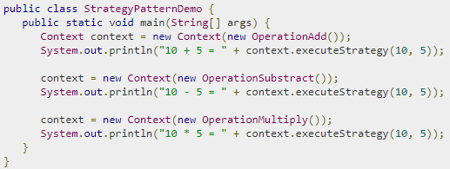

Q: The class diagram is an example of strategy design pattern but in the diagram data fields and methods of «Context» class is missing. Complete the missing parts and implement the Context class.
https://www.tutorialspoint.com/design_pattern/strategy_pattern.htm

Slide 12
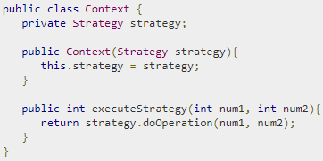
https://www.tutorialspoint.com/design_pattern/strategy_pattern.htm

Slide 13
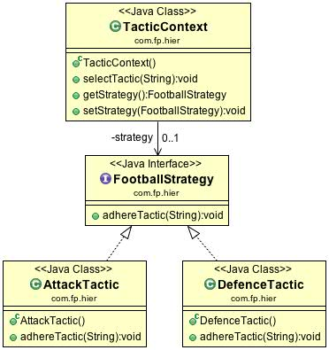
Example
The example will be based on football.
Let’s imagine that any football team can play in two manners: attacking and defending.
These two tactics are particular realisations of a football strategy.
https://www.javacodegeeks.com/2013/06/design-patterns-strategy.html

Slide 14
public class TacticContext {
private FootballStrategy strategy = null;
public void selectTactic(String team) {
strategy.adhereTactic(team);
}
public FootballStrategy getStrategy() {
return strategy;
}
public void setStrategy(FootballStrategy strategy) {
this.strategy = strategy;
}
}
public class Test3 {
public static void main(String[] args) {
String team1 = "Barcelona";
String team2 = "Real Madrid";
TacticContext context = new TacticContext();
context.setStrategy(new AttackTactic());
context.selectTactic(team1);
context.setStrategy(new DefenceTactic());
context.selectTactic(team2);
}
}
public interface FootballStrategy {
public void adhereTactic(String team);
}
Output:
Barcelona will play in attacking football!
Real Madrid will make emphasis on defence!
public class AttackTactic implements FootballStrategy {
public void adhereTactic(String team) {
System.out.println(team + " will play in attacking football!");
}
}
public class DefenceTactic implements FootballStrategy {
public void adhereTactic(String team) {
System.out.println(team + " will make emphasis on defence!");
}
}

Slide 15
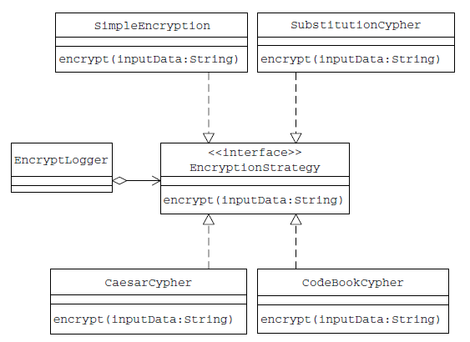
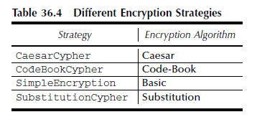
Example
Let us suppose that clients of the EncryptLogger would like to be able to dynamically select and use any of the encryption algorithms.
This requirement can be designed in different ways, including:
Implementing all algorithms inside the existing encrypt(String) method of the EncryptLogger class using conditional statements
Applying inheritance, with each subclass of the EncryptLogger implementing a specific encryption algorithm
Though these options look straightforward, applying the Strategy pattern results in a more elegant and efficient design.
Applying the Strategy pattern, each of the encryption algorithms can be encapsulated in a separate (strategy) class. Table 36.4 shows the list of these strategy classes and the algorithms they implement.
Let us define a common interface to be implemented by each of the strategy classes, in the form of a Java interface EncryptionStrategy, as follows:

Slide 16

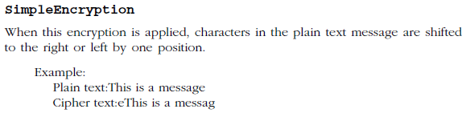
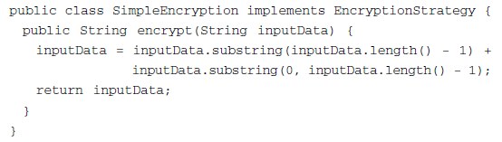
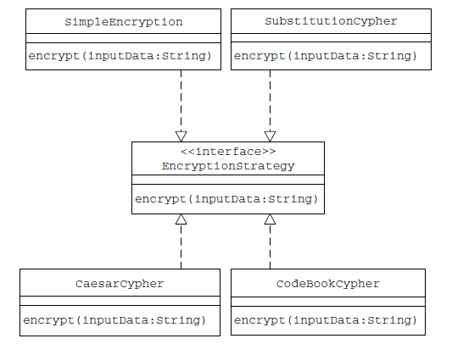
Only the last
public String substring(int startIndex, int endIndex)
startIndex=Inclusive, endIndex=Exclusive

Slide 17
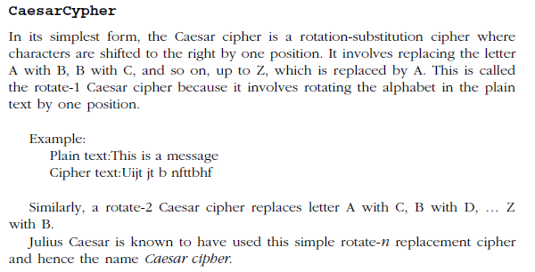
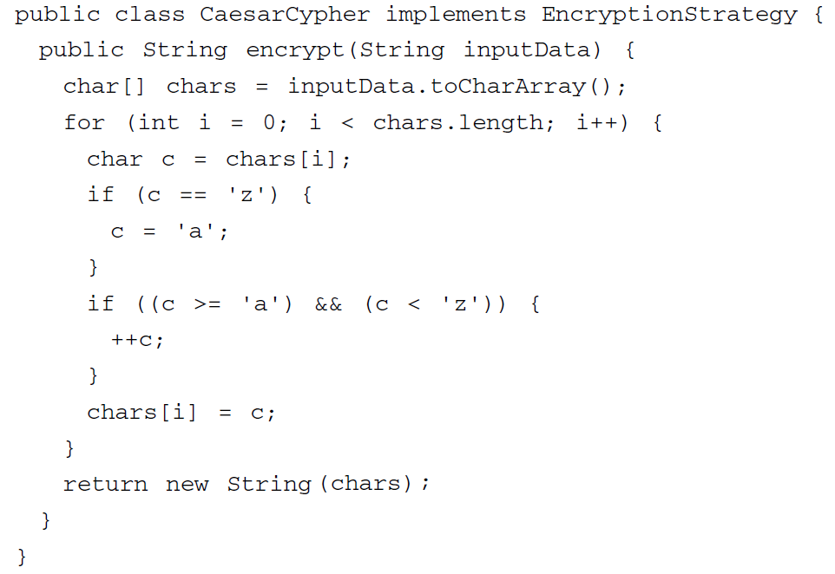
The java string toCharArray() method converts this string into character array. It returns a newly created character array, its length is similar to this string and its contents are initialized with the characters of this string.
String(char[] value)
Allocates a new String so that it represents the sequence of characters currently contained in the character array argument.

Slide 18
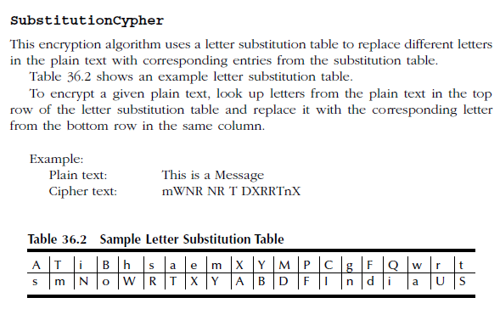
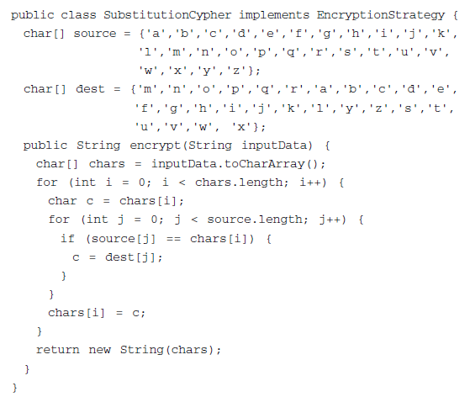

Slide 19
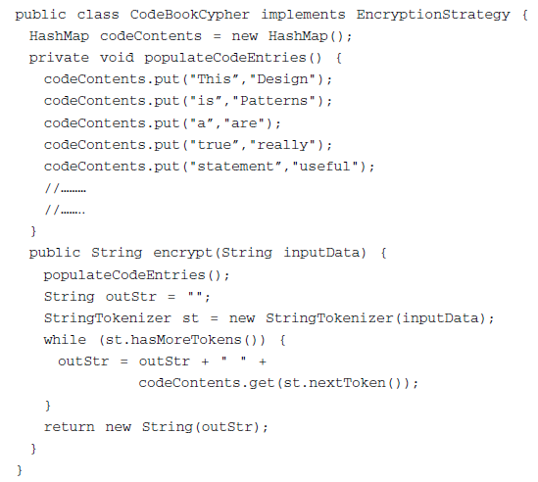
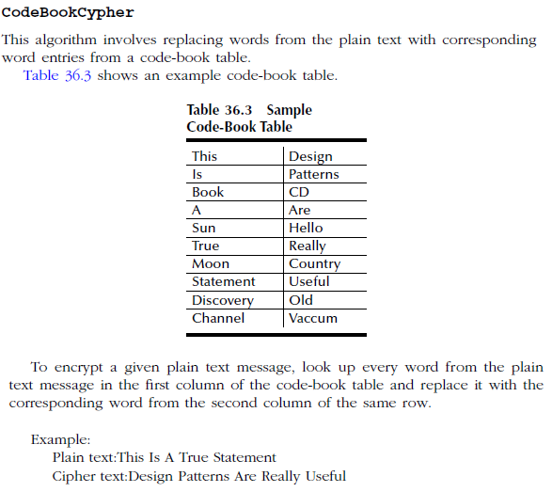
The HashMap class has many useful methods. For example,
To add items to it, use the put() method.
To access a value in the HashMap, use the get() method and refer to its key
Ex: capitalCities.get("England");

Slide 20
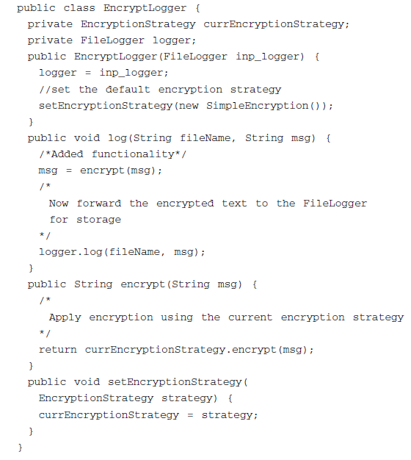
When the EncryptLogger is first instantiated, its current encryption strategy is set to SimpleEncryption inside its constructor.
In the new design, the EncryptLogger (the context) is not affected when changes such as adding, changing or removing an algorithm are made.
In addition, making such changes will be simpler as each algorithm is contained in a separate class.
Note: The EncryptLogger contains an object reference of FileLogger type. This relationship is not included in the class diagram as it is not part of the pattern implementation.

Slide 21
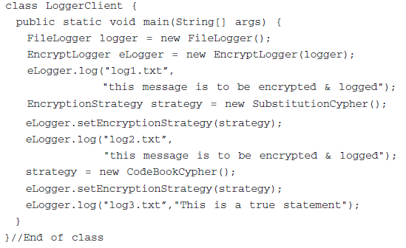

Slide 22
References
Java Design Patterns, A Hands-On Experience with Real-World Examples, Vaskaran Sarcar
Software Architecture Design Patterns in Java, Partha Kuchana

Slide 23
Additional Material

Slide 24
Class StringTokenizer
The string tokenizer class allows an application to break a string into tokens.
The following is one example of the use of the tokenizer. The code:
StringTokenizer st = new StringTokenizer("this is a test");
while (st.hasMoreTokens()) {
System.out.println(st.nextToken());
}
prints the following output:
this
is
a
test

