Slide 1

BDAT_1001 Information encoding standards
Authentication and Authorization System

Slide 2
Team Members
David Owopetu
Abisola Olakanmi
Dhyan Trivedi

Slide 3
Summary
An ASP.NET core web app which lets user register themselves.
First time users can register, and registered users can log-in and see fellow registered users.
All user data is presented in the tabular format
Registration requests get stored in MS SQL Database
Manager can manage user registration request.
Admin manages the entire database.
All user data is maintained by SSMS server.

Slide 4
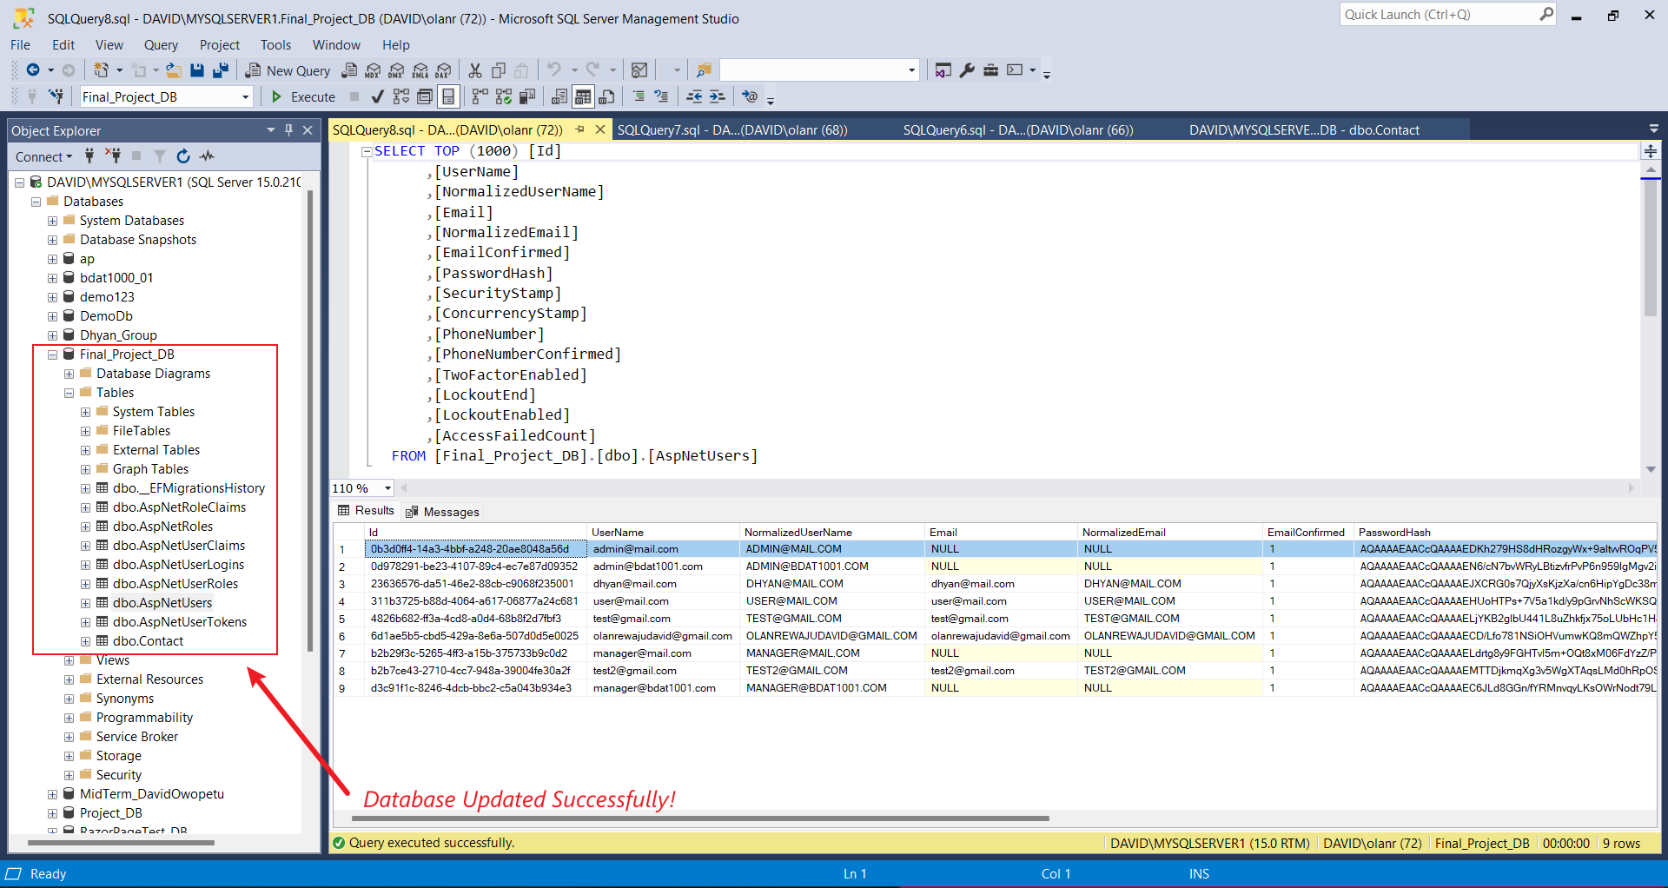
Database Working Fine!

Slide 5
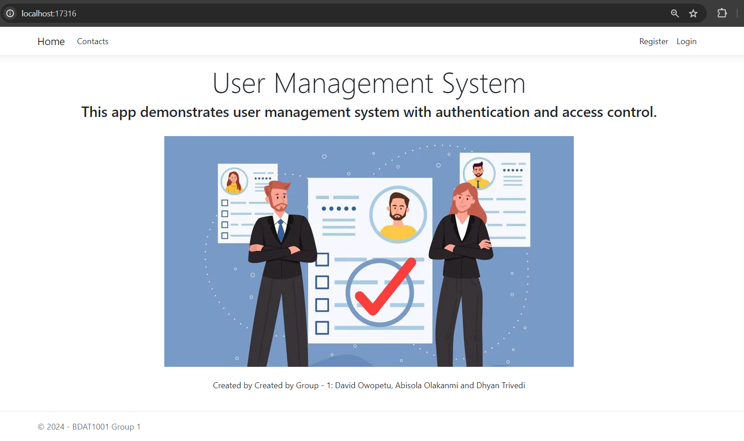
Home Page
Users are asked to register if, they are visiting the website for the first time
If not, they can log in and access their account details
Register users can also see all the users registered in the system

Slide 6
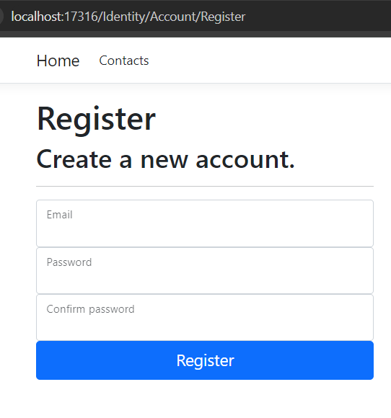
Registration Page
Users are prompted with a registration form in which they must fill in their credentials, such as
Users are asked to confirm their email address for security purpose.
Password
Re-enter the password
Email id
Upon successful confirmation, they are notified.

Slide 7
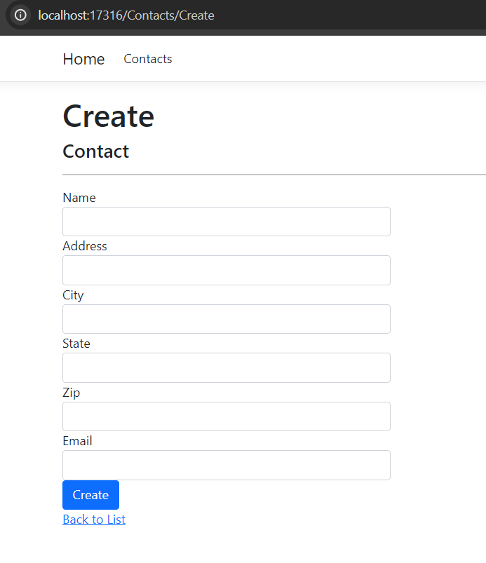
Create New Contacts
All Roles can create Contacts
User
Manager
Admin

Slide 8
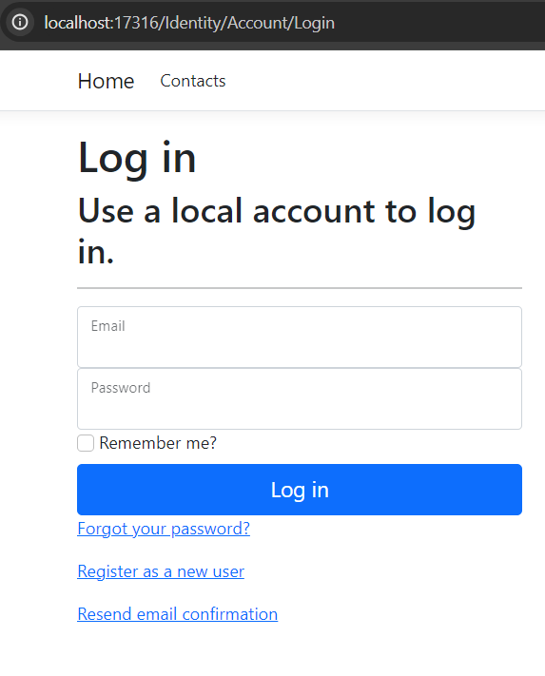
Log in Page
After logging in, users can see details of contacts lists
Email id
Password
Name
E.t.c

Slide 9
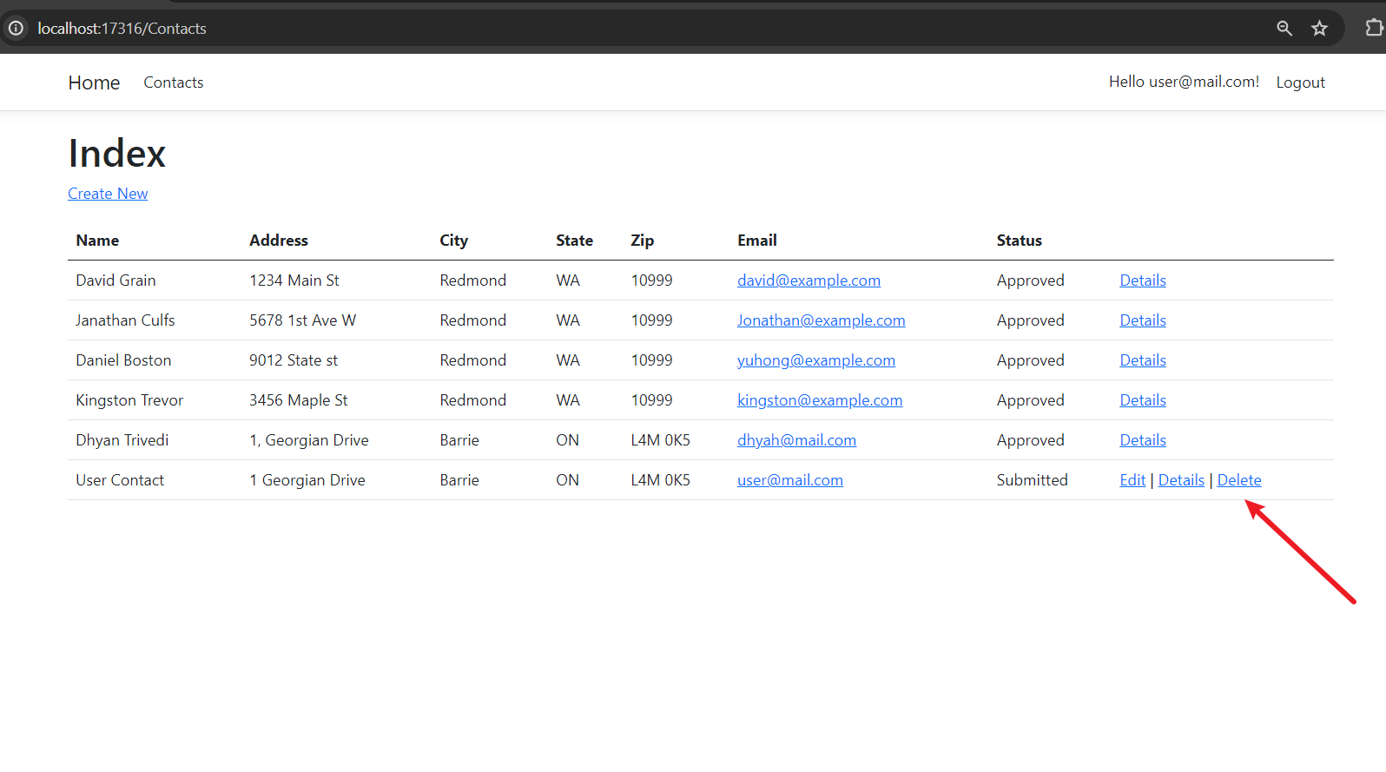
User view
User Only updates it’s
own detail contacts

Slide 10
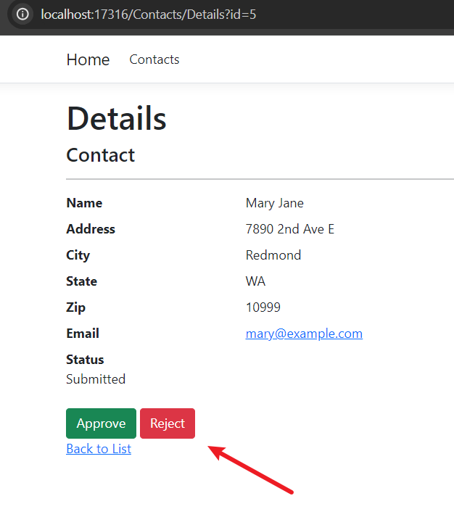
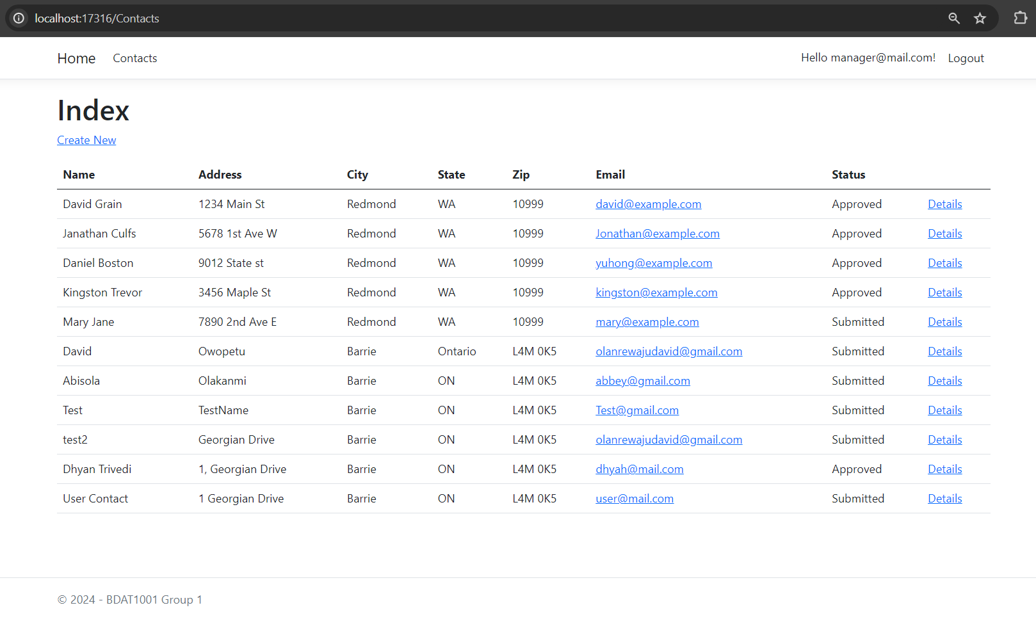
Manager View

Slide 11
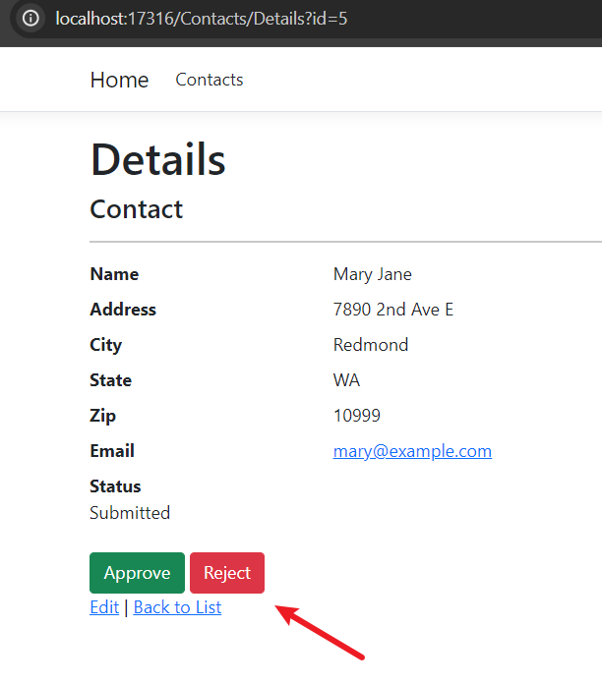
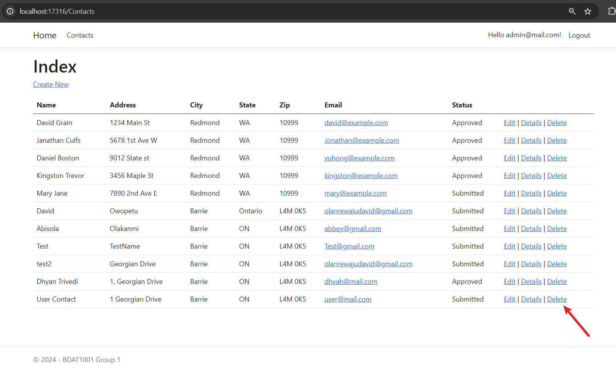
Admin View
Only the Admin can delete any contact

Slide 12
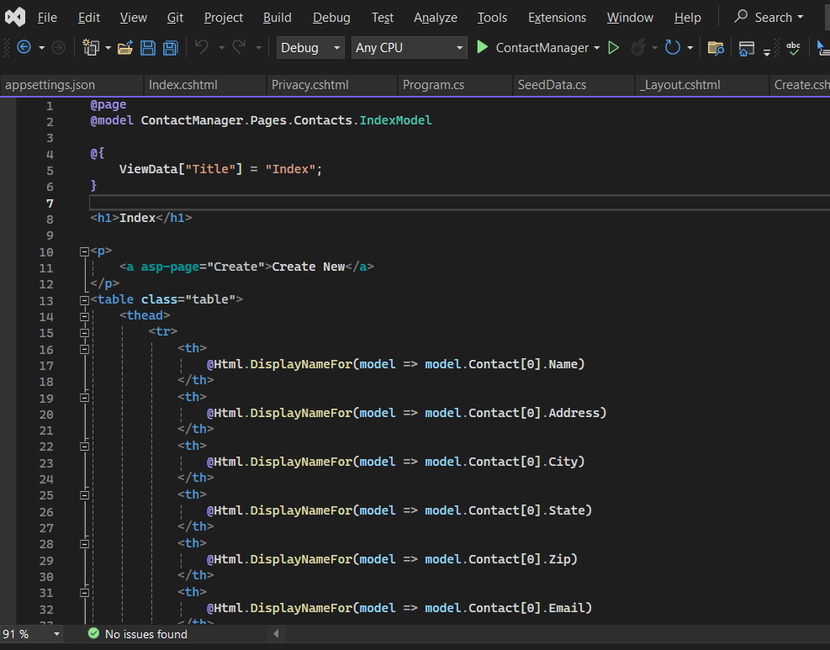
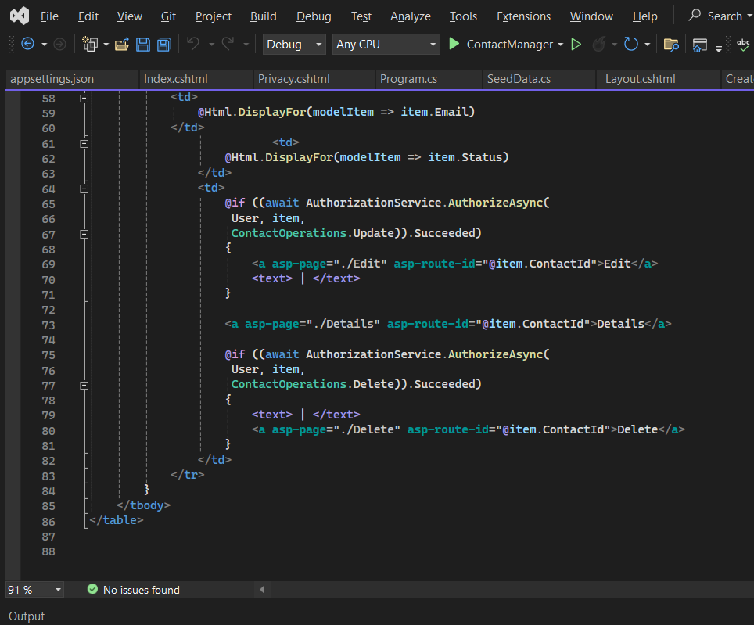
Code View - User

Slide 13
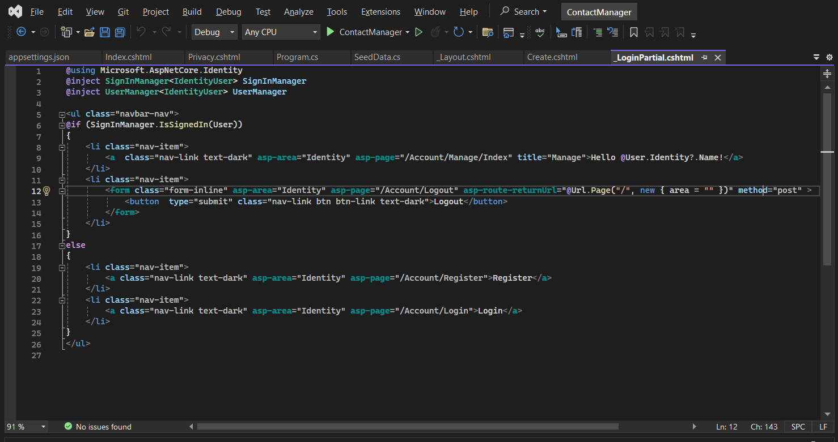
Code View - Manager

Slide 14
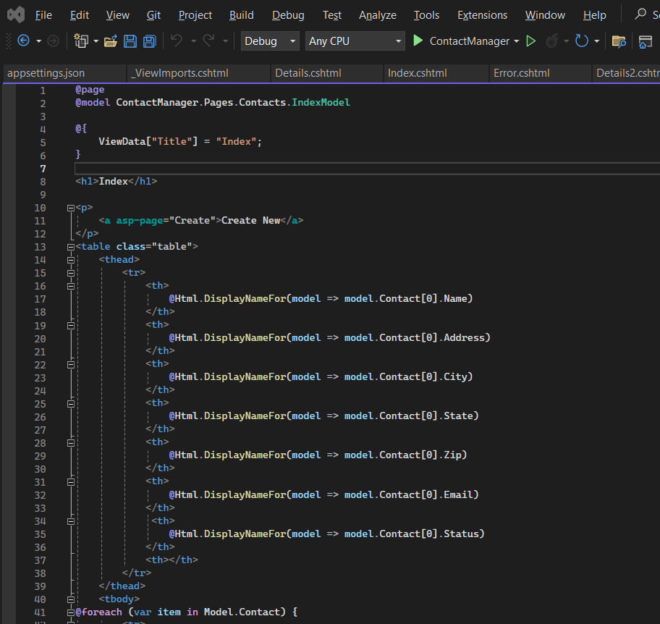
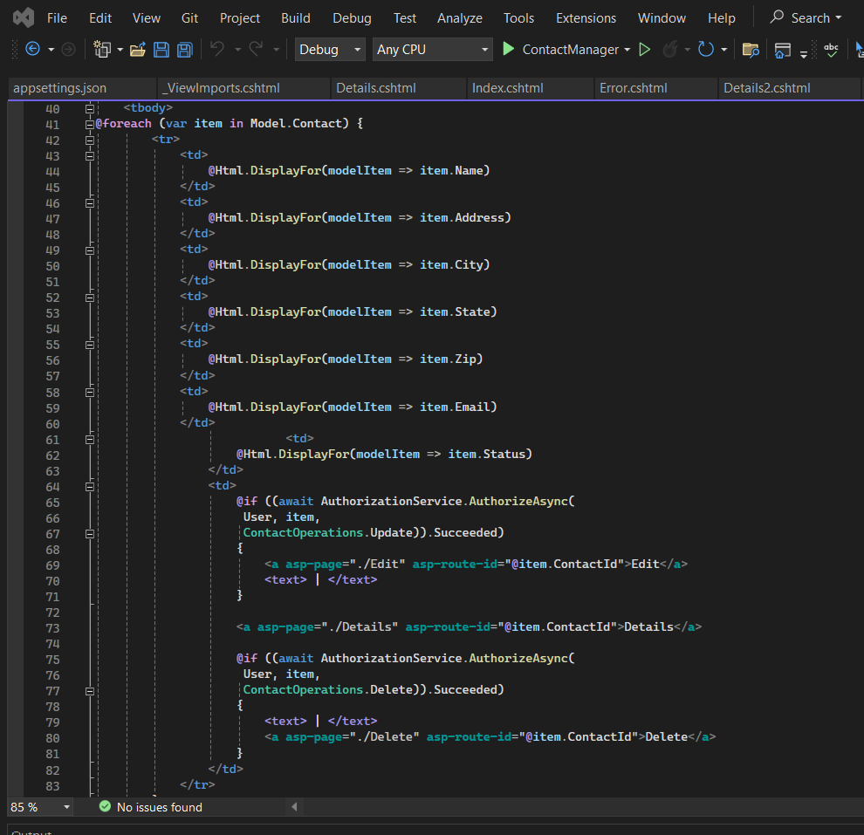
Code View - Admin

Slide 15
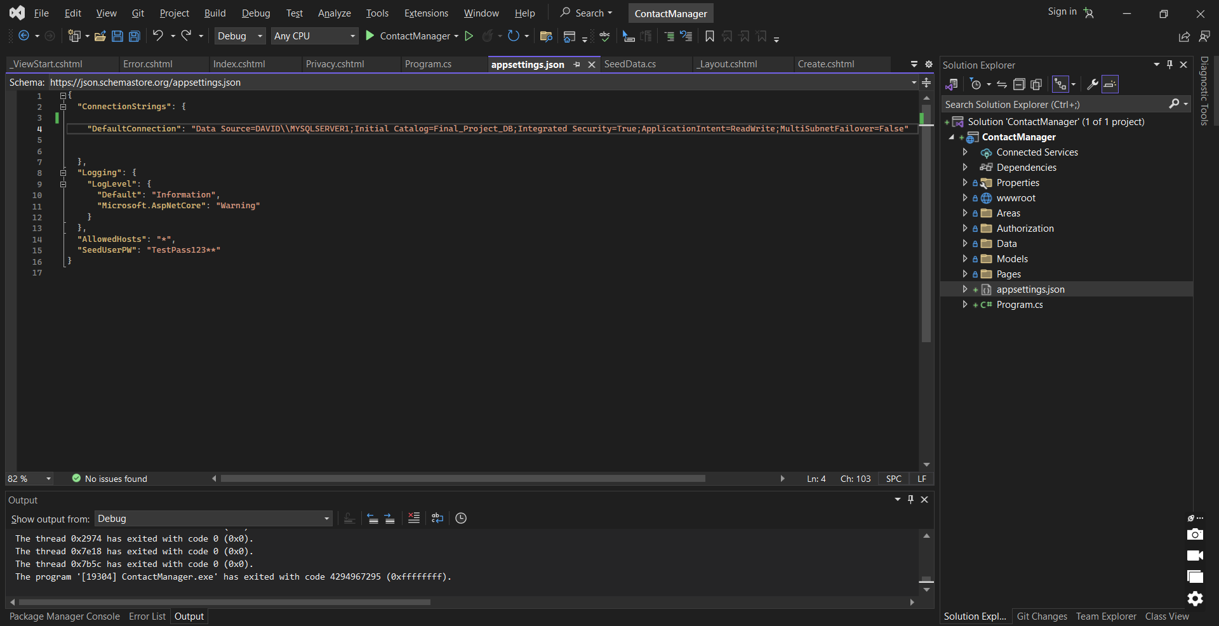
Code View - Database

Slide 16

THANK YOU

